Slide 1


南宁师范大学
Nanning Normal University
Department of tourism & culture
Visitor Attraction Experience
Ivan Monich, Ph.D.
Nanning, 2019

Slide 2
Lecture 5
The complexity of satisfaction measurement
This lecture addresses the complexity of satisfaction measurement in an experiential context. It first presents several conceptualisations of satisfaction and then addresses the particularities of this concept in the consumption of tourism products and services.
The different steps structuring the experience are analysed, highlighted with an example based on a whale-watching experience.

Slide 3
After studying this lecture students should be able to:
Compare and contrast the different definitions of satisfaction.
Appreciate the particularities of evaluating satisfaction in the specific context of tourism.
Understand the complexity of the processes that shape services’ evaluations in the specific tourism context.
Define and understand what the flow experience entails and the conditions that prevail for its occurrence.
Contrast the notions of flow and immersion and understand their respective role in the construction of a satisfying experience.

Slide 4
Introduction
Satisfaction is a complex issue in tourism because of its experiential nature which requires the integration of emotional dimensions. As a result, tangible dimensions are only one side of the equation.

Slide 5
The complex notion of satisfaction
Authors in marketing and consumer behaviour literature have studied the concept of customer satisfaction in different consumption fields (Parasuraman ef al., 1988; Abdeldayem and Khanfar, 2007; Cronin and Taylor, 1992), and various approaches have been used by marketing and consumer researchers to define and measure customer satisfaction.

Slide 6
Tourism industry
In the tourism field, the number of studies focusing on the concept of customer satisfaction in hospitality, travel and recreation is increasing due to the relevance of this concept
In this sense, researchers have frequently focused on identifying the factors or facts which explain tourists' satisfaction judgements and which might contribute to tourists' total satisfaction

Slide 7
How can we define satisfaction?
There are significant differences in the conceptualization of consumer/tourist satisfaction (Bosque and Martin, 2008; Casarin and Andreani, 2003). The concept of satisfaction is multidimensional and may be defined in various ways.
Beyond the cognitive definition of consumer/tourist satisfaction that has been addressed before, there is a set of studies that consider satisfaction as an emotional response derived from a consumption experience.

Slide 8
What is Satisfaction?
Satisfaction is defined as an individual's cognitive-affective state derived both from the individual's cognitive judgements and emotions related to the tourist experience (Bosque and Martin, 2008; Oliver, 1993).
Drawing on the cultural and the experiential perspectives, consumer/tourist satisfaction can also be defined as an emotional response (joy, fear, happiness, etc.) derived from a consumption/tourism experience (Spreng ef al., 1996).

Slide 9
What is Satisfaction?
Consumer satisfaction definitions have either emphasized an evaluation process (Fornell, 1992; Hunt ,1977; Oliver, 1981) or a response to an evaluation process (Halstead ef al., 1994).

Slide 10
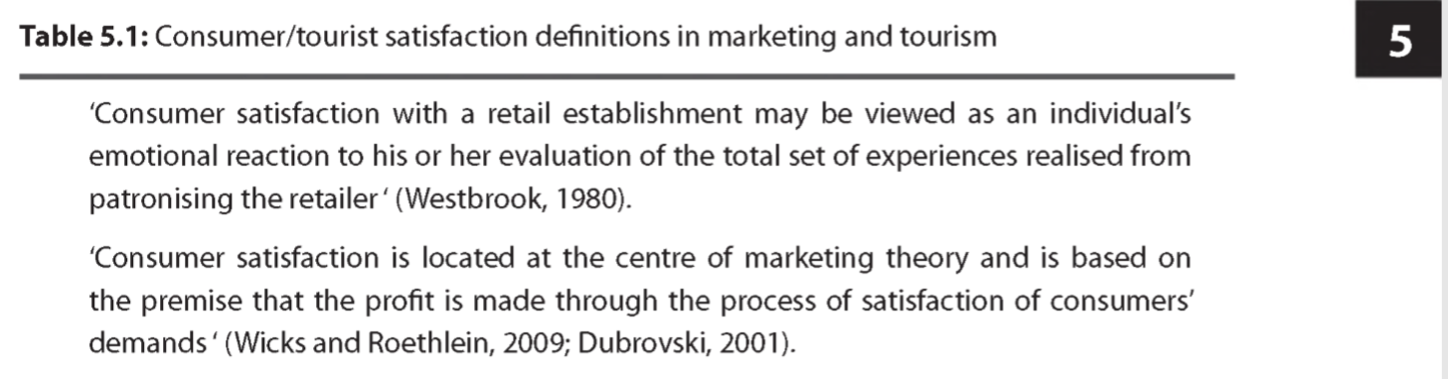
Lecture task:
Please, open the p. 73 of the main textbook, find the Table 5.1: “Consumer/tourist satisfaction definitions in marketing and tourism”.There are 30 definitions of satisfaction
Select your own definition you agree with.
I call your name, you get up and read the definition you agree with

Slide 11
Most definitions shown in Table 5.1 favour the notion of consumer/tourist satisfaction as a response to an evaluation process.
In order to analyse further how satisfaction can be conceptualised in an experiential context, it is essential to investigate how leisure and tourism researchers have studied this concept in their fields of research.

Slide 12
Concepts of satisfaction in the leisure and tourism context
The majority of leisure and tourism studies demonstrate that the heart of satisfaction is to be found in the emotions and sensations that are experienced during consumption.

Slide 13
Concepts of satisfaction
Beard and Ragheb (1980) produced a leisure satisfaction scale which aimed at evaluating the positive perceptions and feelings that constitute this variable in a recreational context. Their scale identified five dimensions to the experience benefits:
psychological (sense of freedom, involvement, and intellectual challenge), educational, social, physiological and aesthetic (pleasing, well designed area of leisure participation).

Slide 14
Concepts of satisfaction
Satisfaction was conceptualised as the fulfilment of the basic needs which stimulated the choice for an activity: 'leisure scientists' use of 'satisfaction' is confined to measuring the psychological outcomes from a leisure experience’.

Slide 15
Lounsbury and Hope (1985)
Lounsbury and Hope (1985) presented an interesting model in which they attempted to analyse vacation satisfaction through a six-item measure which represented 'positive affective states which characterised how the person typically felt while on vacation’

Slide 16
Lounsbury and Hope (1985)
Satisfaction ratings were obtained by asking respondents to fill in a questionnaire prior to their vacation and on their return.
None of the demographic or work variables appeared to be related to satisfaction apart from the level of education (consumers with higher levels of education were relatively less satisfied with their vacation than other consumers).

Slide 17
Concepts of satisfaction
However, the key dimensions related to overall vacation satisfaction were the satisfactions with 'relaxation and leisure', followed by with 'marriage and family' and with 'the opportunities for escape and getting away from it all’.
Consumers would react differently and interpret or react to the environment through personal systems which were portrayed as independent from the attributes provided

Slide 18
Could satisfaction formation be different in leisure and tourism consumption?
Beyond the fact that emotional factors are prominent in satisfaction formation, other researchers indicate the way in which consumers shape their satisfaction might be different. In this line of thoughts, two aspects can be investigated:
the extent to which consumers develop specific satisfaction strategies
and whether they are actually able to elaborate concrete expectations in a hedonic context.

Slide 19
First line of thoughts
Satisfaction strategies developed by consumers
In tourism studies, emotion, hedonism and subjectivity are all important components of the tourist's experience.
Tourists may express anger, joy, stress, anxiety, fear that may result from their experience with the destination or the local people

Slide 20
Holbrook and Hirschman (1982)
Holbrook and Hirschman (1982a) argued that although some consumption could be sought for the negative emotions they could evoke during consumption (fear on a theme park ride for instance), the final judgement could involve a positive evaluation of the whole experience (thrill for instance).

Slide 21
30-10-2019

Slide 22
Strategies
When a tourist is faced with the unpleasant and disrespectful behaviour of other tourists while on holidays, it leaves a negative feeling of anger, especially since such behaviour sends them back to what they often experience in their daily life
Anger leads to a confrontational behaviour (Parrott, 2001). These negative feelings and emotions have a direct impact on the enjoyment of the experience that affect the hedonic behaviour of tourists.

Slide 23
Strategies
The incident began innocently enough on 2 September, when a family identified as the Zengs arrived at the Generator Hostel in Stockholm one night before they had booked to stay.

Slide 24
Strategies
Beijing is demanding an apology from the Swedish government for violating human rights and for "brutal abuse" after footage emerged of Chinese tourists allegedly being thrown out of a hotel by police in Stockholm.
A Chinese man and his parents arrived at the hotel at midnight, hours before their booking would allow them to check in. Their demands to stay in the lobby were refused, leading to the police stepping in.
Video footage circulating online shows police carrying the tourists outside, with the son yelling in English: "This is killing. This is killing." The mother, lying on the ground, is wailing and cries in Chinese: "Save me."

Slide 25
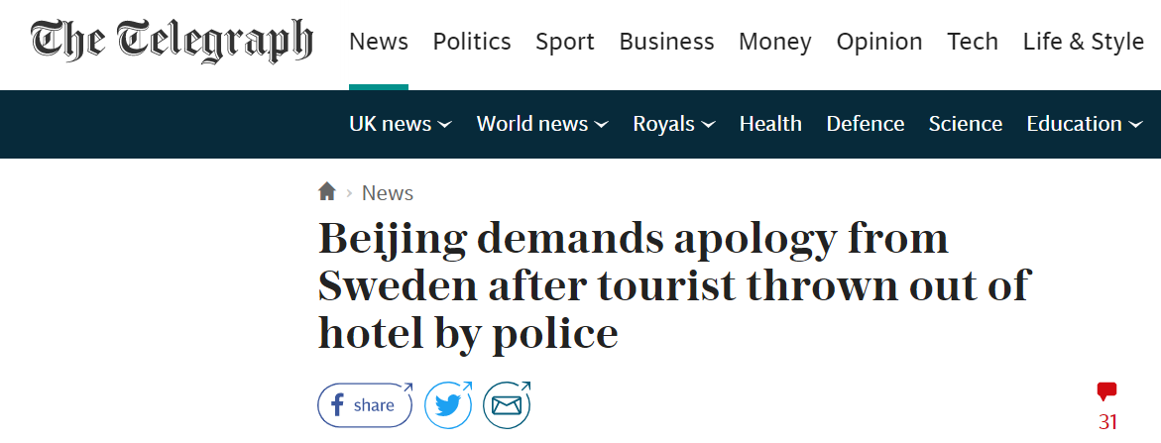

Strategies
https://www.telegraph.co.uk/news/2018/09/17/beijing-demands-apology-sweden-tourist-row-police/

Slide 26
Is negative experience really so bad to have?
The notion of the impact of negative experiences upon the overall satisfaction with a holiday is a very complex ground. For instance, Larsen ef al. (2000) showed that even though tourists may experience negative feelings, the regulation of their emotions allows them to increase pleasure and decrease pain. It is a fact that some negative experiences lived during the holiday might be remembered later as positive occurrences. Kim ef al. (2012) also identified that 'individuals tend to more easily recall positive experiences than negative ones’
!Make a note about the news spreading speed.

Slide 27
Frochot and Kreziak (2009)
Frochot and Kreziak (2009) have also identified that tourists develop satisfaction strategies in order to guarantee a high level of satisfaction during their holiday.
For instance, tourists will purposely choose to ignore some negative elements (within the service delivery, the behaviour of some employee, closure of a service, etc.) because one goal of their holiday is to have a relaxing time. Achieving this state of relaxation involves maintaining oneself in a 'positive mood' therefore avoiding negative occurrences will tend to protect this satisfying state.

Slide 28
Achieving this state of relaxation involves maintaining oneself in a 'positive mood' therefore avoiding negative occurrences will tend to protect this satisfying state.
If you would like to be happy – be happy!
R u agree with it?

Slide 29
The second line
Are consumers able to elaborate expectations in a hedonic context?
One of the difficulties encountered in hedonic contexts is the fact that consumers tend to elaborate holistic sensations and evaluations.
To date, one of the most interesting studies on experiential satisfaction construction was published in 1993 by Amould and Price.
As a result, Amould and Price (1993) suggest that the discontinuation paradigm is inadequate for studying the specific context of extraordinary experiences.

Slide 30
Amould and Price, p.80
Already in the early 1980s, leisure researchers have identified that non-consumptive recreation activities (activities with no clear objectives such as walking or having a picnic) have very vague expectations because they lack specific and clearly defined goals (Vaske ef al., 1982).
The expectations lie with the intensity and 'goodness' of the experience itself, which is a difficult notion to elaborate verbally

Slide 31
Recently, Hosany and Drew (2012) defined tourists' goals as abstract benefits that they aim to obtain by consuming a product or service and that fulfils their needs (or motivations as expressed previously).

Slide 32
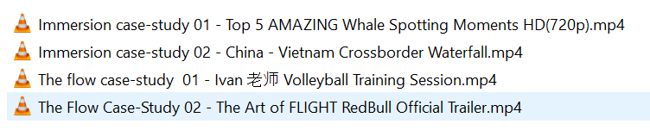
04-11-2019
The structure of the class
Review the concepts of flow and immersion
Case study of the Whale watching tour.

Slide 33


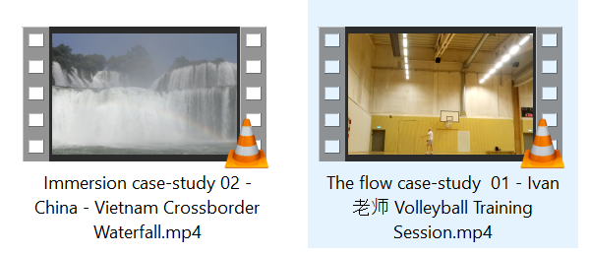

Slide 34
The concepts of flow and immersion at the heart of the tourist experience
The concept of flow
The sport video

Slide 35
The concept of flow
In 1968, Maslow identified a concept named the peak experience, which is particularly relevant to the understanding of tourism consumption. Peak experiences are defined as moments of highest happiness and fulfilment which can be achieved through the consumption of activities such as art, intellectual insight, aesthetic perceptions, nature experience.

Slide 36
What is flow
This concept, borough from psychology, has been historically associated to the work of Mihaly Csikszentmihalyi who produced a detailed analysis of the flow concept and its mechanisms. This researcher's first interest in flow was linked to his study of artists and their capacity to get so involved in painting and creating that they would forget other areas of their life (eating, sleeping, etc.). This level of involvement in the activity led Csikszentmihalyi to study this phenomenon, identify its origins and the conditions of its occurrence.

Slide 37
Flow is conceptualised as a mental state which develops when an individual, performing an activity, is fully immersed in a feeling of focus, full involvement, and enjoyment in its activity (Csikszentmihalyi, 1991). Flow is a holistic sensation that people feel when they act with total involvement.

Slide 38
One of the prime elements that conditions the occurrence of flow is the congruence between one's activity, his/her level of skills and the perception of the challenge of the activity. The challenges experienced in an activity must also be high for flow to occur. For instance, cooking a plate of pasta will rarely create flow (although it is probably at the skill level of the domestic cook), however skiing in powder snow will create intense feelings of flow (as long as it matches the skier's skills).

Slide 39
The main characteristics of flow have been defined as (Csikszentmihalyi, 1991):
Intrinsic enjoyment
Loss of self-consciousness
Skill/challenge balance (notion of optimum level)
Intense focused attention
Immersion in the activity
Clear goals
Immediate but not necessarily ambitious feedbacks
Sense of control over the environment and actions
Momentary loss of anxiety and constraints
Enjoyment and pleasure

Slide 40
How to get into the flow
The activities are seen as being conductive of flow if they have been designed to ease the access to an optimal experience: 'they have rules that require the learning of skills, they set up goals, they provide feedback, they make control possible' (Csikszentmihalyi, 1991, p.72).

Slide 41
Price, costs, time are not important any more
Csikszentmihalyi (1975, 1991) clearly indicated their surrounding environment (including the notion of time) and that the intrinsic reward of the activity could lead people to seek experiences at great costs, for the simple objective of doing it.
The activity is totally satisfying, a notion that goes well beyond the simple sense of 'having fun'

Slide 42
Sport!
Csikszentmihalyi (1997) used the Experience Sampling Method (ESM) to understand the rules of flow. ESM involves an individual writing down on paper where he is, what he is doing, what he is thinking about, and his state of consciousness. Individuals are prompted at random to write those elements. The results of the ESM study shows that people experience flow when doing an activity but rarely when they are in a passive situation. For instance, US teenagers experience 13% of flow when watching television, 34% when they engage in their hobbies and 44% when involved in sports and games. When studying the adult population, work can represent a flow situation as well.

Slide 43
The implications of flow can be fairly wide: Csikszentmihalyi (1997) suggests that increasing the time spent in flow leads to positive affect and performance and increases happiness and successfulness in life. Negative aspects of flow have been associated to addictions (for instance in video games) and risky behaviour.
Some personalities might be more inclined to provoke flow than others. For instance, this would be the case of personality traits that portray curiosity.

Slide 44
If the concept of flow has been used to some extent by leisure theorists, surprisingly it has been the object of limited applications in the field of tourism. In 2008, McGinnis ef al. stated that: 'Extended service encounters such as those found in activities like golf, tennis, and perhaps sailing are capable of producing flow experiences because they provide a clear-cut, challenging goal, especially for those who know the rules and the intricacies of the activity'

Slide 45
The Three Case-Studies Videos to illustrate the State of Flow

Slide 46
Immersion
While the concept of flow translates behaviour associated with intense leisure experiences, the other concept of immersion is also very useful in understanding tourism consumption. Indeed, as we have already explained, if tourism is an out of the ordinary experience, it is not necessarily one of intense immersion similar to flow. Tourists might also have milder expectations of simply spending a good time away from daily routine and stress. In this line of thought, the notion of immersion is particularly interesting and will be detailed in the next section.

Slide 47
Immersion and the tourist experience
consumers will let an experiential environment (often themed) transport them into a servicescape sufficiently different from their daily routines to create a service bubble where they will experience intense and unforgettable emotions.
Caru and Cova (2003) define immersion as 'a feeling of well-being, development and satisfaction'

Slide 48
Within the notion of appropriation, three processes are at stake: nesting, exploration and tagging (Caru and Cova, 2003):
Nesting refers to processes allowing individuals to personalise their environment and create a homely feeling. A maestro explaining the meaning of music before it is being played, helped consumers to develop a feeling of nesting

Slide 49
Guides provide similar situations when welcoming customers, giving information about the place they are about to visit, giving them rules to follow for the service to take place conveniently, etc. All these elements help customers feel closer to the site visited.

Slide 50
The exploration
The exploration involves consumers exploring the service environment in order to identify the elements (services, activities, surroundings) that will allow them to develop their own personal experience.
Typically, visits to historic sites, if they portray ancient exhibits of daily life will give clues to visitors to make sense of the site with their own experience of daily life in the 21st century.

Slide 51
Tagging
Tagging refers more specifically to the personal meaning (inspired from ones' own value system, history and past experience) given by consumers to various elements of the experience. For instance, visits to wineries provide elements of information that will be integrated and understood through a tourist's own value system and previous consumption and knowledge about wine.
Music is a trigger!
Yesterday once more.同桌的你，走吧
月亮代表我的心

Slide 52
According to Cova and Caru (2004), what constitutes the pleasurableness of an experience is the consumers total immersion in an original experience. While some researchers suggest that consumers need an extraordinary experience to create an intense and unforgettable experience (Amould and Price, 1993; Pine and Gilmore, 1999), others indicate that not all experiences need to be extraordinary to procure immersion (Caru and Cova, 2003; Fomerino ef al., 2008). This aspect is important to take into consideration since in the case of tourism, consumers seek at times calm and relaxing moments, and immersion can be achieved through non-extraordinary experiences.

Slide 53
Immersion can be achieved through non-extraordinary experiences.
Flow can be achieved through extraordinary experiences.

Slide 54
The immersion is a key factor in achieving two principal aims and outcomes to a tourist holiday: detachment from everyday life and achieving a state of relaxation.
The reserach showed that the construct of satisfaction is a process that evolves during the holiday and to achieve that state of satisfaction, tourists need to cut free from their everyday life by immersing themselves totally in the holiday. Therefore, immersion can be seen as a condition of access to an optimal experience.

Slide 55
Summary
In summary, the two notions of flow and immersion contribute greatly to the understanding of satisfaction in an experiential context. Both these concepts can lead researchers towards considering that satisfaction can be conceived as a state of being/feeling and as an outcome sought from the experience

Slide 56
However, looking at the emotional dimension of the experience is insufficient on its own since the utilitarian scopes of the service delivery cannot be ignored. Probably the best approach for integrating the two dimensions into a single model is to conceive that the utilitarian aspects of the service delivery represent the elements that allow consumers to achieve the experience they have come to live.

Slide 57
Case-study
Whale watching in New Zealand
Please, open the page 86th of the main textbook. Read the case-study carefully and be ready to reply the questions.
Why do people not socialize during the boat ride?

