Slide 1
南宁师范大学
Nanning Normal University
Department of tourism & culture
Marketing for Tourism, Hospitality and Events
Ivan Monich, Ph.D.
Nanning, 2019

Slide 2

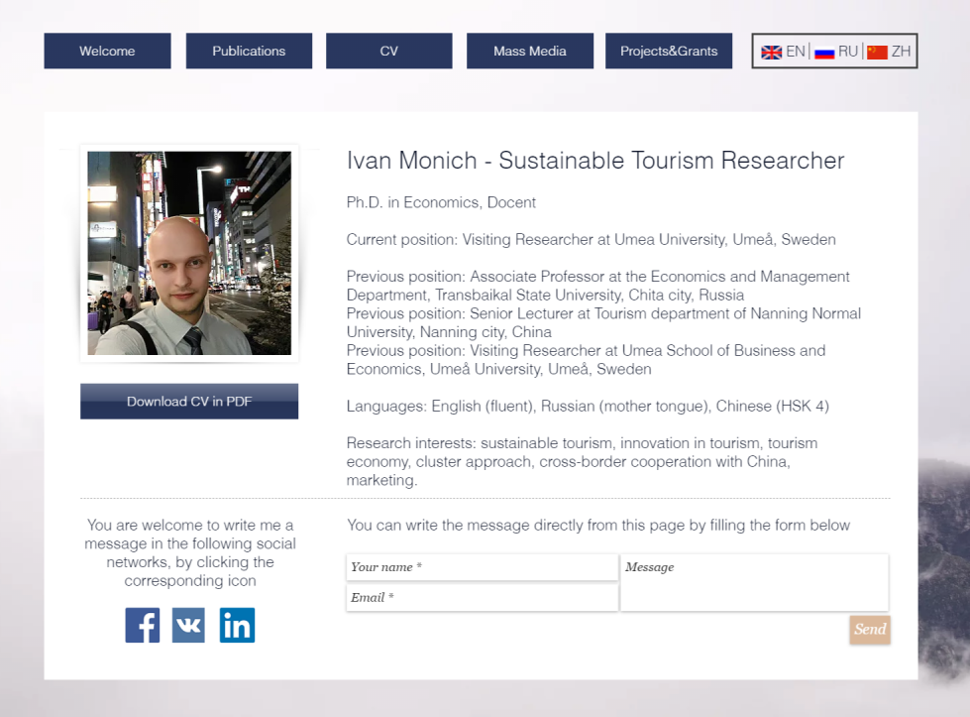
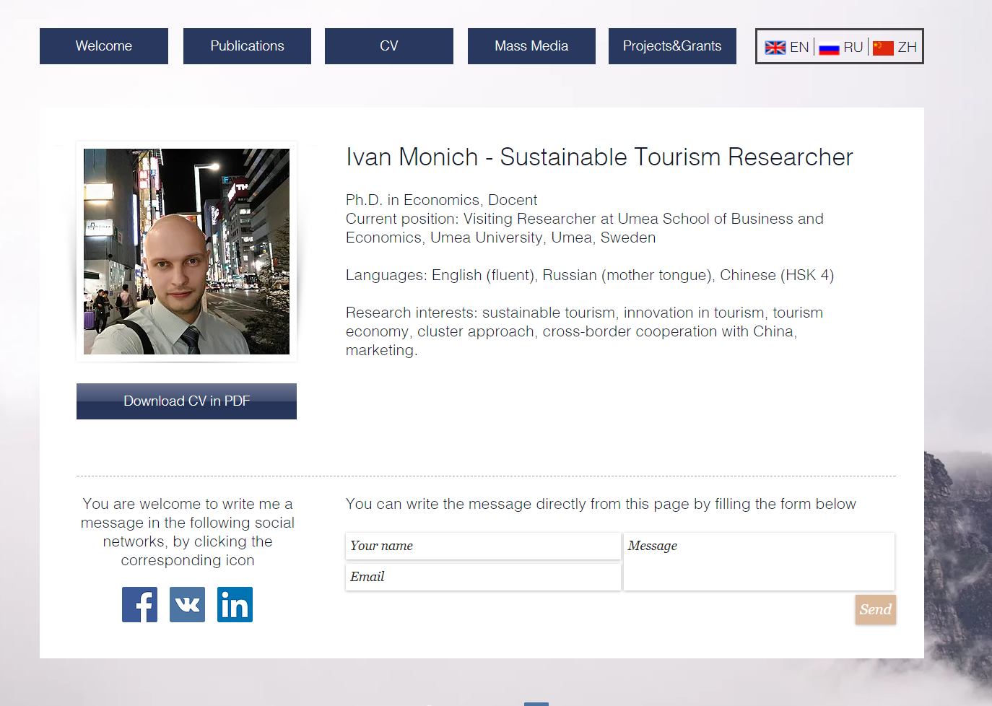
2

Slide 3
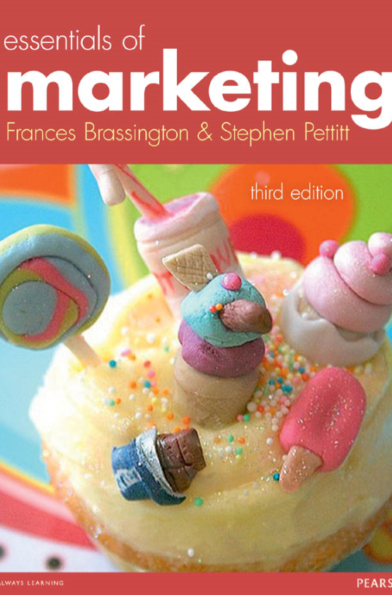
The Main Textbook _{Essentials of Marketing}

Slide 4
Content
1 Marketing dynamics
2 The European marketing environment
3 Buyer behaviour
4 Segmenting markets
5 Marketing information and research
6 Product
7 Price

Slide 5
Content
8 Place
9 Promotion: integrated marketing communication
10 Promotion: advertising and sales promotion
11 Promotion: direct and digital marketing
12 Promotion: personal selling, PR and sponsorship
13 Marketing strategy and planning
14 Services and non-proﬁt marketing

Slide 6

Assessments
Lectures attendance, active participation in the discussions (10%)
Final written Exam (60%)
Project & Presentation (30%)

Slide 7
Marketing dynamics
LEARNING OBJECTIVES:
This lecture will help you to:
define what marketing is;
trace the development of marketing as a way of doing business and consider the ways in which marketing is changing;
appreciate the importance and contribution of marketing as both a business function and an interface between the organisation and its customers;
understand the scope of tasks undertaken in marketing for tourism, and the range of different organisational situations in which marketing is applied.

Slide 8
Marketing is everywhere
Every time you buy or use a product, go window shopping, see an advertising hoarding, watch an advertisement, listen to friends telling you about a wonderful new product they’ve tried, or even when you surf the internet to research a market, company or product for an assignment, you are reaping the benefits (or being a victim) of marketing activities.

Slide 9
Marketing definition
Here are two popular and widely accepted definitions of marketing. The first is the definition preferred by the UK’s Chartered Institute of Marketing (CIM), while the second is that offered by the American Marketing Association (AMA):
Marketing is the management process responsible for identifying, anticipating, and satisfying customer requirements profitably. (CIM, 2001)
Marketing is the activity, set of institutions, and processes for creating, communicating, delivering, and exchanging offerings that have value for customers, clients, partners, and society at large. (AMA, 2007)

Slide 10
Marketing definition part 2
Both definitions make a good attempt at capturing concisely what is actually a wide and complex subject. Although they have a lot in common, each says something important that the other does not emphasise. Both agree on the following points.

Slide 11
Marketing is a management process
Marketing has just as much legitimacy as any other business function, and involves just as much management skill. It requires planning and analysis, resource allocation, control and investment in terms of money, appropriately skilled people and physical resources. It also, of course, requires implementation, monitoring and evaluation. As with any other management activity, it can be carried out efficiently and successfully – or it can be done poorly, resulting in failure.

Slide 12
Marketing is about giving customers what they want
All marketing activities should be geared towards this. It implies a focus towards the customer or end consumer of the product or service. If ‘customer requirements’ are not satisfactorily fulfilled, or if customers do not obtain what they want and need, then marketing has failed both the customer and the organisation.

Slide 13
Marketing identifies and anticipates customer requirements
Both definitions accept that marketing is a set of activities that identifies and anticipates customer requirements largely through market research and assessing the information generated. Although communicated more directly in the CIM definition, both definitions do highlight the anticipation and creation of customer requirements as the starting point of marketing. They are saying that the marketer creates some sort of offering only after researching the market and pinpointing exactly what the customer will want.

Slide 14
Marketing fulfils customer requirements profitably
This pragmatic phrase warns the marketer against getting too carried away with the altruism of satisfying the customer! In the real world, an organisation cannot please all of the people all of the time, and sometimes even marketers have to make compromises. The marketer has to work within the resource capabilities of the organisation, and specifically work within the agreed budgets and performance targets set for the marketing function

Slide 15
Exchanges that have value to customers, clients, partners and society at large
This statement is close to the CIM’s ‘profitably’, but a little more subtle. The idea of marketing as an exchange process to create value is an important one, and was first proposed by Alderson (1957). The basic idea is that I’ve got something you want, you’ve got something I want, so let’s do a deal. For the most part, the exchange is a simple one. The organisation offers a product or service, and the customer offers a sum of money in return for it. Pepsi offers you a can of cola and you offer payment; you sign a contract to offer your services as an employee and the organisation pays you a salary;

Slide 16
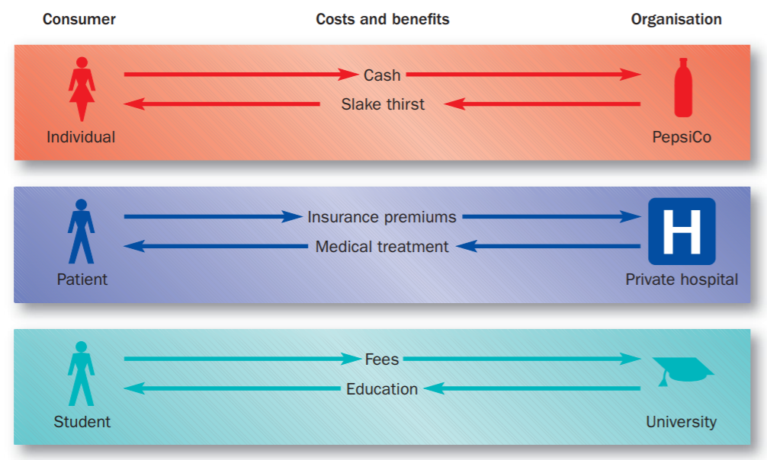
Exchange transactions

Slide 17
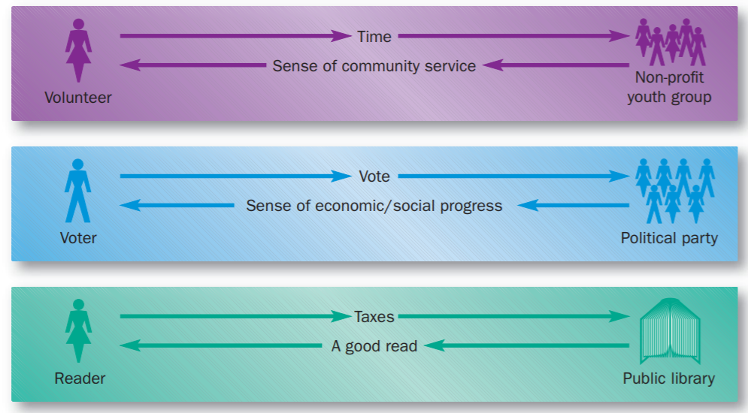
Exchange transactions part 2

Slide 18
Pricing, promotion and distribution of ideas, goods and services
In saying that marketing involves the conception, pricing, promotion and distribution of ideas, goods and services, the AMA definition is a little more specific in describing the ways in which marketers can stimulate exchanges. It suggests a proactive seller as well as a willing buyer. By designing products, setting sensible, acceptable and justifiable prices, creating awareness and preferences, and ensuring availability and service, the marketer can influence the volume of exchanges. Marketing can be seen, therefore, as a demand management activity on the part of the selling organisation.

Slide 19
Society at large
The AMA definition goes much further than the CIM in describing exchanges for society at large. This includes charities, non-profit exchanges and even situations where ideas rather than money are exchanged. It may include funders, volunteers and corporate partners. It allows for a much broader definition of marketing that can encompass far more than traditional profitmaking organisations

Slide 20
Relationship marketing
In contrast, a relationship-focused approach to marketing describes a network of communications and contacts between the buyer and the seller and a series of exchanges over time. Both parties have to be satisfied with the relationship and achieve their respective objectives from it. Marketing, therefore, is part of an interactive process between people

Slide 21
Relationship marketing
Relationship marketing is not just a B2B phenomenon, however. The internet and direct marketing are creating new opportunities for organisations in mass markets to become much closer to their customers.

Slide 22
Wider definition of marketing
Marketing is to establish, maintain and enhance relationships with customers and other partners, at a profit, so that the objectives of the parties involved are met. This is achieved by mutual exchange and fulfillment of promises.
Such relationships are usually, but not necessarily always, long-term.

Slide 23
The development of marketing
The basic idea of marketing as an exchange process has its roots in very ancient history, when people began to produce crops or goods surplus to their own requirements and then to barter them for other things they wanted. Elements of marketing, particularly selling and advertising, have been around as long as trade itself, but it took the industrial revolution, the development of mass production techniques and the separation of buyers and sellers to sow the seeds of what we recognise as marketing today.

Slide 24
Production orientation
In the early days, the late nineteenth and early twentieth centuries, goods were sufficiently scarce and competition sufficiently underdeveloped that producers did not really need marketing.
They could easily sell whatever they produced (‘the production era’ in which a ‘production orientation’ was adopted).

Slide 25
Selling orientation
As markets and technology developed, competition became more serious and companies began to produce more than they could easily sell. This led to ‘the sales era’, lasting into the 1950s and 1960s, in which organisations developed increasingly large and increasingly pushy sales forces, and more aggressive advertising approaches (the ‘selling orientation’).

Slide 26
Marketing orientation
It was not really until the 1960s and 1970s that marketing generally moved away from a heavy emphasis on post-production selling and advertising to become a more comprehensive and integrated field, earning its place as a major influence on corporate strategy (‘marketing orientation’).

Slide 27
Marketing orientation part 2
This meant that organisations began to move away from a ‘sell what we can make’ type of thinking, in which ‘marketing’ was at best a peripheral activity, towards a ‘find out what the customer wants and then we’ll make it’ type of market driven philosophy.

Slide 28
Evolution of Marketing
This finally culminated, in the 1980s, in the wide acceptance of marketing as a strategic concept, and yet there is still room for further development of the marketing concept, as new applications and contexts emerge.
The focus now is on how a marketing orientation can be developed that creates value for the customer and implemented in a manner that is appropriate for all industries

Slide 29
Business orientations
We discuss below the more precise definitions of the alternative approaches to doing business that were outlined above. We then describe the characteristic management thinking behind them, and show how they are used today. The table further summarises this information.

Slide 30
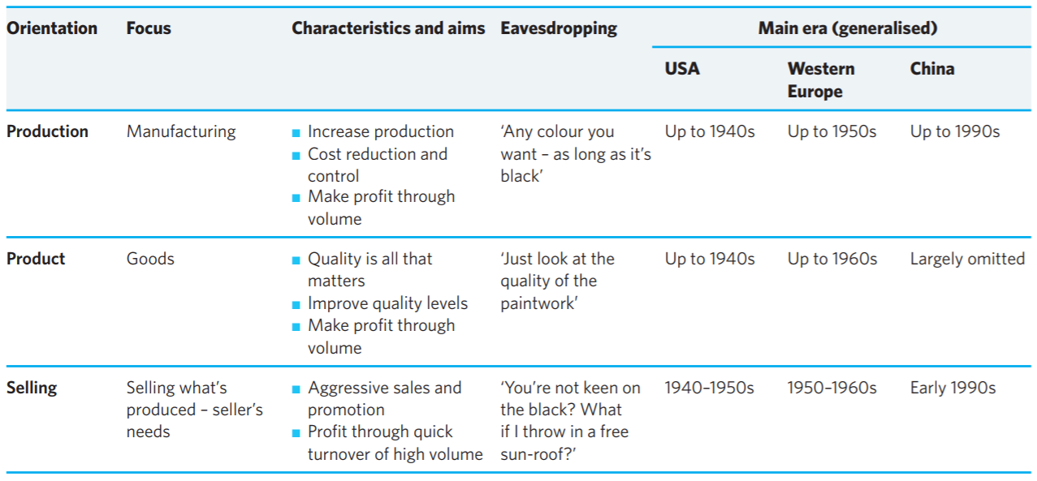

Slide 31
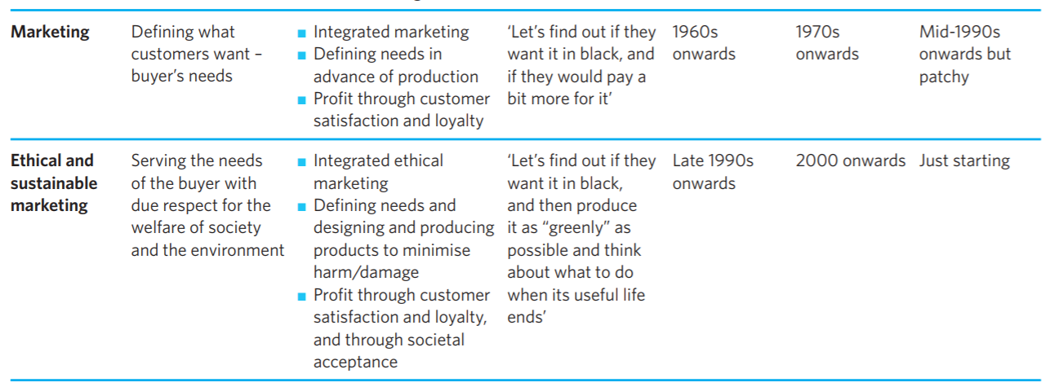

Slide 32

Water is an essential part of a healthy diet. Page 2 of the main textbook

