Slide 1


南宁师范大学
Nanning Normal University
Department of tourism & culture
Visitor Attraction Experience
Ivan Monich, Ph.D.
Nanning, 2019

Slide 2
The structure of the lecture
Teacher introducing
The structure of the course and main objectives
The teaching process, exams and evaluation procedures.
The first lecture of the course.
Researching turism.The Nanning Urban Parks survey outcomes made by students Y16.

Slide 3
Welcome to a new course.
Visitor attraction experience is one of the essential courses of your bachelor program in tourism management.

Slide 4

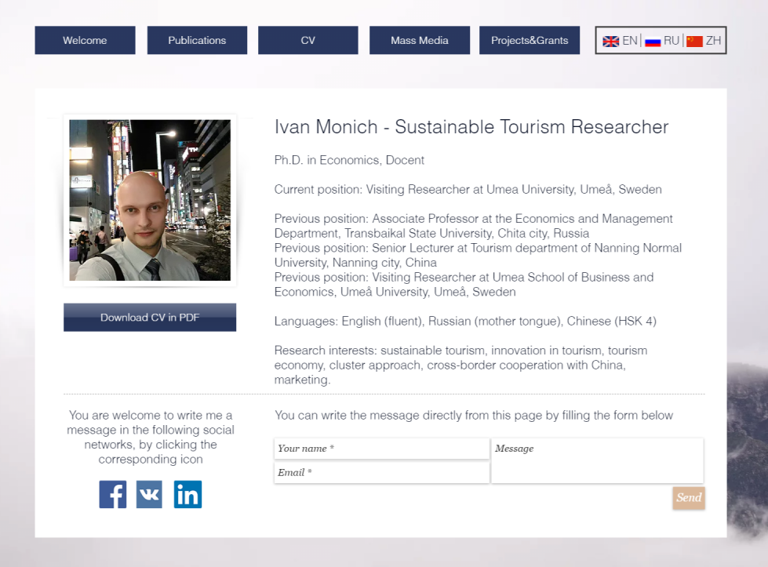
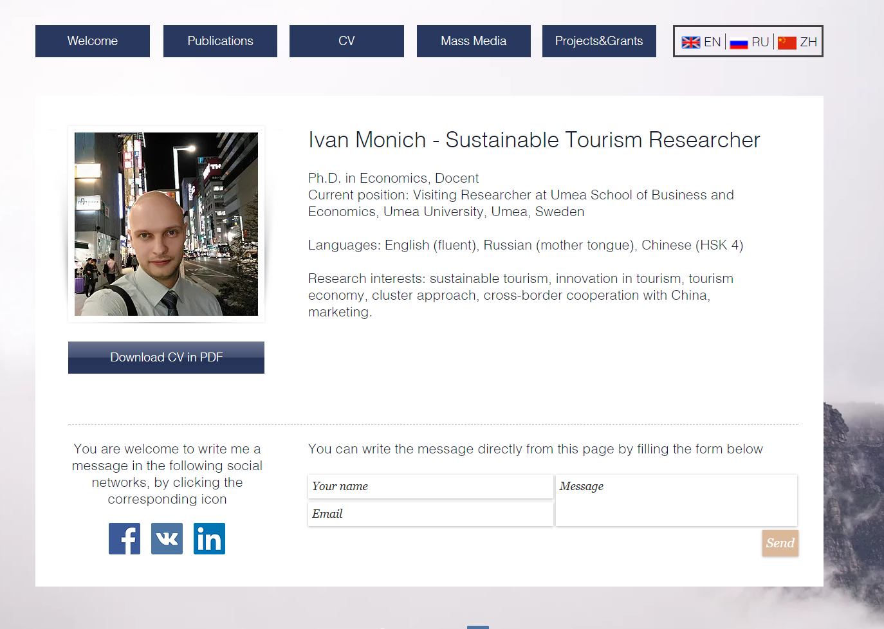
4

Slide 5
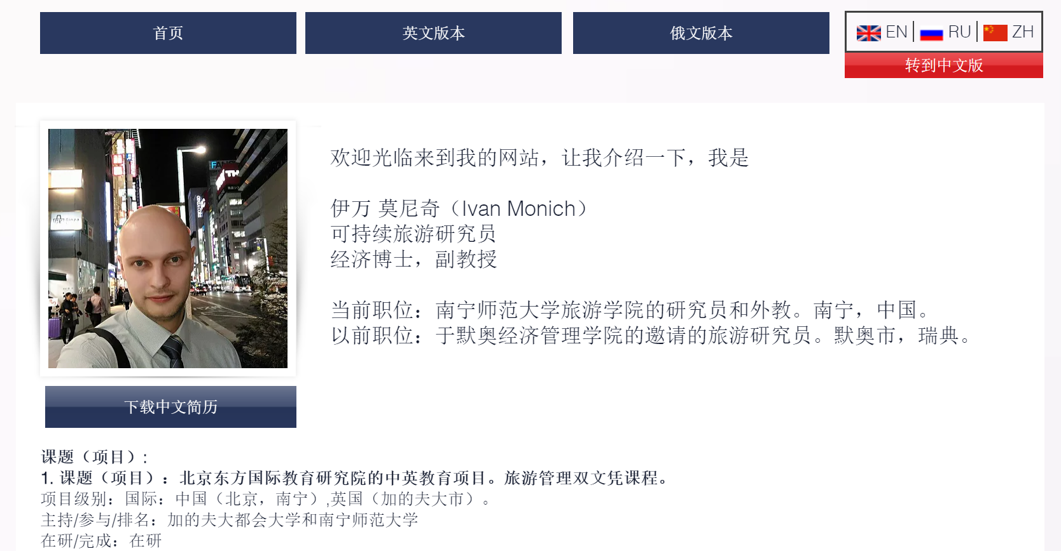

Slide 6
Working experience in Academia and Business

Slide 7
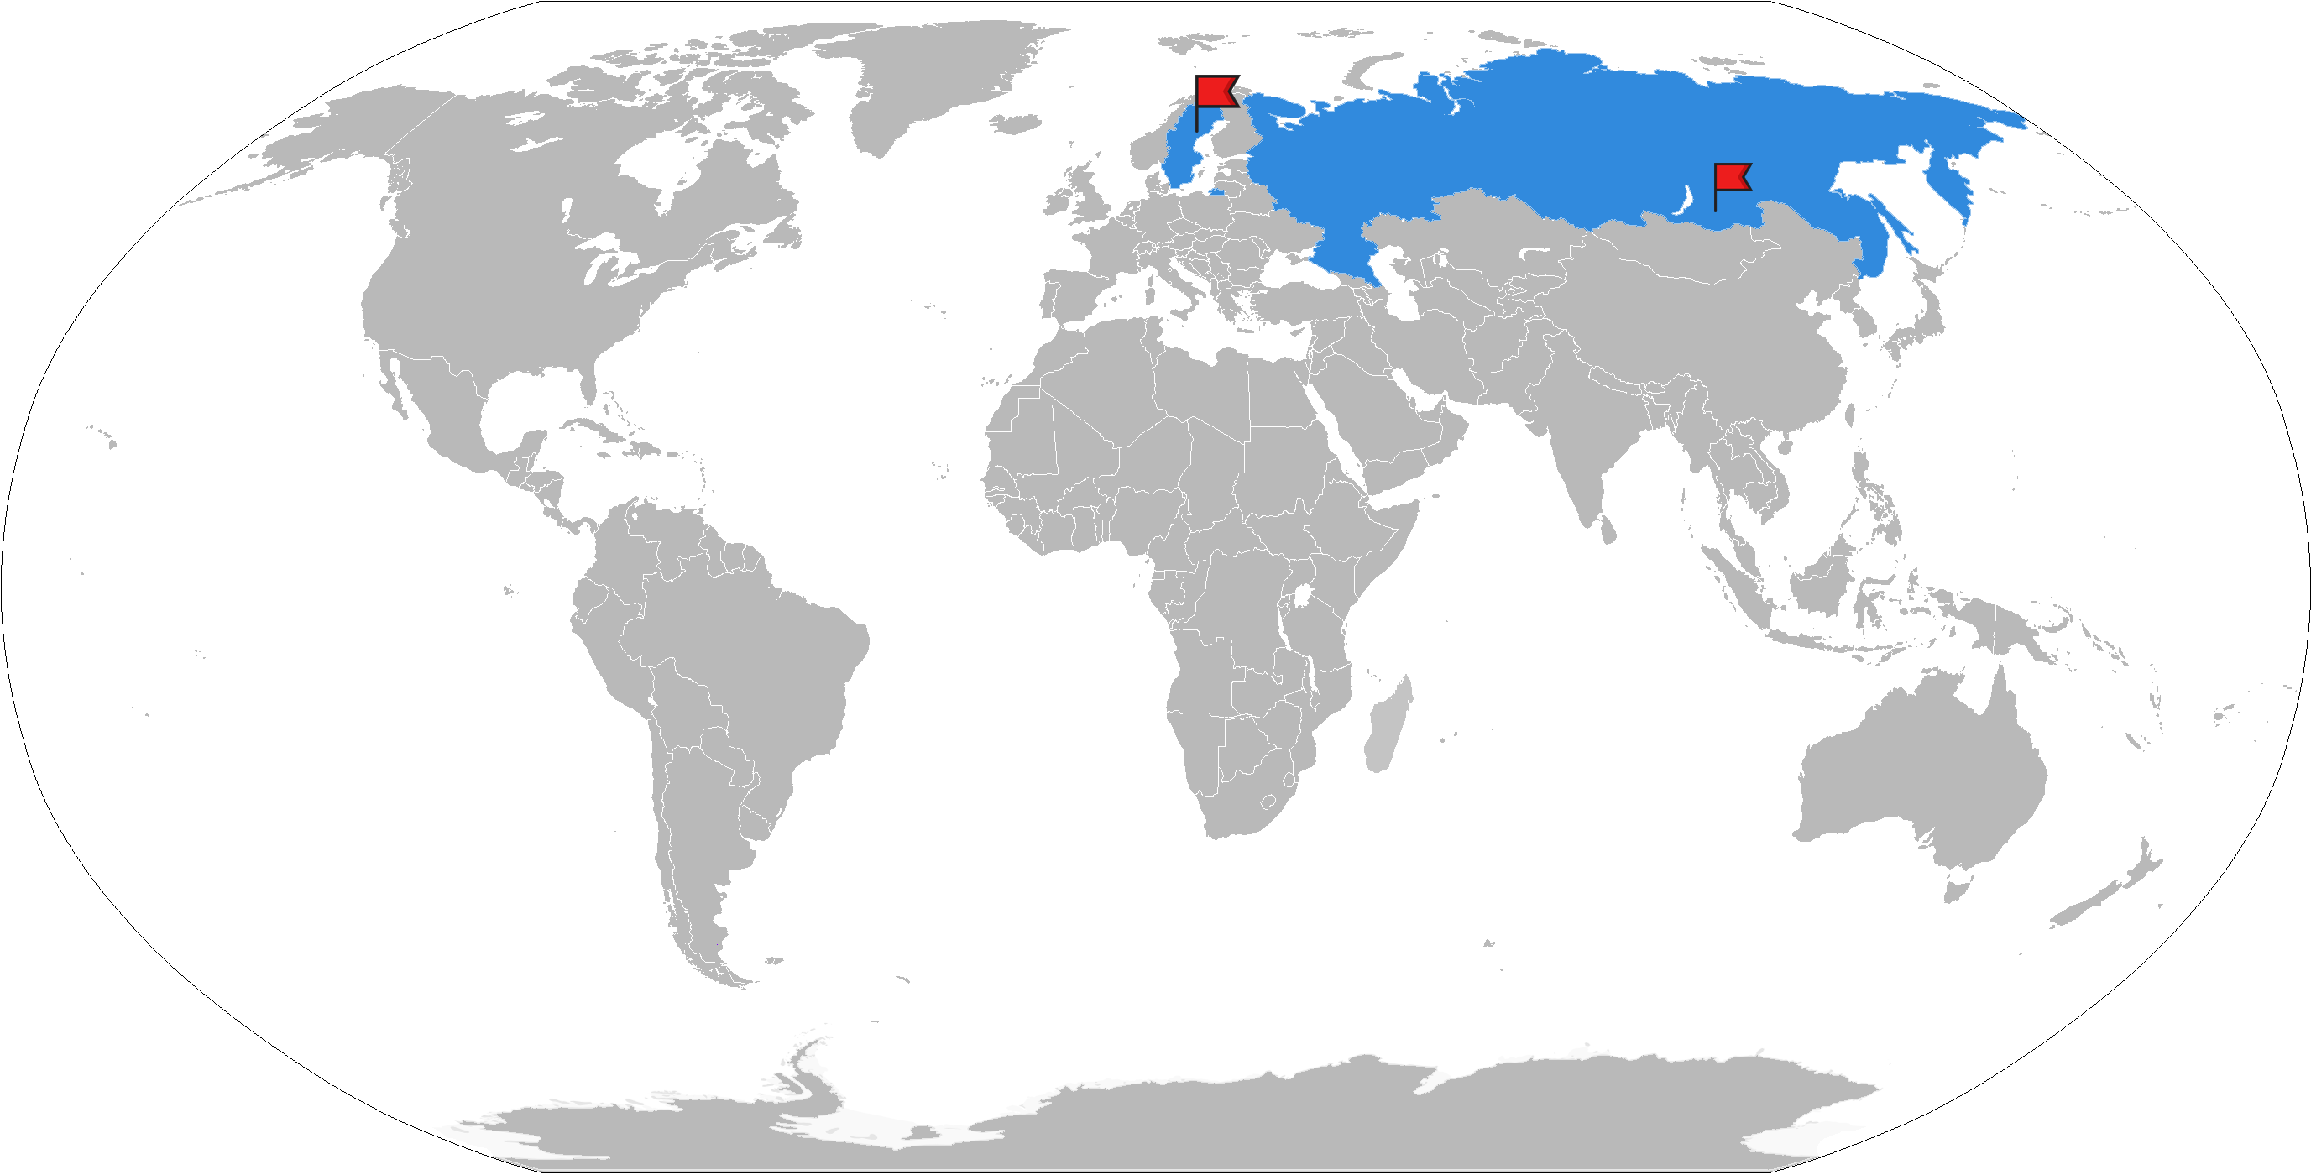
Nanning Umea and My home city
+26°C +7 -47.5°C
Notes:
You can not make such a cold place artificially. It is even colder than in the fridge.

Slide 8
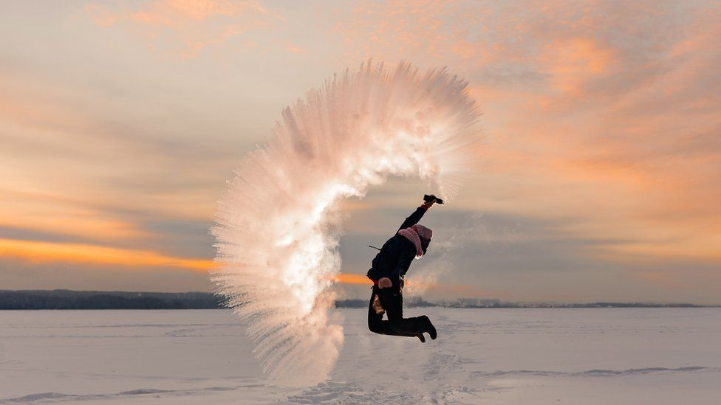
Spilling boiling water in Siberian winter

Slide 9
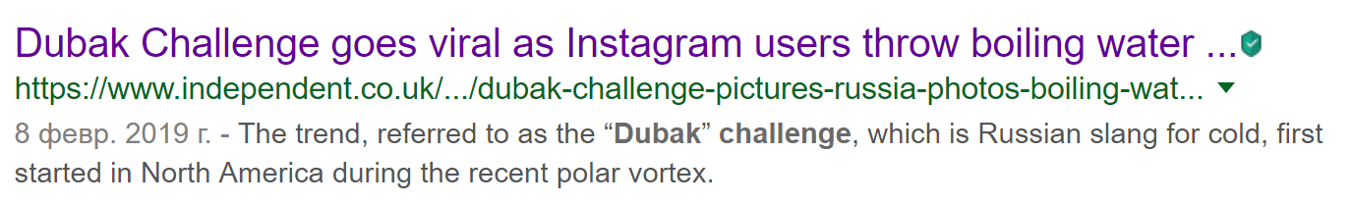

Slide 10
Real Winter!

Slide 11

The teaching process
During the semester we are going to have:
seminars with case-studies
lectures on the main course topics
mixed classes
Research work
It is mandatory to attend the lectures and seminars, otherwise you will be not allowed to take the final exam!

Slide 12
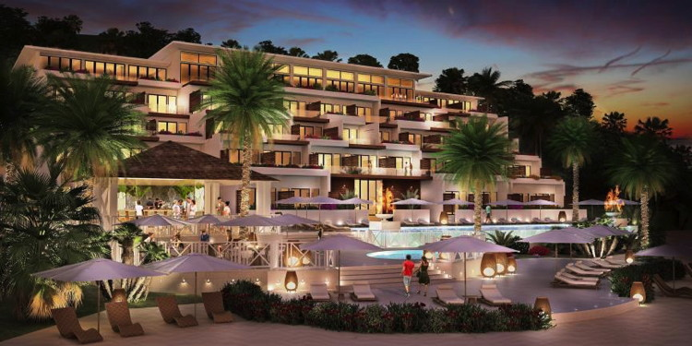
Case-studies from the book
The Kimpton hotels’ green approach

Slide 13
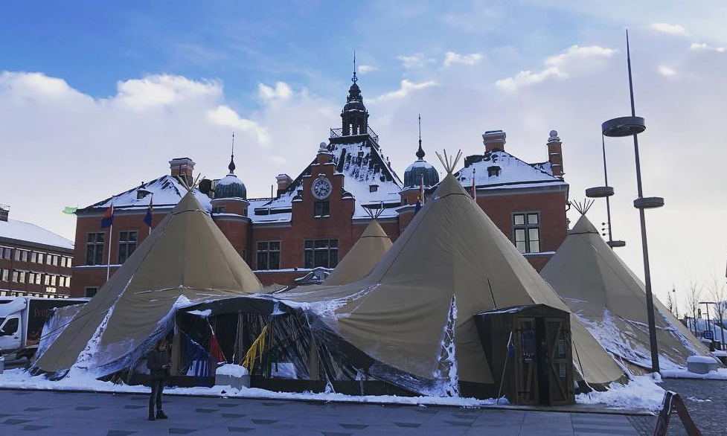
Real and modern case –studies based on my own experience
Saami indigenous people living in Sweden, Finland and Northern Russia
Umeå, Northern Sweden, Saami week March 04-09, 2019

Slide 14
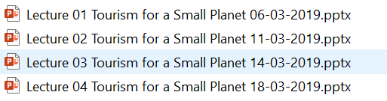
WeChat Group and WeChat (QQ) cloud for the shared files
Please, note that all Power point presentations will be stored on WeChat (QQ) cloud, so you have the access to all needed files.

Slide 15
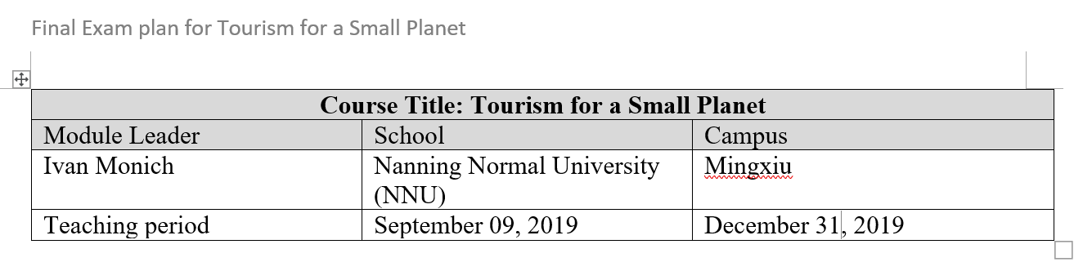
The evaluation procedure
Next week you will be given the Exam plan file containing the information about the course evaluation process.

Slide 16
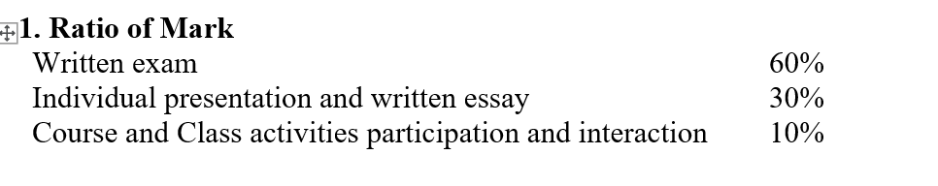
The evaluation procedure

Slide 17
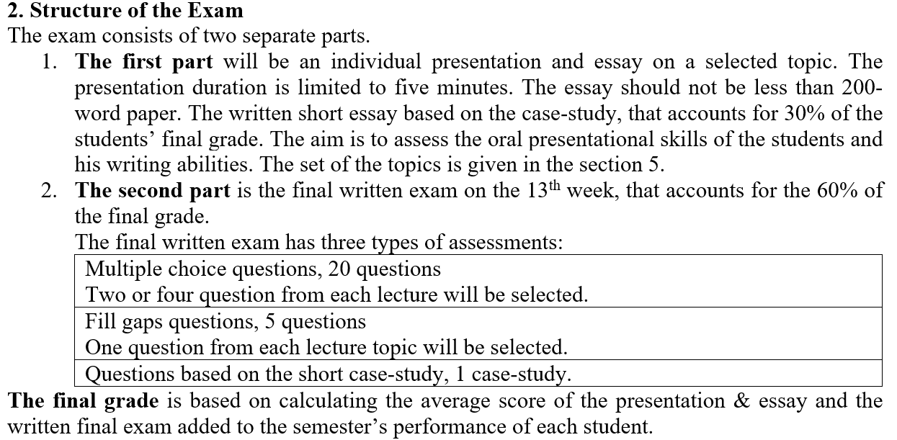
The evaluation procedure

Slide 18
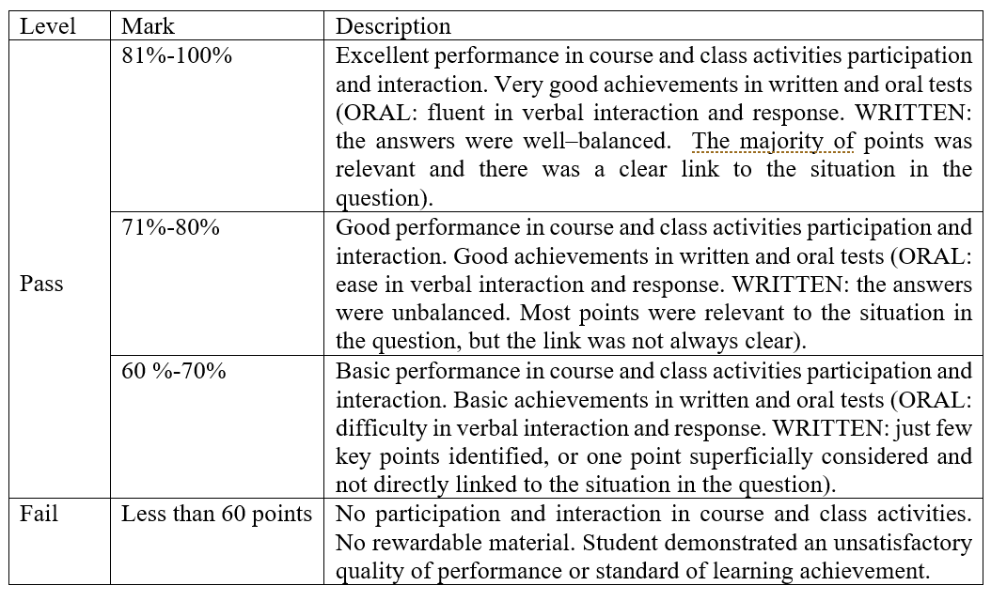
Grading scheme

Slide 19

Conducting the Survey
Design the questionnaire
- via Literature review
- coding scheme
- feedback from colleagues
2. Translate the questionnaire
- native speakers
- online translators
3. Test the questionnaire

Slide 20
Our questionnaire
Dear students. We have designed the questionnaire together.
It is not just a questionnaire, it is a book consisting of 4 pages with built in coding scheme and interviewer instructions. It is the survey manual or survey kit!
Now it is time to get the skills of how to use the coding scheme, how to approach the respondents and how to select the spot for the interview.

Slide 21
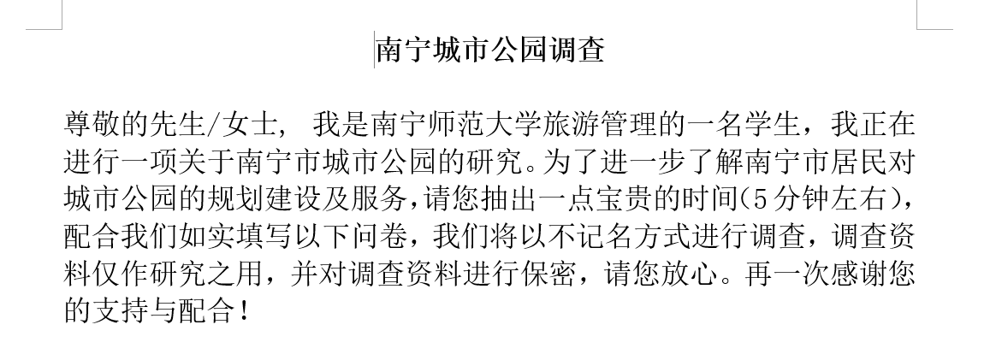
The structure of the questionnaire: Introduction

Slide 22

The structure of the questionnaire:
Hints and instructions
Coding Scheme

Slide 23
What is your favourite Nanning Park
你最喜欢南宁的公园是哪一个？
公园 | 公园
南湖公园 | 狮山公园
花卉公园 | 石门公园
人民公园 | 金花茶园
药用植物园 | 青秀山公园

Slide 24
Research results
In May, our research group did a Survey in 8 Nanning Urban parks for the factors of attractiveness and the impact of the green parks on urban sustainability. We conducted 598 semi-structured interviews and got the filled questionnaires. We are assessing the data now. One of the questions was "What is your favourite urban park in Nanning". I'd like to show the answer results: Nanhu park (157 votes), Qingxiushan park (119), Renmin Park (117 votes), Shishan park (85 votes)...

Slide 25
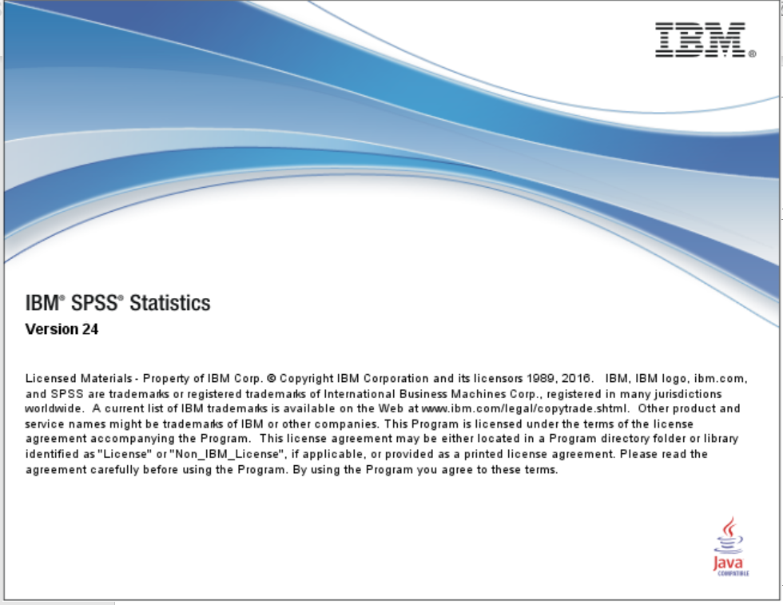

Slide 26
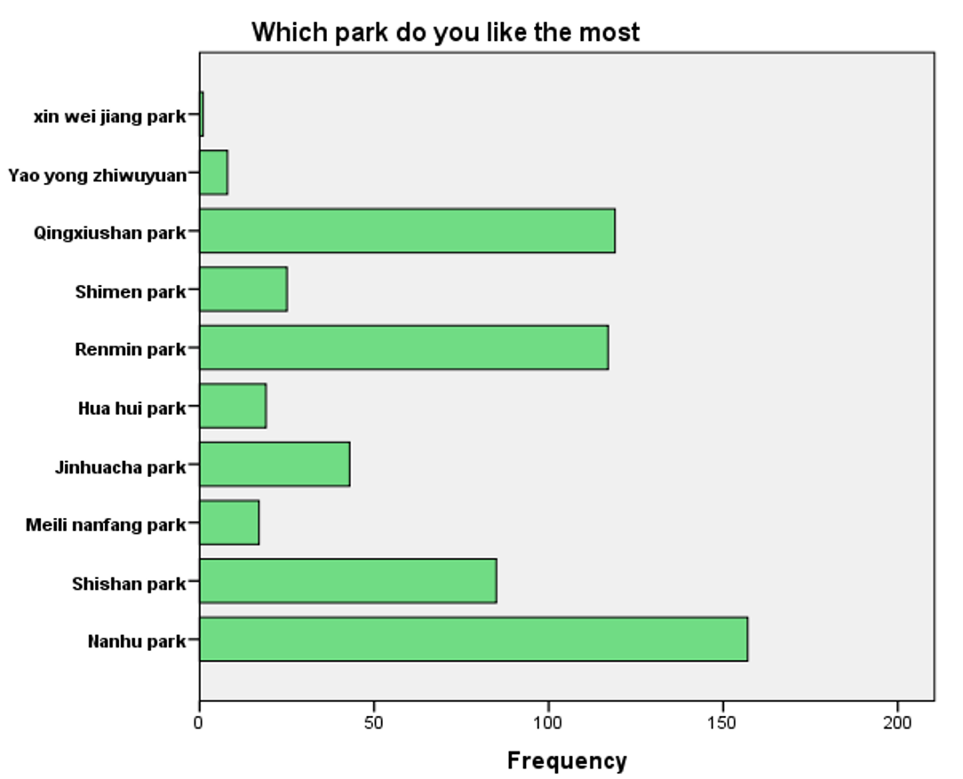

Slide 27
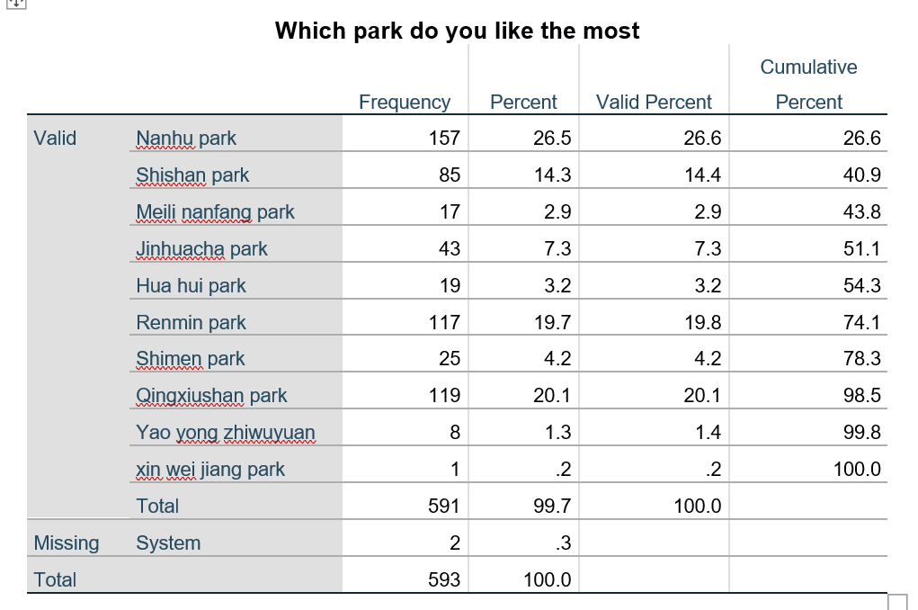
南您师范大学，旅游及文化学院研

Slide 28
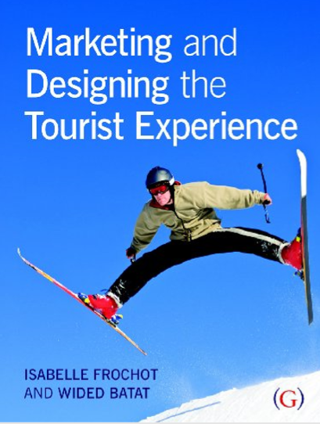
Main text book is
Marketing and Designing the Tourist Experience
© Isabelle Frochot and Wided Batat

Slide 29
How the teaching process goes
Lectures
PPTs with expected learning outcomes in the beginning.
Answering the rising questions and active participation in the lecture process.
One-two videos illustrating the main points of the content
Seminars
Business cases from all over the world to discuss.
Brief video about the case.
Work in the groups

Slide 30
Assessment method
Students' achievements are measured and evaluated by:
the ability to develop a critical appreciation of the role of marketing in tourism industry;
the ability to develop team working skills, in particular: organization, negotiation, delegation;
the ability to build team work; co-operation; leadership; following.
Students’ achievement will be graded according to the faculty and university standard using percentages: 0%- 59% (fail); 60%-100% (pass).
Ratio of mark (the respective sum to 100%)

Slide 31
Assessments
Written exam (mandatory) [50%]
Team project based on case study assessment (presentation and report are mandatory) [30%]
Short individual papers [20%]
Examination is based upon a written comprehensive individual exam, group assignments and short individual papers.

Slide 32
Assessments
The following grading system will be used:
Pass with distinction (75% or more)
Pass (60% or more)
Fail (less than 60%).

Slide 33
The Extended content of the course
Visitor Attraction experience
1
2
3
4
5
6
7
8
9
10
11
12

Slide 34
Content
1 A postmodern and cultural approach to understanding the new tourist/consumer
2 The experiential approach
3 Understanding the quality of the experience
4 Co-construction in tourism service delivery
5 The complexity of satisfaction measurement

Slide 35
Content
6 The service experience escape
7 The influence of images in shaping the consumer experience
8 Authenticity and commodification
9 Using locals as ambassadors: how to create a true experience
10 Alternative methodologies for studying the tourism experience

Slide 36
Introduction
Experience is a concept that is unavoidable in contemporary marketing strategies. When selling cars or new smartphones, sellers and marketers use this concept profusely, to the point that most products are now sold as a consumption experience.
An area where this notion of experience has played a significant role is in the provision of culture, art, leisure and tourism (known as hedonist consumption).

Slide 37
Introduction
Though the experiential approach and tourism researchers have demonstrated the superiority of emotions in the understanding of the experiences and their conceptualization, it cannot be ignored that tourism products remain physical entities that are designed, physically conceptualised and humanely managed.
Therefore, the course aims to try to bridge the gap between utilitarian and experiential approaches: the tangible dimensions of the service delivery are seen as enhancers that will allow consumers to experience more fully the emotions and experiential benefits of the tourism product.

Slide 38
Introduction block.
The summary of the lecture
The first lecture will clarify the broad framework within which the theories presented are nested.
The postmodern paradigm, which emerged as a critique of modernism, will be explained. Modernism foundations will be outlined in order to explain how post-modernism emerged, and its implications in terms of the consumer experience.
The links to the Consumer Culture theory will then be addressed, explaining how this approach takes into account the cultural and symbolic dimensions of consumption practices. Social representations and cultural practices will be presented to help readers make sense of the new consumption phenomenon observed in the contemporary world.

Slide 39
2
The second lecture will narrow down this framework by presenting the experiential theories. We start by addressing the limits of traditional marketing models, especially the rational side of consumers and their aim to maximise utility. From this critic can be understood the emergence of experiential theories that aimed to develop new models to explain consumption practices in specific areas such as culture, art, leisure and tourism. The principles and variables of this approach will be detailed and the evolution of this approach over the last three decades will be presented.

Slide 40
3
If experiential theories and tourism researchers have now established the dominant role of emotions in the tourism experience, it is essential to keep in mind that tourism services are also provided through a service delivery based on physical elements. Lecture 3 will explore those elements by addressing the specificities of the service delivery, the evaluation of service quality and service guarantees. While those approaches have been criticised, they remain powerful management tools to improve service delivery and the authors felt that it was important to address them. The chapter will also discuss the limits of traditional services' marketing models in a tourism context. For instance, can tourists elaborate precise evaluations of services during or following a long service encounter? Is evaluation, in a holiday context, different from other types of products and services? Finally, the notion of indirect service that characterises tourism service provision will be detailed.

Slide 41
4
Moving on from the recognition of the importance of the indirect service delivery in tourism, Lecture 4 will present more recent approaches that are extremely useful to the understanding of tourism experiences. The Service Dominant Logic and the Consumer Dominant Logic will be addressed with a focus on the recognition of consumers' roles as co-producers of the experience. The newer recognition of the independence that tourists might seek in their experience will also be addressed with the notion of auto-construction. The chapter will finish with a presentation of a service continuum which provides a framework for understanding how services alternate between a totally serviced delivery to autonomous consumption situations.

Slide 42
5
Having presented both the utilitarian and the experiential visions of the service delivery, Lecture 5 will address how satisfaction might be evaluated in an experiential context. Evaluating satisfaction in such a situation is a thorny question that researchers have debated for several decades. The chapter will again address the role of emotions in the conception of satisfaction. The specificities of satisfaction formation in an experiential context will also be addressed by advancing the possibility that tourists might develop satisfaction strategies. In an experiential context, the inability that individuals might have in voicing specific expectations will also be raised. Finally the chapter will present the notions of flow and immersion which represent central notions for understanding the consumer experience and satisfaction elicitations.

Slide 43
6
Lecture 6 will address the fact that the physical surrounding can play a central role in the achievement of the experience. It will further detail those elements by looking at how the experiencescape and atmospherics play a major role in determining the consumers' experience. The notion of theming the servicescape, through positioning and design, will be presented. Conceptions of theming at a local (resort) and global (landscape) levels will also be addressed.

Slide 44
7
The notion of servicescape is closely connected to the concept of image, which will be the object of lecture 7. Image is a fascinating but yet complex notion that will be defined and illustrated in the first part of the chapter. The chapter will then present how image has been defined in the tourism context and which elements play a part in its construction. Those elements will be addressed with some detail, investigating the impact of different media in its construction and the role that films also play in the production of image. The variables and models that can be used will also be extensively reviewed, as the concept of image measurement can be particularly complex.

Slide 45
8
Lecture 8 will look at the complex notion of authenticity. Authenticity is also an essential element in the construction of the experience, but its conceptualisation and meanings are complex. This chapter will first identify what authenticity means and how tourists perceive the notion of authenticity. The various conceptions of authenticity will be reviewed, especially by looking at staged and unstaged authenticity. The chapter will conclude with a detailed analysis of Las Vegas and will investigate the extent to which it can be seen as an authentic or unauthentic tourism destination.

Slide 46
9
Within the experience, another element that impacts on visitors' emotions is their connections with local amenities and inhabitants. Lecture 9 will address this aspect, which is another dimension of the authenticity as it implies direct contacts with local inhabitants. It also means that tourists are gradually seeking a more genuine and informal type of information provision. Examples of this are found in a review of accommodation service provisions such as gites and bed and breakfasts. The role of local guides will then be reviewed. Examples of guides in local parks and of homeless guides in London will show that the notion of tourists' guiding is evolving.

Slide 47
10
The last lecture 10 will present different forms of methodologies that can be developed to study and analyse experiences. Since quantitative methodologies have been fairly widely explored, the chapter will concentrate on qualitative methodologies. Presentation of different forms of data collection will be listed and examples will be presented including online qualitative data collection and new smartphone applications that provide very innovative tools to analyse the experience as it is taking place.

Slide 48
Lecture 1
A postmodern and cultural approach to understanding the new tourist/consumer
This lecture explores postmodern society and consumer behaviour in experiential consumption fields such as tourism. The underlying idea is that the consumer society has changed over the past decades due to postmodernism, which has contributed to the emergence of a tourist who has new expectations of products and services.

Slide 49
Lecture 1
A postmodern and cultural approach to understanding the new tourist/consumer
The aim of this first part is to uncover the shift from modernism to postmodernism and the implications of a postmodern and cultural approach to understanding the new tourist/ consumer. The lecture looks at the foundations of the modern era and its critics, the emergence of a postmodern society and theories of postmodernism, such as the Consumer Culture Theory (CCT), which offer a conceptual framework for defining the main characteristics of the new tourist/consumer and postmodernism in tourism studies.

Slide 50
Expected learning outcomes
After studying this lecture students should be able to:
Define the foundations of the postmodern consumer society and distinguish between the modern and postmodern eras.
Define consumer expectations and discuss their relevance from a postmodern consumer behaviour perspective.
Understand the main characteristics of the new consumer/tourist behaviour and the marketing implications related to them.

Slide 51
Expected learning outcomes
Compare and contrast the traditional consumer behaviour models and methodologies with their postmodern equivalents.
Understand the aims of the Consumer Culture Theory and its importance for studying tourist experiences.
Explain how personal experience, studied through a Consumer Cultural Approach, can influence consumer/tourist behaviours and expectations

Slide 52
From modernism to postmodernism
In respect of the consumption field, it appears that consumer society and postmodern society are near enough and may be considered as synonymous (Falk and Campbell, 1997). This lecture begins with an explanation of the foundations of modernism and postmodernism, followed by a cultural critique of modernism based on the distinction between production and consumption. An example of postmodernism in the tourism field will be highlighted at the end of this lecture.

Slide 53
Modern consumer society
Modernity can be explained through two dimensions: economic and cultural.
The economic aspect of modernity encompasses the industrialisation and the mass production era.

Slide 54
Modern consumer society
Definition of modernity, there are five main characteristics of modern society:
Industrial mass production and hence organizational efforts are important to improve productivity;
The belief in efficiency and progress and in productive time - in traditional, typically agricultural, societies time is cyclical, but in the modem society time is linear;
In marketing, the modern paradigm highlights the rationality of the consumer, who is able to identify, understand and satisfy his tangible needs

Slide 55
Modern consumer society
The use of scientific rationality and the experimental method to overcome the imperfections of nature and liberate mankind;
A bureaucratic type of organization for the optimisation of the results;
The hierarchy of bureaucracy, and the rational approach, required for production. In marketing, the modern paradigm highlights the rationality of the consumer, who is able to identify, understand and satisfy his tangible needs.
In marketing, the modern paradigm highlights the rationality of the consumer, who is able to identify, understand and satisfy his tangible needs

Slide 56
The foundations of modernism and its critique
According to a modem perspective, art and architecture follow tradition and have a primary emphasis on rationalism, functionalism and universalism (Jencks, 1987).
This logic has been criticized by postmodernists who put an emphasis on expressive forms and symbolic representations.

Slide 57
The foundations of modernism and its critique
The second critique argues that the modern perspective does not fit with the quest for an ethically ordered social life and the logic of rationality and technology. Rosenau (1992) states that modernism has failed because the material progress promised has turned out to be illusory and has had negative consequences such as poverty, inequality, human misery and violence (Firat and Venkatesh, 1995). A

Slide 58
The emergence of a postmodernism consumer society
The growth of the consumer society has contributed to the emergence of a new body of knowledge, which examines consumption as a socio-cultural process. According to Firat and Venkatesh (1995), this growth was simulated by four major moves:

Slide 59
The emergence of a postmodernism consumer society
1 the separation of the private and the public domains;
2 the construction of the consumer society through various public discourses and practices and by the media initiatives;
3 the assignment of men to the domain of production and of women to the private domain, and the conversion of women into consumers;
4 the conversion of consumers into shoppers by the use of marketing techniques.

Slide 60
The beginning of postmodern consumption was closely related to culture, which is not nature but humanly constructed. In opposition to the modem society that places economy and its norms of resource efficiency at the centre of the reflexion, the postmodern consumer society adopts a cultural position rather than a purely economic vision.

Slide 61
Marketing consumption field
In the marketing and consumption fields, there have been A postmodern and cultural approach to understanding the new tourist/consumer many more or less successful attempts to define the main foundations of the postmodern paradigm (Brown, 2006). The most compelling work was made by the two marketing gurus, Firat and Venkatesh, back in 1995.

Slide 62
Continuation of the lecture
18-09-2019

Slide 63
They defined postmodern marketing according to five main themes:
hyperreality,
fragmentation,
reversed production and consumption,
decentred subjects
and the juxtaposition of opposites.

Slide 64
Themes’ descriptions
Hyperreality. In the tourism sector, hyperreality is an important element, as tourists want to live hyperreal and extraordinary experiences (Macao, Las-vegas)
Fragmentation. Therefore, there is a fragmentation of life, experience, society and, most important, of the narratives (Lyotard, 1992). Fragmentation means the replacement of the single reality by multiple realities all claiming legitimacy.

Slide 65
Reversed production and consumption
In the modem view, there is a natural distinction between consumption and production. In this sense, each act of product induces an act of consumption, and vice versa. The postmodern philosophy goes beyond this simplistic view based on oppositional dichotomies such as object/subject or production/consumption. Indeed, the postmodern consumer is active within his consumption experiences, where he can co-create and co-produce meanings of products or advertising.

Slide 66
Juxtaposition of opposites
The purpose is to combine different dimensions and pleasures by abandoning the received rules in each field. This may be achieved by pastiche, by bricolage, by mixing and matching opposites, or by combinations of contradictory styles

Slide 67
Towards a consumer culture theory approach

Slide 68
Definition of the consumer expectations and their relevance from a postmodern consumer behaviour perspective.
Who is the new consumer/tourist?
Researchers have highlighted the concept of the subjective consumer. In addition to this idea, the concept of the 'new consumer is now considered as a topic of research in marketing to better understand consumer behaviour, the characteristics of his consumption and meanings of his consumption experiences

Slide 69
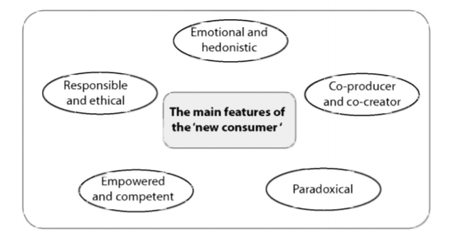
New tourist

Slide 70
A consumer/tourist with responsible behaviour

Slide 71
A consumer/tourist with paradoxical behaviour

Slide 72
A consumer/tourist with an emotional and hedonistic behaviour

Slide 73
A consumer/tourist who is empowered and competent

Slide 74
A consumer/tourist who is co-producer
The new consumer becomes a producer (Cova, 2008) able to create a new meaning for the company's offer (Certeau, 1990) to fit with his needs.
The joint production of goods and services between the company and the customer is not new idea; for example fast food or supermarkets have gained some of their success through customer participation in order to reduce production costs

Slide 75
Postmodernism and tourism studies
In today's postmodern Western societies, tourist behaviour has significantly changed, thanks to the use of information and communication technologies. Travel reservations are more likely to be made without using travel agent's expertise.
Furthermore, new tourism trends, such as individualism, related to the use of electronic media have emerged

Slide 76
Towards a consumer culture theory approach
Marketing and consumer researchers such as Amould and Thompson (2005) have placed the concept of 'experience' at the heart of a new paradigm through the philosophy of CCT 'consumer culture theory', which challenges the utilitarian dominant logic applied to consumer research.

Slide 77
Towards a consumer culture theory approach
In order to have a deeper understanding of the consumer experiences and behaviours, CCT takes into account the cultural and the symbolic dimension of the consumption practices. It goes beyond a simplistic posture of consumer behaviour and takes into account social representations and cultural practices to explain the complex behaviour of the consumer.
Therefore, aspects such as ideological, sociocultural, symbolic and experiential are all an integral part of consumer behaviour and can't be isolated when studying consumption activities in different contexts.

Slide 78
Summary
Tourists travel to different places, interact with people from different cultural backgrounds, and bring back travel memories, and these travel activities become 'embedded within the totality of lived experiences' (McCabe and Foster, 2006, p.194). Thus, the tourist experience is a socially constructed term, whereby the meaning of the tourist experience is associated with multiple interpretations from the social, cultural, environmental, and activity components of the overall experience (Tussyadiah and Fesenmaier, 2009). In this sense, the CCT philosophy conceptualizes the experience as a subjective episode in the construction and the transformation of the individual, with an emphasis on the emotional and sensitive dimensions of the consumer behaviour.

Slide 79
Thank you

