Slide 1
南宁师范大学
Nanning Normal University
Department of Tourism & Culture
Research Methods
Ivan Monich, Ph.D.
Nanning, 2019

Slide 2
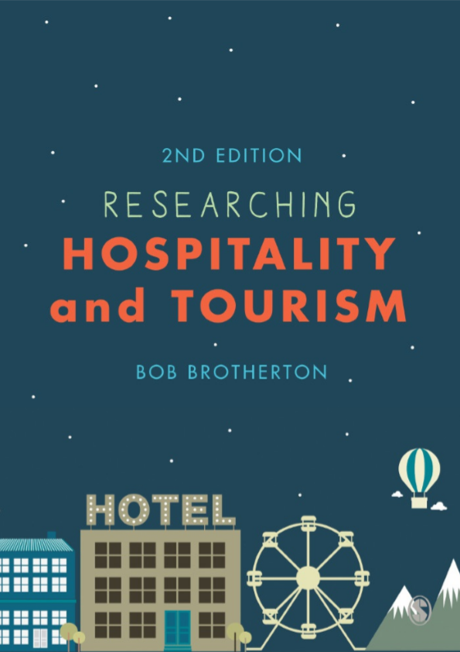
The main textbook is
Researching Hospitality and Tourism

Slide 3


Previous Lecture Content and Issues
The nature of research.
Experience, common sense and theory.
Thinking about research.
The characteristics of scientific research.
Good and bad research.
Pure and applied research.
Theoretical/empirical and primary/secondary research.
Exploratory, descriptive and explanatory research.
Inductive and deductive approaches to research.
Issues that require research solutions.
Some problems that may be encountered.

Slide 4
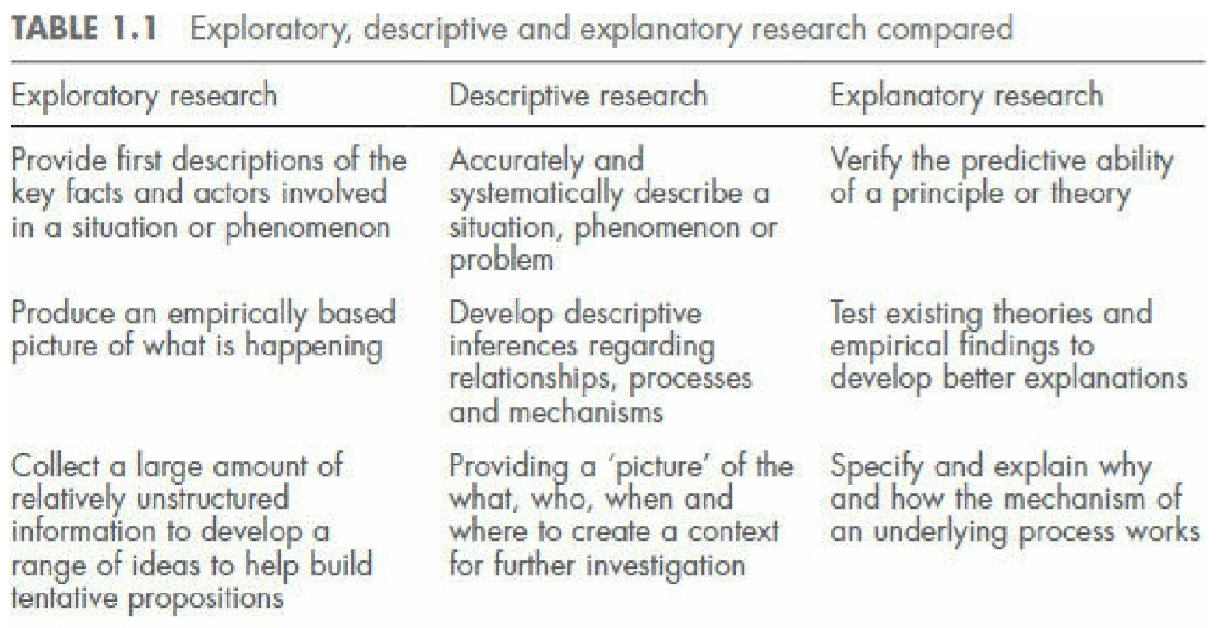

Slide 5
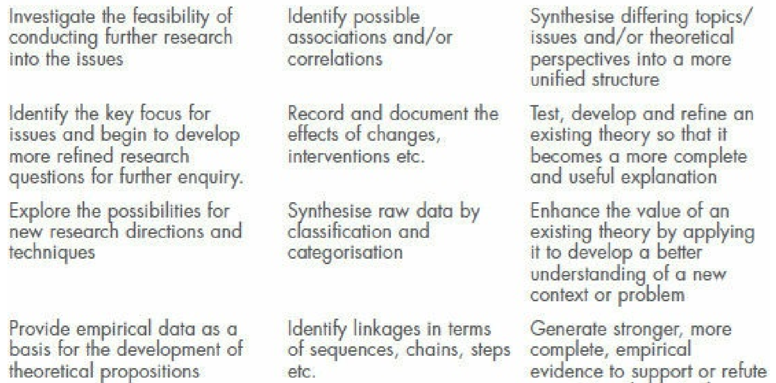

Slide 6
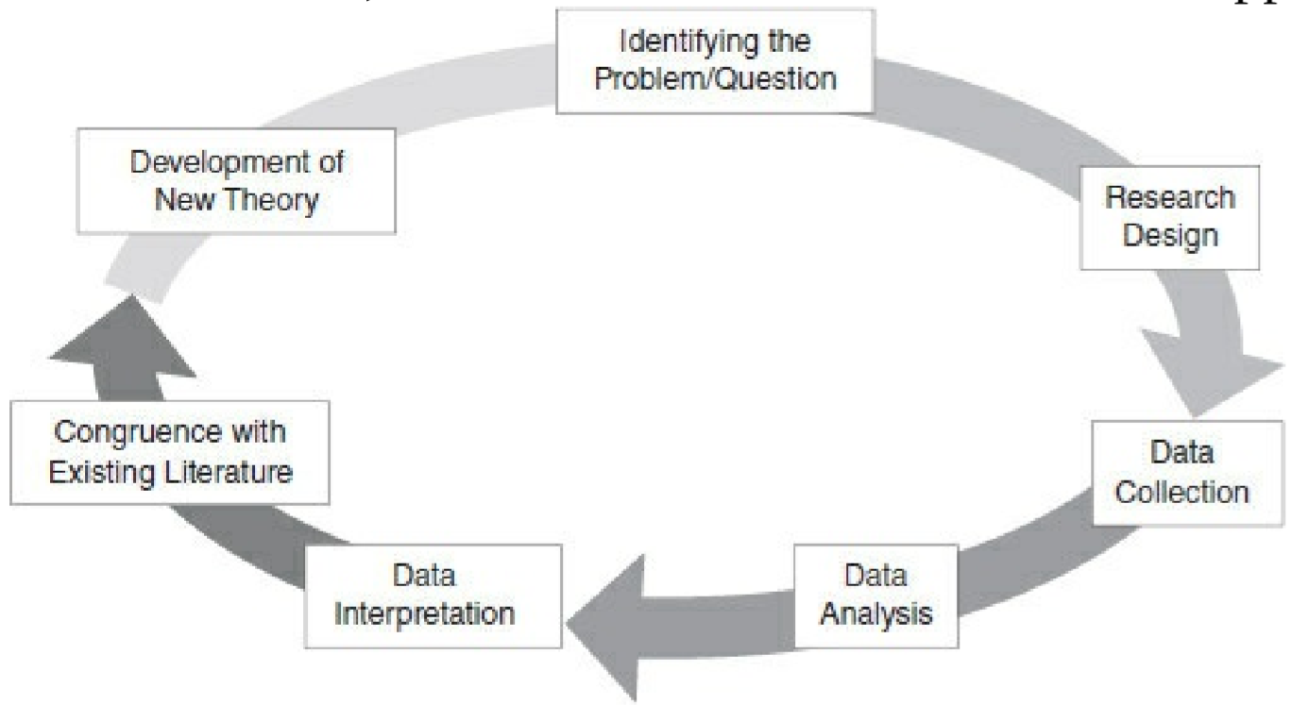
The inductive approach to research

Slide 7
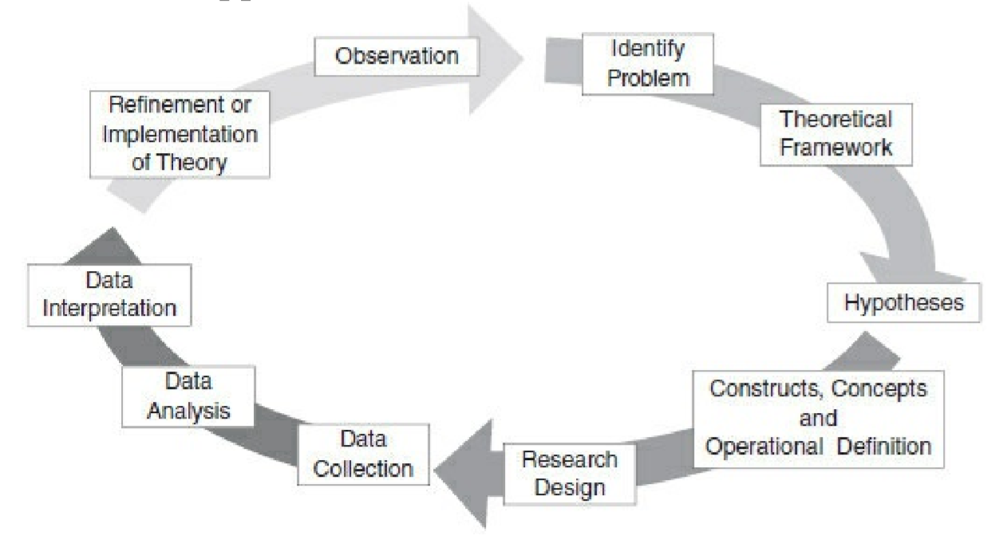
The deductive approach to research

Slide 8
Lecture 02
Research Philosophies and Schools of Thought
Content and Issues:
What is knowledge and how is it created?
Knowledge and reality.
The influence of different philosophies and perspectives.
The ‘ologies’ – ontology, epistemology and methodology.
Objectivity and subjectivity.
Independent factual and socially constructed reality. Schools of thought and paradigms.
Positivism and phenomenology.
Post-modernism, pragmatism and critical realism. Mixed-method designs.

Slide 9
2.1 Introduction
The purpose of this chapter is to introduce you to issues, debates and controversies relating to the philosophical strands of thought that are the most appropriate for informing and guiding your approach to designing and conducting research

Slide 10
2.2 The Nature of Knowledge and Reality
In the first lecture, we touched on some of the issues associated with common sense and more scientific approaches to research and the enhancement of knowledge.
Before we consider some of the academic thinking and jargon related to these issues, let us consider them in a more easily understandable context. Read the text in the Research Reality Scenario box – Knowledge and Reality
Task #1

Slide 11
Research Reality Scenario box – Knowledge and Reality
Article contains a short, perhaps fairly typical, conversation between a hypothetical general manager and the members of his departmental management team, discussing a problem that has arisen at their hotel, and think about how the different characters react to the so-called problem in terms of their acceptance of it, their perceptions of what could be done to address it and what they accept as factual and real.

Slide 12
2.2.1 The ‘ologies’
In the academic jargon, these three things are known as ontology, epistemology and methodology (the ‘ologies’) and, collectively, they have quite a fundamental influence on how people design and conduct research.
Ontology, for example, is concerned with beliefs about the nature of reality.

Slide 13
Ontology vs Epistemology
Observer: The Volga River flows into the Caspian Sea!
Epistemologist: How do you know about this?
Ontologist: What does “to flow” mean? Where is the border between the river and the sea? And by the way, what is "Volga"?

Slide 14
Ontology vs Epistemology
Observer: Economic crises are eventually caused by Senorage!
Epistemologist: How did you get it?!
Ontologist: Are you not confused with the financial crisis? Why don't you say "greed" instead of "Senorage"

Slide 15
Ontology vs Epistemology
Observer: What's going on here? I don't understand anything!
Epistemologist: How do you know you don't understand anything?
Ontologist: Pick up the textbook, it's probably all written inside ☺

Slide 16
Онтология и эпистемология
Философы выделили и описали два типа проблем. Первый - это проблемы того, каковы вещи, что есть личность и каков этот мир - т.е. проблемы онтологии. пытаются понять, почему возникает определенная вещь, как она связана с другими вещами. Второй тип - это проблемы того, каким образом мы что-либо знаем, или, более точно, каким образом мы узнаём, каков этот мир, и что мы за существа, которые вообще могут знать нечто (или, возможно, ничего) о данном предмете. Это проблемы эпистемологии.

Slide 17
Эмпирические знания получают через опыт. Человек утверждает факт, основанный на его предыдущем опыте или встречах, связанных с определенной темой. Например, когда он говорит, что огонь горячий или лед холодный, это из-за его собственного опыта. В то время как не эмпирическое знание основано на рассуждениях. Когда человек говорит, что Антарктида холодная, он объясняет, что, говоря, что районы возле южного полюса получают меньше солнечного света, и, следовательно, они холодные. Пропозициональное знание - это когда человек знает факты о разных областях. Индивидуальные знания основаны на том, что один человек утверждает. Коллективные знания основаны на том, что знает конкретное сообщество людей. Эпистемология охватывает все эти типы знаний.

Slide 18
The relationship between ontology, epistemology
Taylor and Edgar (1999: 27) succinctly summarise the relationship between ontology, epistemology and methodology in stating that:
‘the belief about the nature of the world (ontology) adopted by an enquirer will influence their belief as to the nature of knowledge in that world (epistemology) which in turn will influence the enquirer’s belief as to how that knowledge can be uncovered (methodology)’.

Slide 19
2.2.2 Schools of thought and paradigms
As it is self-evident there are groups of people in society sharing different views of the world based on different philosophical, political, religious or cultural beliefs, it should not surprise you to know that such divisions also exist in the world of academic enquiry.
In short, each different group will tend to have a different view of the most appropriate philosophical stance, or ontology, epistemology and methodology, that should be used to develop knowledge. Such groups are often referred to as ‘schools of thought’.

Slide 20
Economy Schools
Such groups are often referred to as ‘schools of thought’. For example, in economics there are, among others, monetarist and Keynesian schools of thought. To illustrate in a simple way the implications of the differences between these two schools of thought, we might consider their views on how to manage an economy. Unsurprisingly, the monetarist school believes that it is money and, more specifically, the supply of money that are the prime determinants of economic activity and outcomes. Consequently, and logically, if it is possible to control and manipulate the supply of money in an economy, usually via interest rates, then the economy itself can be controlled and manipulated. Alternatively, while not denying that money has importance, the Keynesian school believes that other factors are more important than the supply of money in determining the state of an economy and would suggest that the use of fiscal measures (taxation and government expenditure) to manipulate the economy are likely to be more effective than changing interest rates. Therefore, the ontology, epistemology and methodology adopted and advocated by the two schools of thought are different.

Slide 21
2.3 Two main philosophies or paradigms – positivism and phenomenology (also sometimes referred to as interpretative or constructivist)
These are generally regarded as the two main opposing paradigms for conducting research.
To illustrate the fundamental differences between the positivistic and phenomenological (also sometimes referred to as interpretative or constructivist) philosophies, read the conversation in the Research Reality Scenario box – Different Strokes.
Task #2

Slide 22
2.3.1 Positivism
Positivism is a belief based on, and derived from, the view that a ‘real’ world of tangible social and physical phenomena exists independently – that is, objectively – of how such phenomena are perceived and conceptualised by people and what is required to understand and explain these is impartial, value free, logical, empirical, scientific research. In short, the truth is out there and it can be revealed by applying an appropriate methodology.

Slide 23
2.3.1 Positivism
As you might expect, positivism is the mindset of the archetypal whitecoated laboratory scientist, but it is also a significant, if not the most dominant, philosophy in management research, including that into hospitality and tourism.

Slide 24
2.3.1 Positivism
The positivist assumes that people and/or organisations behave in a self-interested, logical and rational manner. Phenomena and events can be explained by general, or universal, cause–effect laws.
To be capable of achieving this, positivists would take the view that scientific research is the only way to discover the truth and it must be conducted in an objective manner, deterministic in purpose (to determine cause–effect relationships), mechanistic in process and use well-established and validated methods.

Slide 25
2.3.1 Positivism
Positivists take the view that the ‘best’, or most valid, way to learn the truth is to conduct experiments.
Experimentation – or, more specifically, laboratory experimentation – is the preferred method of the positivist because it enables the research to be designed and conducted with the maximum degree of control

Slide 26
2.3.1 Positivism
Critics of the positivist approach also point out that researchers cannot be totally objective in the way they conduct research, that objectivity is a myth.
As human beings, we cannot avoid being influenced by our beliefs, values and prejudices, whether we consciously realise this or not.
An approach may have value, but it does carry the danger that the answers it delivers may be more simplistic and partial than the reality it is trying to describe and explain, and hence, be less valid as a result. (Onion)

Slide 27
2.3.2 Phenomenology
Phenomenological, constructivist or interpretative approaches to research place considerably less emphasis on the need to develop socalled objective research methods and more on the need for interpretation in research.
This is a view based on the belief that the real world, and the phenomena and events that occur in this world, are created by the subjective thoughts, actions and interactions of people who inhabit it. In short, it is socially constructed rather than being a separate and independent entity that determines people’s behaviour.

Slide 28
2.3.2 Phenomenology
In terms of the methods favoured by the phenomenological approach, it is clear that those advocated by the positivists – experimentation or surveys – are generally seen to be inappropriate.
Methods such as case studies and what are referred to as ‘field study’ techniques – participant or non-participant observation – are the type of methods preferred by phenomenologists.

Slide 29
2.3.2 Phenomenology
This, in turn, implies that research undertaken from a phenomenological perspective is more likely to involve the collection of qualitative rather than quantitative data. In general, this tends to be the case, but it should not be assumed that all positivistic research is quantitative and all phenomenological research is qualitative in nature.

Slide 30
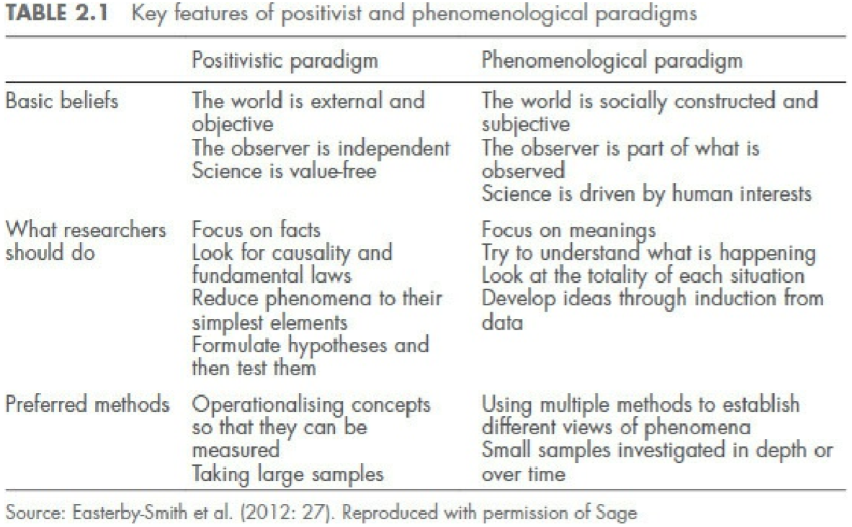

Slide 31
Scientists types
Scientist based on differences concerning the two dimensions of the type of input data and decisionmaking they prefer. The combination of these two dimensions produces four types of researcher:
academic scientist (AS)
conceptual theorist (CT)
particular humanist (PH)
conceptual humanist (CH).

Slide 32
Viewing these in a simplistic manner, we would conclude that the AS and the CH are very much the archetypal positivist and phenomenologist.

Slide 33
2.4 Post-modernism and Pragmatism
This ‘modernity’ was therefore a period within which the dominance of science and rational/linear thinking came to the fore, being typified by the centrality of causation, or cause–effect relationships and mechanisms, to scientific, and indeed more gene
Post-modernists would claim that the world, certainly in the final couple of decades of the twentieth century and into the twenty-first, has become much more uncertain, unstable, less predictable and much more fluid and diversified than was the case previouslyral, thinking.

Slide 34
2.4 Post-modernism and Pragmatism
People are behaving differently, their identities are becoming more varied and defined by attributes and factors that were not as significant in the past, technology is changing – often radically – the nature of work, organisations and how people interact in everyday life.

Slide 35
2.4.2 Pragmatism
In short, if we sign up to a particular set of beliefs about the nature of the world (ontology) that then determines what we regard as knowledge and how we can know this (epistemology) and the ways by which this knowledge can be revealed and proven (methodology), we become locked into a particular belief–action system.

Slide 36
Who Am I?
✓ What are my basic beliefs about the world? Am I a realist, a critical realist or a constructivist?
✓ Which philosophical stance do I favour? Positivism, phenomenology, post-modernism or pragmatism?
✓ Which type of epistemology would I advocate? Is knowledge best obtained from an objective, external observer stance that sees the world as existing independently of you or from a more subjective, involved observer stance that sees we are part of the knowledge that is being obtained?

Slide 37
Who Am I?
✓ What type of strategic approach to developing knowledge (methodology) do I favour? The ‘scientific approach’ or one more closely associated with ‘social constructionism’?
✓ What type of data do I need to collect – quantitative, qualitative or both?
✓ Which empirical methods and procedures would be the best to answer my research question/s – survey, case study, experiment, comparative, observational, mixed?

Slide 38

Is Anything Real?

