Slide 1
南宁师范大学
Nanning Normal University
Department of tourism & culture
Marketing for Tourism, Hospitality and Events
Ivan Monich, Ph.D.
Nanning, 2019

Slide 2

Topic
Marketing information and research
26-11-2019

Slide 3
LEARNING OBJECTIVES
This lecture will help you to:
• recognise the importance of information to an organisation and the role information plays in effective marketing decision-making;
• understand the role of a marketing information system and a decision support system, and develop an awareness of the various types of information available;
• become familiar with the various steps involved in the marketing research process;
• outline the sources of secondary and primary data, understand their role and the issues involved in their collection and analysis; and
• appreciate some of the ethical concerns surrounding marketing research.

Slide 4
INTRODUCTION
Every aspect of marketing considered in this course, including the definition of markets and market segments, the formulation of an integrated strategy based on the 4Ps and planning and control mechanisms, requires the collection and analysis of information.
The better the planning, data collection, information management and analysis, the more reliable and useful the outputs become, and thus marketers are able to make decisions that are more likely to satisfy the needs and wants of selected market segments

Slide 5
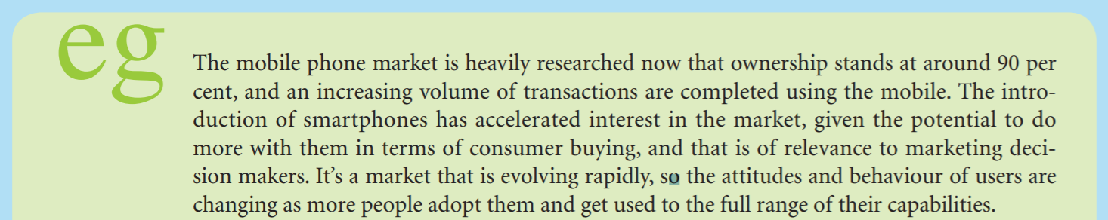
Page 162

Slide 6
This lecture first considers the role of marketing research and discusses the structure of the marketing information system (MkIS) as a means of collecting, analysing and disseminating timely, accurate and relevant data and information throughout the organisation.
It then looks at the marketing research planning framework.

Slide 7
Marketing research: definition and role
Marketing research is at the heart of marketing decision-making and it is important to understand what it involves and its place within the organisation. This section thus discusses the meaning of marketing research and the role that it plays in helping managers to understand new or changing markets, competition, customers’ and potential customers’ needs and wants.

Slide 8
Defining marketing research
Marketing research links the organisation with the environment in which it is operating and involves specifying the problem, gathering data, then analysing and interpreting those data to facilitate the decision-making process.
Marketing research is a critical input into marketing decisions and has been defined by the American Marketing Association (AMA) as follows:

Slide 9
Defining marketing research
. . . a function that links the consumer, customer and public to the marketer through information – information used to identify and define marketing opportunities and problems; generate, refine and evaluate marketing actions; monitor marketing performance; and improve the understanding of marketing as a process. Marketing research specifies the information required to address these issues, designs the method for collecting information, manages and implements the data collection process, analyses the results and communicates the findings and their implications. (www.marketingpower.com/ AboutAMA/Pages/DefinitionofMarketing.aspx).

Slide 10
The role of marketing research
Marketing research is essential for ensuring that segments exist and that they are viable, and for establishing what they want and how to reach them.
As markets become increasingly European and global in their scope, marketing research plays an even more crucial role in helping the organisation to Europeanise or globalise its marketing effort, and to decide when to standardise and when to vary its approaches as new markets are opened up.

Slide 11
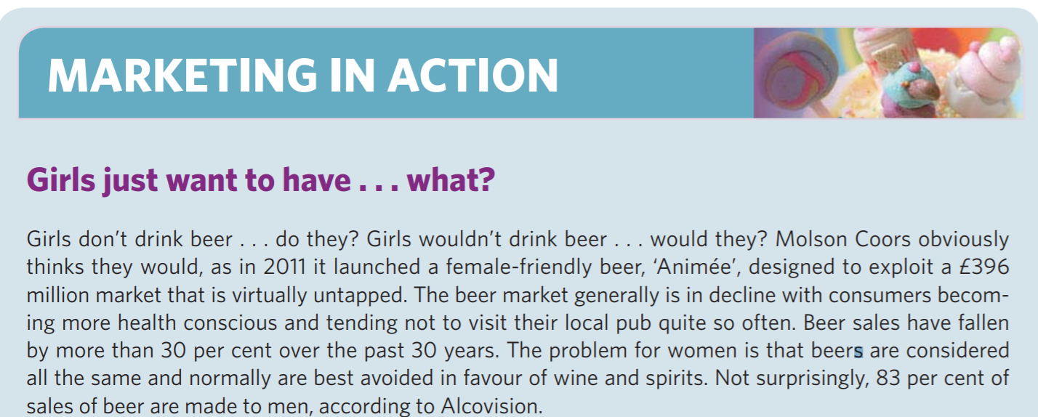
Page 165

Slide 12
B2B markets
In B2B markets, the role of marketing research is still very similar to that in consumer markets, in that it helps the organisation to understand the marketing environment better and to make better informed decisions about marketing strategies. Where the two types of market may differ is in the actual design and implementation of marketing research, because of some of the underlying factors peculiar to B2B markets, such as the smaller number of customers and the closer buyer–seller relationships.

Slide 13
Types of research
So far, the discussion of marketing research has been very general and has not distinguished between different types of research. There are, however, three main types of research, each suitable as an approach to different kinds of problem.

Slide 14
Exploratory research
Exploratory research is often undertaken in order to collect preliminary data to help clarify or identify a problem, rather than for generating problem solutions. Before preparing a major proposal, some exploratory work may be undertaken to establish the critical areas to be highlighted in the main body of the research.

Slide 15
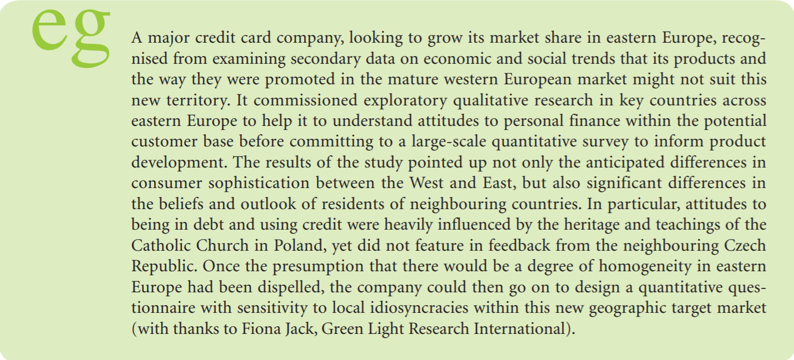
Page 167

Slide 16
Descriptive research
The second type of research, descriptive research, aims to provide the marketer with a better understanding of a particular issue or problem. Descriptive research can range from quite specific briefs, for example profiling the consumers of a particular brand, assessing the actual purchase and repurchase behaviour associated with that brand and the reasons behind the behaviour exhibited.
Most research in this category tends to be of a large-scale survey type, designed to provide a means of better understanding of marketing problems through the presentation of both quantitative and qualitative data.

Slide 17
Causal or predictive research
Finally, causal or predictive research is undertaken to test a cause-and-effect relationship so that reasonably accurate predictions about the probable outcome of particular actions can be made. The difficulty with this kind of research for the marketing manager is that to be confident that more of x does cause more of y, all the other variables that influence y must be held constant

Slide 18
The origins of research data
There are two main types of data, which are generated by fundamentally different research approaches.

Slide 19
Qualitative research:
■ survey research/questionnaires
■ focus groups
■ in-depth interviews
■ observational techniques
■ experimentation.

Slide 20
Quantitative research
Quantitative research usually involves larger-scale surveys or research that enable a factual base to be developed with sufficient strength to allow statistically rigorous analysis.

Slide 21
Continuous research
A large number of research projects are developed specifically to better understand and to overcome marketing problems as they are identified.
There are a number of different approaches to generating continuous data.

Slide 22
Consumer panels
Market research companies recruit large numbers of households that are prepared to provide information on their actual buying and consumption patterns on a regular basis. The panel may be constituted to provide as wide a coverage of the population as possible, or it may be defined to home in on a particular segment.

Slide 23
Home audits.
Omnibus surveys
There are three types of omnibus survey: those carried out face-to-face during an interviewer visit to the home, telephone surveys and finally internet surveys.

Slide 24
Taylor Nelson Sofres (www.tns-ri.co.uk/what-we-do/bmrb-omnibus.aspx) runs a number of regular omnibus surveys as well as specific industry- or issue-based marketing research reports. These include
:■ OnlineBus: this survey is run online twice a week using between 1,000 and 2,000 adults, and results are turned around within two to three days.
■ 24 Hours – NightLine: this is run Monday to Friday and offers a 24-hour turnaround from surveys of 1,000 adults.
■ CAPI – Face to face Omnibus: this is the largest UK omnibus survey, run twice a week with between 1,000 and 4,000 adult respondents and a ten-day turnaround of results.
■ PhoneBus: this survey runs once each weekend, reaching 1,000 adults with a four-day turnaround of results.
■ Ncompass International: this covers over 80 international markets, with large sample sizes and a weekly run in most of those markets. The results can be turned around in about a week.
■ Kids Omnibus: this uses online techniques to survey 1,000 children aged between eight and 15 every month, with a one-week turnaround of results. Face-to-face techniques are also used on a continuous basis to survey 500 children aged between seven and 14, and 500 young people aged between 15 and 19, with a four-week turnaround of results.
■ ChatterBus: this is a live, moderated online discussion that takes place every Wednesday evening. Clients buy time in the discussion in five-minute blocks. A full transcript of the relevant sections of the discussion is available to the client within 24 hours.

Slide 25
Retail audits
The retail audit concept is perhaps the easiest to implement, as it relies on trained auditors visiting selected retail stores and undertaking regular stock checks, although barcode scanning and integration between retailers’ systems and those of suppliers is providing even more up-to-date information on what is sold where and when

Slide 26
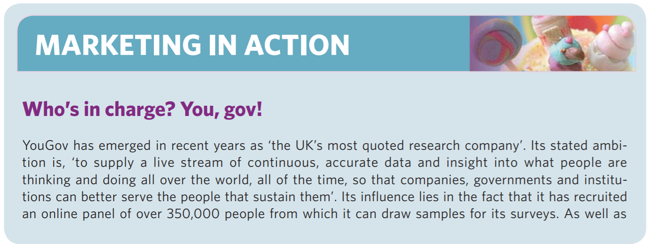
Page 170

Slide 27
Marketing information systems
In order to serve the information needs of the organisation and to support decision-making, marketers need to focus not only on collecting data and information, but also on how to handle and manage issues of storage, access and dissemination (McLuhan, 2001). There is little point in having a highly complex information system that cannot readily deliver what managers want, when they want it and how they want it. Any system must be responsive to the needs of the users.

Slide 28
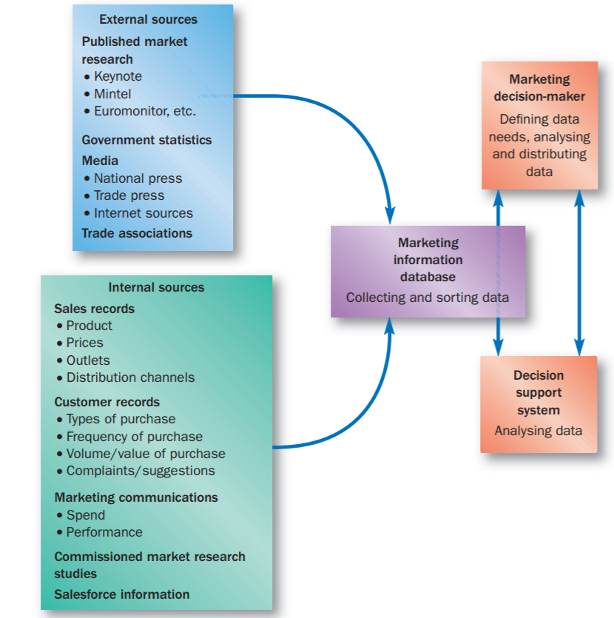
The marketing information system

Slide 29
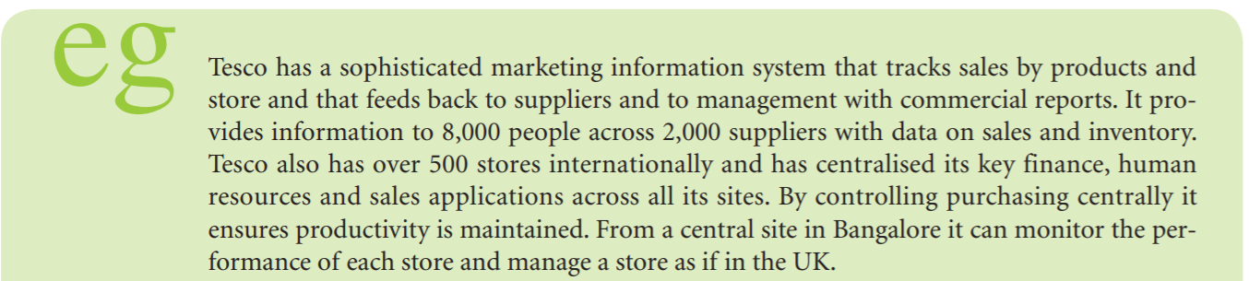
Page 173

Slide 30
Sources of marketing information
As indicated at the outset of this chapter and in the previous Figure, there are two main sources of information for an MkIS system, internal and external.

Slide 31
External sources
External sources are either ad hoc studies using secondary and primary research, or continuous data provided by the various syndicated and omnibus studies mentioned earlier. Information comes from sources external to the organisation, such as customers, suppliers, channels of distribution, strategic alliance partners, independent third parties, commercial agencies, industry associations, governmental sources such as Eurostat, etc., and external sources like the internet.

Slide 32
Internal sources
These include the internal record keeping system (production, accounting, sales records, purchase details, etc.), marketing research, sales representatives’ field reports, call details, customer enquiries and complaints, productreturns.

Slide 33
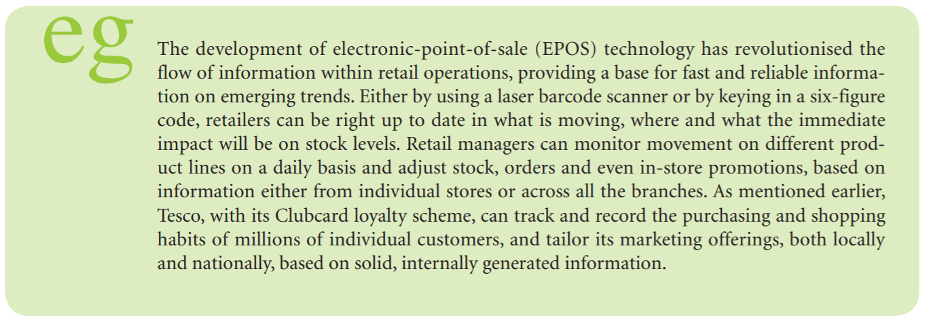

Slide 34
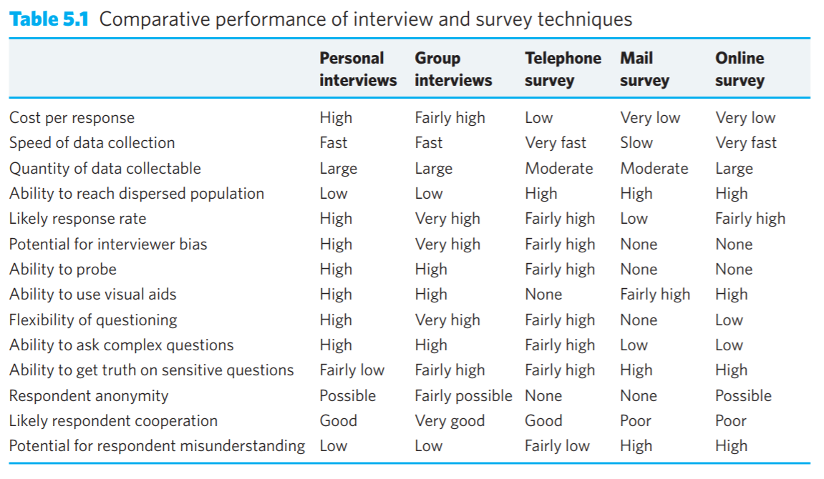

Slide 35
Page 183

Slide 36
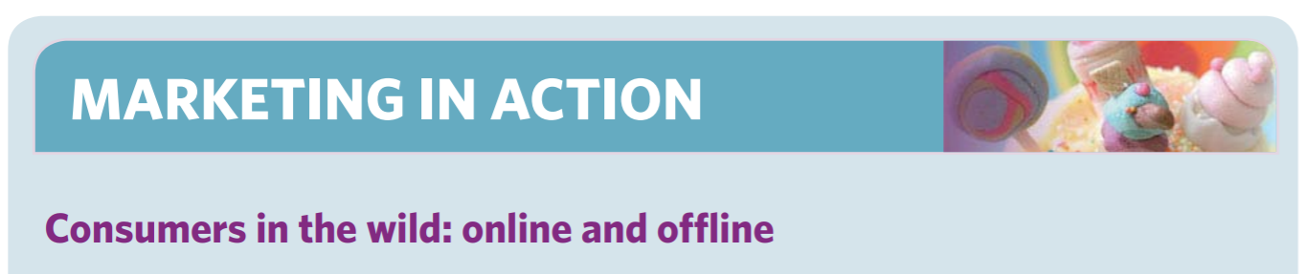
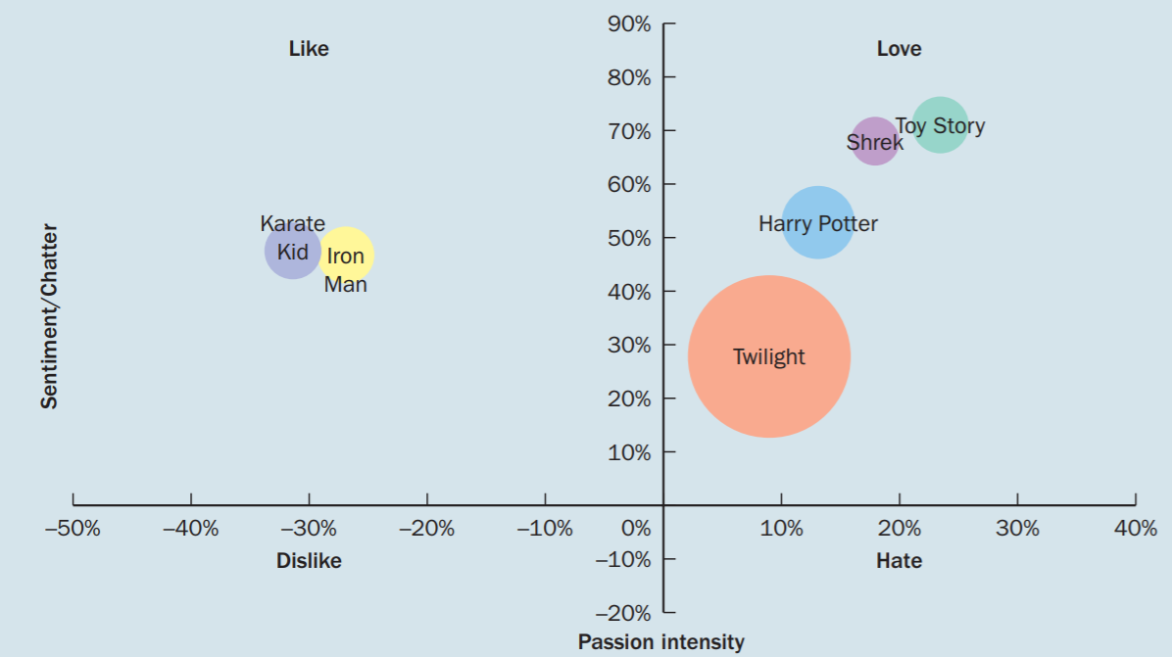

Slide 37
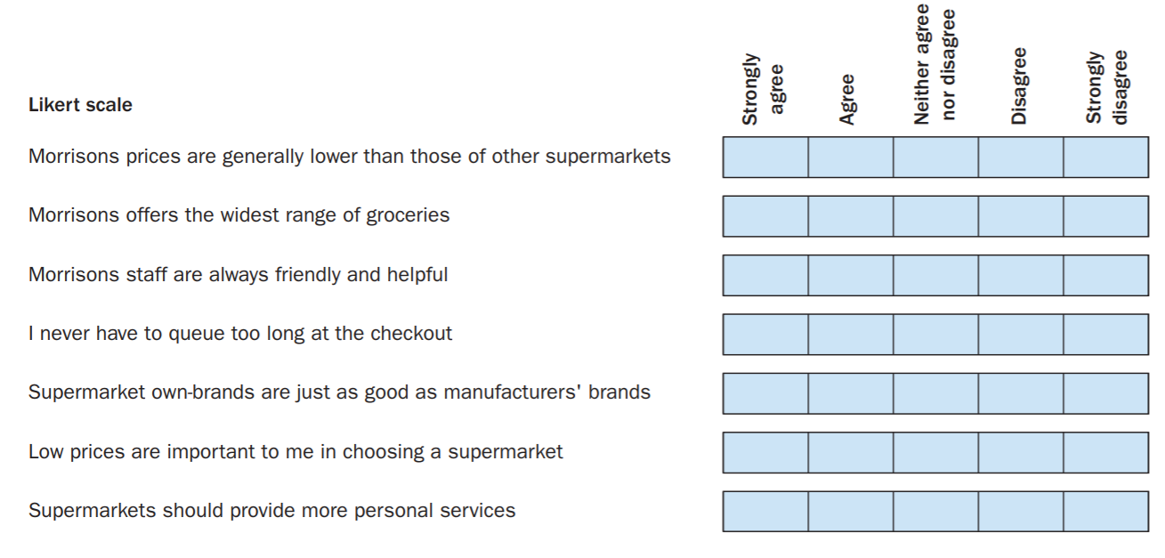

Slide 38
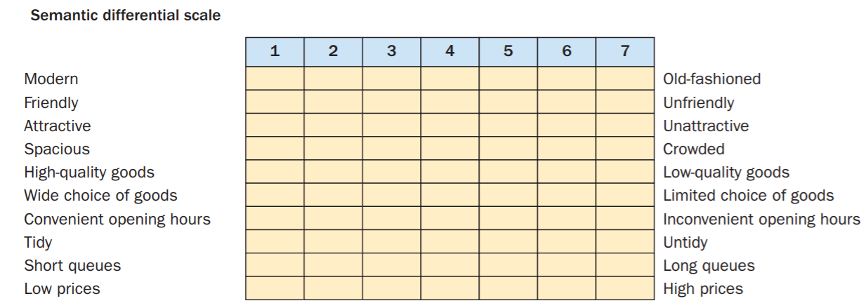

Slide 39
Ethics in marketing research
The ethical concerns surrounding market research have been the subject of an ongoing debate in the industry for a long time. Because much consumer research involves specific groups of consumers, including children and other groups that might be considered vulnerable, it is essential that the researchers’ credibility is maintained and that the highest standards of professional practice are demonstrated, and so the industry has established a set of professional ethical guidelines.

Slide 40
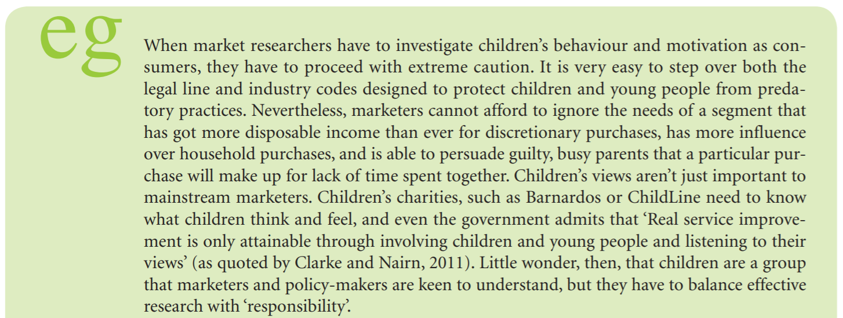
When market researchers have to investigate children’s behaviour and motivation as consumers
Page 199

Slide 41
Ethical legislation
In terms of UK research, all researchers are bound by the legislation covered by the Data Protection Act. There is also the MRS (Market Research Society), a trade association representing the interests of market researchers and market research companies and helping to regulate them. It has its own regulations and codes of conduct for ethical conduct of research by which its members are required to abide.

Slide 42
Quality Standards Association (MRQSA)
Quality Standards Association (MRQSA), an all-industry body that brings together several relevant professional and trade organisations, and part of its work involves accrediting market research companies that comply with international standard ISO20252 for research, data collection and processing.

Slide 43
www.mrs.org.uk
See www.mrs.org.uk/standards/other.htm for a comprehensive set of links to various relevant bodies and codes of practice.
Of course, not all providers of market research are committed to compliance and not all bad practice can be eliminated, but considerable progress is being made.

Slide 44


Slide 45
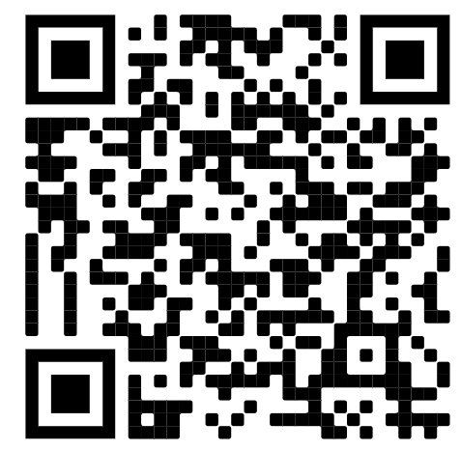
https://www.mrs.org.uk/standards/research-in-practice

Slide 46
https://www.mrs.org.uk/standards/research-in-practice

Slide 47
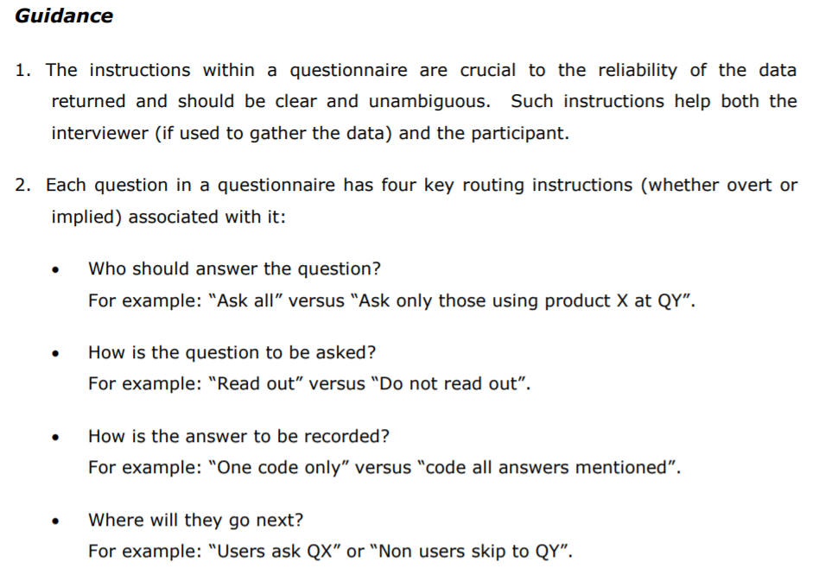
www.mrs.org.uk

Slide 48


Slide 49
Lecture summary
The organisation needs to coordinate its information, collected from a variety of sources, into an MkIS. A formal MkIS brings everything together under one umbrella and provides timely and comprehensive information to aid managers in decisionmaking.

Slide 50
Code of Conduct
October 2019 by MRS
Please, download the last shared file from WeChat group. Read it carefully. Get ready to reply on these questions:
1
2
3
3
4

Slide 51
Lecture summary
There is a general framework for the conduct of a marketing research project that can be applied to almost any kind of market or situation. It consists of eight stages: problem definition, research objectives, planning the research, data collection, research implementation, data analysis, reporting findings and research evaluation

Slide 52
Lecture summary
Marketing managers find it impossible to make decisions effectively without a constant flow of information on every aspect of marketing. Everything, from defining target markets to developing marketing mixes to making long-term strategic plans, has to be supported with appropriate information

Slide 53
Lecture summary
Secondary research provides a means of sourcing marketing information that already exists in some form, whether internal or external to the organisation. Gaps in secondary data can be filled through primary research. The main methods of primary research are interviews and surveys, observation and experiments. Sampling is a crucial area for successful market research.

Slide 54
Lecture summary
Ethical issues in market research are very important. Researchers have to comply with codes of practice to protect vulnerable groups in society from exploitation. They also have to ensure that respondents recruited for market research studies are fully aware of what they are committing themselves to and that they are not misled at any stage in the research process.

Slide 55
Exercise
Design a questionnaire. It should contain about 20 questions and you should use as many of the different types of question as possible. Use www.SurveyMonkey.com to build it online
The objective is to investigate respondents’ attitudes to downloading music and their purchasing habits. Pilot your questionnaire on 12 to 15 people (but preferably not people on the same course as you), analyse the results and then make any adjustments. Within your seminar group, be prepared to discuss the rationale behind your questionnaire, the outcome of the pilot and any data analysis problems.

