Slide 1

南宁师范大学
Nanning Normal University
Department of tourism & culture
Marketing for Tourism, Hospitality and Events
Ivan Monich, Ph.D.
Nanning, 2019

Slide 2
Promotion: personal selling, PR and sponsorship

Slide 3
LEARNING OBJECTIVES
This lecture will help you to:
appreciate the role that personal selling plays in the overall marketing effort of the organisation and define the tasks undertaken by sales representatives;
analyse the stages involved in the personal selling process and appreciate the responsibilities involved in sales management;
appreciate the contribution that trade shows and exhibitions can make to achieving B2B marketing objectives;

Slide 4
LEARNING OBJECTIVES
define PR and understand its role in supporting the organisation’s activities, and outline the techniques of PR and their appropriateness for different kinds of public;
understand the role of sponsorship in the marketing communications mix and the benefits and problems of different types of sponsorship; and
understand the nature of cause-related marketing and the benefits it offers to all parties involved.

Slide 5
According to Fill (2002, p. 16), personal selling can be defined as:
An interpersonal communication tool which involves face to face activities undertaken by individuals, often representing an organisation, in order to inform, persuade or remind an individual or group to take appropriate action, as required by the sponsor’s representative.

Slide 6
As a basic definition, this does capture the essence of personal selling. Interpersonal communication implies a live, two-way, interactive dialogue between buyer and seller (which none of the other promotional mix elements can achieve); an individual or group implies a small, select audience (again, more targeted than with the other elements); to inform, persuade or remind . . . to take appropriate action implies a planned activity with a specific purpose

Slide 7
Note that the definition does not imply that personal selling is only about making sales. It may well ultimately be about making a sale, but that is not its only function. It can contribute considerably to the organisation both before and, indeed, after a sale has been made. As a means of making sales, personal selling is about finding, informing, persuading and at times servicing customers through the personal, two-way communication that is its strength. It means helping customers to articulate their needs,

Slide 8
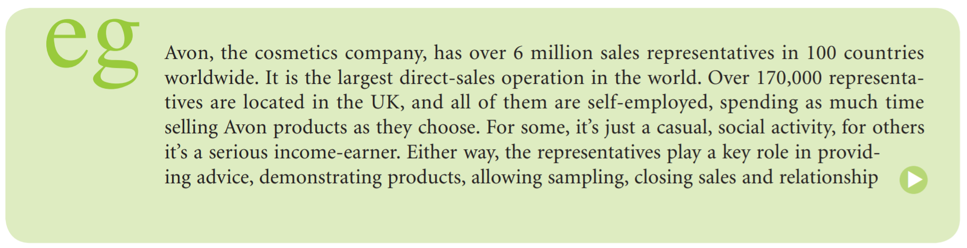

Slide 9
Advantages of personal selling
Impact
If you do not like the look of a TV advertisement, you can turn it off, or ignore it. If a glance at a print advertisement fails to capture your further attention, you can turn the page. If an envelope on the doormat looks like a mailshot, you can put it in the bin unopened. If a sales representative appears on your doorstep or in your office, it is a little more difficult to switch off.

Slide 10
A person has to be dealt with in some way, and since most of us subscribe to the common rules of politeness, we will at least listen to what the person wants before shepherding them out of the door. The sales representative, therefore, has a much greater chance of engaging your initial attention than an advertisement does.

Slide 11
Precision
Precision represents one of the great advantages of personal selling over any of the other promotional mix elements, and explains why it is so effective at the customer’s point of decision-making. There are two facets of precision that should be acknowledged: targeting precision and message precision.
Targeting precision arises from the fact that personal selling is not a mass medium.
Message precision arises from the interactive two-way dialogue that personal selling encourages.

Slide 12
Cultivation
The sales force has a crucial role to play in both creating and maintaining such relationships. Sales representatives are often the public face of an organisation, and their ability to carry the organisation’s message professionally and confidently can affect judgement of that organisation and what it stands for

Slide 13
When Avon, the cosmetics company, decided to target the beauty business for teenagers and younger women, it realised that to build and maintain customer relationships it had to reconsider whether the direct sales force employed was suitable for the different customer group. The new sub-brand ‘Mark’ was launched in the USA in 2008, but instead of using an army of traditional ‘Avon ladies’, the company recruited 18–24-year-olds who are better placed to demonstrate and promote the products to that audience (Sweeney, 2010).

Slide 14
Cost
All the advantages and benefits discussed above come at a very high cost, as personal selling is extremely labour intensive. In addition, costs of travel (and time spent travelling), accommodation and other expenses have to be accounted for.

Slide 15
Alexander Proudfoot, an international consultancy group, found in an international study that on average, just 11 per cent of a sales rep’s time is spent in active selling. A further 9 per cent is spent in prospecting, and 18 per cent in problem solving. The rest of the rep’s time is spent in admin (31 per cent), travelling (15 per cent) and ‘non-value-added time’ (16 per cent) (Alexander Proudfoot, 2011).

Slide 16
Tasks of personal selling
Prospecting
Prospecting is an important task, particularly for organisations entering a new market segment or for those offering a new product line with no established customer base.

Slide 17
Informing
Informing is giving prospective customers adequate, detailed and relevant information about products and services on offer. In B2B markets, once contact has been made with prospects, the sales representative needs to stimulate sufficient information exchange to ensure a technical and commercial match that is better than the competition.

Slide 18
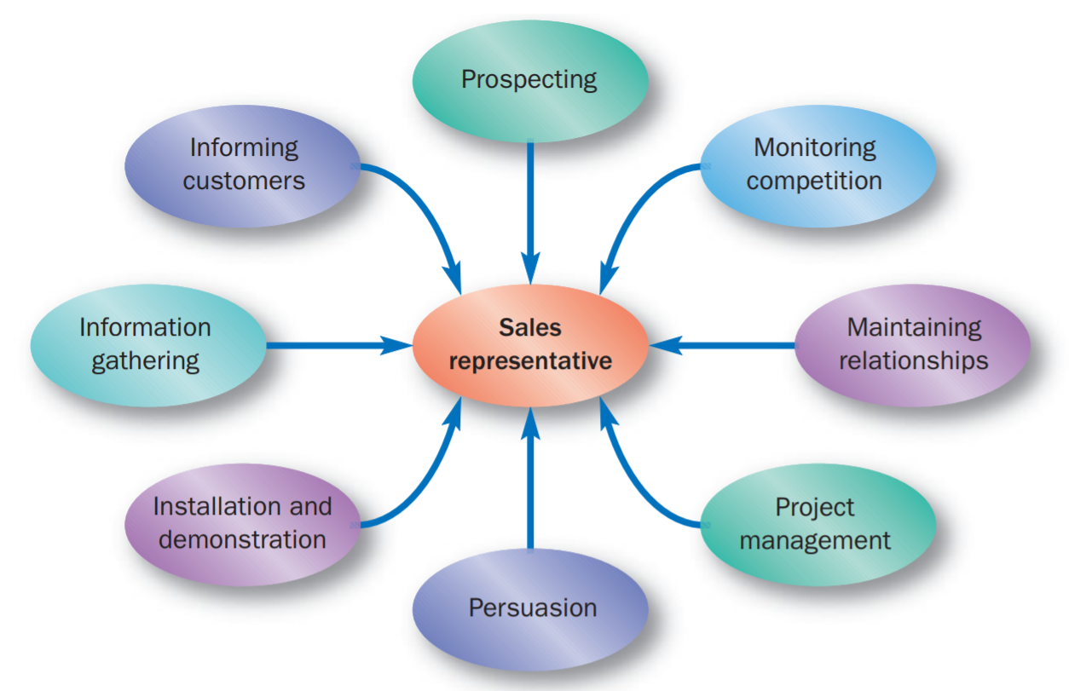
Typical tasks

Slide 19
Persuading
Persuading is helping the prospective customer to analyse the information provided, in the light of their needs, in order to come to the conclusion that the product being offered is the best solution to their problem.

Slide 20
Installing and demonstrating
Particularly with technical B2B purchases, the buyer may need considerable support and help to get the equipment installed and to train staff in its use. The sales representative may join a wider team of support personnel to ensure that all this takes place according to whatever was agreed and to the customer’s satisfaction

Slide 21
Coordinating within their own organisation
The role of the sales representative is not just about forward communication with the buyer. It is also concerned with ‘representing’ the customer’s interests within the selling organisation.

Slide 22
Maintaining relationships
Once an initial sale has been made, it might be the start of an ongoing relationship. In many cases, a single sale is just one of a stream of transactions and thus cannot be considered in isolation from the total relationship. An important role for the sales representative is to manage the relationship rather than just the specifics of a particular sale.

Slide 23
Information and feedback gathering
The gathering of information and the provision of feedback emphasises the need for representatives to keep their eyes and ears open, and to indulge in two-way communication with the customers they deal with

Slide 24
Monitoring competitor action
The representative works out in the field, meeting customers and, in all probability, competitors. As well as picking up snippets about what competitors are planning and who they are doing business with.

Slide 25
The personal selling process

Slide 26
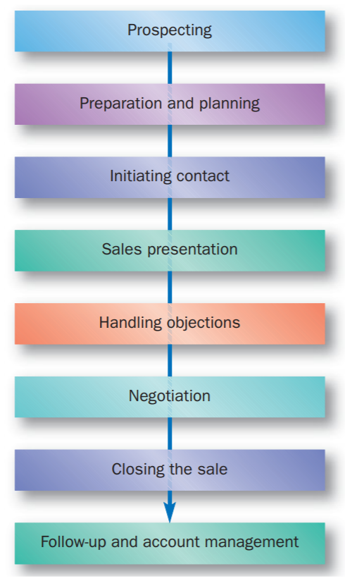

Slide 27
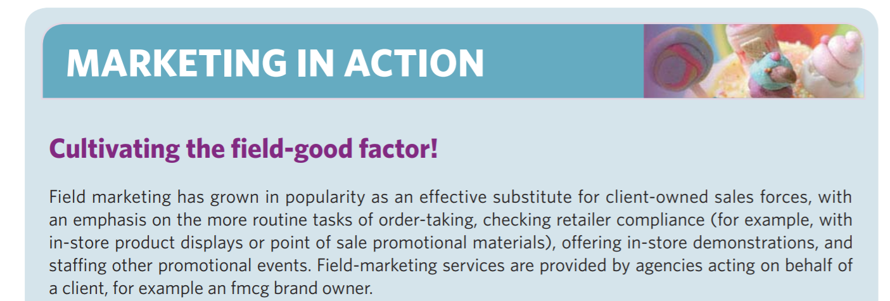

Slide 28
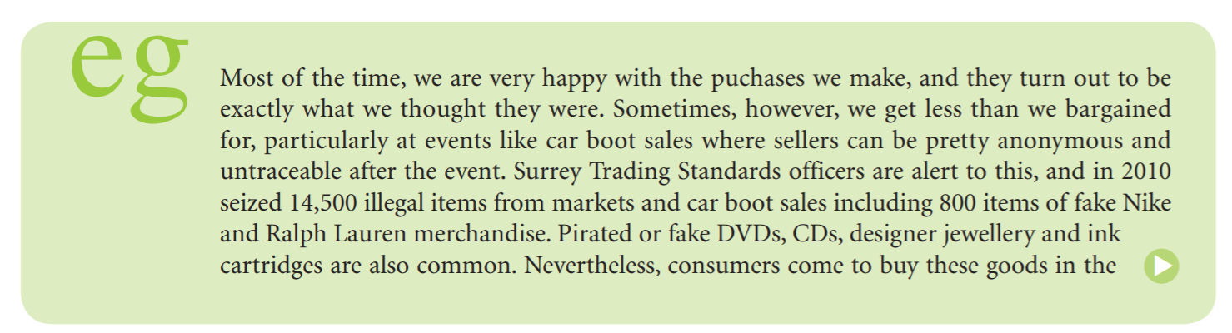

Slide 29
Sales management
The previous section concentrated on the mechanics of selling something to a prospective buyer. That is important, certainly, because if the selling process does not work well, then there will be no sales and no revenue. Equally important, however, is the management of the sales force.

Slide 30
Planning and strategy
The sales plan outlines the objectives for the selling effort and the details of how the plan should be implemented. This plan itself arises from, and must fit closely with, the marketing objectives set for products and market share, etc. These marketing objectives need to be translated into sales objectives, both for the sales force as a whole, and for individuals or groups within the sales force.

Slide 31
A further decision has to be made on the ideal size of the sales force. A number of factors need to be considered, such as the calling frequency required for each customer, the number of calls possible each day, and the relative division of the representative’s time between administration, selling and repeat calls (Cravens and LaForge, 1983).

Slide 32
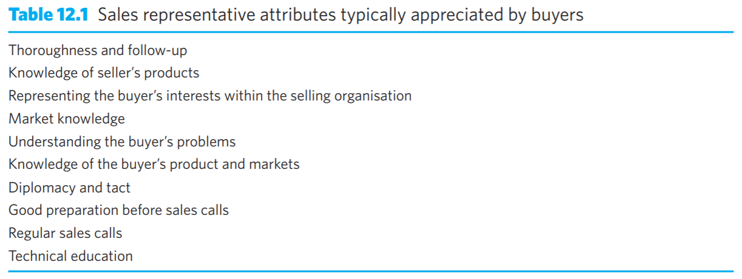
Recruitment and selection

Slide 33
Training
The recruitment process generally provides only the raw material. Although the new recruit might already have appropriate skills and a good attitudinal profile, training will help to sharpen both areas so that better performance within the sales philosophy of the employing organisation can be developed

Slide 34
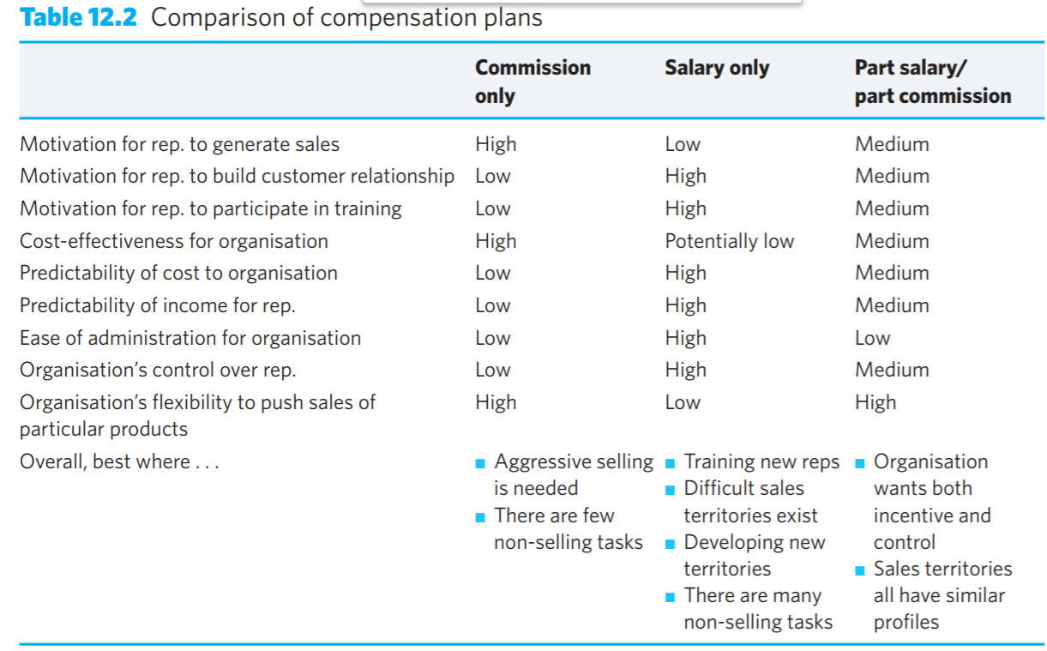
Motivation and compensation

Slide 35
Performance evaluation
The sales representative’s performance can be measured in both quantitative and qualitative terms. Quantitative assessments can be related to either input or output measures, usually with reference to targets and benchmarks (Good and Stone, 1991). Input measures assess activities such as the number of calls and account coverage. Output measures focus on the end rather than the means, and include measurement of sales volume, sales development, number of new accounts and specific product sales.

Slide 36
Trade shows and exhibitions
Exhibitions and shows can be of particular importance to the smaller business that may not have the resources to fund an expensive marketing communications programme. The exhibition can be used as a cost-effective means of building more ‘presence’ and reputation with the trade, and to generate potential sales leads

Slide 37
Public relations
Stanley (1982, p. 40) defined public relations as:
A management function that determines the attitudes and opinions of the organisation’s publics, identifies its policies with the interests of its publics, and formulates and executes a programme of action to earn the understanding and goodwill of its publics.

Slide 38
The Chartered Institute of Public Relations (CIPR)
is rather more rounded in its definition: Public relations is about reputation – the result of what you do, what you say and what others say about you. Public relations is the discipline which looks after reputation, with the aim of earning understanding and support and influencing opinion and behaviour. It is the planned and sustained effort to establish and maintain goodwill and mutual understanding between an organisation and its publics. (www.cipr.co.uk/content/careerscpd/careers-pr/what-pr)

Slide 39
10-12-2019

Slide 40
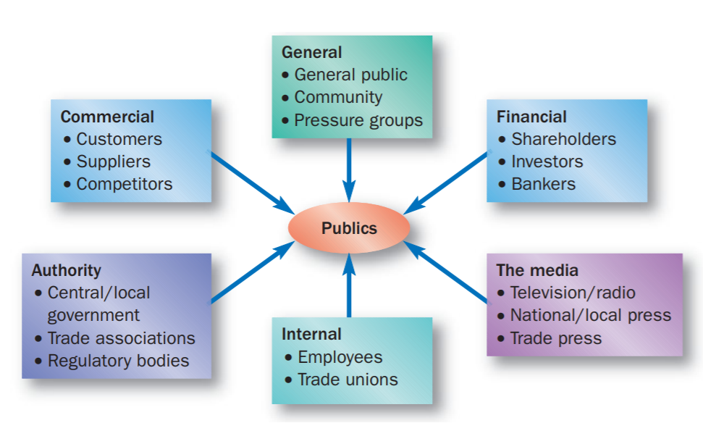

Slide 41
Role of PR
As with any marketing activity, managers must be sure that PR integrates with the rest of the organisation’s promotional efforts, and that it is clearly related to wider company objectives. Cutlip et al. (1985) distinguish between marketing PR and corporate PR. Although the two are not mutually exclusive, there may be differences in their scope and objectives.

Slide 42
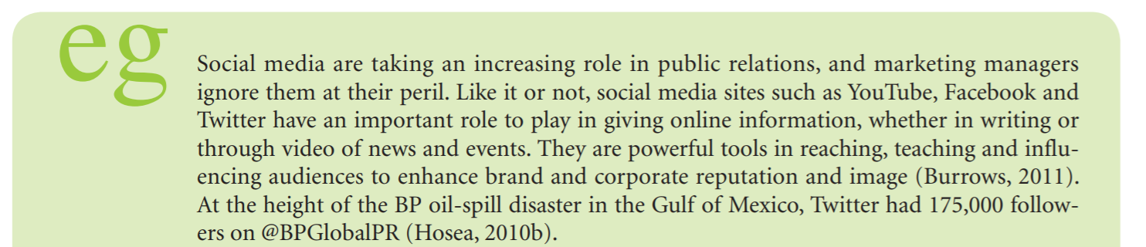
Techniques in public relations
Publicity and press relations

Slide 43
Other external communication
An organisation can host or participate in various events for PR purposes. As well as press conferences, mentioned above, the organisation may host other social events.
An important public is the one with a financial interest in the organisation. The organisation’s annual general meeting is an important forum for both shareholders and the financial media

Slide 44
A well-presented annual report, distributed primarily to shareholders and the financial media, but often sent out to anyone who expresses an interest in the organisation, like the annual general meeting, is an opportunity to present the organisation in the best possible positive light and to make public statements about the organisation’s achievements and its future directions.

Slide 45
Lobbying is a very specialised area, designed to develop and influence relationships with ‘authority’, particularly national and EU governmental bodies. Lobbying is a way of getting an organisation’s views known to the decision-makers, and trying to influence the development and implementation of policy.

Slide 46
Internal communication
The two main types of communication are written (house journals, intranet pages or newsletters) and verbal (management briefings, for instance). Few people would want to read a long working paper written by the managing director on quality management or production targets, but most would at least glance at a well-illustrated, short, clearly written summary of the important points presented in journalistic style.

Slide 47
Sponsorship
Definition and role Sponsorship is defined by BDS Sponsorship
. . . a business relationship between a provider of funds, resources or services and an individual, event or organisation which offers in return some rights and association that may be used for commercial advantage. (www.sponsorship.co.uk) as:

Slide 48
History of the sponsorship
Sponsorship grew in popularity during the 1980s, partly because of its attractiveness as a supporting element in the promotional mix, and partly because of the growing cost of media advertising compared with the potentially greater coverage of various sports and arts activities (Meenaghan, 1998).

Slide 49
Types of sponsorship
Sport
Broadcast sponsorship
The arts
Sponsorship money plays an important role in the funding of arts organisations. Such organisations derive only around 38 per cent of their income from their own earnings (e.g. ticket sales etc.), 47 per cent from public sources (for example, the Arts Council, local authorities and lottery funding, etc.), and 16 per cent from private investment, which includes business investment worth around £144 million per year (Mermiri and Tuchner, 2011).

Slide 50
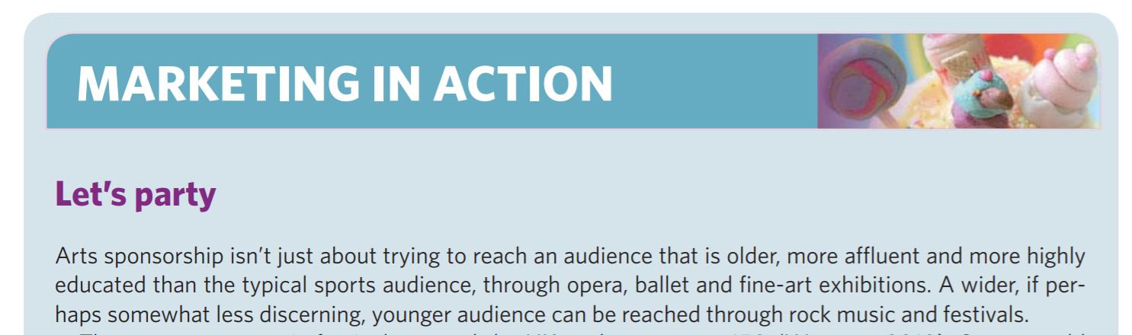

Slide 51
Cause-related marketing
Linkages between organisations and charities benefit both parties. If, for example, a company runs a sales promotion along the lines of ‘We’ll donate 10p to this charity for every pack you buy’, the charity gains from the cash raised and from an increased public profile. Consumers feel that their purchase has greater significance than simple self-gratification and feel good about having ‘given’, while the company benefits from the increased sales generated by the promotion and from the extra goodwill created from associating its brands with a good cause.

Slide 52
Task:
Write a news regarding your future trip to the Lingyun county.
Title: The Tourism Management students of NNNU will visit Lingyun county
News Title
5Ws+1H
5Ws: What? When? Where? Who? Why?
1H: How
Details
‘’Quote’’
cite someone
Background

Slide 53
Task:
Write a news regarding your future trip to the Lingyun county.
Title: Students from Nanning Normal University will make a research in Lingyun.
5Ws: The students of tourism management major from Nanning Normal University will make a research trip to the Lingyun county in the end of December to get the practical skills.
1H: The three days trip is organised and funded by the Tourism and Culture School of Nanning Normal University. Students are waiting for the trip. Linda, a student of y18 said: “We are so excited to explore wonderful Lingyun!”. Ivan Monich, 外教，stressed the importance of such research trips for getting the practical skills.
Background: The trip is going to be held under the agreement between Cardiff Metropolitan University from UK and Nanning Normal University for the double diploma program in Tourism Management.

