Slide 1
南宁师范大学
Nanning Normal University
Department of tourism & culture
Marketing for Tourism, Hospitality and Events
Ivan Monich, Ph.D.
Nanning, 2019

Slide 2

Chapter 3 material
02-04-2019

Slide 3
Environmental influences
What is important is to recognise that decision-making is not completely divorced from the environment in which it is happening, whether the consumer is conscious of it or not.

Slide 4
Sociocultural influences
Individuals are influenced both by current trends in society as a whole and by a need to conform with the norms of the various social groups to which they belong, as well as to enhance their status within those groups.
Examples of social group pressures can be seen in children’s markets. Many parents feel unfairly pressured into buying particular goods or brands because the children’s friends all have them.

Slide 5
Technological influences
Technology affects many aspects of consumer decision-making. Database technology, for example, allows organisations to create (almost) personal relationships with customers. At its extreme, this means that consumers receive better tailored personalised offerings, and thus that their expectations are raised in terms of the quality of the product, communication and service.

Slide 6
Technological influences
Many of these products used to be extended problemsolving goods, but they have moved rapidly towards the limited problem-solving area.
As they become cheaper and more widely available, the amount of risk inherent in the purchase reduces for the consumer, who does not, therefore, need to spend quite so much time searching for and evaluating alternative options.

Slide 7
Economic influences
The late 2000s saw recession and economic hardship across Europe and this inevitably affected consumers’ attitudes, as well as their ability and willingness to spend.
With uncertainty about employment prospects, many consumers postponed purchasing decisions, adjusted their decision-making criteria or cut out certain types of spending altogether.
Price, value for money and a conscious assessment of the need to buy become prevalent influences in such circumstances

Slide 8
Retailers, in turn, had to respond to the slowdown in trade caused by the economic environment. Money-off sales became prevalent in the high street throughout the year, not just in the traditional post-Christmas period. While this did stimulate sales in the short term, it had one unfortunate effect for retailers. Consumers began to see the lower sale price as ‘normal’ and resented paying full prices, preferring to wait for the next sale that they were confident would come along soon.

Slide 9
Ethical influences
Ethical credentials could be a key factor in decision-making, affecting decisions about what to buy, why, using what criteria, where or from whom

Slide 10
Political and legal influences
Political and legal influences, emanating either from the EU or from national bodies, can also affect the consumer. Legislation on minimum levels of product safety and performance, for example, means that the consumer does not need to spend time getting technical information, worrying about analysing it and comparing competing products on those criteria.

Slide 11
Political and legal influences
Legislation and regulation, whether they relate to product descriptions, consumer rights or advertising, also reduce the inherent risks of making a decision. This takes some of the pressure off the customer, leading to better-informed and easier decisions and less risk of post-purchase dissonance.

Slide 12
Ecological influences
In wider society, for example, there has been a move in recent years towards demanding more environmentally friendly products, and many consumers who are not necessarily ‘deep green’ have allowed this to influence their decision-making, looking more favourably on fair trade, CFC-free, recycled or non-animal-tested products.

Slide 13
Psychological influences: the individual 93
Although marketers try to define groups of potential customers with common attributes or interests, as a useful unit for the formulation of marketing strategies, it should not be forgotten that such groups or market segments are still made up of individuals who are different from each other.
This section, therefore, looks at aspects that will affect an individual’s perceptions and handling of the decision-making process, such as personality, perception, learning, motivation and the impact of attitudes.

Slide 14
Personality
In the mid- to late 1980s, advertising in particular was full of images reflecting the personality traits associated with successful lifestyle stereotypes such as the ‘yuppie’. Independent, level-headed, ruthless, ambitious, self-centred, materialistic traits were seen as positive characteristics, and thus marketers were anxious to have them associated with users of their products.
The 1990s saw a softening of this approach, featuring images oriented more towards caring, concern, family and sharing as the route to self-fulfilment.

Slide 15
In choosing clothing, for instance, an extrovert self-confident achiever with an extravagant streak might select something deliberately avant garde, stylishly daring, vibrantly coloured and expensive, as a personality statement. A quiet, insecure character, with underdeveloped social skills, might prefer to wear something more sober, more conservative, with less attention-seeking potential.

Slide 16
Perception
Perception represents the way in which individuals analyse, interpret and make sense of incoming information, and is affected by personality, experience and mood.
No two people will interpret the same stimulus (whether it is a product’s packaging, taste, smell, texture or its promotional messages) in exactly the same way.
Even the same individual might perceive the stimulus differently at different times.

Slide 17
For example, seeing an advertisement for food when you are hungry is more likely to produce a positive response than seeing the same advertisement just after a heavy meal. Immediate needs are affecting the interpretation of the message.

Slide 18
Naturally, marketers hope that their messages reach target audiences when they are relaxed, at leisure and at ease with the world, because then the individual is more likely to place a positive interpretation on the message and is less likely to be distracted by other pressures and needs.

Slide 19
Selective attention
Consumers do not pay attention to everything that is going on at once. Attention filters allow the unconscious selection of what incoming information to concentrate on.
In daily life we filter out the irrelevant background noise: the hum of the computer, the birds in the garden, the cars in the street, the footsteps in the corridor.

Slide 20
As consumers we filter out the irrelevant marketing messages. In reading the newspaper, for instance, a split-second glance spots an advertisement, decides that it is irrelevant and allows the eye to read around it.

Slide 21
This means that marketers have to overcome these filters, either by creating messages that we will decide are relevant or by building attention-grabbing devices into the message. An internet advertisement,
for example, might use its position on the page, intense colour, movement or startling images to draw the eye, and more importantly the brain, to it.

Slide 22
Selective perception
The problems do not stop once the marketer has got the consumer’s attention, since people are infinitely creative in interpreting information in ways that suit them.

Slide 23
Selective retention
People have the capacity to remember what they want to remember and to filter out anything else. The reasons for retaining a particular message may be because it touched them emotionally, or it was of immediate relevance, or it was especially entertaining, or it reinforced previously held views. The reasons are many, but the consumer is under no obligation to remember anything

Slide 24
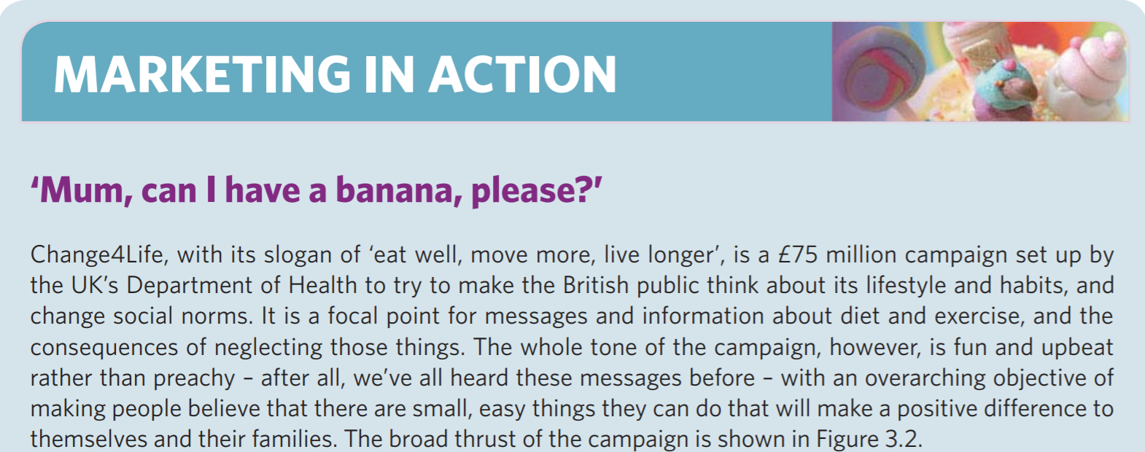

Slide 25
Learning
Perception and memory are closely linked with learning. Marketers want consumers to learn from promotional material, so that they know which product to buy and why, and to learn from experience of the product, so that they will buy it again and pass on the message to others.

Slide 26
Humour, and other methods of provoking an emotional response to an advertisement, can also help a message to stick because the recipient immediately becomes more involved in the process.

Slide 27
Motivation
One definition of marketing puts the emphasis on the satisfaction of customers’ needs and wants, but what triggers those needs and wants, and what drives consumers towards their fulfilment?
Motives for action, the driving forces, are complex and changeable and can be difficult to research, since individuals themselves often cannot define why they act the way they do.

Slide 28
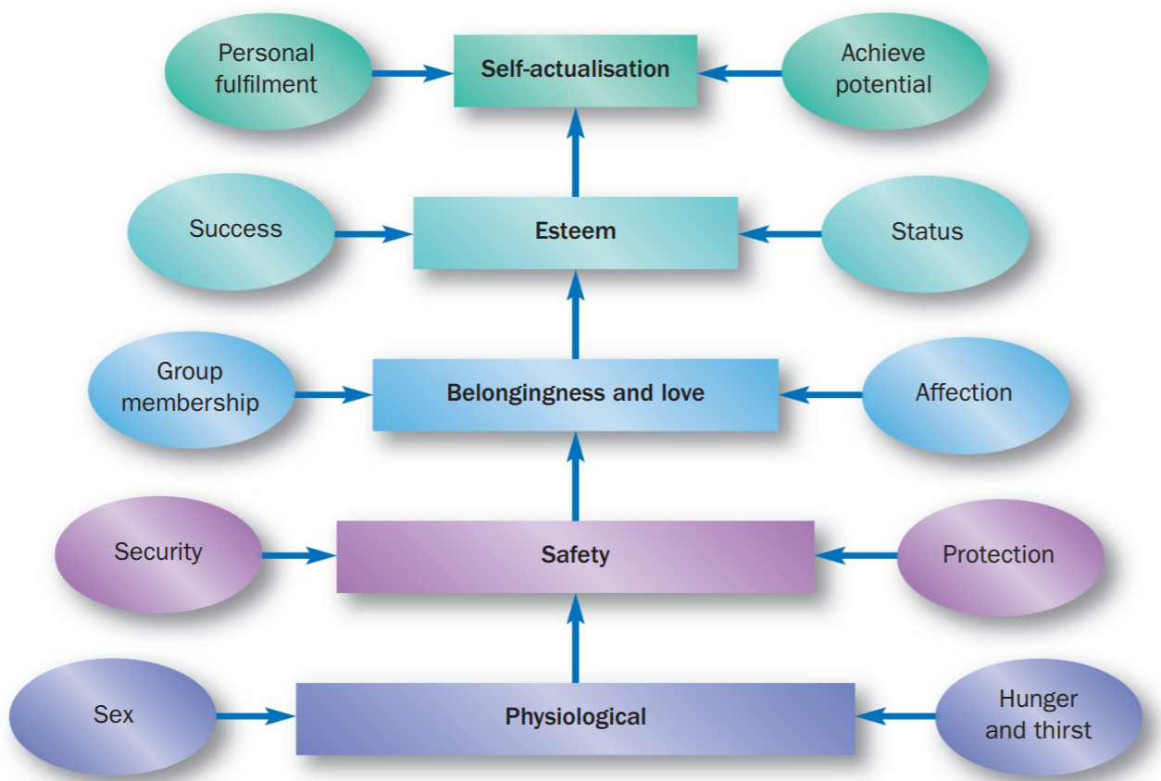
Maslow’s (1954) hierarchy of needs has long been used as a framework for classifying basic motivations.

Slide 29
Task #1
Please, read Maslow’s (1954) hierarchy of needs and think about its implementation to the tourism industry. Pages 97-99 of the main textbook.

Slide 30
Attitudes
an attitude is a stance that an individual takes on a subject that predisposes them to react in a certain way to that subject. More formally, an attitude has been defined by Hilgard et al. (1975) as:
. . . an orientation towards or away from some object, concept or situation and a readiness to respond in a predetermined manner to these related objects, concepts or situations.

Slide 31
19-11-2019

Slide 32
Williams (1981), in summarising the literature, describes attitudes as having three different components.
Cognitive
Affective
Conative

Slide 33
Cognitive
Cognitive attitudes relate to beliefs or disbeliefs, thus: ‘I believe that margarine is healthier than butter’. This is a component that the marketer can work on through fairly straightforward advertising.
Repeating the message that your product is healthy, or that it represents the best value for money, may well establish an initial belief in those qualities.

Slide 34
Affective
Affective attitudes relate to feelings of a positive or negative nature, involving some emotional content, thus: ‘I like this product’ or ‘This product makes me feel . . .’. Again, advertising can help the marketer to signal to the consumer why they should like it, or how they should feel when they use it.

Slide 35
For some consumers, of course, affective attitudes can overcome cognitive ones. For example, I may believe that margarine is healthier than butter, but I buy butter because I like the taste better. Similarly, I believe that snacking on chocolate is ‘bad’, but it cheers me up so I do it anyway.

Slide 36
Conative
Conative attitudes relate to the link with behaviour, thus attitude x is considered likely to lead to behaviour y. This is the hardest one for marketers to predict or control, because so many things can prevent behaviour from taking place, even if the cognitive and affective attitudes are positive:
‘I believe that BMWs are excellent quality, reliable cars, and I feel that owning one would enhance my status and provide me with many hours of pleasurable driving, but I simply cannot afford it’, or it may even be that ‘Audi made me a better offer’

Slide 37
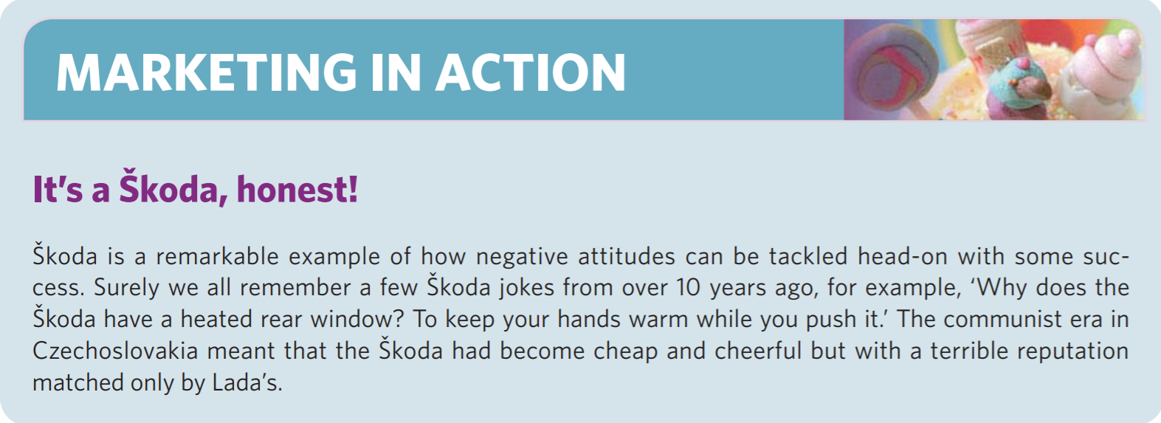
Guru of Marketing
Jokes from Skoda!

Slide 38
Sociocultural influences: the group
Individuals are influenced, to a greater or lesser extent, by the social and cultural climate in which they live. Individuals have membership of many social groups, whether these are formally recognised social units such as the family, or informal intangible groupings such as reference groups

Slide 39
Inevitably, purchasing decisions will be affected by group membership, as these sociocultural influences may help the individual to:
differentiate between essential and non-essential purchases;
prioritise purchases where resources are limited;
define the meaning of the product and its benefits in the context of their own lives; and thus to
foresee the post-purchase implications of this decision

Slide 40
social class
Nevertheless, today social class is established largely according to occupation, and for many years, British marketers have used the grading system outlined in Table 3.1. It has been widely used to group consumers, whether for research or for analysing media readership.

Slide 41
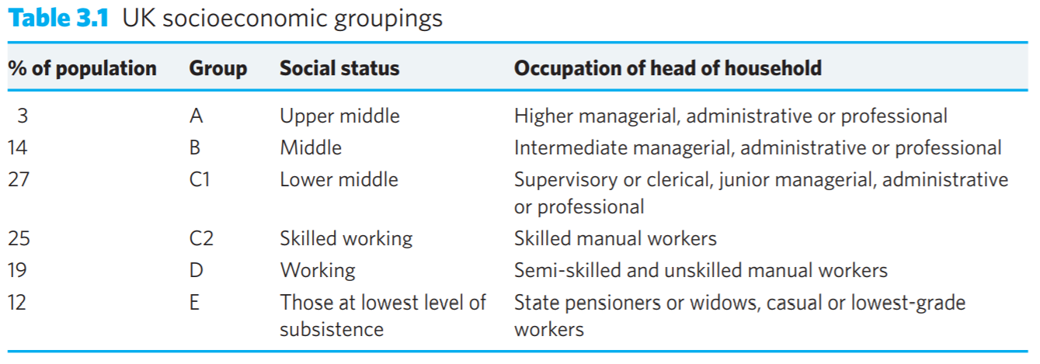
UK socioeconomic groupings

Slide 42
Culture and subculture
Culture can be described as the personality of the society within which an individual lives. It manifests itself through the built environment, art, language, literature, music and the products that society consumes, as well as through its prevalent beliefs, value systems and government. Rice (1993, p. 242) defines culture as:
The values, attitudes, beliefs, ideas, artefacts and other meaningful symbols represented in the pattern of life adopted by people that help them interpret, evaluate and communicate as members of society

Slide 43
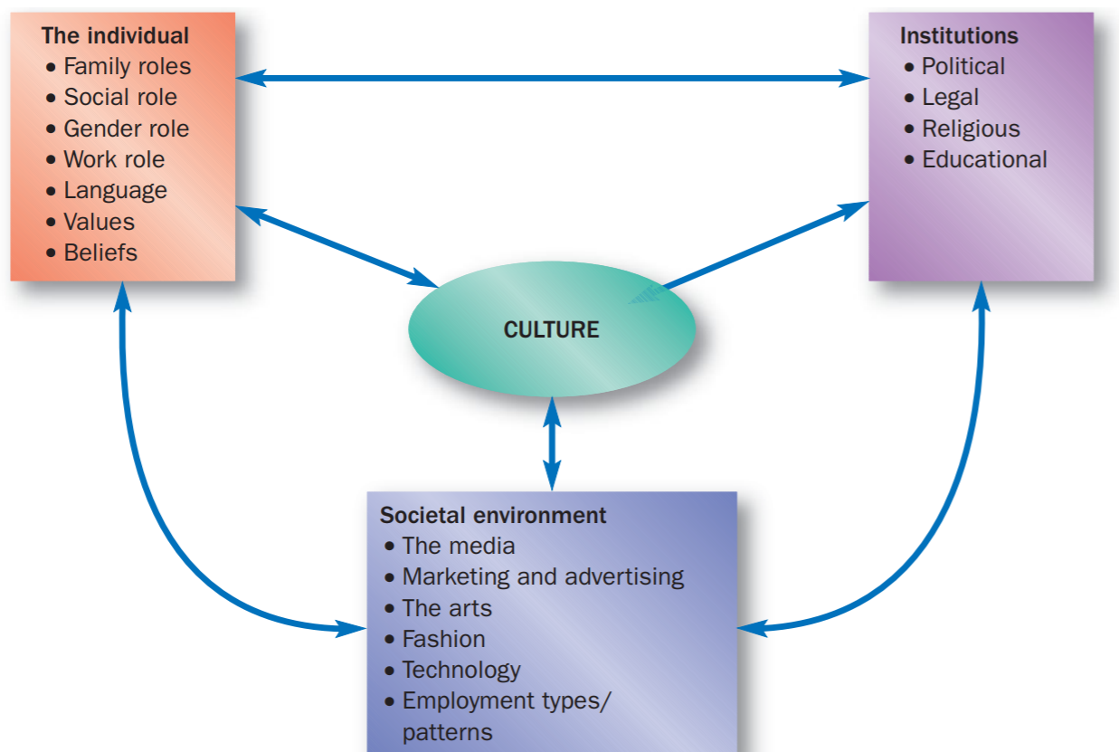

Slide 44
Over the past 10 years or so, for example, it has become more and more socially unacceptable in Europe for organisations to use animals for testing cosmetics.

Slide 45
Changing attitudes to tobacco, alcohol and marketing to children are also examples of areas within which cultural change is altering organisations’ approaches to business. In the UK, for instance, food marketers have been criticised for aiming too much advertising of products such as sweets, soft drinks, sugary cereals, crisps and fast foods at children

Slide 46
Any culture can be divided into a number of subcultures, each with its own specific characteristics, yet existing within the whole.

Slide 47
Reference groups
Reference groups are any groups, whether formally or informally constituted, to which an individual either belongs or aspires to belong, for example professional bodies, social or hobbyoriented societies, or informal, vaguely defined lifestyle groups (‘I want to be a yuppie’). There are three main types of reference group, each of which affects buying behaviour, and these are discussed in turn below.

Slide 48
Membership groups
These are the groups to which the individual already belongs. These groups provide parameters within which individuals make purchasing decisions, whether they are conscious of it or not. In buying clothing, for example, the purchaser might think about the occasion for which it is going to be worn and consider whether a particular item is ‘suitable’. There is great concern here about what other people will think.

Slide 49
Aspirant groups
These are the groups to which the individual would like to belong, and some of these aspirations are more realistic than others. An amateur athlete or musician might aspire to professional status in their dreams, even if they have little talent
The existence of aspirant groups, therefore, attracts consumers towards products that are strongly associated with those groups and will either make it appear that the buyer actually belongs to the group or signal the individual’s aspirations to the wider world.

Slide 50
The Harley-Davidson brand p. 106

Slide 51
Dissociative groups
These are groups to which the individual does not want to belong or to be seen to belong. A supporter of the England soccer team would not wish to be associated with its notorious hooligan element, for example
An upmarket shopper might prefer not to be seen in a discount store such as Aldi or Lidl just in case anyone thinks they are penny pinching.

Slide 52
Clearly, these dissociations are closely related to the positive influences of both membership and aspirational groups. They are simply the other side of the coin, an attempt to draw closer to the ‘desirable’ groups, while differentiating oneself from the ‘undesirable’

Slide 53
Family
The family, whether two parent or single parent, nuclear or extended, with or without dependent children, remains a key influence on the buying behaviour of individuals. The needs of the family affect what can be afforded, where the spending priorities lie and how a purchasing decision is made.

Slide 54
Traditionally, marketers have looked to the family lifecycle as proposed by Wells and Gubar (1966), and shown in Table 3.2. Over the years, however, this has become less and less appropriate, as it reflects a path through life that is becoming less common in the West.

Slide 55
It does not, for example, allow for single parent families, created either voluntarily or through divorce, or for remarriage after divorce which may create new families with children coming together from previous marriages, and/or second families

Slide 56
Other trends too undermine the assumptions of the traditional model of the family lifecycle. According to Whitehead (2009), estimates from the Office for National Statistics in the UK forecast that 20 per cent of women may never have children.
Those who currently do elect to have children are tending to leave childbearing until later in their lives, so that they can establish their careers first.

Slide 57
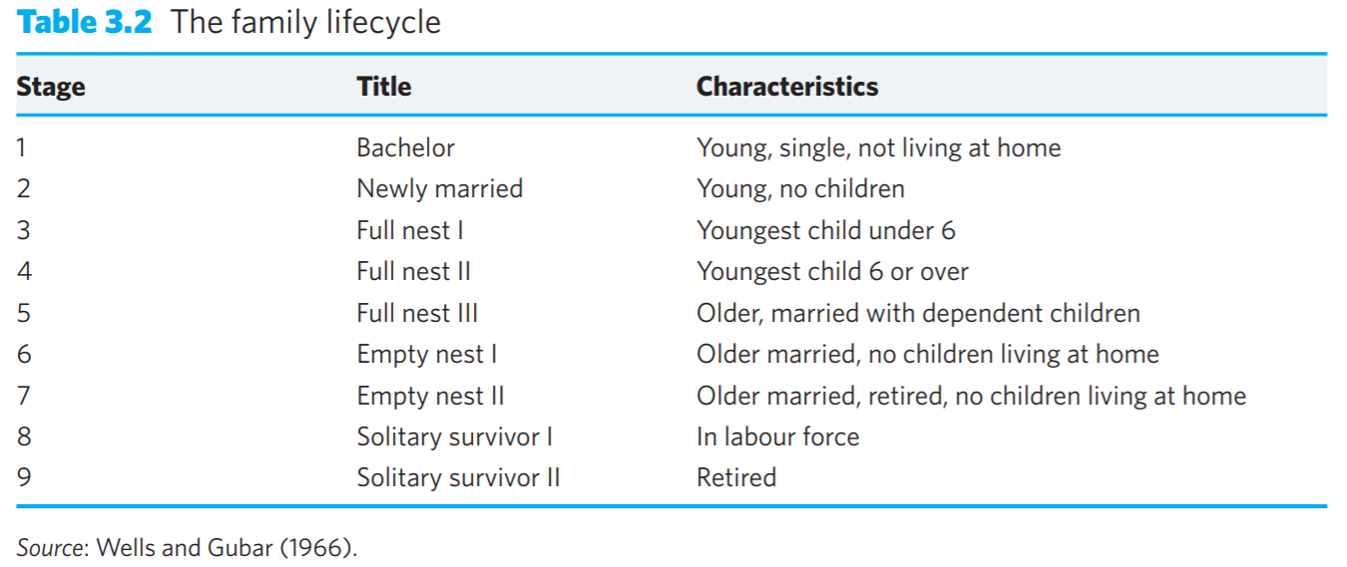

Slide 58
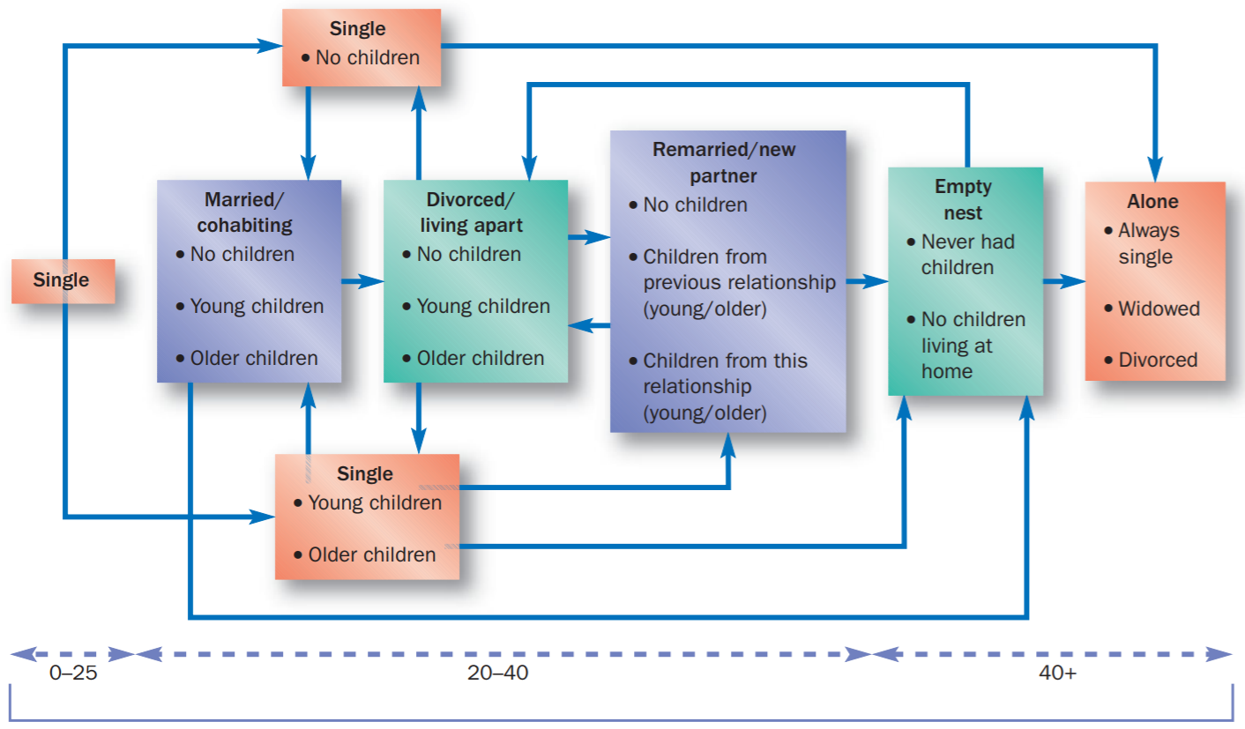
A modern family-lifecycle model

Slide 59
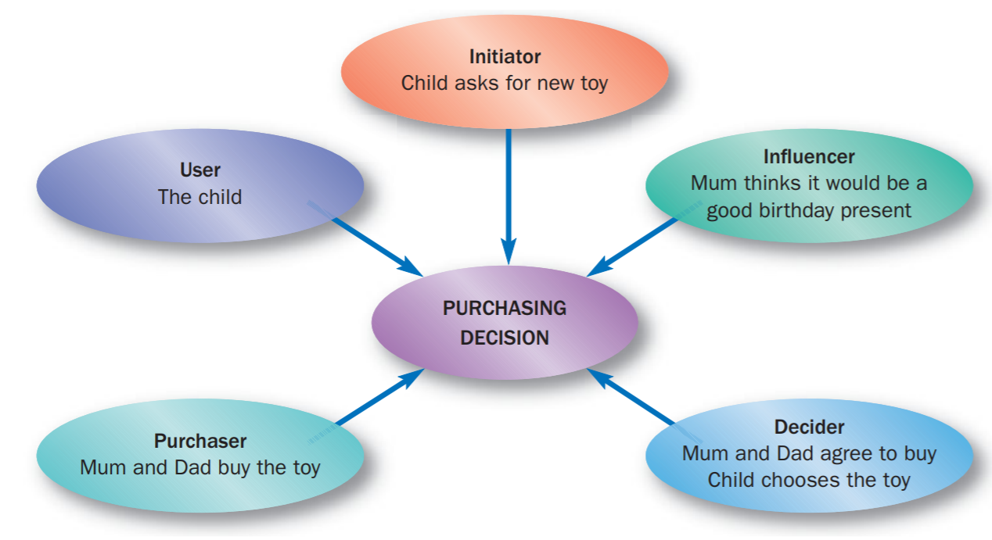
The family as a decision-making unit

Slide 60
Children are an important target group for the marketer, partly because of their ability to pester their parents and influence family purchasing, and partly because of the marketer’s desire to create brand loyalty as early as possible in consumers’ lives. Not surprisingly, many teachers, parents and consumer groups are concerned that the young and vulnerable may be exposed to unreasonable marketing pressures.

Slide 61
New topic

Slide 62
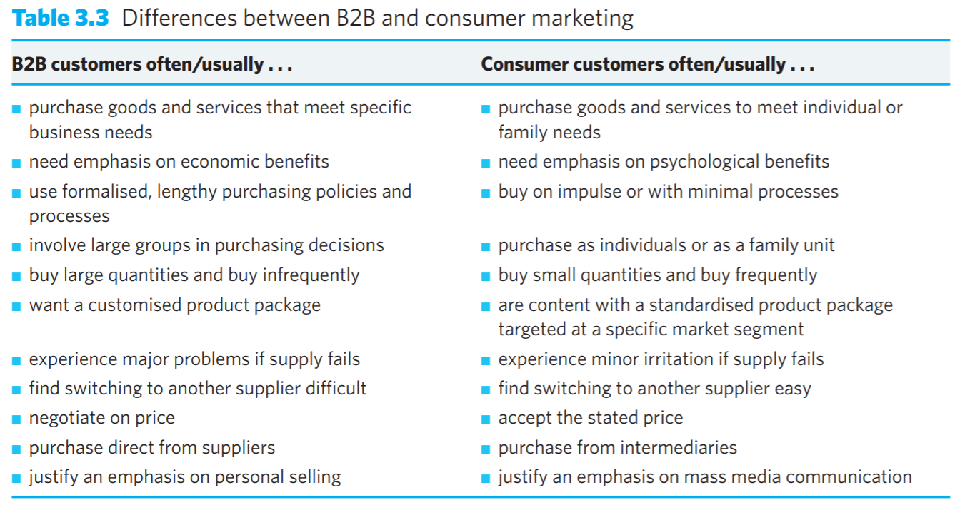
Defining B2B marketing

