Slide 1
南宁师范大学
Nanning Normal University
Department of Tourism & Culture
Research Methods
Ivan Monich, Ph.D.
Nanning, 2019

Slide 2

Is Anything Real?

Slide 3


POEM
Paradigm – your beliefs and principles around conducting research
Ontology – your perspective on existence; representing what you believe to be ‘real’
Epistemology – the relationship between the knower and the known; representing what you count as knowledge
Methodology – the actual methods you use; the most suitable methods to address the positions and perspectives outlined by the previous factors.

Slide 4
Positivism (significant part)
As a positivist, you are likely to have a realist ontology and an objective epistemology, meaning that you view the social world as a matter of fact and you remain impartial regarding the way you generate knowledge – after all, it is what it is!

Slide 5
Interpretivism (significant part)
As an interpretivist, you are likely to have a relativist ontology and a subjective epistemology. This means you view the world as a connected place, whereby phenomena within that world influence other phenomena and all are connected through intersubjectivity. You view the interconnected elements as one, having influence over one another – after all, the reality of what is seen is not clear cut.

Slide 6
Post-positivism (significant part)
As a post-positivist, you are likely to have a critical realist ontology and a dualist/objective epistemology, meaning you view the social world as a matter of fact and you remain impartial about the way you generate knowledge, to some extent, because you interrogate reality until knowledge has been gained. You think you know but want to be certain, before you state something as being a matter of fact. You challenge reality.

Slide 7
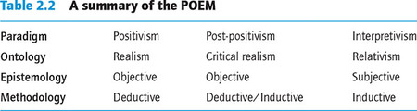

Slide 8
Lecture 04
Developing the Research Proposal and Plan

Slide 9
Expected learning outcomes
The intellectual and real-world value of a research topic.
Sources of research topics.
Choosing something of interest and value.
Limiting the conceptual and empirical aspects of the research topic to make it more manageable and feasible.
Considering the use of replicative studies. Developing the initial research question(s), aims and objectives to focus the work and state a clear outcome. Producing a research proposal.
How the research proposal relates to the research process. Ethical considerations.

Slide 10
The ‘blank page syndrome
The ‘blank page syndrome’ is usually the starting point for a research project
‘I have no idea what topic I want to explore.’ It is difficult to think about and begin to formulate a research proposal, especially one that will be of interest to others and feasible to complete in the time available. However, the task is not an impossible one.

Slide 11
Guide
To help you get to the point where you have a clear idea of what you are going to research, why this will be of interest and importance, how you plan to investigate it and what the desired end product will be, this lecture takes you through the process of identifying, refining and finally specifying the focus, method(s) and purpose of your research project.

Slide 12
Let the journey begin
In taking this journey, you will encounter issues associated with possible sources of inspiration that you may want to consider exploring to stimulate ideas on what may be interesting topics and issues to research and how to think about the intellectual and real-world value of any of them.
You will also be able to think through the process of narrowing and refining initial ideas into a final format that is more focused and feasible than your starting point and has a clearly stated purpose and outcomes to be achieved at the end of the process.

Slide 13
Finding and Refining a Topic
Choosing a topic with potential value
However, as King et al. (1994) point out, there is no particular rule governing which topic to choose for research. That said, they go on to suggest that research projects should satisfy two criteria:
first, that the project should pose, and address, a question that is of importance in the real world. In short, that it has some significance in terms of developing understanding, explanation and possibly prediction and is therefore not trivial in nature.

Slide 14
Finding and Refining a Topic
Second, that a project should make a contribution to the scholarly literature relating to the research topic. Essentially, the point they are making is that the research should have value, both a practical value in the real world and an intellectual value in relation to enhancing the existing state of knowledge on the topic.

Slide 15
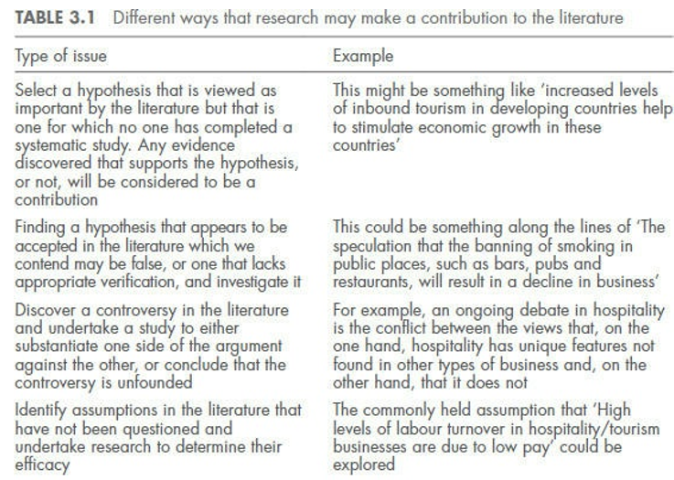

Slide 16
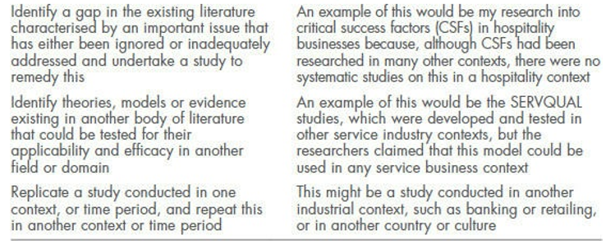

Slide 17
Planning a project
From attending this lecture, you should be able to:
outline how you would go about planning and preparing an academic research project
understand the differences of approach between pure research, market research and consultancy research projects
determine the various stages in the planning process
appreciate the need to modify the planning stages for different types of project.

Slide 18
Why is it being done?
At university, the most common research project you will be required to undertake is an academic research project, for instance an undergraduate dissertation.
An academic research project is an example of pure research which differs in purpose to other forms of research. The next table demonstrates that research of this nature seeks to make a contribution to knowledge, in a specific area or discipline, rather than to solve a commercial problem.

Slide 19
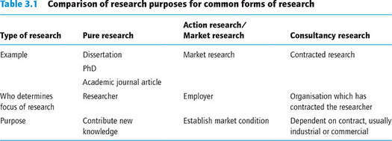
Forms of research

Slide 20
Pure research
Pure research is not governed by a wide agenda as with market research or consultancy research. These forms of research will be conducted with a specific purpose and application in mind. Although some pure research may have practical implications, this is not the primary focus in conducting the research. A pure research project will advance knowledge by exploring new ideas or building on the research of others within a certain field. Pure research can be used to test existing theories and to create new theories.

Slide 21
Pure research
As the purpose of pure research is to contribute new knowledge, it is important that the researcher demonstrates full understanding of the subject area. In order to achieve this, a greater focus is placed on reviewing research that has already been conducted in this area. Conclusions will be drawn from the research to identify the contribution that the project has made.

Slide 22
Overview of the planning stages
There are a wide variety of models suggested by authors regarding the stages of a research project. Veal (2011) identifies 10 key stages in planning a research project, seven preparatory stages, one investigatory stage and one analysis stage.
Pure research is clearly distinct from a consultancy contract where objectives may be solely determined by the client.

Slide 23
Planning a research project
Stage 1 Definition of the problem and development of research questions
Stage 2 Identification of information needs, to include:
  literature review
  review of secondary sources
  primary data requirements
  data collection methods
  sampling frame
  fieldwork arrangements
  analysis requirements
  budget implications.

Slide 24
Planning a research project
Stage 3 Redefinition of the problem, the question and information needs (often in the light of budget and time constraints)
Stage 4 Statement of aims and objectives
Stage 5 Development of a research programme
Stage 6 The pilot stage
Stage 7 Data collection
Stage 8 Data coding and analysis
Stage 9 Report and presentation preparation

Slide 25
The stages explained
Each of these stages will now be considered in more detail.
Stage 1: Definition of the problem and developing research questions

Slide 26
Before a research project can begin, a topic area must be chosen. In the case of pure research, the project will usually come about from the researcher’s own interests. In some instances, the researcher may have to work within a specified topic area. Negotiation may be necessary in order to finalise the topic. This may take place between a student and their supervisor, or between a team of researchers working on the same project.

Slide 27
Definition of the problem
At the outset of planning a research project, the researcher should begin by familiarising themself with the topic they wish to explore. The likelihood is that this will involve finding out what has been done before in the same or similar topic areas. Once a thorough understanding of the topic area has been gained, the researcher can identify a research problem to help guide the project.

Slide 28
The type of thinking necessary at this stage (and throughout the initial stages) will be developed in the following hypothetical example
Illustration 3.1 Winter sports tourism research project
A tourism management student was required to write a dissertation on a topic of their choice during the final year of their degree. Due to a personal interest in winter sports, and an academic interest in consumer behaviour, the student chose to explore the motivations of UK residents who participate in winter sports tourism.
Initially, to gain an understanding of the topic the student needed to establish:
the size of the winter sports market in the UK
behavioural trends of British skiers
trends in the global ski industry
motivations for participating in winter sports.

Slide 29
After initial work in defining the problem, it was possible to develop some research questions – that is, to turn the initial statements or topics into the form of questions or research. In the case study, this might conceivably include:
Initial statement: To explore the motivations of UK residents who participate in winter sports tourism. Research questions:
Is motivation commonly used to segment tourists?
Why do people participate in sport tourism and winter sports tourism?
What are the reasons for non-participation in winter sports?
What factors influence the choice of ski resort and other consumer behaviour?

Slide 30
Hence, the general statement has begun to be broken down into smaller, more achievable, parts or research questions.

Slide 31
Stage 2: Identification of information needs
The second stage of the project overlaps with the first in as much as the definition of the problem will inevitably involve some identification of material that will be used in the later stages. However, what distinguishes this stage of the project is the move away from ‘what the project is about’ to ‘how it might be carried out’. Depending on the nature of the project, there are several aspects which would warrant some consideration.

Slide 32
(a) Literature review
As already mentioned before, a review of the relevant literature is an essential stage. The researcher may gain ideas about the sorts of questions which should be addressed or tips on successful methods of data collection and analysis. Similarly, ideas about how a research project could be organised can be usefully gained by looking at the work of others.

Slide 33
A literature review would involve reading articles in academic journals, textbooks, magazines, trade journals and newspapers. When scanning an article, it is always worthwhile seeing who the author has referred to and following up on these references.

Slide 34
Academic and public libraries allow you to search electronically for relevant books and articles. Academic libraries will usually have a number of subscriptions to discipline-specific journals and ebooks which can be accessed electronically. In addition to works published by authors writing about the topic, or their own research findings, other types of sources may provide valuable tips. Examples of brochures or other forms of printed information could be investigated.

Slide 35
Illustration 3.2 Winter sports tourism research project – literature search
Sources investigated include articles from journals such as:
Annals of Tourism Research
European Sport Management Quarterly
Journal of Sustainable Tourism
International Journal of Tourism Research
Journal of Hospitality and Tourism Research
Journal of Leisure Research

Slide 36
Sources investigated include articles from journals such as:
Journal of Sport Management
Journal of Sport Tourism
Journal of Travel and Tourism Marketing
Journal of Travel Research
Journal of Vacation Marketing
Scandinavian Journal of Hospitality and Tourism Research
Tourism Management.

Slide 37
(b) Secondary sources of data
The difference between items in a literature review and sources of secondary data relate to how the information will be used. As previously explained, the purpose of the literature review is to gain knowledge of the subject, pick up tips and perhaps use references in a report to help justify or compare. Secondary sources of data form part of the actual data collection. The ‘secondary’ element indicates that the data have already been collected for another purpose. Sources of secondary data can be categorised in a number of ways; one example follows.

Slide 38
(b) Secondary sources of data
Internal secondary sources
External secondary sources

Slide 39
Internal secondary sources
These are sources of data available from within an organisation. They include:
minutes of meetings
reports from sales representatives and the like
financial records
internal reports.

Slide 40
External secondary sources
There are a variety of external sources of secondary data which can be further sub-divided:
(i) Official statistics
(ii) Commercial Sources

Slide 41
(i) Official statistics
Government departments and other public sector agencies in the UK undertake surveys for all sorts of purposes. In the tourism field, some of the main examples include:
Office for National Statistics:
UK Government:
Visit Britain:
Visit England:

Slide 42
(i) Official statistics
Office for National Statistics:
  monthly overseas travel and tourism
  Social Trends
UK Government:
  National Travel Survey
  control of immigration statistics
Visit Britain:
  inbound tourism performance
  International Passenger Survey
Visit England:
  GB Tourism Survey
  the value of tourism in England
  GB Day Visits Survey
  Tourism Business Monitor
  Trip Tracker
  Beyond Staycation
  Annual Survey of Visits to Visitor Attractions
  England Occupancy Survey.

Slide 43
(i) Official statistics
The above is a small part of the wide variety of official statistics available, often free of charge. In addition, international sources of statistical information are available from organisations such as Eurostat, the World Tourism Organization (WTO) and the Organisation for Economic Co-operation and Development (OECD).

Slide 44
(ii) Commercial Sources
There are some commercial organisations who undertake surveys which researchers can subscribe to or purchase reports on. Organisations which do this sort of work include Mintel, the Economist Intelligence Unit (EIU), Keynote, BMI Research, Euromonitor International and Plunkett Research Ltd.
As an example, Mintel produced a report entitled ‘Snowsports UK’ (2014), which researchers can purchase at
http://reports.mintel.com/display/679944

Slide 45
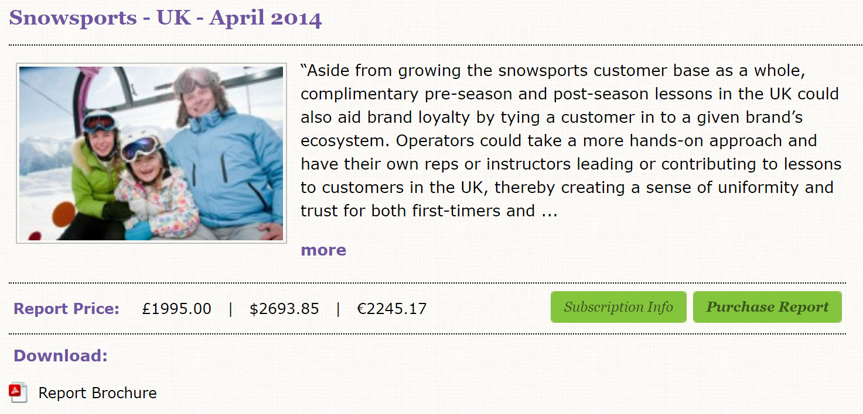
(ii) Commercial Sources

Slide 46
Illustration 3.3 Winter sports tourism research project – secondary sources
In this case, no internal sources were utilised as the research project was not focusing on a specific business, instead a range of external sources were used. In order to understand the tourism market in the UK, the ‘British National Travel Survey’, conducted by the UK Government, and the ‘Monthly Overseas Travel and Tourism Report’, produced by the Office for National Statistics, were used. Although these reports presented trends in tourism amongst UK residents, more information was needed relating to the UK ski market.

Slide 47
Illustration 3.3 Winter sports tourism research project – secondary sources
In order to fill this gap, Mintel reports, focusing on the ski industry and mountain tourism, were referred to. Commercial reports were also used to this end. Companies such as Crystal Ski produce an annual report on the UK ski market. Such reports identify trends in consumer behaviour such as destination choice, length of stay and resort considerations. In this project, external sources were used to understand existing trends in UK outbound tourism and the ski industry more specifically.

Slide 48
(c) Primary data requirements
Having scoured the literature and become aware of the range of secondary data sources available, the next decision is to consider what will still have to be found out. Thus, remaining gaps will require specific methods of data collection for the purpose of the research project.

Slide 49
Illustration 3.4 Winter sports tourism research project – primary data
Secondary sources of information were used to provide an understanding of the existing market for winter sports, however if the British winter sports market was to be segmented, the collection of primary data would be necessary. Primary data collection allows the researcher to identify the motivations of people participating in winter sports, their decision making to select a certain resort, their socio-demographic characteristics and their characteristics as a skier.

Slide 50
(d) Data collection methods
Once the necessity of primary data has been established, the methods of data collection require consideration. As outlined in the lecture 2, a decision will have to be made as to a quantitative or qualitative approach, or a mixture of both. The pros and cons of the individual methods will have to be evaluated and limitations recognised.

Slide 51
Illustration 3.5 Winter sports tourism research project – data collection methods
To establish primary information on the characteristics, motivations and behaviour of British skiers, a self-completion questionnaire was constructed and distributed online through UK ski clubs. This method of data collection provided quantitative information about British skiers and allowed the questionnaire to be completed by a wide range of skiers. Additionally, a series of in-depth personal interviews was carried out with a sample of British ski club members to provide qualitative information on characteristics, motivations and behaviour.

Slide 52
(e) Sampling frame
This aspect will be discussed more fully in the following lectures. At this stage in the planning process, decisions need to be made regarding how many people to question or interview, where and when to question or interview, and the length of the survey period. Again, the nature of the survey will determine sample size, for example, as well as the expected response rate for the data collection method and available resources.

Slide 53
Illustration 3.6 Winter sports tourism research project – sampling frame
As a relatively small proportion of the UK population participate in skiing, it is unviable to collect data from a representative sample. Instead, a convenience sample will be used to collect data from those known to have an interest in skiing.
The online self-completion questionnaire will be distributed to members of 12 British ski clubs via email. As these 12 ski clubs have a combined total of 4000 members, the population size for this study is 4000. The sample itself is likely to be much smaller due to non-responses. It is unlikely that all members of the population can be reached by an online self-completion questionnaire. Some members may not have supplied the ski club with their email address, or their contact details may not be up to date. Many of those who are emailed the questionnaire may not wish to participate in the research. In the case of the interviews, interviewees were sought from ski clubs in the UK.
Response rates for online surveys tend to be much lower than those of paper-based surveys. The opinion, on what an acceptable response rate is, varies between researchers. It is agreed, however, that when the response rate is greater, the research will have a greater ability to represent the whole population. In total, 1200 skiers completed the questionnaire, a response rate of 30%. Although a response rate of 30% may not be able to fully represent all ski club members, a sample of 1200 responses was more than adequate to conduct the required statistical tests. In the case of the interviews, a smaller sample was required as the data generated is more detailed. The researcher determined, after 25 interviews, that no new information was being generated.

Slide 54
(f) Fieldwork arrangements
Depending on the nature of the project and the methods of data collection selected, there will be a variety of fieldwork to organise. At this stage in the planning process, it is a case of preliminary identification of what will be required. This may well include:

Slide 55
Fieldwork to organise
arranging permission to interview at a site
gaining access to the names and addresses of potential respondents
getting quotes for the printing of paper-based questionnaires or the cost of online surveys
identifying any equipment that is required, for instance voice-recording technology
establishing the training requirements of staff, or the need for the recruitment of staff
obtaining ethical approval from your university before research can take place.

Slide 56
Illustration 3.7 Winter sports tourism research project – fieldwork arrangements
Permission to contact ski club members will be essential for the success of this research. At this stage, consideration is given as to which clubs would be approached to distribute the questionnaire. Once this decision is made, the clubs and forums will be contacted and briefed on the project before permission can be granted and the questionnaire made avaliable to their members. In order to get ethical approval, from the university, for the research to commence all respondents and interviewees must be over the age of 18. Permission to use the data must also be obtained from each participant so consent forms need to be drafted. The qualitative interviews require a trained interviewer. Identification of a suitable person will be necessary if the researcher is not going to conduct the interviews. Clerical assistance may also be required in the coding of questionnaires and transcription of the interviews.

Slide 57
(g) Analysis requirements
Before any data are collected, it is worth considering how the data will be analysed in terms of what computer package will be used and what statistical techniques will be performed. Statistical tests could include:

Slide 58
Statistical tests could include:
Chi-square test
Mann Whitney
Spearmans Rank
Pearsons Correlation
T-tests
ANOVA
Multiple regression analysis
Principal component analysis
Importance performance analysis.

Slide 59
Analysing the data
At this stage, it is necessary to reflect on how the research questions posed might be answered when analysing the data. If this is by means of statistics, the requirements of the proposed statistical test must be considered. Some tests require a minimum number of responses to be reliable, whilst others require questions to be formatted in a specific way. For instance, it is often more useful to ask a respondent to rank variables, rather than select all that apply, when it comes to data analysis.

Slide 60
Illustration 3.8 Winter sports tourism research project – analysis requirements
The quantitative survey will be analysed using statistical techniques to determine the socio-demographic characteristics of the respondents and their characteristics as skiers, their motivations and behaviour. Independent variables such as age, sport, group type and level of experience will be cross-tabulated against dependent variables such as the choice of destination, equipment-buying behaviour, importance of resort features and motivations. Chi-square tests will be used to establish the significance of the variables. The likely response rate is sufficiently large for variation amongst the respondents to be established by this technique. Due to the number of responses and the statistical tests required, quantitative analysis software, IBM SPSS, will be used. The qualitative interviews will be analysed, using content analysis to identify key themes and areas of contradiction and agreement within the transcripts. QSR NVivo will be used to organise, code and visualise the data.

Slide 61
(h) Budget implications
It is highly unlikely that financial implications have not already been considered by this point in the planning process. For research projects at undergraduate level, it is most likely that the budget will be determined by the researcher. Expenses will vary dependent on the nature of the project but may include travel to and from the fieldwork site, accommodation at the fieldwork site, printing of questionnaires, postage and subscription fees for online survey sites .

Slide 62
Illustration 3.9 Winter sports tourism research project – budget implications
Costs of the fieldwork, including hosting a survey online, travelling to interviews and transcription costs need to be assessed at this point. It is anticipated that enough ski club members will be interested in interviews that participation will not need to be incentivised.

Slide 63
Stage 3: Redefinition of the problem
This is perhaps one of the most awkward stages in the research process. The researcher has undertaken literature searches, identified a range of secondary data sources, thought about the primary data requirements, methods of data collection, fieldwork, analysis and prepared a budget. It is now necessary for the researcher to determine whether the project is viable.

Slide 64
Redefinition of the problem
The possible outcomes at this stage may well include the following:
Everything is fine and the research may progress.
Further clarification is needed.
The project is too costly and a less expensive option is needed, perhaps concentrating on the secondary sources alone or a smaller sample size.

Slide 65
Time is crucial
In surveys of a travel and tourism nature, there may be a precise season when data collection must take place, otherwise few tourists are available for interview.

Slide 66
Stage 4: Statement of aims and objectives
Following any necessary changes and redefinition, the project is ready to begin. At this point, it may be useful to reiterate the aims and objectives. In the case of an academic research project, these may have changed whilst the literature review was undertaken.

Slide 67
Illustration 3.11 Winter sports tourism – aims and objectives
Whilst exploring the academic literature surrounding winter sports tourism, it is identified that no research has been undertaken which explores the differences in motivation between skiers and snowboarders. This becomes the research problem.
A clear aim is established: to develop a typology of British winter sports tourists through the identification and analysis of different trends in skier behavioural characteristics.
Four objectives are identified in order to achieve the aim:
To analyse the relevant literature to determine key factors influencing the British winter sports market.
To undertake data collection of key stakeholders involved in British winter sports tourism, including ski clubs and independent travellers.
To analyse data, relating findings to the key literature to enable the structure of a typology.
To analyse differences in characteristics between the participants of skiing and of snowboarding.

Slide 68
Stage 5: Development of a research programme

Slide 69
The preliminary work of stage 2, if largely unchanged, will be developed at this stage. This entails:
Further reviews of literature
Acquisition of secondary sources
Confirmation of primary data requirements and methods of data collection
The development of a sampling frame
The design of questionnaires and observation recording sheets (if appropriate)
Specification of the fieldwork arrangements
Specification of the analysis requirements.

Slide 70
Illustration 3.12 Winter sports tourism research project – develop a research programme
At this stage, the student will develop a research programme and undertake the preliminary work that is necessary before data collection can begin. This will include reviewing literature and consulting secondary sources to determine what information needs to be gathered through primary data collection. Changes will be made to the initial plans if any new information is found. A suitable sampling frame will be established, a questionnaire designed and set up online, an interview schedule written and ethical approval for data collection obtained. Permissions, from selected ski clubs, will be gained, and interviews will be arranged with ski club members. The student will ensure, at this stage, that the questions asked in both the quantitative and qualitative research will meet the requirements for analysis.

Slide 71
Stage 6: The pilot stage
Having designed the necessary questionnaires, it is vital to test them out before the final launch into the data collection.
The researcher, having put such effort into the project to date, may easily believe that the whole world is as interested in the topic as he/she has become. It is then easy to lose sight of how respondents will react and what level of understanding they might have.

Slide 72
Therefore, it is necessary to see how things might work out. Thus, questionnaires, interviews or observations should be carried out on a small number of potential respondents first. This is called a pilot survey, which highlights:

Slide 73
This is called a pilot survey, which highlights:
problems with questionnaires (wording, layout etc.) causing misunderstanding
problems with interviewers not fully conversant with their requirements
an indication of the likely response rate
an indication of the range of responses to the questions which can be suggestive of the likely results.

Slide 74
Pilot study is not the main study!
From the pilot survey, modifications may have to be made and re-tested if necessary. If there are few or no changes to be made, it may be tempting to include the results of the pilot survey within the main data collection. However, before this dangerous course of action is undertaken, consideration should be given to what effects this extension of the survey period (to include the pilot stage) might have.

Slide 75
Pilot study is not the main study!
Moreover, what differences might the respondents of the pilot have against respondents of the main survey? Were they contacted by interviewers in the same way as will respondents in the main survey? Few authors comment on this point, perhaps assuming that the results of the pilot will affect the main survey in such a way that the inclusion of pilot data is never contemplated. In the opinion of the authors, this practice is setting a dangerous precedent

Slide 76
Illustration 3.13 Winter sports tourism research project – the pilot stage
The student will pilot the questionnaire and interview schedule to test that the questions and formatting make sense to respondents. Due to the terminology used, the questionnaire will be piloted by a small group of people who participate in winter sports. The problems that are highlighted during the pilot stage will be rectified before the data collection continues.

Slide 77
Stage 7: Data collection
This stage is either dreaded most or comes as a welcome relief. All the planning has been completed and the survey begins. If personal interviews or face-to-face questionnaires are being used, the project begins to ‘run itself’ in terms of actually doing the fieldwork and travelling to the site or people’s homes.
With self-completion questionnaires, there can be a brief lull in the proceedings. Having distributed the questionnaires, there may be a delay before they start being returned.

Slide 78
Whilst the data collection is under way, there is much that the researcher can be getting on with, assuming that they are not directly involved in interviewing or conducting face-to-face questionnaires.
As the early interviews are completed, or questionnaires returned, the initial coding work and transcription can be started ahead of analysis.

Slide 79
Where interviewers are employed, however, checks should be made on their progress to ensure that all questions are being asked in the way that was intended and that their completion of the forms is up to standard.
If interviewers are being employed by the completion rate, this aspect is of particular importance, as their interest in the project is likely to be much less than their interest in being paid! On this latter point, prompt payment can go far in maintaining the quality of an interviewer’s work

Slide 80
Illustration 3.14 Winter sports tourism research project – data collection
The student will distribute the online questionnaire and wait for responses to be returned. During this period, the student will be directly involved in interviewing the ski club members, which may involve some travel. To stay on top of the work that needs to be done, before analysis can commence, the student will transcribe the interviews as they go.

Slide 81
Stage 8: Data coding and analysis
The requirements of the software package used for analysis will have been taken into account in the questionnaire design. A number of software packages are available for both quantitative and qualitative data analysis.
IBM SPSS, Minitab, Stata and Statistica are popular software packages for analysing, managing and visualising quantitative data. QSR NVivo, ATLAS.ti and MAXQDA are packages for qualitative data analysis

Slide 82
Coding, of the questionnaires and interview transcripts into the software, will be undertaken before statistical analysis can take place. Paper-based questionnaires will need to be coded into this software manually. If questionnaires are distributed online, the results can often be downloaded into an appropriate software package. The researcher will still need to code this data.
Despite advances in analysis software, coding remains a distinct stage before the statistical analysis can begin.

Slide 83
When it comes to the analysis, many of the software packages avaliable offer greater sophistication in terms of the tests that can be run. These packages do, however, require the sample to be relatively large.
For smaller surveys, where the sample size is perhaps less than 100 respondents and the purpose is largely descriptive, the researcher should question whether such packages are necessary.

Slide 84
In such instances, familiar spreadsheet software, such as Microsoft Excel, may meet the data analysis requirements. This aspect, though, should have been established earlier in the planning process, rather than, having collected the data, the researcher now wondering how to analyse it.

Slide 85
Following this initial stage, the data must be analysed and statistical tests performed in a systematic way. This is more fully explained in Lecture 7

Slide 86
Illustration 3.15 Winter sports tourism research project – data coding and analysis
Once data have been collected, they will be coded into the appropriate software and analysis will be conducted using the planned methods, in this instance Chi-square tests on the quanititative data and thematic content analysis on the qualitative data. It is important that plenty of time is allowed to explore the data.

Slide 87
27-03-2019

Slide 88
Stage 9: Report and presentation preparation
The final stage for the researcher is often writing a report of the research findings and providing recommendations for future research. As part of a pure research project, it is unlikely that a presentation of the research will have to be given. Findings may be reported in a journal article or written up in a thesis and are therefore publicly available. The techniques for report writing and presentation are developed in Lecture 08.

Slide 89
Illustration 3.16 Winter sports tourism research project – report and presentation preparation
The final stage is to write up the findings of the study. As this project is an undergraduate dissertation, the findings will be presented in a report.

Slide 90
Writing tenders for consultancy projects
Commissioning consultants to undertake research is common practice both within and outside the tourism industry.
Tender documents for consultancy projects involve the researcher/consultant outlining how they would plan to do the project and what he/she will charge if they are awarded the contract. It can be seen, therefore, that for this type of research project consultants need to be able to demonstrate the ability to plan projects clearly before any data collection takes place in anticipation of what the client will require.
This is normally done in the form of a written statement called a tender document or proposal.

Slide 91
Consultants tender for all kinds of research work and, as such, the nature of tender proposals varies accordingly. In the context of this book, where some kind of survey research may be specified, a typical proposal would normally have to demonstrate:

Slide 92
A typical proposal would normally have to demonstrate
an understanding of the problem
an explanation of the methods to be used in collecting the data
an explanation of how the data will be analysed
details of who will be carrying out the work and of their credentials
the number of client meetings and the nature of interim reports
the presentation of results – a presentation, a report or perhaps a management plan
a clear schedule of the programme of work for the project

Slide 93
A typical proposal would normally have to demonstrate
that the consultant has all the necessary facilities to run the project (e.g. computing equipment)
if a subcontractor is to be used, what credentials and experience are available (the proposal must provide information about the subcontractor on other aspects in as much depth as you would expect from a proposal to be completed solely in-house)
that the consultant’s resources are not over-committed
the costs to be paid by the client
the fees to be paid to the consultant.

Slide 94
On these last aspects, that of costs/fees for the project, it is often the case that the available budget is only known to the client or contracting agency.
Some contracting agencies will stipulate a maximum budget in the invitation to tender whilst others may be unsure of what their project should cost, and some may specifically decide not to indicate any financial information at all.

Slide 95
If a budget is indicated in the tender, then it is unlikely that consultants will strive to offer a lower amount (assuming the budget indicated is acceptable).
However, if the contracting agency does not outline what the maximum budget is, consultants may state a low fee in the hope of receiving further work from the client or a high fee as an ‘off-chance’.

Slide 96
In the opinion of the authors, it is preferable for clients to indicate clearly what the maximum budget for a given project is.

Slide 97
3.5 Considerations for market research
Market research differs significantly from academic research in terms of purpose, working relationships involved and the conducting of research. The following considerations will be discussed below:
the purpose of the market research
working with an employer
conducting market research.

Slide 98
3.5.1 Purpose of the research
When developing a market research project, it is important to recognise why the project is being undertaken. Market research is conducted in order to establish the market conditions, however there will be a further agenda prompting the research. For instance, market research is often conducted when a company is considering entering into a new market or developing a new product. Another situation which occasionally arises is that market research is carried out when the organisation is in a crisis as market research can be used to aid management decisions.

Slide 99
It is important that the research requested can meet the purpose for which it is meant. In some situations, it is unrealistic to expect that the results of a market research exercise can provide the answers desired. For a research budget to be justifiably allocated, there must be initial confidence in the validity of the research that has been requested and this requires communication between the employer and the researcher.

Slide 100
3.5.2 Working with an employer
In market research, the researcher will be working closely with an employer in order to conduct the research they require. Considerable negotiation will take place between the researcher and whoever is commissioning the research in order to define the research problem. Time spent on this stage avoids awkward comments in the final presentation such as ‘we knew that’ or (even worse) ‘that wasn’t what we wanted’.

Slide 101
During the research process, there may be a number of briefing meetings between the employer and the researcher. For the employer, these meetings are used to ensure that the research is successfully completed and that a suitable researcher is recruited. The researcher must use these meetings as an opportunity to gain a full understanding of the project requirements and to convince the employer that they are suitable and competent.

Slide 102
Thus, the researcher must ask questions in the briefing meeting that lead to a thorough understanding of the project requirements on both sides. Pertinent questions in briefing meetings also enable the researcher to establish whether there is a ‘hidden agenda’ at play. For instance, the researcher may identify that the market research is being used to disguise and facilitate a particular course of action that has already been determined.

Slide 103
3.5.3 Conducting market reseach
Initially, the researcher should begin by familiarising themself with the topic of the enquiry. This will involve finding out what research has previously been conducted in the same or similar topic areas. Unlike an academic research project, less knowledge will be drawn from academic literature and a greater focus will be placed on secondary data sources and existing market research.
Having reviewed these sources, the researcher will plan their primary data requirements by identifying gaps in their knowledge of the market.

Slide 104
In market research, the budget is fundamental in determining the scope of a project. A budget will usually be pre-determined and the researcher will have to bear this in mind in the early planning stages. This will govern the methods used in primary data collection and the resources avaliable to the researcher in terms of time, people and software.

Slide 105
Market research is generally conducted on a larger scale than academic research, therefore, with a sizable budget, the researcher may employ researchers to conduct and transcribe interviews or code questionnaire data.
The researcher will have a fundamental role in managing the researchers employed to ensure consistency in their work.

Slide 106
Once the findings have been analysed, a report on the research findings will be required. Often, the researcher will also need to give a presentation of these findings to their employer and key figures within an organisation.
In market research, the report is often required to identify recommendations for a suitable course of action or outline the implications of the research.

Slide 107
3.6 Summary & Exercises
Identify the different purposes of pure research, action research and consultancy research and then list the different considerations that will need to be made for each form of research.
Explain why the time spent reviewing literature and searching for secondary data sources is worthwhile.
Identify the two different types of external secondary data sources and provide an example for each.

Slide 108
3.6 Summary & Exercises
Select four different types of survey methodology and identify the necessary fieldwork arrangements.
Discuss the implications of an inappropriate sample for the outcome of a research project.
Examine why it is necessary to consider data analysis requirements prior to data collection.

Slide 109
Further reading
Altinay, L. and Paraskevas, A. (2011). Planning Research in Tourism and Hospitality. 2nd edition. Oxon: Routledge.
This book provides clear guidance on planning a research project in the context of tourism and hospitality. This book is particularly applicable to students undertaking a research project covering the literature review, research design, fieldwork and analysis.
O’Leary, Z. (2004). The Essential Guide to Doing Research. London: Sage.
This book is aimed at undergraduate and post-graduate students. Although it does not have a chapter dedicateded to planning a research project, the chapters on working with literature, methodological design and exploring populations provide useful insight into planning a project.
Veal, A.J. (2011). Research Methods for Leisure and Tourism: A practical guide. 4th edition. Harlow: Pearson Education.

