Slide 1
南宁师范大学
Nanning Normal University
School of the Tourism and Culture
Major Incidents and Crisis Management
Ivan Monich, Ph.D.
Nanning, 2020

Slide 2
Section II Response Planning and Preparedness
Lecture 03
Stress Management and Responders

Slide 3
Why Stress Management Is Important to Emergency Managers
In crisis situations, community management has two populations to attend to and manage: their civilian citizens and their own employees.
This chapter offers emergency planners and community management professionals a framework of important components to build into their emergency response plan in a pre-disaster situation.

Slide 4
Why Stress Management Is Important to Emergency Managers
There are a number of benefits for building this structure. The first is obvious, having a solid plan ready to put into place in a disaster or emergent situation helps optimize success in response and recovery.

Slide 5
The organization commitment has been shown to directly relate to the perceived leadership style, especially where the leadership defines roles of personnel toward defined goals through assigned tasks, using specific procedures, timelines, and communication (Dale and Fox, 2008).
Further, research demonstrates that planning targeting reduction of perceived role stress and increasing or solidifying interpersonal factors have benefits to the organization (Dale and Fox, 2008).

Slide 6
Strategic planning
Law enforcement has built into its pre-incident strategic planning interventions to add to their incident command approaches. Five components have been identified as necessary to build into preincident planning (Sheehan et al., 2004).

Slide 7
Strategic planning
This includes assessment and triage, specific crisis intervention with individuals, small and large group crisis intervention, and strategic planning. Within the context of an emergency situation, the community manager will want to optimize the chance for retention and ability to return to function in a typical daily work routine.

Slide 8
Strategic planning
Strategic planning should take into account elements of the design of tasks, management style, interpersonal relationships, work roles, career concerns, and environmental concerns (Goetzel et al., 1998 in Colligan et al., DHHS-NIOSH). Specifically, each of these is important to consider in their contribution to stress for the employee:

Slide 9
Strategic planning elements
The design of tasks involves heavy workload, infrequent breaks, long work hours, shifts, tasks with little personal meaning, underutilizing of skills, and lack of control.
Management style where employees do not contribute in decision making, poor communication, and the absence of family-friendly policies.
Poor social environment and interpersonal relationships among coworkers and supervisors.

Slide 10
Strategic planning elements
Work roles that have conflicting or uncertain job expectations, or too much responsibility.
Job insecurity, lack of potential for advancement, or rapid changes for which workers perceive they are unprepared contribute to career concerns.
Unpleasant or dangerous physical conditions contribute to environmental concerns.

Slide 11
Minimal attention in emergency planning has focused on the potential secondary survivors, specifically the responders and emergency service workers who attend to all of those demands. One element often not accounted for in planning is the nonemergent and nonimmediate human impact element for the responders.

Slide 12
It is important to consider the well-being of the employees because when a disaster strikes their community they become victim responders. Their commitment will be to do what they have to do for their job and community. Their minds and hearts will be preoccupied with their own families, homes, and neighborhoods.

Slide 13
Stress-Related Disorders
In a disaster situation, the rate of impact is generally greater. Research demonstrates that individuals without the benefit of prior disaster training or experience are at greater risk for PTSD (post-traumatic stress disorder) (Perrin et al., 2007). In a study of PTSD post-WTC, the rate was 21.2% for construction, engineering, sanitation, and unaffiliated workers, compared to the rate of 12.4% for rescue/ recovery workers (Perrin et al., 2007).

Slide 14
Stress-Related Disorders
These are important to highlight so as to consider the mental health needs of not only primary survivors but also the secondary survivors and personnel: No one who sees a disaster is left untouched by it.

Slide 15
Understanding Stress along the Continuum
Stress occurs as a function of living. Stress reactions are normal, but can be adaptive or maladaptive. Stress can be motivating and positive or negative and destructive. In extreme situations, reactions can be viewed as “normal responses to abnormal events rather than signs of psychopathology” (Rogers, 2007, p. 3). Stress can be short term and in the form of both small and large demands. Typical stress symptoms can impact the body’s ability to be healthy and can interfere with the ability to fight illness or infection.

Slide 16
Understanding Stress along the Continuum
When something happens that is out of the norm, the potential for problematic stress occurs. An unanticipated event with serious and unexpected impact, such as a tornado with damage to the community, a significant fire or flood, has far-reaching impact with regard to the length of time, extent of response needed to meet the demands of the extent of and recovery from the event. Exposure to these situations causes reactions that may include terror, horror, fear for one’s safety and well-being. Reactions may be anywhere from mild to severe, and impact people in a number of different ways over a long time. Most reactions are temporary

Slide 17
Understanding Stress along the Continuum
First responders and support personnel in emergency situations performing rescue and recovery work are exposed to stressors beyond their normal daily emergency-task demands.

Slide 18
Stress Reactions
There are a number of symptoms that interfere with emotions or feelings, physical health or with thinking. Because these problems affect our thinking, feeling and physical functioning, our behaviors and the way we manage in our daily lives can become problematic and influenced in many ways.

Slide 19
Stress Reactions
Most of us have a typical baseline for recovering from stress and stressful events in our lives. We may be thrown off for a period of time, for example, a couple of days. However, when these problems do not resolve, then stress may be moving to distress or even cumulative stress. At the worse, these cause negative impact on physical health as well.

Slide 20
Educating people on stress in terms of physical, emotional or cognitive signs gives them an opportunity to watch for changes in themselves and in each other. Creating a culture of positive self-care and encouraging people to practice stress management daily is a solid foundation for preventative care for future situations.

Slide 21
Symptoms of the Stress Reactions
There are Physical Symptoms, Emotional Symptoms, and Cognitive Problem.

Slide 22
Physical Symptoms
Constant fatigue or lack of energy • Inability to relax
Sexual problems
Weight changes
Cold sweaty palms
Changes in sleep patterns, trouble falling asleep, poor sleep or lack of restorative sleep
Difficulties with attention or poor concentration • Aches, pains, and muscle tension
Headaches
Grinding teeth, clenched jaw
Stomach and gastrointestinal problems such as upset stomach, nausea, diarrhea, and indigestion
Loss of appetite
Racing heart beat, shallow breathing, tightness in the chest

Slide 23
Emotional Symptoms
Feeling irritability or short tempered
Sad, blue, or down
Worry, apprehension
Isolating self
Feeling isolated
Crying, tearfulness
Lessened ability to relax or to enjoy things
Feeling abandoned or targeted
Feeling out of it, overwhelmed, ineffective
Thinking of death as an option
Hopelessness
Anxious, fearful
Panic, terror, hypervigilance
Compulsions, checking, putting things in order
Anger/rage
Apathy, lethargy

Slide 24
Cognitive Problem
Feeling overwhelmed or unable to manage demands in daily life
Problems with remembering things and new learning
Forgetfulness
Problems with problem-solving
Difficulties concentrating
Difficulties making sense of things
Slowed thinking
Rigid or obsessive thinking
Problems with word finding • Reliving an event over and over
Denial or blame
Difficulties dreams
Denial/blaming
Suspiciousness
Doubting faith
Disorientation
Confusion
Easily overwhelmed

Slide 25
Acute Stress
Acute stress reactions are generally very distressing to the individual, and often the individual does not recognize these reactions as connected to the event. And in emergency situations, everyone can be so consumed with responding to the crisis, people may not realize that either they themselves or their peers are experiencing acute stress response.

Slide 26
Acute Stress
In the heightened focus of the moment, people may not be aware of their own reactions. There may be panic, shock, disbelief, disorganization, and/or distress. Many people experience a sense of being out of control.

Slide 27
Acute Stress
People who experience this acute stress report a variety of problems and changes in their behavior. These changes or problems occur in feelings, thinking, physical functioning, and behaviors. These problems include those listed above, and can be very intense and disturbing to the individual.

Slide 28
Manager’s Responsibilities in a Critical Event
There are two levels of attention that a manager must take into account during a critical event. First is their responsibility in organizing and implementing their crisis response plan. The second is their responsibility to their people responding to and implementing the crisis response plan.

Slide 29
Manager’s Responsibilities in a Critical Event
helps them recognize that when stress symptoms become too much, that it is important they are encouraged and supported to get the help they need before it becomes traumatic or critical incident stress.

Slide 30
Planning: Helping Take Care of Your Responders in Advance
There is at least one way to help mitigate the stress incurred to responders in a disaster situation: assure their families are as safe as possible because of anticipated preparedness. The family is prepared to respond, and therefore in a more secure position to react and be self-sufficient. Controlling those elements that can be foreseen and premanaged is the foundation to any good strategic plan

Slide 31
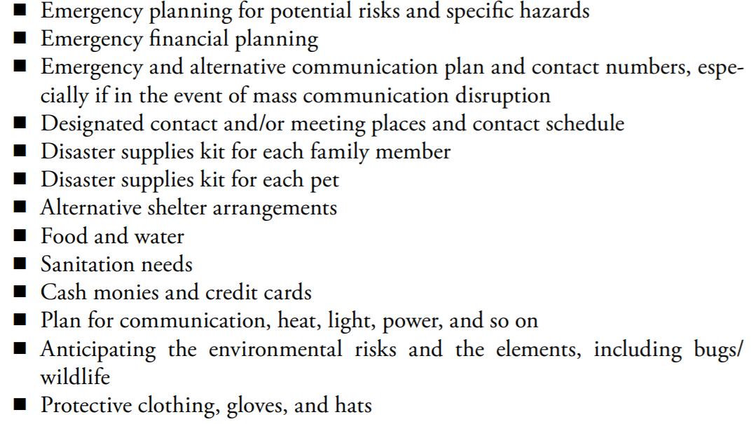
A general family plan should at least have elements including:

Slide 32
Among the components listed above, the agency can provide suggestions to encourage employees to have their crisis response plan in place, so if they are not there to assure the safety of their families, their family members know what to do related to:

Slide 33
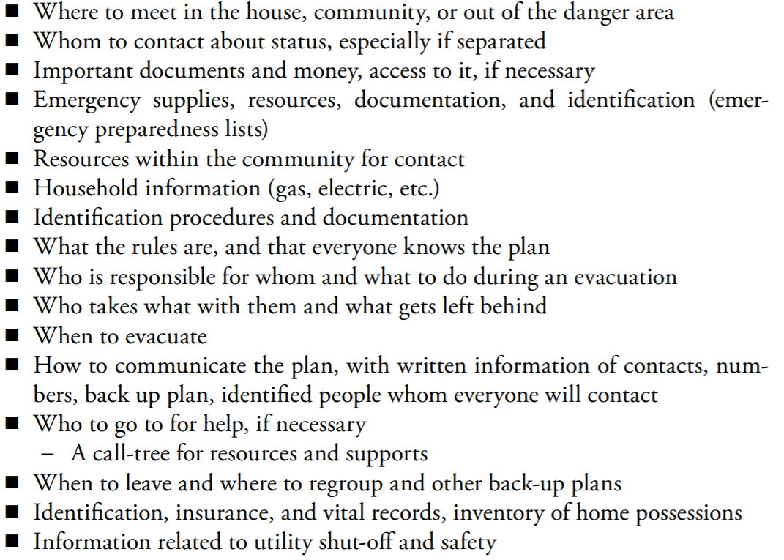

Slide 34
Here are some ideas to build into the emergency plan the following elements that focus specifically on anticipating the needs of employees for their families and homes.
Educate all employees about the specific agency policies and expectations for their responses during a major incident or disaster.
Include an avenue for communication and contact for employees and their families.
Have a system in place to assure that your responders can have communication with their family members and support persons.
Anticipate a centralized and accessible area for responders only, place where information can be posted. This can include a schedule of informational briefings, centralized posting of information, and post schedules of when updates are going to occur

Slide 35
Suggestions for Supporting Your Responders
There are several strategies to assist your responders to organize themselves and attain their goals while lessening their stress levels during a critical event.
Page 38.

Slide 36
Psychological First Aid
One resource is Psychological First Aid (PFA) (Ruzek et al., 2007), which is comprised of eight core actions designed at reducing post-traumatic distress and improving short- and long-term adaptive functioning for responders.

Slide 37
The eight core actions are based on the following principles (Hobfoll et al., 2007) of promoting:
A sense of safety
Calming
A sense of self- and community efficacy
Connectedness
Hope

Slide 38
Critical Incident Stress Management
Objectives:
Mitigation of the impact of the event through decreasing stress reactions.
Accelerate recovery process, by increasing normal recovery processes, in those experiencing stress reactions.
Restoring adaptive functioning.

Slide 39
Conclusion
Stress is a part of our daily lives. We can manage it while we live with it. When disaster strikes, it impacts the core of our existence and perception of safety and security. Different situations impact people’s lives, physical and emotional health differently. It can have long-lasting impact on our communities and the people within them. This not only affects people, but also it impacts economics and resources within the community.

Slide 40
Conclusion
With consideration of the above factors in mind, it is important to develop plans that anticipate and plan for a wide range of possible community disasters. Keeping this in mind, you can anticipate the needs of both community and your responders. While critical incidents and disasters are unpredictable, they can be planned for with some degree of anticipation of the factors discussed above. While

Slide 41
Conclusion
While we plan based on the worst we have known, we need to plan for the worst we can image with impact greater than that we are afraid to contemplate. We also need to think outside the box, reaching for resources we have not considered, and plan to keep our personnel resources as healthy and supported as possible, not only because we need their professional skills to help us through the disaster but also because we care about them as valuable community members.

Slide 42
Thank you

Slide 43


