Slide 1
南宁师范大学
Nanning Normal University
Department of Tourism & Culture
Research Methods
Ivan Monich, Ph.D.
Nanning, 2019

Slide 2

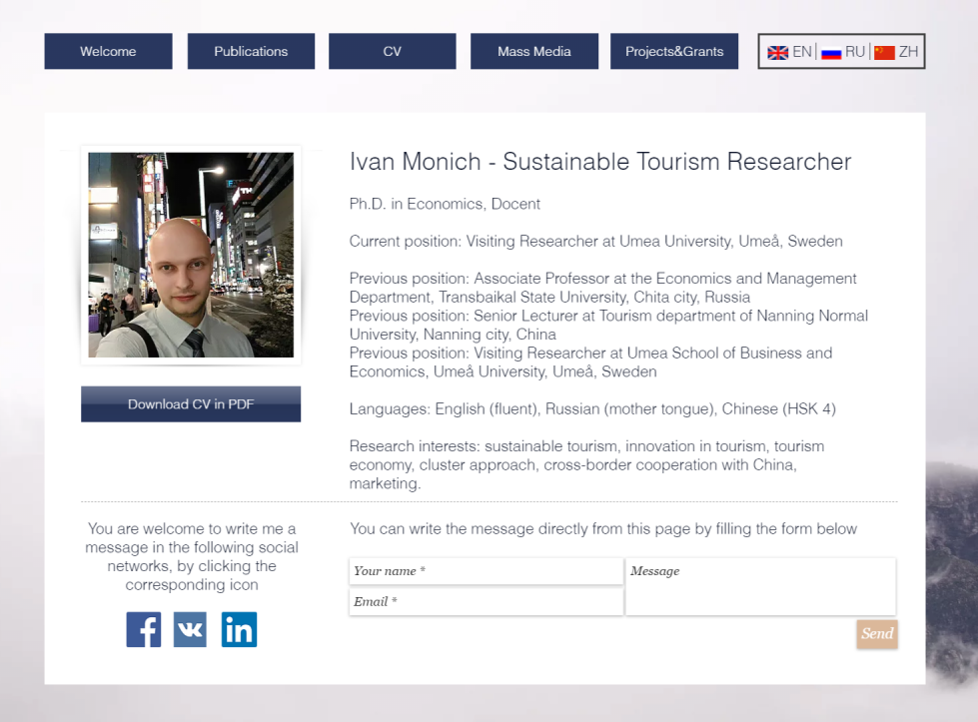
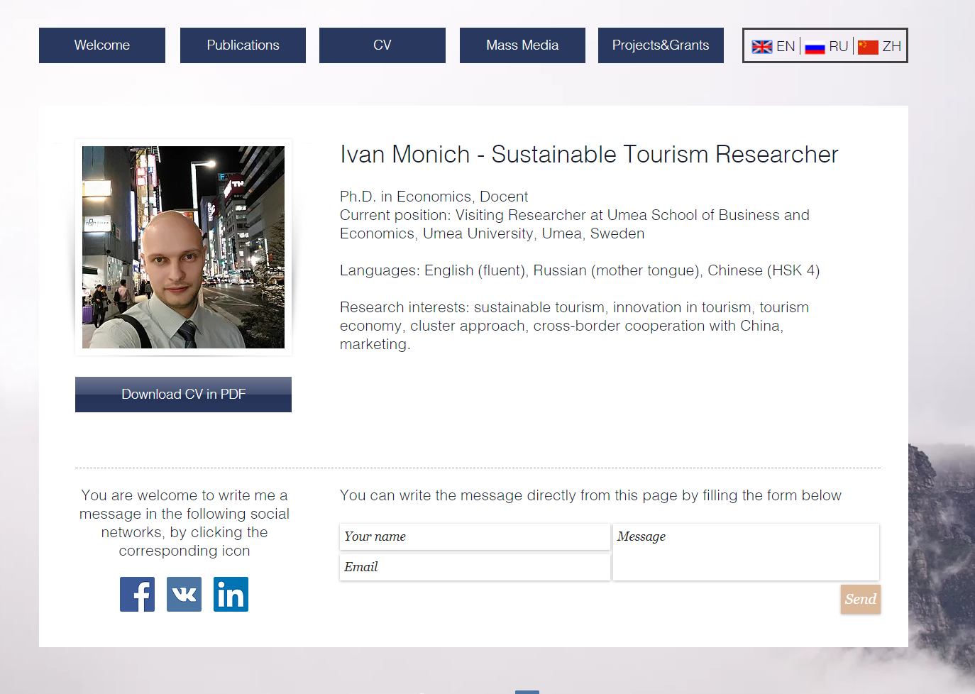
2

Slide 3
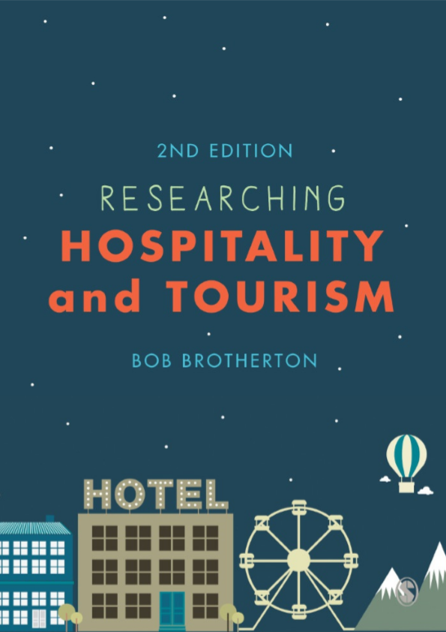
The main textbook is
Researching Hospitality and Tourism

Slide 4


Assessments
Lectures attendance, active participation in the discussions (10%)
Final written Exam (60%)
Project & Presentation (30%)

Slide 5
The course content
1
2
3
4
5
6
7
8
9
10
11

Slide 6
Introduction
In terms of reports and thesis structure and the contents, this course takes you through the issues and decisions that need to be considered and made to conceive, plan, conduct and write up the type of research project. In this sense it seeks to take you through each decision and action stage of the research process, from identifying a topic and formulating the research question or aim and objectives to writing up the final document.

Slide 7
Lecture 01
The Nature and Relevance of Research

Slide 8
Lecture Content and Issues
The nature of research.
Experience, common sense and theory.
Thinking about research.
The characteristics of scientific research.
Good and bad research.
Pure and applied research.
Theoretical/empirical and primary/secondary research.
Exploratory, descriptive and explanatory research.
Inductive and deductive approaches to research.
Issues that require research solutions.
Some problems that may be encountered.

Slide 9
Introduction
The purpose of this lecture is to provide you with a clear understanding of what research is and what it is designed to do. To achieve this, we will explore the nature of research in terms of its main purposes, functions and characteristics. We will also examine different types of research and focus on how these might be used to address or solve theoretical or practical problems, as well as the two basic approaches used to design and conduct research.

Slide 10
The Nature of Research:
Experience and common sense
Not all managerial decisions can be successfully made on the basis of experience, common sense or quick thinking.
One person’s experience can never be the same as another’s. Even if the people concerned share similar past experiences, the ways in which they perceive them and learn from them will differ.

Slide 11
Common sense
Common sense is a generally accepted view or belief of what is seen to be a sensible way to act or understand certain questions, issues or events. Such a view or belief may indeed be accurate, but, equally, it may not.

Slide 12
1.2.1 Thinking about research
As a practising hospitality or tourism manager, you will have to engage in various aspects of research then – because the questions and problems facing the contemporary manager are increasingly becoming ones that are new and complex and cannot be answered or solved by using experience or common sense alone.

Slide 13
What is Research
Consider the following issues for a moment: you want to go on holiday, you want to buy a car, you want to find a suitable venue for your twenty-first birthday party, you want to get the best return you can on your savings. How do you decide where to go on holiday, which car to buy, where to hold your party and which form of investment will give you the best return?

Slide 14
What is Research
All of these issues have alternative answers or solutions and you need to find and select the one that fits your needs or criteria the best. How would you do that? Simply by collecting information to identify the options associated with each, then by analysing the information and selecting the best option. In short, you would research the issue in order to identify the most suitable solution.

Slide 15
Widely accepted definition of research
Many textbooks refer to, or define, research in terms of it being an activity that creates or generates new knowledge or as something that produces a contribution to the existing body of knowledge. The types of words that are commonly used in definitions of what research is include ‘discovery’, ‘investigation’, ‘new facts’, ‘advancement of knowledge’, ‘original insights

Slide 16
A couple of views from the literature
Sekaran (2013: 4) suggests that research is, ‘an organised, systematic, data-based scientific enquiry or investigation into a specific problem which is undertaken with the objective of finding solutions or answers to it’.
By contrast, Wilson (1997: vi) takes the view that ‘research is a process of “principled compromise”, informed by professional knowledge of the techniques and limitations of research methods, driven by personal energy, and presented with whatever honesty and objectivity that can be mustered’.

Slide 17
1.3 The Characteristics of Scientific Research
Logically, good research should reflect the characteristics of the ‘ideal’ and bad research the opposite. The ‘ideal’ is variously called scientific enquiry, scientific research or the scientific method and is regarded as having nine general characteristics to distinguish it from other forms of research.

Slide 18
Characteristics of Research
Purposeful
Any research project should have a clear focus that is achievable, as the research process itself is a means to an end. For example, it is a way to obtain answers to a question or solutions to a problem.

Slide 19
Characteristics of Research
1. Purposeful
Any research project should have a clear focus that is achievable, as the research process itself is a means to an end. For example, it is a way to obtain answers to a question or solutions to a problem.
To achieve this overall result, a number of tasks or stages will have to be completed. These will be the research objectives and, in this case, might be expressed as follows.

Slide 20
The research objectives
To conduct a literature review to identify the nature of CSFs, both in general and in relation to the budget hotel operations context of the project.
To develop a theoretical framework/conceptual model of the CSFs from the literature review and produce associated hypotheses.
To collect empirical data from budget hotel companies and other appropriate organisations and/or individuals associated with the project’s context.
To analyse the empirical data and test the study’s hypotheses.
To produce conclusions and recommendations for further research.

Slide 21
2. Rigorous
This characteristic is concerned with the quality of the design and how the research is conducted. Essentially, if a piece of research has been conducted in a rigorous manner, it is more likely that it will be seen as credible and the results believed and accepted than would otherwise be the case.

Slide 22
3. Testable
Testability is concerned with the nature of the question being researched. For the research to be able to answer the question it is designed to address, the question must be answerable. This means that the question, or a hypothesis derived from it, must be written or phrased in a form that will enable it to be tested or proved.

Slide 23
Example
For example, one factor that could be regarded as critical for this type of hospitality operation is the cleanliness of the guest bedrooms. So, we might speculate, or hypothesise, that the higher the levels of cleanliness, the more successful the budget hotel would be

Slide 24
4. Replicable
If the design and procedures used to undertake a piece of research are transparent and available in the public domain for others to see, then other researchers will be able to replicate or repeat that research to test the rigour of its processes and the accuracy of its findings. This is the same idea as one researcher repeating the same experiment a number of times to see if the same results are obtained

Slide 25
4. Replicable part 2
Whatever the context, the key issues here are those of comprehensiveness and transparency. For you to be able to replicate someone else’s study or for someone else to repeat yours, the process used must be recorded in detail.

Slide 26
5. Precision
Because of the scale, scope and complexity of most real-world situations, we are often forced to restrict our research to a sub-set or sample of the full population. Where this is the case, we face an issue concerning the extent to which the findings we obtain from our sample are a true reflection of the population as a whole.
There are many issues associated with this, particularly those concerned with sample design/selection, that will be dealt with later in the course

Slide 27
6 Confidence
This is related to precision and is concerned with the likelihood, or probability, that the findings from the sample are correct or, put another way, how confident we can be about the accuracy of the research findings.
The general convention is that a 95 per cent level of confidence is the minimum acceptable. This means that the probability of the findings being incorrect is only 5 per cent and, conversely, 9½ times out of every 10 they will be correct.

Slide 28
7 Objective
As we have seen earlier, this characteristic is one that has received criticism in terms of whether or not it is really possible for any individual to be truly objective and value-free when designing and conducting research.
In addition to this, we should be aware of where our subjectivity has influenced the research and be prepared to recognise this and the impact it may have had.

Slide 29
8 Generalisable
It is self-evident that all research is undertaken within a particular context or situation, but this does not mean that the findings from this research will be applicable to other contexts or situations that are related or unrelated to the original context in which the research was conducted. However, it would increase the value of the research if it were to be generally applicable rather than relevant only to that one context.

Slide 30
9 Parsimonious
This characteristic is essentially concerned with simplicity. Any issue being researched is likely to be one that could be influenced by a wide range of factors, but not all of these possible influences will be equally strong or important to the overall answer.

Slide 31
1.4 Types of Research
1.4.1 Exploratory, descriptive and explanatory research
In terms of differing purposes, exploratory research is really selfevident.
Descriptive research will be designed to establish a factual picture of the issue under investigation, whereas explanatory research will be concerned with explaining the why and how of the situation.
Explanatory research frequently includes descriptive elements but goes beyond this to identify and explore the causes lying behind the effects and the nature of the relationships between the two.

Slide 32
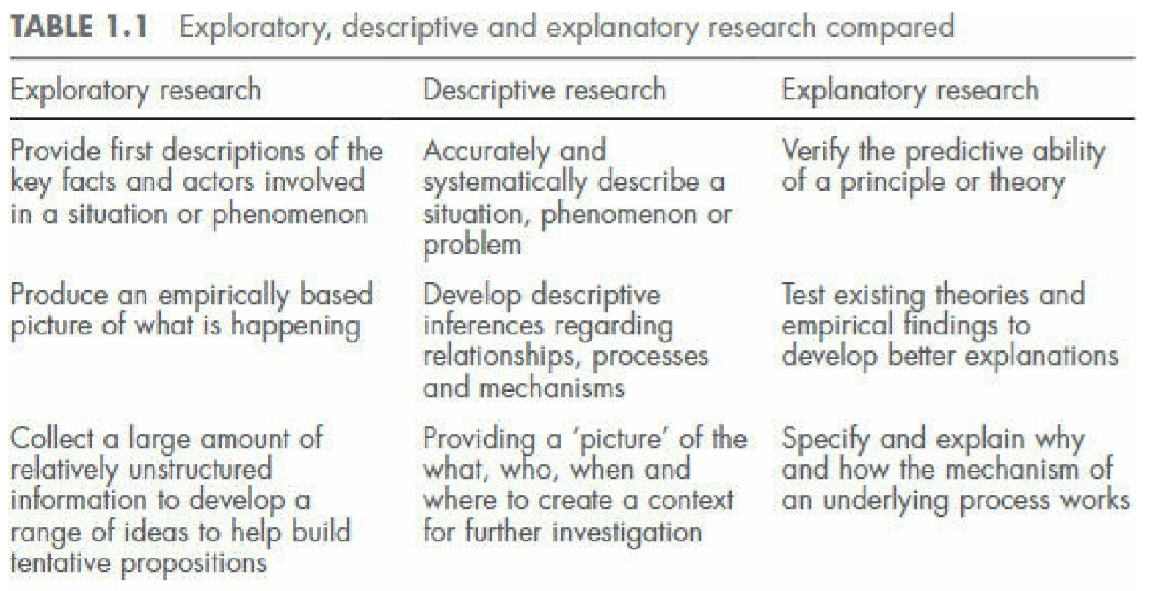

Slide 33
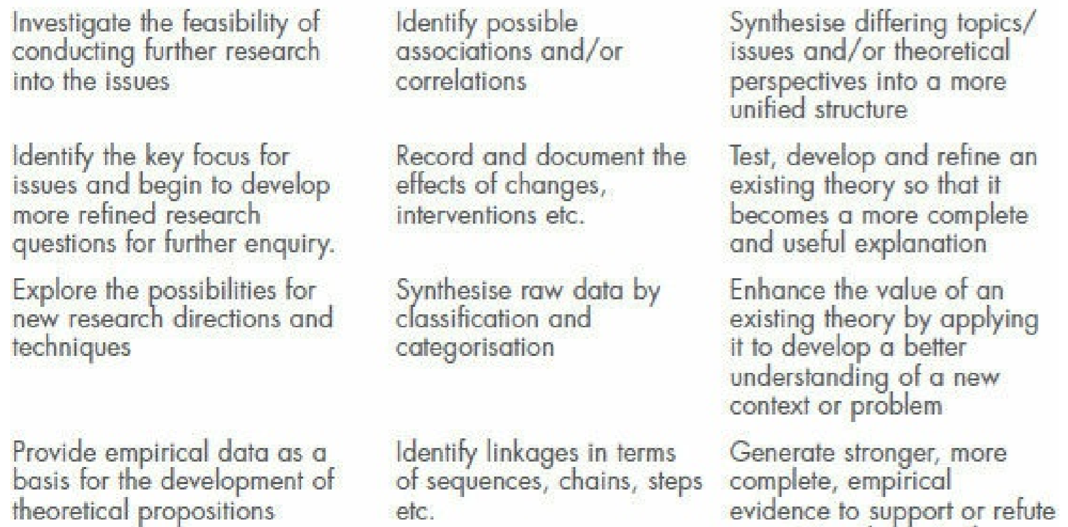

Slide 34
1.4.2 Pure and applied research
You will also find that the research methods literature will almost universally distinguish between pure, or basic, and applied research as two types of research with very different purposes
Blue sky thinking

Slide 35
1.4.3 Theoretical/empirical and primary/secondary research
Secondary research relies on data that already exist – in short, that contained in the literature relating to the issue in question – whereas primary research involves the collection of new data

Slide 36
1.5 The Main Research Approaches

Slide 37
1.5.1 Induction
This is an approach that essentially works by going from the unknown to the known. As Figure 1.1 illustrates, the starting point for an inductive approach to conducting research is the identification of the problem or question to be addressed.

Slide 38
In this respect it is synonymous with the deductive approach, but that is where the similarities end, as will become evident as we proceed to examine the two approaches. As the main purpose of induction is to build new theory, rather than test existing theory

Slide 39
Inductive research
Having collected the empirical data, the inductive researcher then has to make sense of it by analysing it for patterns, connections, relationships and so on in order to interpret its significance and produce meaningful explanations or theories.
Inductive research invariably involves the collection of qualitative rather than quantitative data
In this sense, inductive research is frequently seen as synonymous with qualitative research

Slide 40
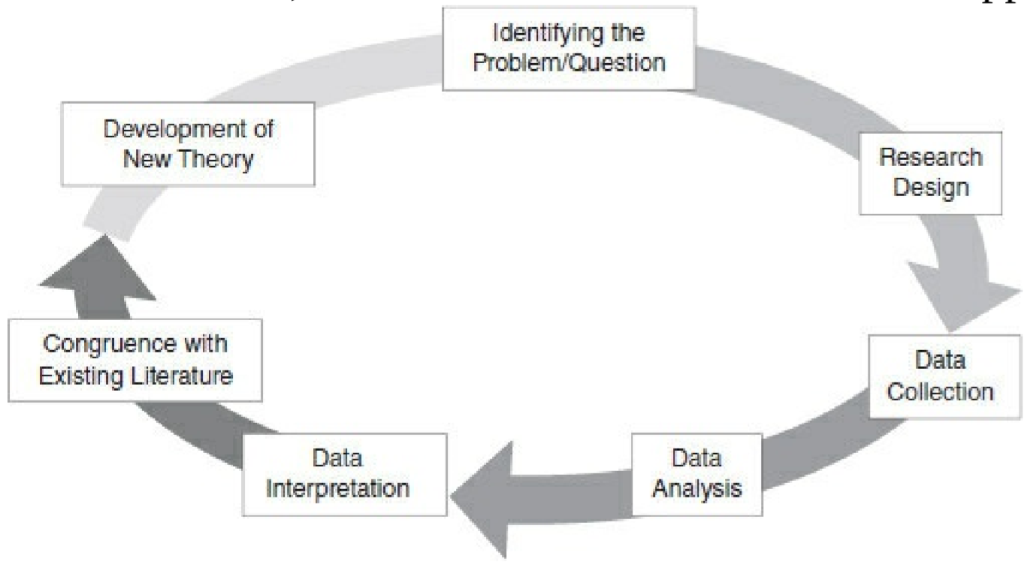
The inductive approach to research

Slide 41
1.5.2 Deduction
This is the approach to research adopted by archetypal scientists who believe that the world and knowledge are factual and objective. This is based on a set of beliefs known as positivism and we shall explore these beliefs and their implications further in Lecture 2, but as Figure 1.2 shows, this approach takes the existing body of theoretical and empirical knowledge as its primary starting point.

Slide 42
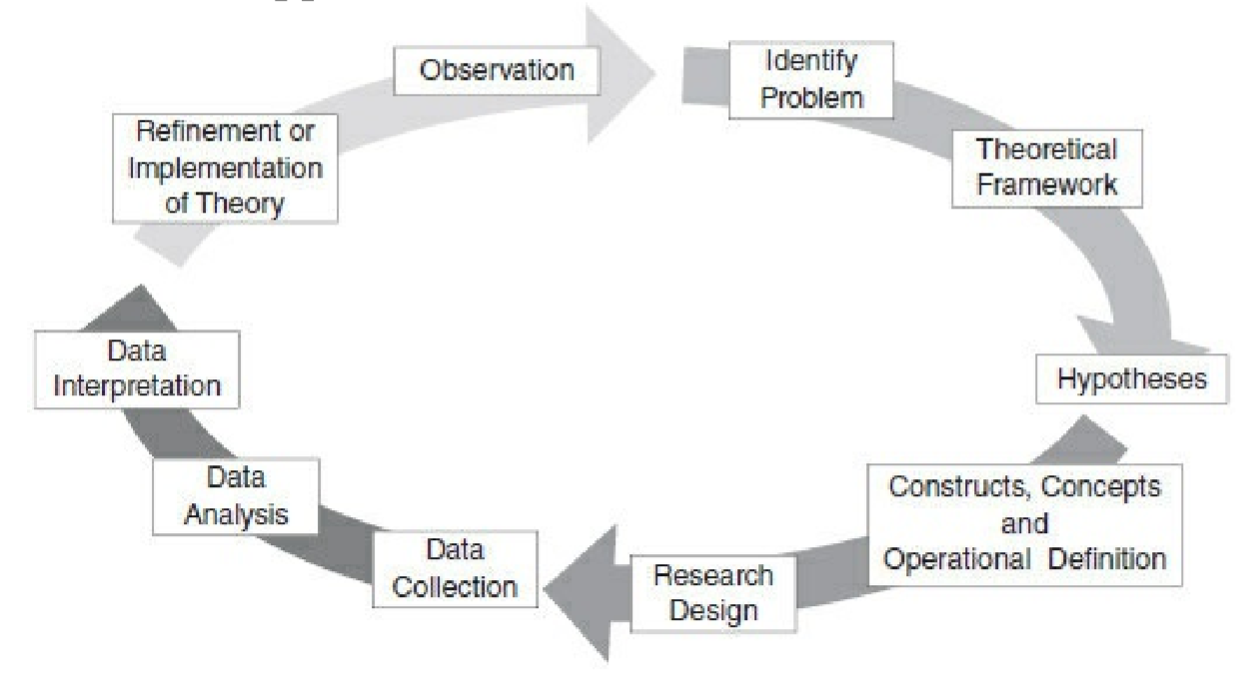
The deductive approach to research

Slide 43
Deduction vs Induction
So, deduction is concerned with testing existing theory, whereas, as we have seen, induction seeks to create new theory.
Once the literature has been reviewed, the deductive researcher will be in a position to develop the theoretical framework that informs and helps to structure and guide the remainder of the research process.

Slide 44
Deduction
At the end of the process, once the data have been analysed, the theory tested during this process will either be supported, or confirmed, by the evidence or it may require modification in the light of the evidence or, in extreme cases, it may need to be replaced by an entirely new theory.

Slide 45
1.6 Research Issues, Questions and Problems
Consider the following questions, which are probably the fairly typical issues such hospitality & tourism managers would be interested in:
How can we increase the level of satisfaction among the guests who stay in our hotel?
What would be the best types of location for our new, branded restaurant outlets?
How can we reduce the level of staff turnover?

Slide 46
Continuation of the questions’ list.
Which advertising media and methods would give us the greatest return for our expenditure?
What do we have to do in order to attract more visitors to this part of the country?
Why have fewer people visited our theme park this year than in previous years?
These all represent common practical issues and problems faced by hospitality or tourism businesses. At the same time, however, they all suggest a relationship between at least two things – a cause and an effect.

Slide 47
Lecture Summary

