Slide 1


南宁师范大学
Nanning Normal University
Department of tourism & culture
Visitor Attraction Experience
Ivan Monich, Ph.D.
Nanning, 2019

Slide 2
Review of the previous lecture content

Slide 3
Modern consumer society
Modernity can be explained through two dimensions: economic and cultural.
The economic aspect of modernity encompasses the industrialisation and the mass production era.

Slide 4
Postmodern society
The beginning of postmodern consumption was closely related to culture, which is not nature but humanly constructed. In opposition to the modem society that places economy and its norms of resource efficiency at the centre of the reflexion, the postmodern consumer society adopts a cultural position rather than a purely economic vision.

Slide 5
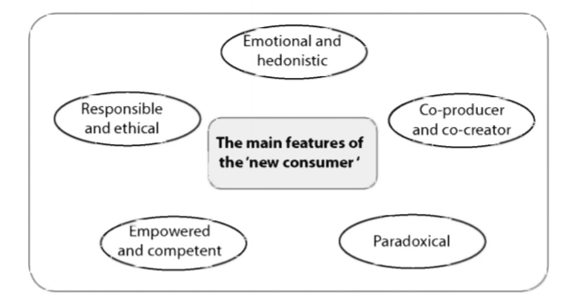

Slide 6
Lecture 2
The experiential approach
The second lecture will narrow down the framework by presenting the experiential theories. We start by addressing the limits of traditional marketing models, especially the rational side of consumers and their aim to maximise utility. From this critic can be understood the emergence of experiential theories that aimed to develop new models to explain consumption practices in specific areas such as culture, art, leisure and tourism. The principles and variables of this approach will be detailed and the evolution of this approach over the last three decades will be presented.

Slide 7
The framework
Lecture presents the experiential approach, looking at its foundations and the reason why this theory emerged. After explaining the limitations that some researchers identified with utilitarian approaches in understanding consumer behaviour, the chapter then explains the foundations of experiential marketing.

Slide 8
The framework and case-studies
This approach evolved has tremendously throughout the 1990s, especially with the emergence of the experience economy. The chapter also looks at the important role of emotions in understanding hedonic consumption and provides several examples that highlight different facets of the experience in various tourism contexts. Those examples include wildlife watching encounters, the Paris Syndrome, and the art of storytelling

Slide 9
After studying this lecture students should be able to:
Understand in which consumption contexts the traditional utilitarian approach encounters its limits.
Define the aims of the experiential approach and explain what it implies for marketers.
Appreciate the role of emotions in creating a memorable experience and understand how it can be managed to generate a worthy experience.
Understand the various senses involved in an experience and what might trigger them.
Comprehend the various steps involved in setting up an experience and be able to apply this knowledge to different experiential contexts.

Slide 10
What is consumer experience
The knowledge of consumer experience is very important in determining the success of destinations and products' marketing. Studying the experience implies analysing what an individual goes through during the pre-experience, experience and post-experience stages.
Decision-making processes, attitudes, emotions, experience and satisfaction and loyalty is necessary for understanding the consumer experience in tourism, hospitality and leisure (Crouch and Ritchie, 2005).

Slide 11
The limits of the utilitarian approach
The main criticism of the traditional and cognitive approaches lies with the fact that they mainly focus on a utilitarian logic. This logic has prevailed among marketing and consumer researchers who view the consumer as a rational economic actor: an idea that follows the 'homo economicus' philosophy. The cognitive and behaviourist models have indeed dominated the marketing research for decades (Cova and Cova, 2002).

Slide 12
In 1959, Levy had recognised that the evaluation of products could not be limited to their tangible attributes since they portrayed meanings to individuals beyond those tangible specificities: 'People buy things not only for what they can do, but also for what they mean' (p.118). Levy (1959) stated that products had personal and social meanings beyond their functional qualities
In 1980, Sheth criticised traditional consumer behaviour models for their conceptualisation of consumers as rational thinkers. This author suggested that such conceptualisation did not allow for a clear understanding of various unrational behaviours, such as compulsive behaviour and fashion purchases. Sheth (1980)

Slide 13
Aestheticism and hedonism
Baudrillard (1970) showed that consumption practices are represented as social activities, in which consumers produce meanings and exchange symbols. Thus, consumers do not consume products in order to satisfy a given biological human need, but rather in response to the meaning of these products and the image they reflect.
Taiwan (frontline staff)

Slide 14
Schmitt (1999) used the term 'traditional marketing' to refer to the cognitive approach, which views consumers as rational decision makers who care about functional features. For Schmitt, the concepts and methodologies of traditional marketing are organised according to three aspects: the nature of products, the behaviour of consumers and the competitive activity in the marketplace.

Slide 16
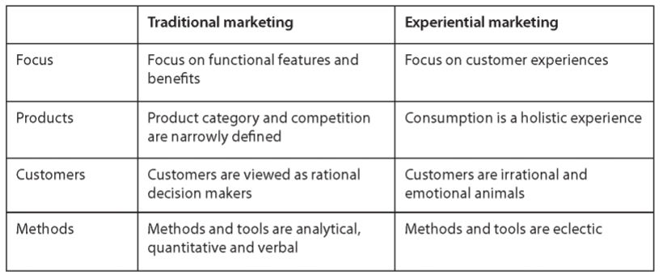
Traditional marketing versus experiential marketing

Slide 17
As a result, some authors have investigated the possibility of developing models that would rely more profoundly on emotional and symbolical consumption dimensions. In this new vision, Holbrook and Hirschman were pioneering researchers who brought a new perspective on consumer behaviour by introducing the experiential theory (1982a, b). This approach is particularly seductive in leisure and tourism consumption since hedonic, emotional and imaginary outcomes appear to have a central place in the understanding of tourist behaviour.

Slide 18
The experiential approach
The evaluation of products' utilitarian functions, portrayed by the information processing perspective, would need to be reconsidered by adding in the enjoyment and resulting pleasure feelings that the consumption of a product might bring.
These pleasurable aspects of consumption were portrayed as seeking 'fun, amusement, fantasy, arousal, sensory stimulation, and enjoyment' (Holbrook and Hirschman, 1982a, p. 134).

Slide 19
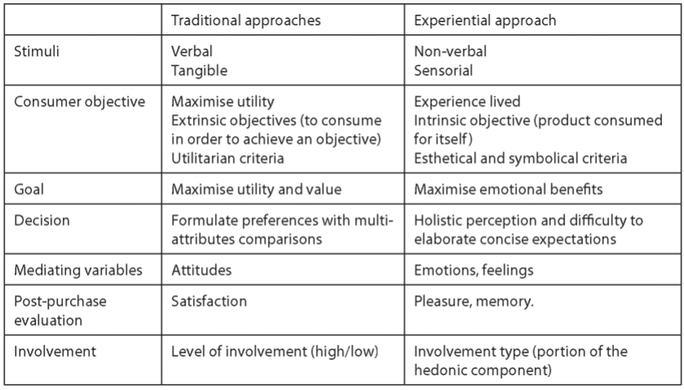
: Variables used in traditional approaches compared to experiential theories

Slide 20
Consumer experience
The Holbrook and Hirschman (1982a) vision of the consumer experience as a subjective and personal experience influenced later research in the consumption and tourism field and placed sensations and emotions at the heart of the consumption activity, whichis seen as an integral part ofthe consumer's questforidentity (Badot and Cova, 2003).

Slide 21
The impact of childhood experiences upon adult cultural consumption habits
In 2003, the French National Institute for Statistics and Economic Studies produced an interesting study on cultural consumption in the French population. Their results firstly indicated that the most influential variables lie with the level of education, then the social class, then age.
The impact of practice during childhood is essential: 83% of individuals who have a cultural practice at an adult age, were introduced to cultural activities during their childhood, and this is applicable to all cultural practices.

Slide 22
Recognition of the importance of emotions
Although the term emotions and affect have been used equivocally by some researchers, emotions are usually understood as subjective states experienced during product usage or consumption experiences, while affect refers to a 'class of mental phenomena uniquely characterised by a consciously experienced, subjective feeling state, commonly accompanying emotions and moods' (Westbrook, 1987, p.259). T

Slide 23
The concept of emotions can be defined as a two-dimensional construct: pleasure and arousal.
On one hand, pleasure measures the degree to which consumers feel happy, joyful or generally in a positive mood when envisaging a situation. On the other hand, arousal reflects to the way of a person feels active and stimulated (Bigne ef al., 2005).

Slide 24
What is emotion
Emotion is a complex mix of subjective and objective interactions, mediated by neural/ hormonal systems which
a) creates affective experiences such as feelings of arousal, pleasure and displeasure;
b) generates cognitive processes with emotionally related effects, appraisals and labelling processes;
c) activates physiological regulation to the arousing conditions; and
d) leads to behaviour that is often, but not always, expressive, goal- directed, and adaptive

Slide 25
The power of storytelling
Though storytelling has been the object of a lot of attention in recent years, it is an approach that has been used for many centuries and developed heavily by politicians and marketers alike. The idea behind storytelling is to reach the consumer through his emotions by using the strong emotional connections that stories provide.(Jobs and Apple)
The aim is, through narrating stories, to elicit emotions (rationality will only come in later to motivate the purchase) which should lead customers to be more receptive to the message conveyed.

Slide 26
The power of storytelling
For example, a hotel room could be described using a traditional communication mode: description of the location, standards of service and amenities.
A storytelling approach will aim to describe the place by explaining,for instance, whatthe visitor will see from the hotel room (describing the landscape and nearby sights) and what can be undertaken close by, for example a visit to a local farm that produces a memorable food product (it is even better ifthe owner is named personally, as a friend).
The narrative may also have suggestions for types of activities that can be undertaken nearby (for instance, if it is cycling, brief explanations of the type of roads available, degree of difficulty, etc.). T

Slide 27
The power of storytelling
In November 2012, Tourisme Quebec launched a storytelling strategy in France, New York and New Jersey markets. Their website displayed the videos of six couples through their holiday in Quebec. The couples were filmed on several occasions and described how they felt about different elements oftheir experience.

Slide 28
The power of storytelling: Home task
Traditional approach: Two rooms apartment located in the city center of Nanning inside the Nanning Normal University campus equipped with AC.
The story telling approach. The apartment is wonderful. It is located inside the lovely campus. There is an awesome view from the balcony to the local garden.
Please, use both approaches to describe your dormitory room. You have 10 minutes to write it down.

Slide 29
September 30, 2019

Slide 30
The evolution of the hedonic approach
Pine and Gilmore (1998) argue that companies or destinations, to achieve a competitive advantage towards their competitors, should produce experiences, a new category of offer that can be marketed to consumers. Experiences are seen as being internal to the consumer who engages with them on an emotional, physical, intellectual or even spiritual level.
Many examples exist of this shift and have been given different fashionable names such as edutainment, entertailing, eatertaining, shoppertainment, etc

Slide 31
Pine and Gilmore model
Pine and Gilmore differentiated experiences into four categories across to two spectra, which ranged from absorption to immersion and passive to active participation.
The first category, entertainment, groups experiences that involve absorption with passive participation. This category includes activities such as watching television, attending concerts, reading a book. The consumer is totally absorbed in his activity but his behaviour is rather passive, and there are not many connections with other individuals or the provider

Slide 32
The second category, educational, also includes absorption with the activity but the individual is more actively involved in the delivery. This could be the case of a class or a guided tour where the consumer listens to the information given, is absorbed by the activity but can actively contribute (he can ask questions, exchange information, work in groups, etc.).
The third category, escapist, describes occurrences where consumers are in immersion with the activity and active in its delivery. For instance, skiing, sky diving, roller coasters and aquaparks are all instances where the customers will learn or be entertained and will be fully immersed in his activity.

Slide 33
The last category, aesthetic, involves equal levels of immersion but in a more passive form. These experiences are also found in tourism consumption: watching Niagara Falls or observing Milford Sound in New Zealand are characteristic of those experiences.

Slide 34
The different steps of the experience
Following the experiential perspective, the consumer becomes an active economic actor involved within his consumption experiences. Furthermore, the role of companies is to assist their customers in the production and the achievement of their experiences

Slide 35
Key concepts of the experiential marketing approach
As proposed by O'Sullivan and Spangler (1998), the key concepts of the experiential marketing approach can be categorized as
(1) user involvement (physical, mental, emotional, social and spiritual)
(2) the users co-participation in the product's offer
(3) the relevance of the product's or service's symbolic values
(4) the product's or service's multi-functionality and
(5) the centrality of experience in consumption.

Slide 36
Pine and Gilmore identified five key experience design principles:
Theming which will help to organize the impressions consumers encounter when in the premises of the provider. The objective here is to unify the different elements provided around a coherent story-line
Harmonize impressions with positive cues: it is important to produce indelible impressions that consumers can take away with them and that will help to fulfil the theme.

Slide 37
Pine and Gilmore identified five key experience design principles:
Eliminate negative cues eliminate anything that detract or diminishes the quality of the experience
Mix in memorabilia: items that visitors can purchase as a reminder of the experience
Engage all five senses: the more senses an experience will engage, the more memorable it will be for the consumers.

Slide 38
Amould and Price (1993) have divided the consumption experience into four major stages:
The pre-consumption experience, which involves searching for, planning, day-dreaming about, foreseeing or imagining the experience;
The purchase experience which derives from choice, payment, packaging, the encounter with the service and the environment;
The core consumption experience including the sensation, the satiety, the satisfaction/dissatisfaction, the irritation or flow, the transformation;

Slide 39
Amould and Price (1993) have divided the consumption experience into four major stages:
The remembered consumption experience and the nostalgia experience activates photographs to re-live a past experience, which is based on accounts of stories and on discussions with friends about the past, and which moves towards the classification of memories.

Slide 40
Conclusion
The experiential approach has developed well beyond its original aim of investigating emotionally laden experiences, such as those encountered in the art, leisure and tourism contexts.
For tourism researchers, it is an approach that unifies more mainstream marketing theories to the works conducted for decades by tourism sociologists and behaviourists.

