Slide 1
南宁师范大学
Nanning Normal University
Department of tourism & culture
Marketing for Tourism, Hospitality and Events
Ivan Monich, Ph.D.
Nanning, 2019

Slide 2
Previous lecture content

Slide 3
Content
1 Marketing dynamics
2 The European marketing environment
3 Buyer behaviour
4 Segmenting markets
5 Marketing information and research
6 Product
7 Price

Slide 4
Content
8 Place
9 Promotion: integrated marketing communication
10 Promotion: advertising and sales promotion
11 Promotion: direct and digital marketing
12 Promotion: personal selling, PR and sponsorship
13 Marketing strategy and planning
14 Services and non-proﬁt marketing

Slide 5
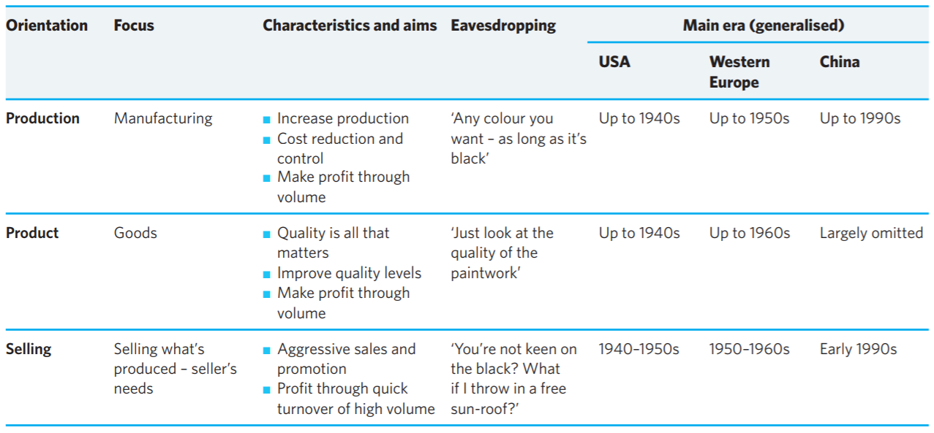


Slide 6
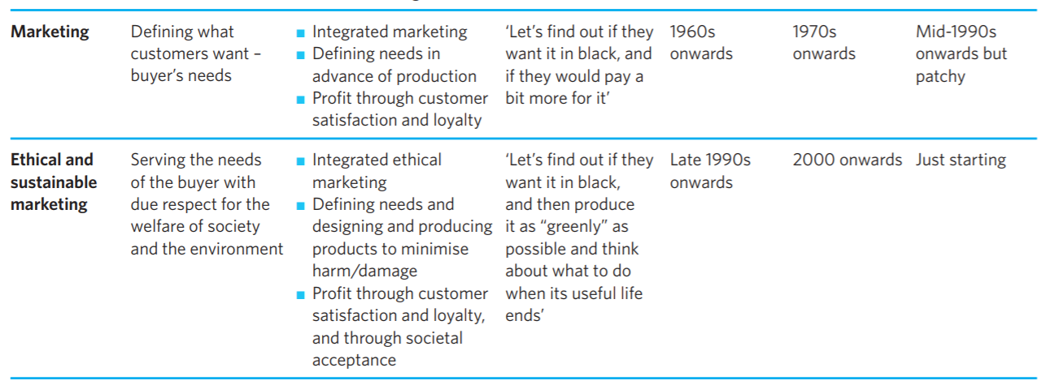

Slide 7
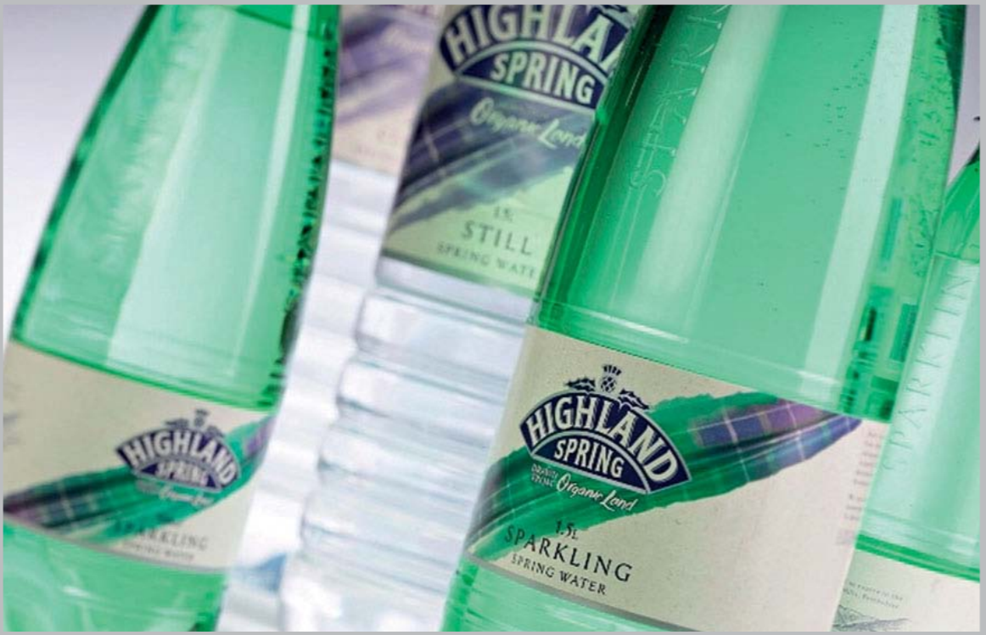
Water is an essential part of a healthy diet. Page 2 of the main textbook

Slide 8
Lecture 02

Slide 9
Emergent marketing philosophies
The marketing concept and the philosophy of a marketing orientation continue to evolve. In increasingly competitive global markets consisting of increasingly demanding customers, organisations are continually striving to find more effective ways of attracting and retaining customers, and sometimes that could mean refining further exactly what marketing means.

Slide 10
Corporate social responsibility: societal and ethical marketing
Corporate social responsibility (CSR) suggests that organisations should not only consider their customers and their profitability, but also the good of the wider communities, local and global, within which they exist. As Smith and Higgins (2000) put it, consumers now are not only looking for environmentally sensitive and ethically considerate products, but also for businesses to demonstrate a wider set of ethical commitments to society

Slide 11
The European Commission’s definition of CSR is:
The voluntary integration of social and environmental concerns in to business operations and in to their interaction with stakeholders. (European Commission, 2010)
Marketing within a CSR context is concerned with ensuring that organisations handle marketing responsibly, and in a way that contributes to the well-being of society.

Slide 12
Marketing within a CSR context
Of course, its not just about marketing as CSR has a wider impact on the workforce, community relations and the accountability of an organisation (Vilanova et al., 2009). It needs to develop programmes and policies that highlight and measure social and environmental performance, while engaging with various stakeholders during this process (Pearce and Doh, 2005).
CSR is rapidly changing from being a ‘would like’ to a ‘must have’ feature of business.

Slide 13
Ikea – a CSR strategy that’s anything but flat-packed
Ikea is a well respected international retailer operating over 300 stores in 37 countries. Swedish companies, in general, have a very good reputation for high ethical standards and green marketing. Ikea is no exception and has interpreted its corporate values into a series of themes.
Pages 14-16 of the main textbook.

Slide 14
Consumers behaving badly?
While we are all so busy demanding that organisations take their CSR seriously, it is perhaps easy to forget that responsibilities and obligations of ‘good citizenship’ extend to us as consumers as well. Don’t organisations also have the right to ask just how ethical their customers are? Babakus et al. (2004)
Respondents tended to regard behaviours such as ‘taking towels from hotels and blankets from aircraft as souvenirs’ as far less wrong than ‘drinking a can of soda in a supermarket and not buying it’.

Slide 15
Why sustainability is IKEA's growth - Peter Agnefjäll, CEO, IKEA Group
"Our business case, I would say, is very good. We’ve decided to grow but we have decided to grow within the limits of the planet.
Please, open the file IKEA.PDF from WeChat group. The case-study title is “Ikea – a CSR strategy that’s anything but flat-packed”

Slide 16
Home task. Deadline is October 08,2019
Please, write down one of the descriptions of the IKEA’s corporate values. Strengthen it with your own opinion.
People and the environment
Products and materials
Climate change
Code of conduct
Working conditions
Social initiatives
Use the IKEA.PDF from WeChat group. The case-study title is “Ikea – a CSR strategy that’s anything but flat-packed”

Slide 17

IKEA Sustainable living

Slide 18

The IKEA Group - The Story of How We Work

Slide 19
Towards ‘sustainable marketing’
Inextricably tied in with the concept and best practice of CSR in its widest sense is the idea of sustainable development.
Sustainability was defined in the Brundtland Report of 1987 as:
development that meets the needs of the present without compromising the ability of future generations to meet their own needs. (WCED, 1987)

Slide 20
Sustainability
Sustainability is not just concerned with environmental and ecological issues, as important as these are, but also with the social, economic and cultural development of society.
The wider ‘softer agenda’ includes, therefore, the fair distribution of economic benefits, human rights, community involvement and product responsibility. This has to be taken seriously by business.

Slide 21
Sustainable Marketing
The term ‘sustainable marketing’ came to the fore when Sheth and Parvatiyar (1995) discussed marketing efforts that were both competitively sound and environmentally sustainable. It is now accepted that it is ethically wrong for individuals and firms to pollute and destroy the ecological stability of the planet, reducing the opportunities for tomorrow’s consumers (García-Rosell and Moisander, 2008).

Slide 22
Sustainable Marketing?!
This sounds very idealistic: in a competitive world in which the customer is free to choose and, moreover, in which business operates on the principle of meeting customers’ needs and wants, it sometimes requires courage for a business
In short, consumers today, whatever the market imperative, cannot be allowed to destroy the opportunities for society tomorrow by taking out more than is being put back in. This not only embraces environmental and ecological issues but also the social and cultural consequences of a consumer society that equates ‘more’ with ‘better’.s to change those principles

Slide 23
Definition of Sustainable Marketing
We, therefore, would like to define sustainable marketing as:
The establishment, maintenance and enhancement of customer relationships so that the objectives of the parties involved are met without compromising the ability of future generations to achieve their own objectives.

Slide 24
How Sustainable Marketing works?
How does all this impact on the marketing process? The internalisation of costs (making the polluters pay), green taxes, legislation, support for cleaner technology, redesigned products to minimise resources and waste streams, reverse distribution channels to receive products for recycling and consumer education on sustainability are all an essential part of a new marketing agenda for the twenty-first century. To some it is not a choice, but a mandate that cannot be ignored

Slide 25
How it worked before
The old adage ‘reduce, recycle and reuse’, for example, has influenced the type of packaging materials used to ensure recyclability. Clothing manufacturers have produced plastic outdoor clothing that can be recycled; glue manufacturers have reduced the toxic emissions from their products; car manufacturers, in accordance with the EU’s End-ofLife Vehicle Directive, now have to consider the recycling or other means of disposal of old cars.

Slide 26
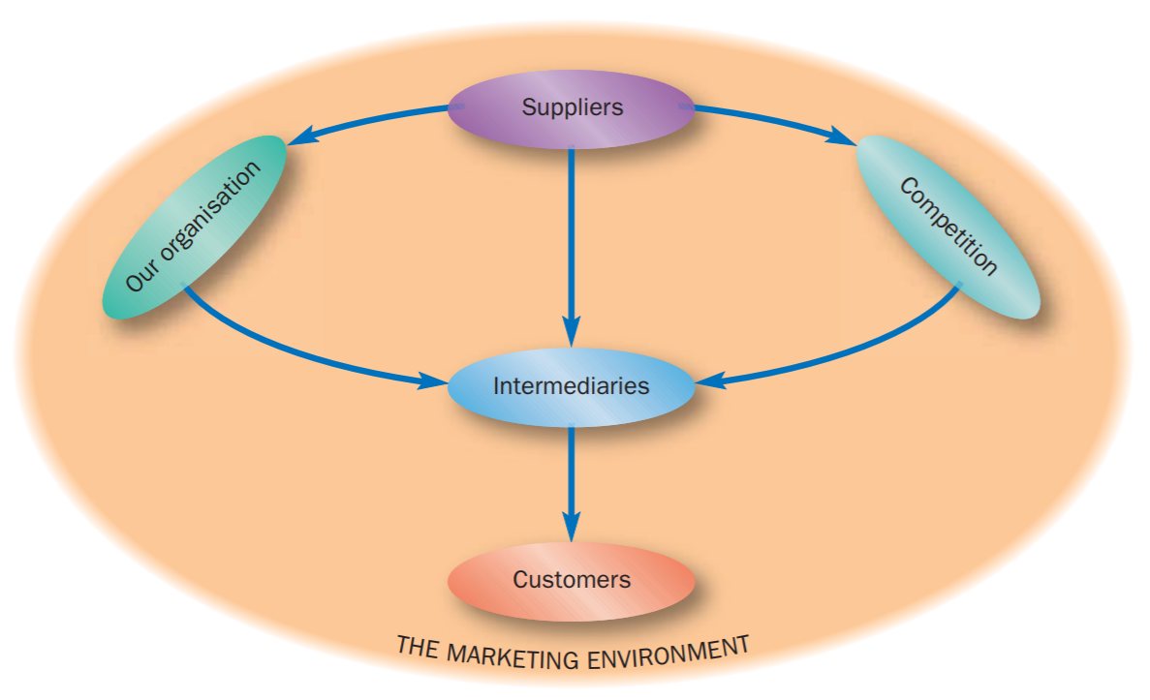
Marketing environment
The external organisational environment

Slide 27
The internal organisational environment
Finance. The finance function, for example, sets budgets, perhaps early in the financial year, and expects other functions to stick to them
Purchasing. A focus on economical purchase quantities, standardisation and the price of materials, along with the desire to purchase as infrequently as possible, can all reduce the flexibility and responsiveness of the organisation
Production
Research and development and engineering

Slide 28
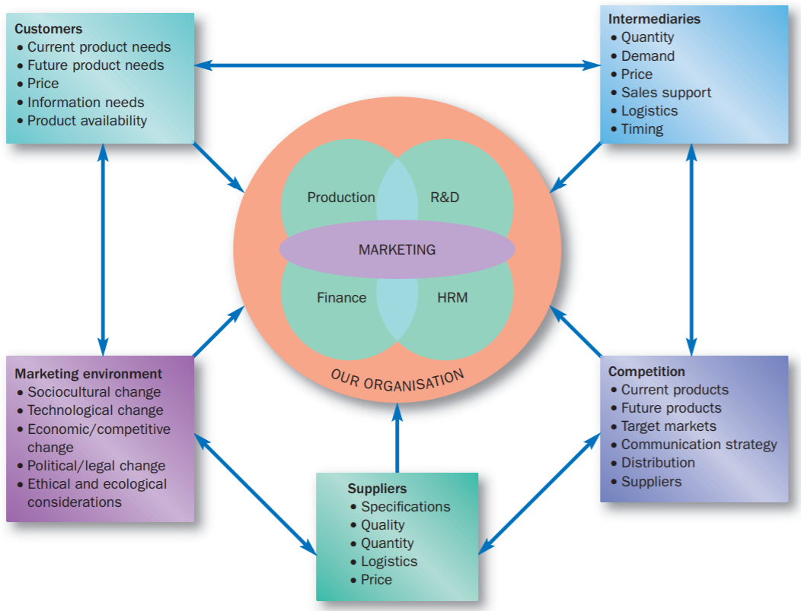
Marketing as an integrative business function

Slide 29
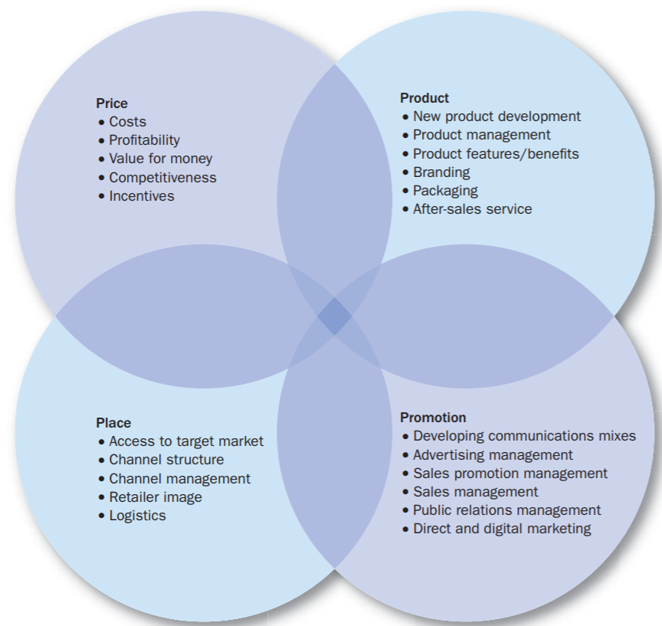

Slide 30
7Ps of Marketing
In the services sector in particular, they cannot fully describe the marketing activities that are going on, and so an extended marketing mix, the 7Ps, was proposed by Booms and Bitner (1981), adding people, processes and physical evidence to the traditional 4Ps.

Slide 31
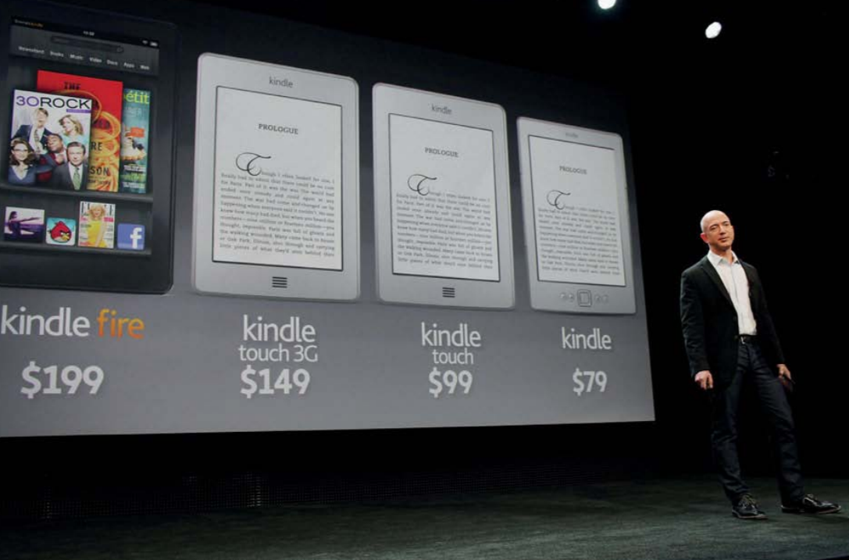
Case study 1. Devices & Desires

Slide 32
Kindle E-Reader

Slide 33
Case Study questions:
1 If a publisher was to ask you, ‘What business are we in?’, how might you respond?
2 Why do you think the Kindle has been so successful? Discuss this with reference to its marketing mix.
3 Printed books have been around for centuries. It could be argued that they have served their purpose very well and that readers are perfectly satisfied with printed books as a means of knowledge transfer and as a source of personal emotional fulfilment. To what extent, therefore, can you argue that the development of the e-reader and the e-book is a marketing rather than a product oriented business philosophy?
4 Is the traditional, independent bookshop dead?

Slide 34
Lecture 03

Slide 35
The European marketing environment
LEARNING OBJECTIVES, this lecture will help you to:
understand the importance of the external environment to marketing decision making;
assess the role and importance of scanning the environment as a means of early identification of opportunities and threats;
appreciate the evolving and diverse nature of the European marketing environment;
define the broad categories of factors that affect the marketing environment; and
understand the influences at work within each of those categories and their implications for marketing.

Slide 36
Environment
Although the environment consists of a wide variety of factors and influences, it is possible to group them under seven broad headings: sociocultural, technological, economic, ethical, political, legal and ecological, thus making the acronym STEEPLE.

Slide 37
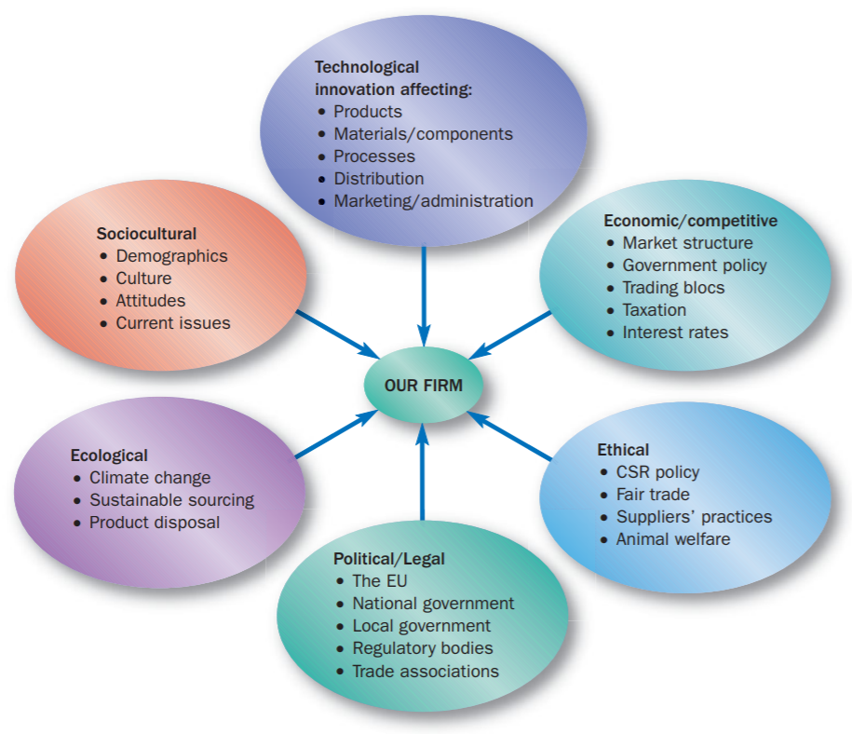

Slide 38
Consumerism and consumer forces
In the UK, Which? (formerly the Consumers’ Association) has long campaigned for legislation to protect consumers’ rights, such as the right to safe products and the right to full and accurate information about the products we buy. As well as lobbying government and organisations about specific issues, Which? also provides independent information to consumers, testing and comparing the features, performance and value for money of competing goods and services in various categories. In a similar vein, specialist websites and magazines, in fields such as computing and hi-fi, also undertake comparative testing of products of interest to their readership.

Slide 39
Consumers have also been encouraged to think about their personal health as well as that of the planet. Sometimes sponsored by government (for example through the UK government’s Department of Health) and sometimes through independent groups with a specific interest such as Action on Smoking and Health (ASH) or the British Heart Foundation, the public are urged to change their lifestyles and diets. Once it is generally known and accepted that too much of this, that or the other is unhealthy, food manufacturers are anxious to jump on the bandwagon and provide products to suit the emerging demand.

Slide 40
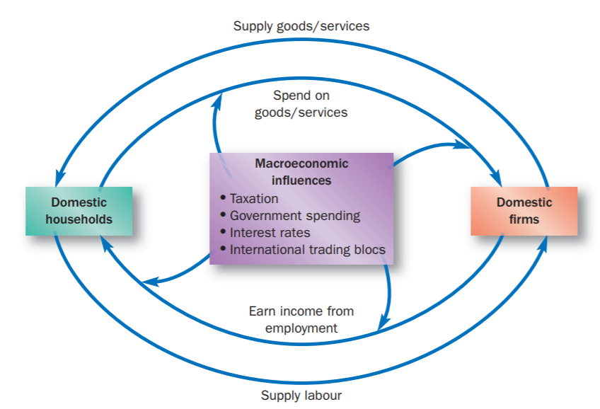

Slide 42


The power of storytelling
In November 2012, Tourisme Quebec launched a storytelling strategy in France, New York and New Jersey markets. Their website displayed the videos of six couples through their holiday in Quebec. The couples were filmed on several occasions and described how they felt about different elements oftheir experience.

Slide 43
The power of storytelling
Traditional approach: Two rooms apartment located in the city center of Nanning inside the Nanning Normal University campus equipped with AC.
The story telling approach. The apartment is wonderful. It is located inside the lovely campus. There is an awesome view from the balcony to the local garden.
Please, use both approaches to describe your dormitory room. You have 10 minutes to write it down.

Slide 44
Huawei Mate 30 series’ Story
Berlin: September 2019

