Slide 1
南宁师范大学
Nanning Normal University
Department of tourism & culture
Marketing for Tourism, Hospitality and Events
Ivan Monich, Ph.D.
Nanning, 2019

Slide 2

Relax and read the marketing related news:

Slide 3

2019 China Cup to take place in Nanning in March
Goal
NANNING, China, Feb. 26 (Xinhua) -- The 2019 GREE China Cup International Football Championship will be held from March 21 to 25 in Nanning, capital city of South China's Guangxi Zhuang Autonomous Region.
The four-team tournament will feature national teams from Uruguay, Uzbekistan, Thailand and hosts China.

Slide 4
"The China Cup is a great platform for China to play against top class teams, which will be good preparation for the 2022 FIFA World Cup Qualifiers later this year", said Qi Jun, vice secretary-general of the Chinese Football Association (CFA).
First run in 2017, the China Cup is an A-grade international event acknowledged by football's world governing body FIFA. Star players such as Gareth Bale and Luis Suarez have taken part in previous editions of the tournament.

Slide 5
China will face Thailand in the tournament's opening match on March 21, and Uruguay will meet Uzbekistan the following day. The winners of the first two games will progress to the final on March 25.

Slide 6


Slide 7

Semifinal highlights
Uruguay 3 : 1 Uzbekistan

Slide 8
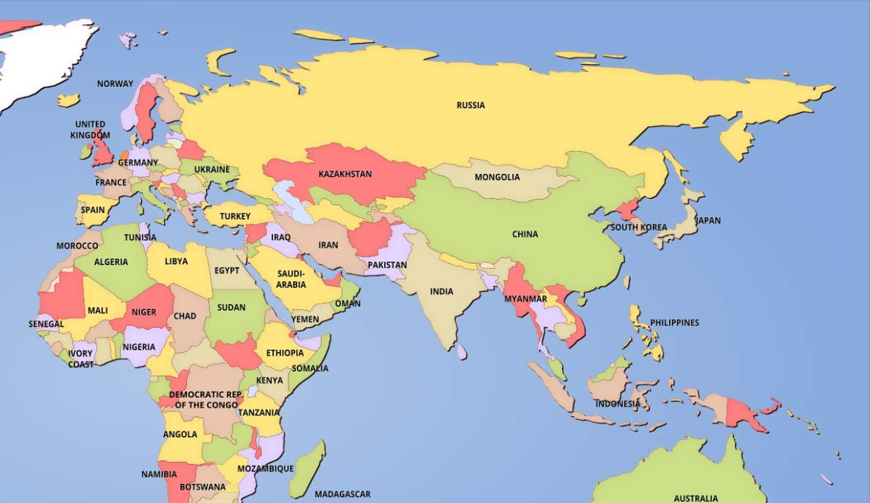

European women’s boxing championship

Slide 9
Summary of the previous lecture
This lecture has explored the importance of the external marketing environment as an influence on the way in which organisations do business and make their decisions. Ways in which customers, markets, competitors, technology and regulation are changing are all important pointers to future strategy

Slide 10
Summary of the previous lecture
The main framework for the chapter is the categorisation of the marketing environment into STEEPLE factors: sociocultural, technological, economic, ethical, political and legal, and ecological.

Slide 11
Summary of the previous lecture
The economic environment constitutes the third STEEPLE factor, and can be further divided into macro- and microeconomic environments. The macroeconomic environment analyses the effects of the broader economic picture, looking at issues such as taxation, government spending and interest rates. It also takes account of the threats, opportunities and barriers arising from membership of international trading blocs. The microeconomic environment is a little closer to the individual organisation, and is concerned with the structure of the market(s) in which it operates.

Slide 12
Summary of the previous lecture
The political and legal environments give us the fifth and sixth STEEPLE factors. Laws, regulations and codes of practice emanate from national governments, the EU, local government, statutory bodies and trade associations to affect the way in which organisations do business.
Consumer groups and other pressure groups, such as those representing the ecological movement, health issues and animal rights, are active in trying to persuade government to deregulate or legislate, or to influence the scope and content of new legislation

Slide 13
Summary of the previous lecture
The final STEEPLE factor is the ecological environment, reflecting a growing concern about the natural environment and the impact of consumerism upon it. Organisations need to consider, for example, how they can reduce their carbon footprints and continue to satisfy consumer needs and wants more sustainably.

Slide 14
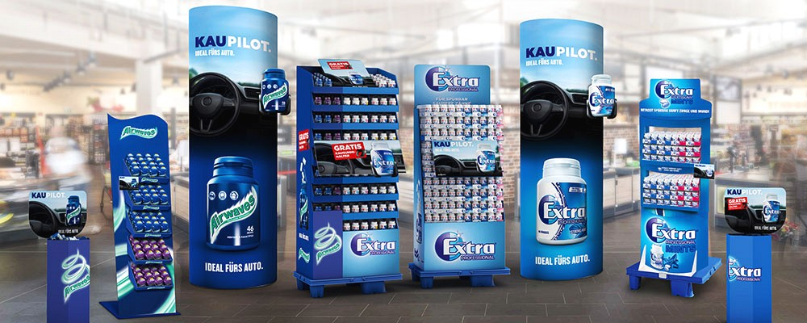
Case study 02, page 75
GOT ANY GUM, CHUM?
Wrigley’s has a dominant position in the global chewing gum market with annual sales of over $22 billion with sales in 180 countries.

Slide 15

The Founding of a Chewing Gum Empire: Wrigley and His Freebies

Slide 16

BUBBLEGUM | How It's Made

Slide 17
Questions
1 Summarise the ways in which STEEPLE factors affected the UK gum market in 2007.
2 Thinking about the microeconomic environment in particular (p. 58 et seq.), how would you describe the market structure (a) before Trident’s entry, and (b) in 2010? Why do you think the market structure has evolved in that way?
3 Why do you think that Cadbury was initially so successful in competing against the market leader, Wrigley’s, with the Trident launch?
4 Which factors should manufacturers pay particular attention to today, in order to achieve a strong and sustainable position in this market? Why?

Slide 18



Slide 19
Lecture 05
Buyer behaviour
LEARNING OBJECTIVES. This lecture will help you to:
understand the decision-making processes that consumers go through as they make a purchase;
appreciate how those processes differ between different buying situations;
understand the influences that affect decision-making, whether environmental, psychological or sociocultural and the implications of those processes and influences for marketing strategies;
understand the nature and structure of B2B buying and the differences between B2B and consumer buying; and
analyse the B2B buying process and the factors that influence the outcomes

Slide 20
INTRODUCTION
IN CONTRAST TO topic 2, which looked at the broad backdrop against which marketers have to do business, this lecture focuses closely on consumers and B2B customers who are at the centre of many a marketer’s universe. It is very important to understand the more personal and specific influences affecting those customers and the nature of the decision-making processes through which they go.

Slide 21
This lecture, therefore, begins by looking at consumers as buyers and analysing the factors, both internal and external, that determine how and why they make their choices.
The later part of the lecture examines B2B buyer behaviour. Having considered some of the differences between consumers and B2B customers in terms of how and why they purchase goods and services, we shall then analyse the B2B buying process and the pressures that shape the decisions that are made within an organisational market.

Slide 22
The consumer decision-making process
Figure 3.1 - The consumer buying decision-making process and its influencing factors - offers a deceptively simple model of buyer behaviour presented as a logical flow of activities, working through from problem recognition to purchase to post-purchase evaluation. This section of this lecture deals with this core process.

Slide 23
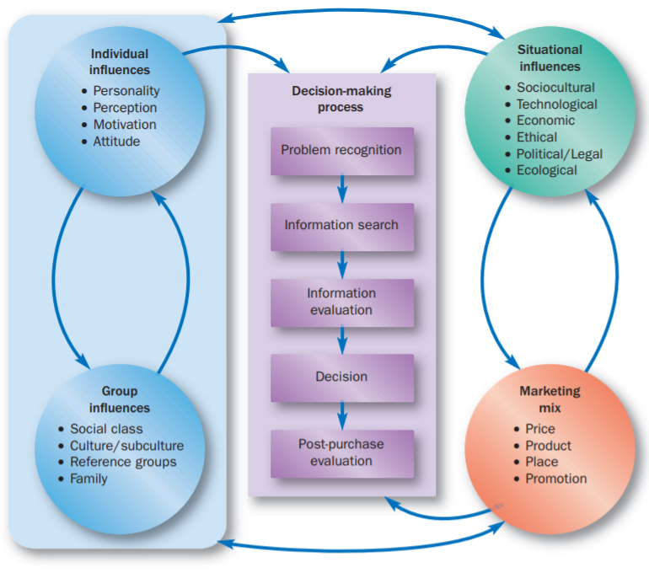

Slide 24
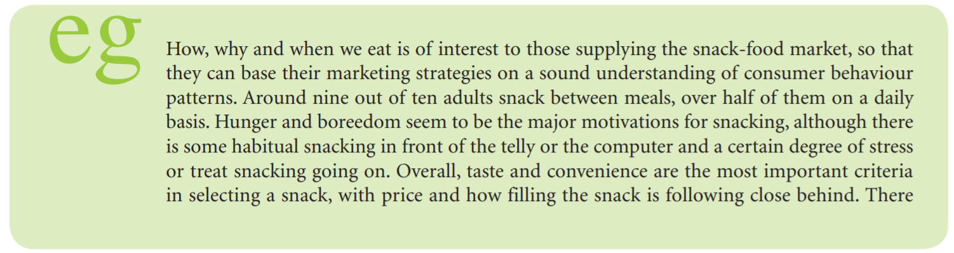
How, why and when we eat is of interest to those supplying the snack-food market p. 82

Slide 25
Decision-making models
There have been many attempts to create models of consumer decision-making of greater or lesser complexity and detail that try to capture the richness of the experience.
The Engel, Blackwell and Miniard (1990) model presented here, although concise and simple in its outline, provides a framework that still allows us to consider, through discussion, many of the more complex elements. It traces the progress of a purchasing event stage by stage from the buyer’s point of view, including the definition of likely information needs and consideration of the level of rationality and analytical behaviour leading to the eventual decision.
We now look at each stage in turn. look at each stage in turn.

Slide 26
Problem recognition
In trying to rationalise the decision-making process, this is a good place to begin. After all, if you are not aware that you have a ‘problem’, how can you decide to purchase something to solve it?

Slide 27
Where psychological needs are involved, however, the problem recognition may be a slow dawning or may lead to a sudden impulse, when the consumer, realising that the current position or feeling is not the desired one, decides to do something to change it through a purchase (Bruner and Pomazal, 1988).
Imagine, for instance, that you are wandering round the supermarket after a tough day at work. You’re tired, listless and a bit depressed. You’ve filled your trolley with the potatoes, bread and milk you intended to buy, but you also slip a bar of chocolate (or worse!) in there on the basis that it will cheer you up as you drive home. The ‘problem’ here is less definable, based on a vague psychological feeling, and it follows that the solution is also less definable – it could be chocolate, cream buns, wine or clothing, whatever takes the purchaser’s fancy

Slide 28
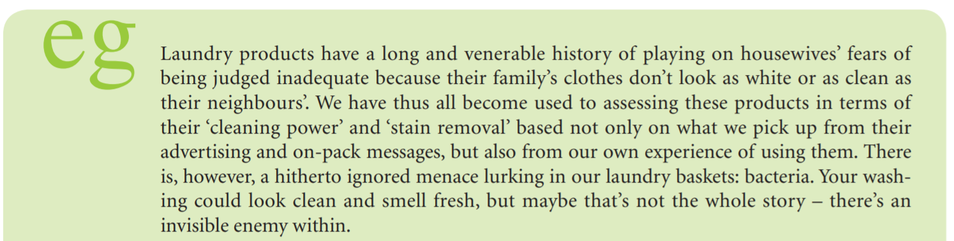
Example from the 84th page
Laundry products have a long and venerable history of playing on housewives’ fears of being judged inadequate because their family’s clothes don’t look as white or as clean as their neighbours’.

Slide 29
There is, of course, a significant difference between being aware of a need or problem and being able to do something about it.
Many needs are latent and remain unfulfilled, either because consumers decide not to do anything about it now, or because they are unable to do anything.
We might all feel the need for a three-week holiday in some exotic part of the world, but we must not only be willing, but also financially able.
Problem recognition, if it is to lead anywhere, therefore requires both the willingness and the ability to fulfil the emerging need.

Slide 30
Information search
Defining the problem is one thing, but defining and implementing the solution is something else. The questions to be answered include what kind of purchase will solve the problem, where and how it can be obtained, what information is needed to arrive at a decision and where that information is available.
In some cases, consumers will actively search out relevant information with a view to using it in making a decision, but they can also acquire information passively, storing it away until it is needed.

Slide 31
Information search
Not all external sources of information are controlled by the marketer – don’t forget the power of word of mouth as a marketing tool. Friends, family and colleagues, for example, may all give advice, whether based on experience, knowledge or opinion, to the would-be decision maker in this phase. People are more likely to trust information given through word of mouth

Slide 32
Information search
In other situations, the consumer might seek out information from the internet, specialist publications, retailers or even from marketing literature.
For example, when buying a car, potential buyers will probably visit competing dealerships to talk to sales staff, look closely at the merchandise and collect brochures.

Slide 33
Information search
Hauser et al. (1993) emphasise the fact that time pressure can interfere with the information search. They found that consumers spend less time searching for different sources as pressure increases. At the other end of the spectrum, however, information overload may cause problems for the potential purchaser. There is evidence to suggest that consumers cannot cope with too much information at product level (Keller and Staelin, 1987).

Slide 34
Information search
Thus the greater the relevance of the information to consumers, such as the key benefits and applications of the product, the easier it is for them to assimilate and process that information as part of their decisionmaking. In other words, better and more extensive information may actually lead to poorer buying decisions!

Slide 35
Information evaluation
To make the decision easier, the consumer often adopts mental ‘rules of thumb’ that cut corners and lead to a faster decision. The consumer is especially prepared to compromise on the quality and thoroughness of assessment when the problem-solving situation is less risky and complicated. They may focus on brand, store choice, pricing, promotion or packaging, and will serve to limit the size of the evoked set and to eliminate some of the options.

Slide 36
Decision
The decision may be a natural outcome of the evaluation stage, if one of the options is noticeably more impressive on all the important criteria than the rest. If the choice is not as clear cut as this, the consumer may have to prioritise the criteria further, perhaps deciding that price or convenience is the one overriding factor. In the car exhaust example, the decision-making is a conscious act, whereas with the impulse purchase of chocolate, the decision may be made almost unconsciously.

Slide 37
Decision
In any case, at this stage the consumer must finalise the proposed deal, and this may take place in a retail store, over the telephone, by mail or in the consumer’s own home.
In the supermarket, finalising the deal may be as simple as putting the bar of chocolate into the trolley with the rest of the shopping and then paying for it at the checkout.

Slide 38
Decision
With more complex purchases, however, the consumer may have the discretion to negotiate the fine details of cash or credit, any trade-in, order quantity and delivery dates, for example. If the outcome of the negotiation is not satisfactory, then the consumer may regretfully decide not to go ahead with the purchase after all, or rethink the decision in favour of another supplier – you cannot be certain of your customer until they have either handed over their money or signed the contract!

Slide 39
Decision
Suppliers, of course, can make it easy or difficult for potential customers to make their purchases. Lack of sales assistants on the shopfloor, long queues or bureaucratic purchasing procedures may all tax the patience of consumers, giving them time either to decide to shop elsewhere or not to bother buying at all. Even if they do persist and make the purchase (eventually), their impression of the supplier’s service and efficiency is going to be damaged and this may influence their repeat purchasing behaviour negatively.

Slide 40
Vending machines, page 87th
Open the book – read the case-study
1. Please, think about the popularity of such vending machine in
南宁师范大学明秀东路校区？
Nanning?(Subway)
Shanghai?(Venus+)
Hong kong? (Greta+)
Owen,Bernie,Prince, Ann, Amber, Rosanna,
2.Define the requirements for the successful coffee machine vending business via 4’P’s of Marketing mix: Price, Place, Promotion and Product.

Slide 41
Vending machines, page 87th
Open the book – read the case-study
2.Define the requirements for the successful coffee machine vending business via 4’P’s of Marketing mix: Price (Iris+)(Joker+, vicky), Place (lilly+, Rita+), Promotion and Product (Crystal+),Lucky+-, Joy+, Draco+-, Eelena-+, Rebekah+.
Izzy,Greica, Stephanie, Katherine, Belinda (he is here), carr, Bill, Stone, Alissa, Phoenix, Yuki,

Slide 42

Vending machines

Slide 43

Vending machines

Slide 44
Post-purchase evaluation
The consumer’s involvement with the product does not finish when cash changes hands, nor should the marketer’s involvement with the consumer.

Slide 45
Post-purchase evaluation
Thus the post-purchase evaluation stage is important for a number of reasons. Primarily, it will affect whether the consumer ever buys this product again. If expectations have not been met, then the product may not even make the shortlist next time. If, on the other hand, expectations have been met or even exceeded, then a strong possibility of lasting loyalty has been created. The next shortlist may be a shortlist of one!
Monitoring of post-purchase feelings is an important task of marketing

Slide 46
There are some points to note about the process as presented here.
First, the consumer may choose to end the process at any stage. Perhaps the information search reveals that there is no obvious acceptable solution to the problem, or the information evaluation demonstrates that the cost of solving the problem is too high.

Slide 47
It is, of course, the marketer’s job to sustain the consumer’s interest throughout this process and to prevent them from opting out of it. Second, the process does not necessarily have to run from stage 1 to stage 5 in an unbroken flow. The consumer may backtrack at any point to an earlier stage and reiterate the process.

Slide 48
Finally, the time taken over the process may vary enormously, depending on the nature of the purchase and the nature of the purchaser. Many months of agonising may go into making an expensive, important purchase, while only a few seconds may be invested in choosing a bar of chocolate.
The next section looks more closely at this issue.

Slide 49
Buying situations
In the discussion of the decision-making process, it has been made clear that both the flow and the formality of the process, and the emphasis that is put on each stage, will vary from situation to situation. Some of these variations are to do with the particular environment relevant to the transaction

Slide 50
Buying situations
As the heading of this section implies, a routine problem solving purchasing situation is one that the consumer is likely to experience on a regular basis.
Most grocery shopping falls into this category, where particular brands are purchased habitually without recourse to any lengthy decision-making process.

Slide 51
Buying situations
As with the chocolate-buying example above, there is virtually no information search and evaluation, and the buying decision is made simultaneously with (if not in advance of) the problem recognition stage. This explains why many manufacturers spend so much time and effort trying to generate such loyalty and why it is so difficult for new products to break into an established market.

Slide 52
Buying situations
When the consumer thinks ‘We’ve run out of Colgate’ rather than ‘We’ve run out of toothpaste’, or when beans really do mean Heinz, then the competition has an uphill marketing task on its hands.

Slide 53
Buying situations
Some other products may be purchased as the result of a sudden impulse.
The impulse may be triggered, as mentioned in the previous section, by a realisation of need (‘I’m depressed and this chocolate is just what I need to cheer me up’), or by external stimuli, for example eye-catching packaging attracting the shopper’s attention.
For example:

Slide 54

Famous singer & actor

Slide 55

Liu Wen
Famous top model

Slide 56
The trigger need not even be inside the store: the smell of coffee or freshly baked bread wafting into the street may draw a customer into a café on impulse, or an attractive shop window display may attract a potential customer into a clothing store that they otherwise had no intention of visiting (even though clothing is not necessarily a routine problem-solving purchase). Whatever the trigger, there is no conscious preplanning or information search.

Slide 57


Slide 58


Slide 59


Slide 60
The items that fall into the routine problem-solving category do tend to be low-risk, lowpriced, frequently purchased products. The consumer is happy that a particular brand satisfies their requirements, and there is not enough benefit to be gained from switching brands to make the effort of information search and evaluation of alternatives worthwhile.
These so-called low involvement purchases simply do not carry enough risk, whether measured in terms of financial loss, personal disappointment or damage to social status, for the consumer to get excited about the importance of ‘making the right decision’.

Slide 61
Limited problem solving
Limited problem solving is a little more interesting for the consumer. This is a buying situation that occurs less frequently and probably involves more deliberate decision-making than routine problems do. The goods will be moderately expensive (in the eyes of the individual consumer) and perhaps will be expected to last a long time. Thus, the risks inherent in a ‘wrong’ decision are that much higher

Slide 62
Environmental influences
Extended problem solving represents a much more serious investment of money, time and effort from the consumer and, consequently, a much higher risk. Purchases of major capital items such as houses or cars fall into this category

