Slide 1
南宁师范大学
Nanning Normal University
Department of tourism & culture
Tourism for a Small Planet
(Sustainable Tourism)
Ivan Monich, Ph.D.
Nanning, 2019

Slide 2
The structure of the lecture
Teacher introducing
The structure of the course and main objectives
The teaching process, exams and evaluation procedures.
The first lecture of the course.
The Nanning Urban Parks survey outcomes made by students Y16.

Slide 3
Welcome to a new course.
Tourism for a Small Planet (Sustainable Tourism) is one of the essential courses of your bachelor program in tourism management.

Slide 4

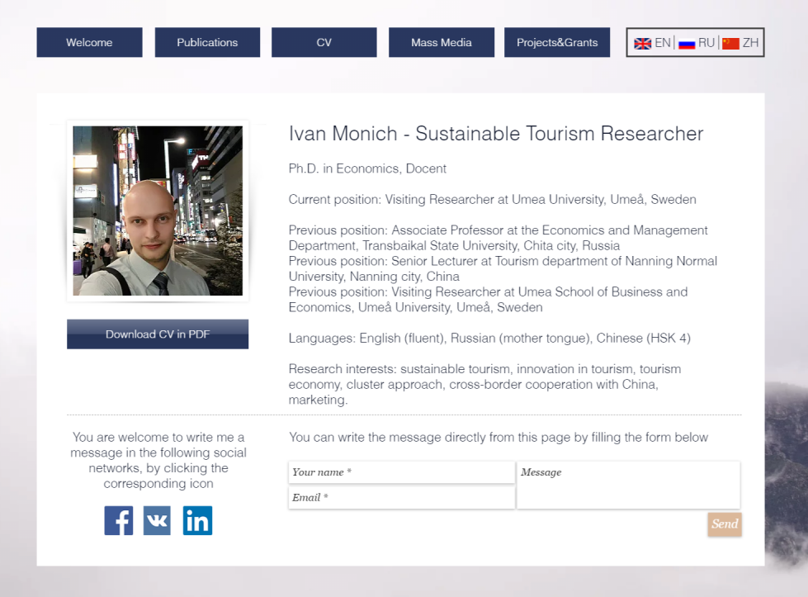
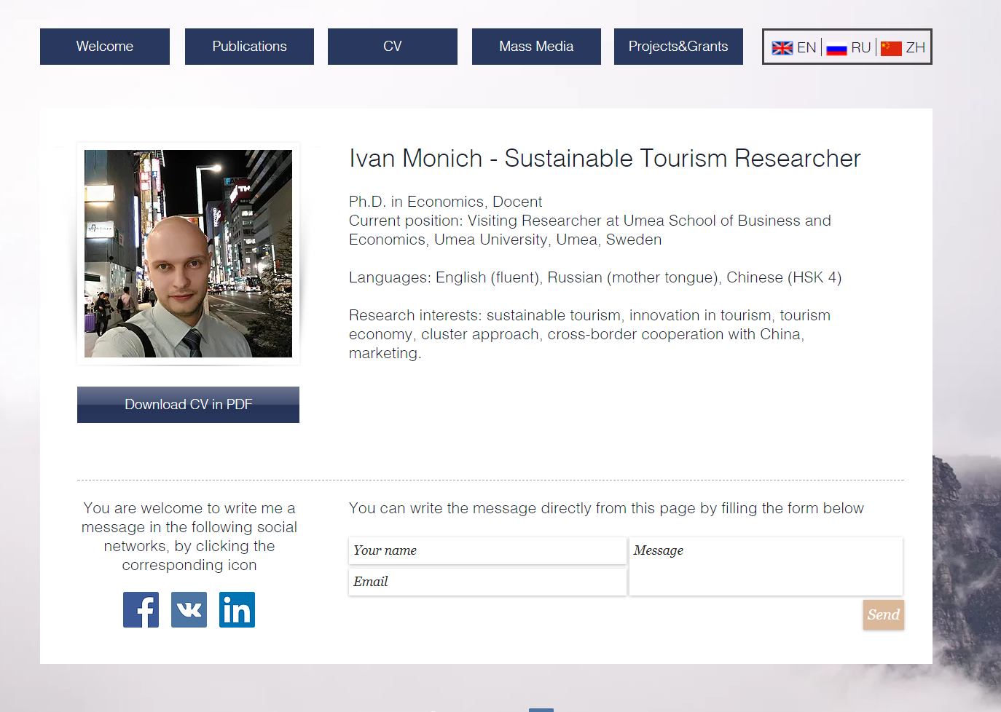
4

Slide 5


Slide 6
Working experience in Academia and Business

Slide 7
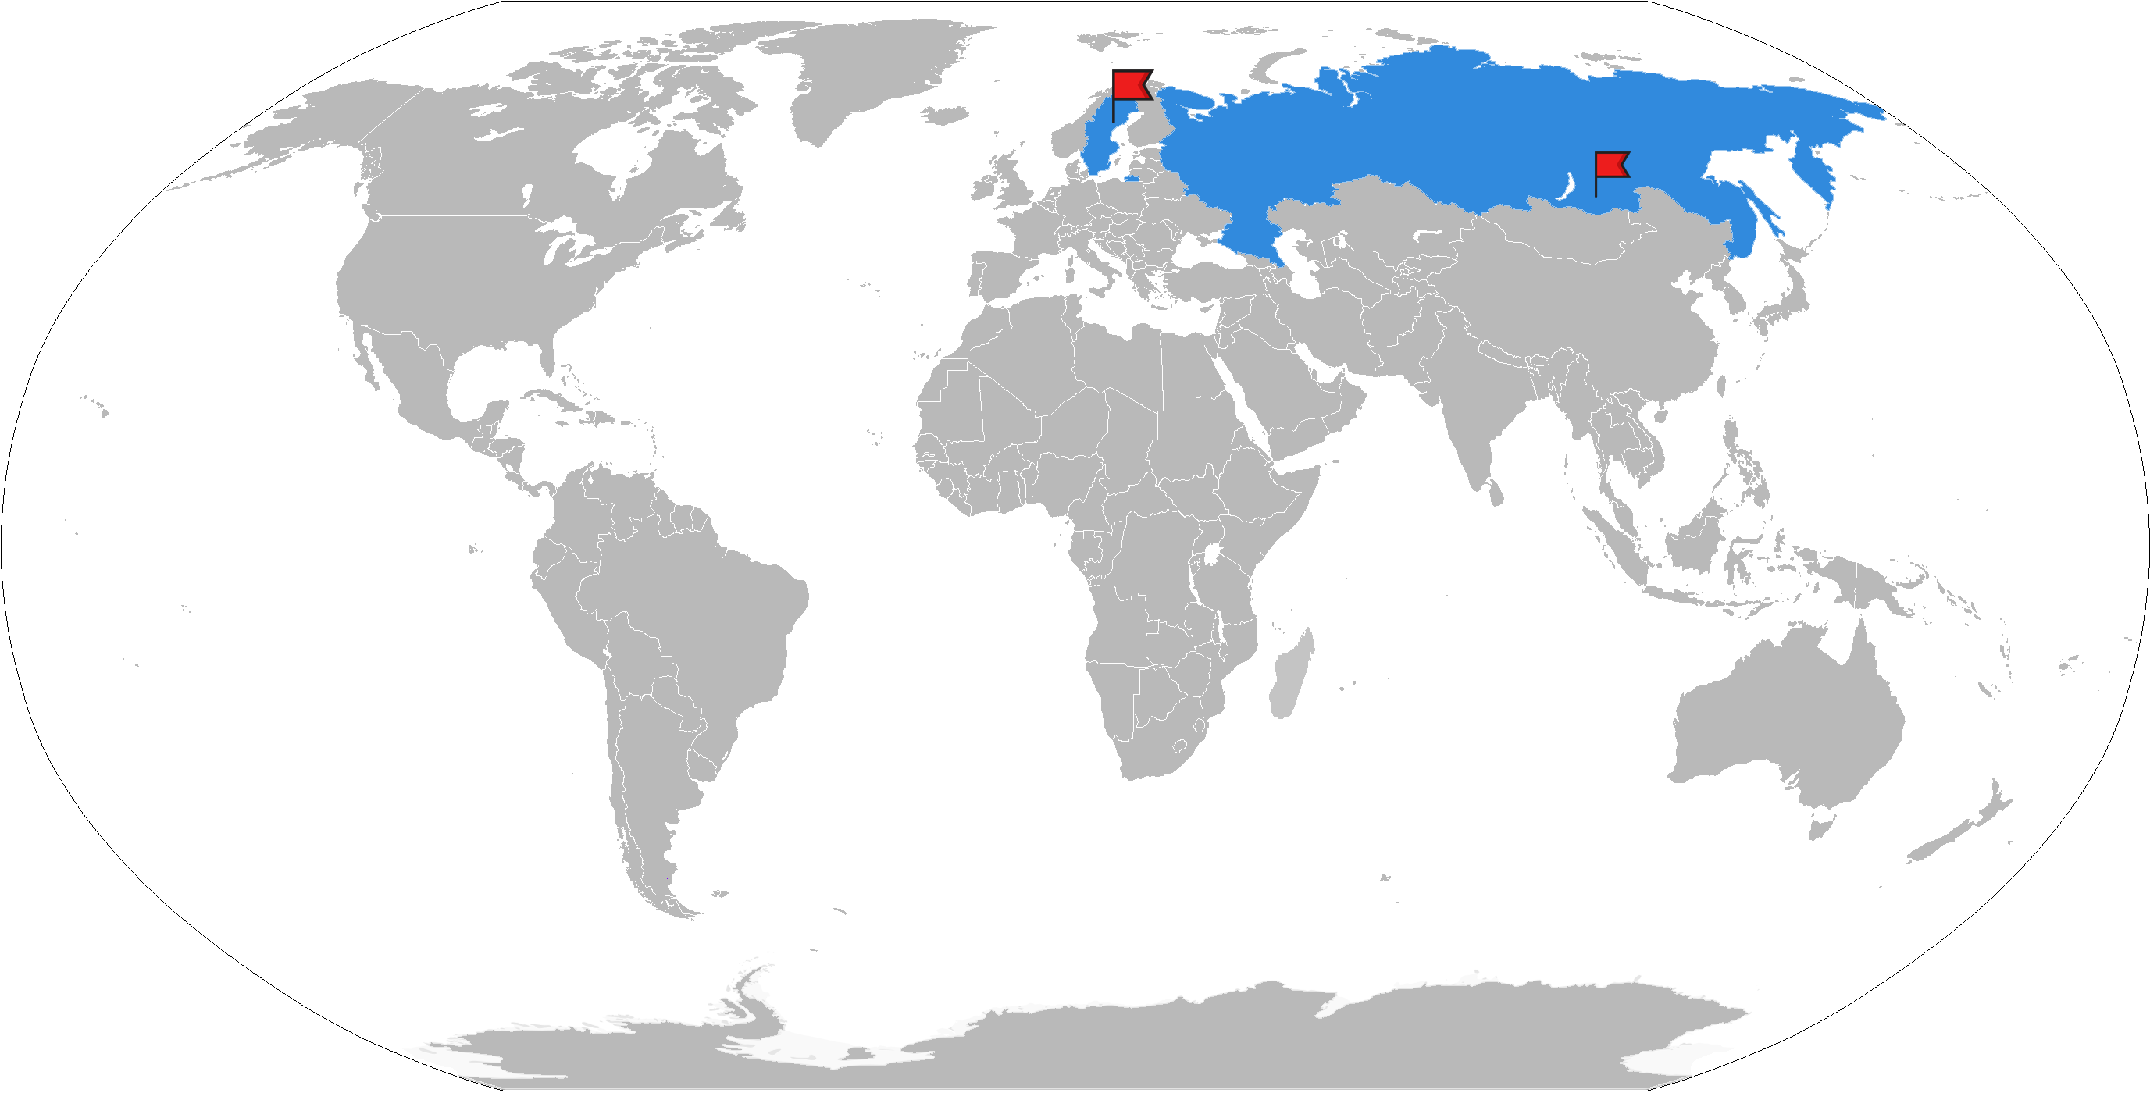
Nanning Umea and My home city
+26°C +7 -47.5°C
Notes:
You can not make such a cold place artificially. It is even colder than in the fridge.

Slide 8
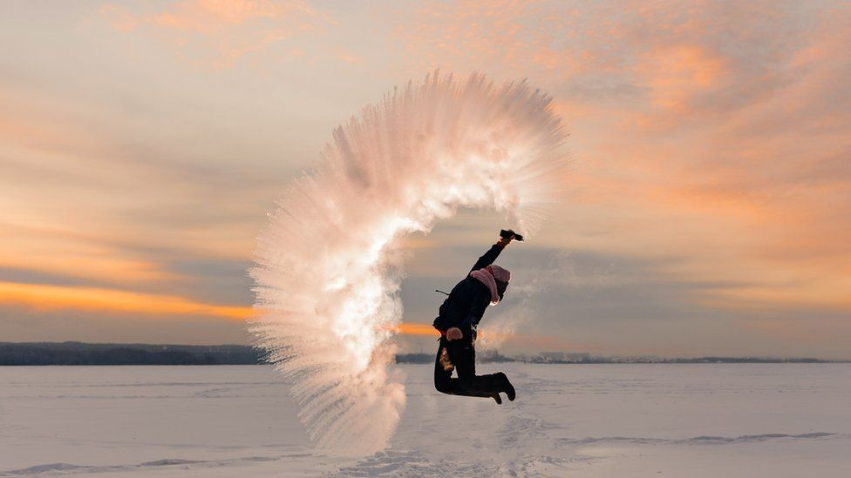
Spilling boiling water in Siberian winter

Slide 9
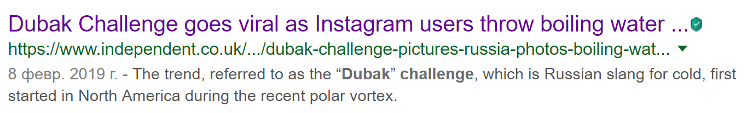
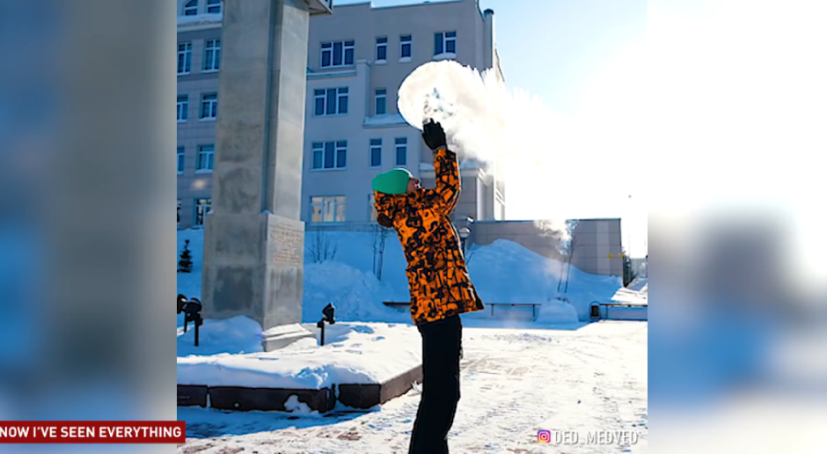

Slide 10
Real Winter!

Slide 11

The teaching process
During the semester we are going to have:
seminars with case-studies
lectures on the main course topics
mixed classes
Research work
It is mandatory to attend the lectures and seminars, otherwise you will be not allowed to take the final exam!

Slide 12
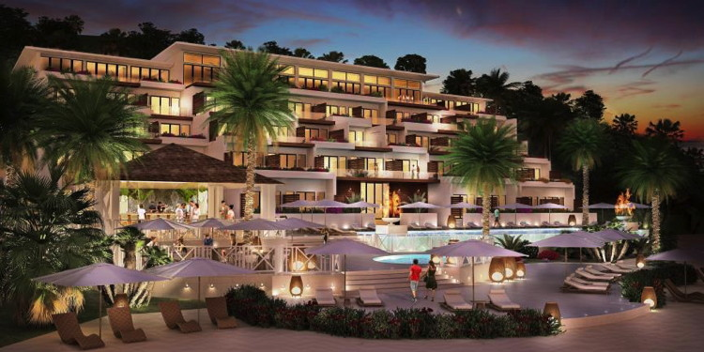
Case-studies from the book
The Kimpton hotels’ green approach

Slide 13
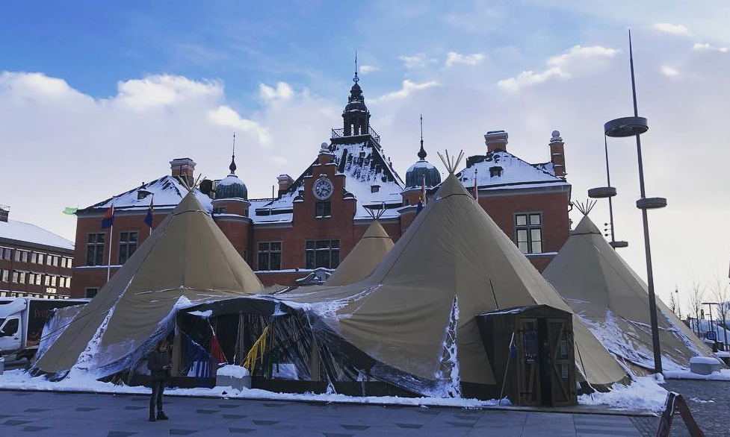
Real and modern case –studies based on my own experience
Saami indigenous people living in Sweden, Finland and Northern Russia
Umeå, Northern Sweden, Saami week March 04-09, 2019

Slide 14
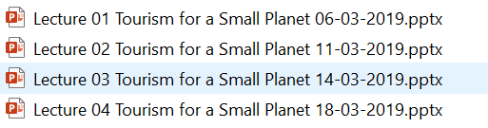
WeChat Group and WeChat (QQ) cloud for the shared files
Please, note that all Power point presentations will be stored on WeChat (QQ) cloud, so you have the access to all needed files.

Slide 15
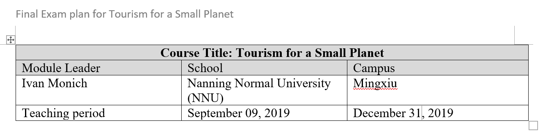
The evaluation procedure
Next week you will be given the Exam plan file containing the information about the course evaluation process.

Slide 16
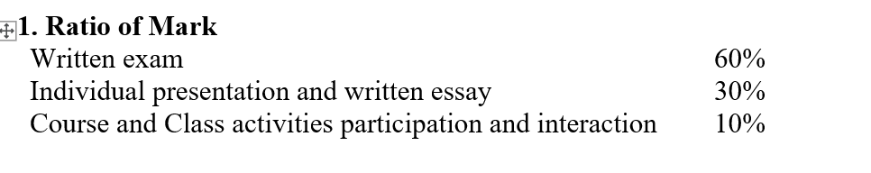
The evaluation procedure

Slide 17
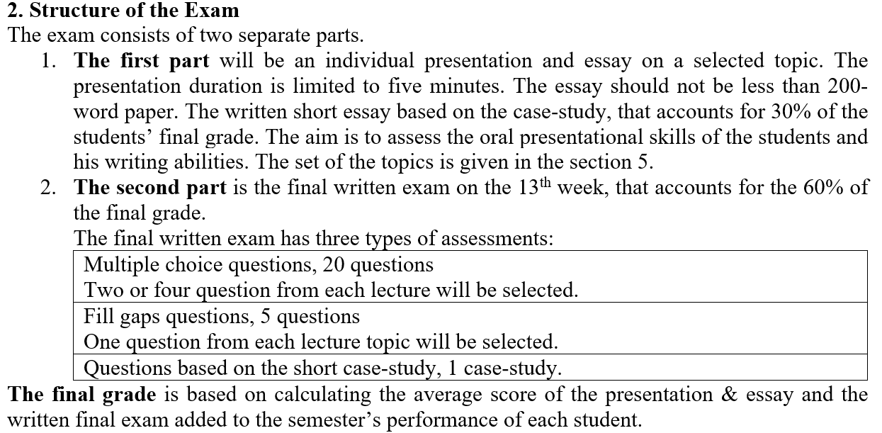
The evaluation procedure

Slide 18
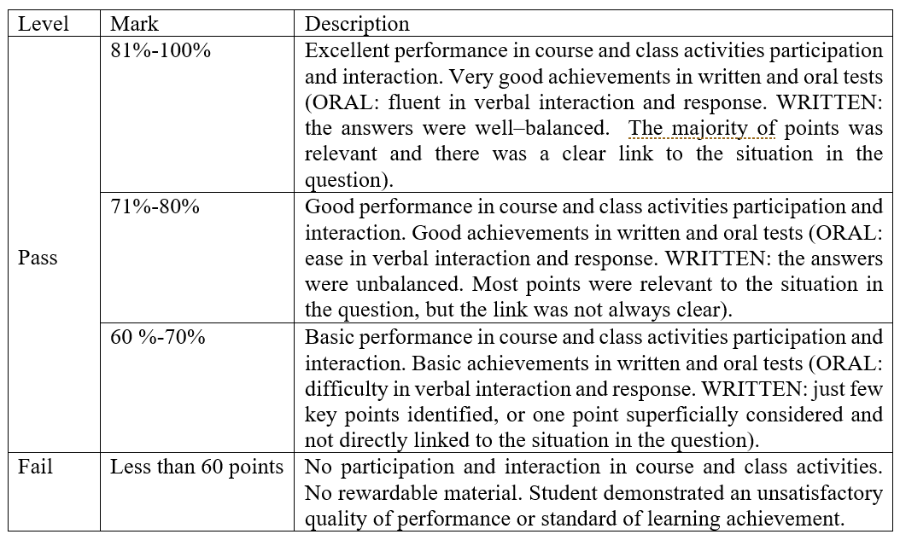
Grading scheme

Slide 19
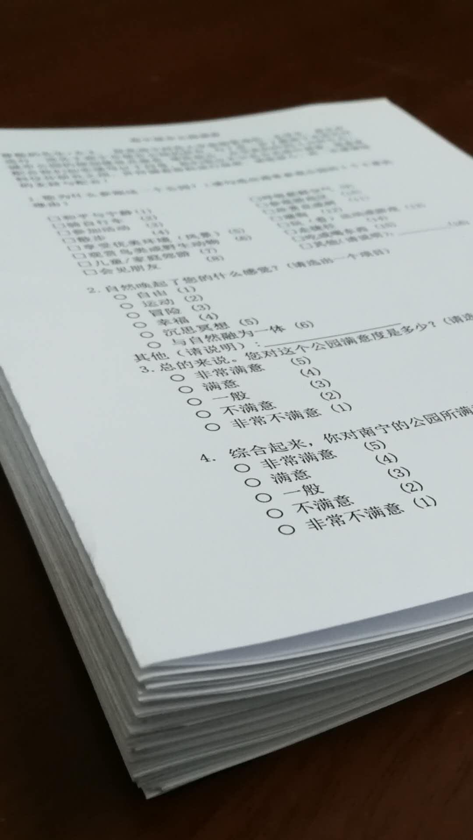
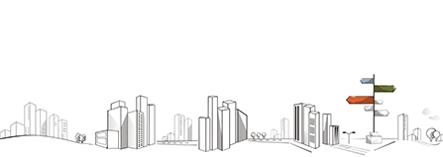
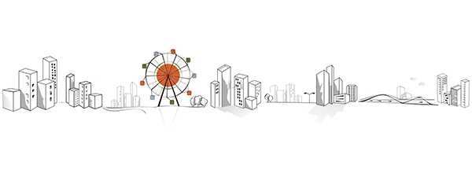
Conducting the Survey
Design the questionnaire
- via Literature review
- coding scheme
- feedback from colleagues
2. Translate the questionnaire
- native speakers
- online translators
3. Test the questionnaire

Slide 20
Our questionnaire
Dear students. We have designed the questionnaire together.
It is not just a questionnaire, it is a book consisting of 4 pages with built in coding scheme and interviewer instructions. It is the survey manual or survey kit!
Now it is time to get the skills of how to use the coding scheme, how to approach the respondents and how to select the spot for the interview.

Slide 21

The structure of the questionnaire: Introduction

Slide 22
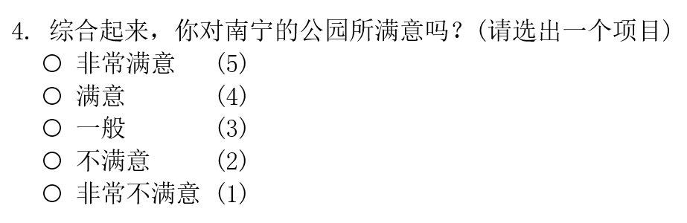
The structure of the questionnaire:
Hints and instructions
Coding Scheme

Slide 23
What is your favourite Nanning Park
您最喜欢南宁的公园是哪一个？
公园 | 公园
南湖公园 | 狮山公园
花卉公园 | 石门公园
人民公园 | 金花茶园
药用植物园 | 青秀山公园

Slide 24
Research results
In May, our research group did a Survey in 8 Nanning Urban parks for the factors of attractiveness and the impact of the green parks on urban sustainability. We conducted 598 semi-structured interviews and got the filled questionnaires. We are assessing the data now. One of the questions was "What is your favourite urban park in Nanning". I'd like to show the answer results: Nanhu park (157 votes), Qingxiushan park (119), Renmin Park (117 votes), Shishan park (85 votes)...

Slide 25
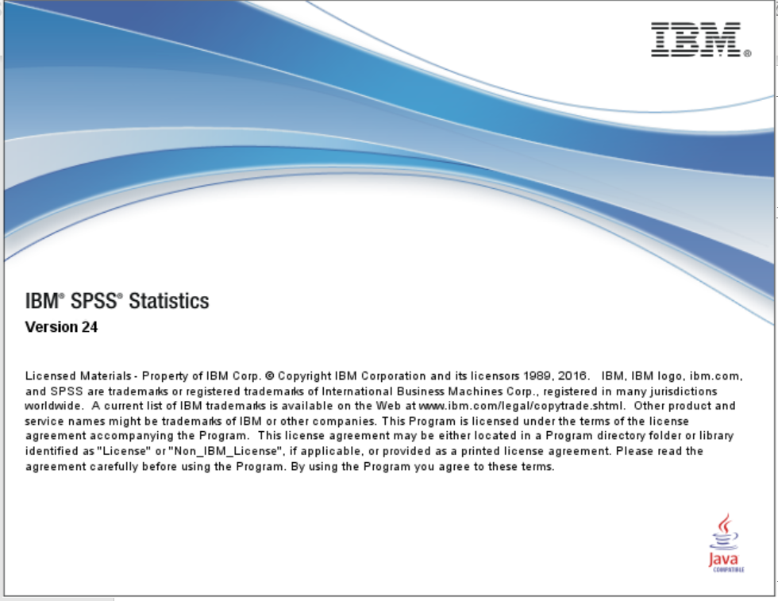

Slide 26
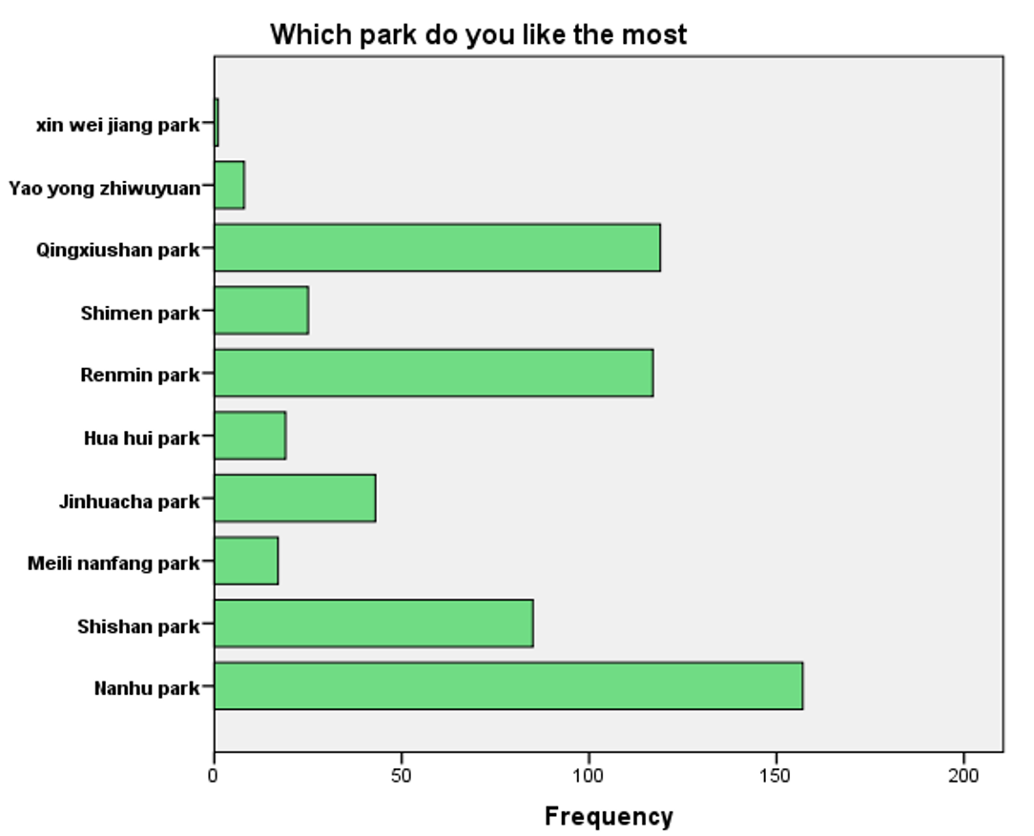

Slide 27
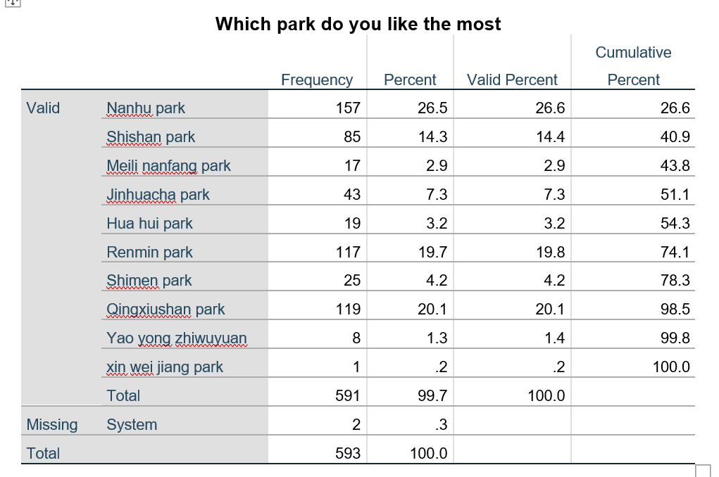
南您师范大学，旅游及文化学院研

Slide 28
Start of a new content

Slide 29
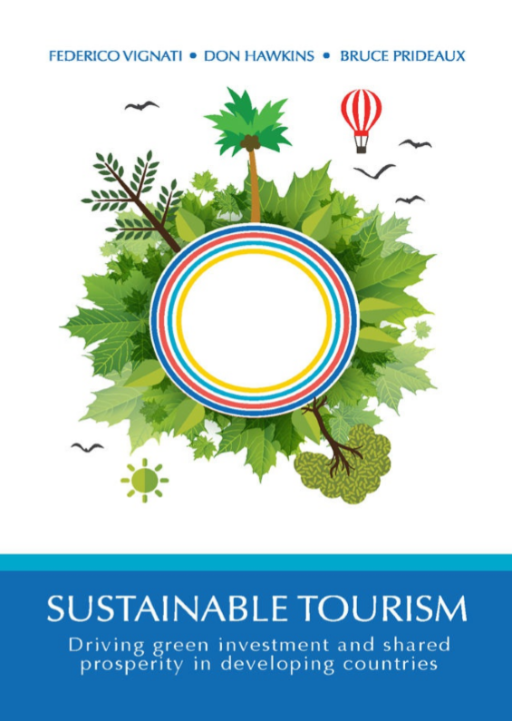
The main textbook _{SUSTAINABLE TOURISM}
Driving green investment and shared prosperity in developing countries

Slide 30

The main textbook Sustainable Tourism: A Small Business Handbook for Success

Slide 31
The structure of the course
Contents
Understanding Ecotourism
Sustainable Business: Building and Operating Your Business
Community Development
Environmental Stewardship
Developing an Ecotourism Business Plan
Ecotourism Marketing Basics
Conclusion
Products Suggestions Resources

Slide 32
Introduction to the course
Tourism normally has an important multiplier effect for local or national economies. Therefore, tourism can be practised in a sustainable inclusive manner whereby it contributes to the wellbeing of the tourists and of the local people it employs and who live in the areas tourists go.
So if we want to develop social and economic impacts we need to think about sustainability and sustainable tourism: Environmental sustainability, Economic and financial sustainability, Social and cultural sustainability

Slide 33
Introduction to the course part 2
Tourism is the largest growing industry on earth, It already represents 7 trillion USD annual turnover or 9.5 % of global GDP and is rising with 4% every year. Tourism has created directly 100 million jobs (3.4% of global employment) and supports 270 million jobs indirectly. If Global
Tourism would be a country, its economy would rank third.

Slide 34
Introduction to the course part 3
The coming generation of tourism operators, managers and policy makers have the obligation to include sustainability in their plans and operations. The industry has moved already great strides but still more can be done. I hope that this course will inspire students to think about tourism sustainability and act upon it.

Slide 35
Lecture 01
Sustainable tourism and Understanding Ecotourism

Slide 36
Understanding Ecotourism
TOURISM IS ACCOUNTING FOR AN INCREASING portion of the world economy. According to the World Travel and Tourism Council, in 2011 alone, travel and tourism made up 9% of GDP, employed 250 million around the world, and boasted a profit of 6 trillion USD
Tourism have the potential to make a significant impact on the world. We propose tipping the balance in favor of making a positive impact on the world, and we will explore the economic, social, and environmental benefits of ecotourism.

Slide 37
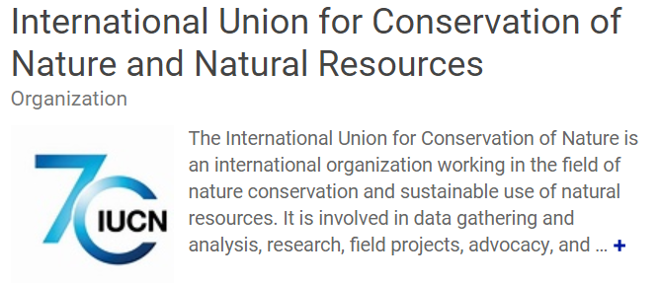
Definitions of Ecotourism

Slide 38
What is Ecotourism
Ecotourism, as defined by IUCN, is “environmentally responsible travel and visitation to relatively undisturbed natural areas, in order to enjoy and appreciate nature (and any accompanying cultural features— both past and present) that promotes conservation, has low visitor impact, and provides for beneficially active socio-economic involvement of local populations”

Slide 39
What is Ecotourism part 2
Ecotourism is an effective way for businesses in a tourism destination to have a positive impact on their host community. Whether the business at stake is a conservation organization, a lodging facility, a product-based company, a service provider, or anything in between, ecotourism provides the proper guidelines for sustainable and responsible business practices that promote the preservation of natural resources and wildlife and contribute to the socio-cultural and economic growth of the local community.

Slide 40
Principles of ecotourism
With the principles of ecotourism in mind, it is possible to devise a business model that promotes and protects the environment and local community. In order to successfully embody ecotourism, businesses need to consider the following three measures: Sustainable Business Practices, Community Development and Environmental Stewardship.

Slide 41
Sustainable business practices
Sustainable business practices are the steps that a business takes to minimize its environmental impacts and maximize its self-sufficiency, which includes building material selection, energy choices, waste management, and water usage

Slide 42
Community development
Community development entails the social, cultural and economic effects that the business and its visitors have on the local inhabitants. Not only should local culture, traditions and values always be respected while running a business, but there should also be a commitment to supporting and strengthening the local community.

Slide 43
Environmental stewardship
Environmental stewardship is the activities and experiences made available to visitors that allow them to discover and appreciate the beauty of the natural environment and wildlife. Arts and crafts featuring local and sustainable materials, hiking, cooking classes, and canoeing are only a few examples of activities that allow visitors to delve into the destination and engage with the environment.
This can also include encouraging visitors to partake in local volunteer preservation or conservation projects, either physically or financially.

Slide 44
Three Principles of Ecotourism
By placing these three pillars as the supporting blocks of any tourism related operation, businesses can promote
environmental,
social and
economic sustainability
and have a lasting positive impact on the host community.

Slide 45
Sustainable Business: Building and Operating Your Business
WHEN CREATING AN ECOTOURISM FACILITY and business model, green initiatives should be implemented at every stage of the building and management processes. The overarching goals are to minimize the impact on the environment and maximize selfsufficiency.
With these two standards in mind, an eco-tourism center can be created that aesthetically complements the surrounding area, is respectful and beneficial to the local community, minimizes energy requirements, and creates a closed-loop waste system.

Slide 46
MINIMIZING ENVIRONMENTAL IMPACTS
The primary goal when constructing a new structure or making an existing structure your own is to create a net positive effect on the local environment.
Minimizing your impact on your natural surroundings is a key component of preserving and conserving the beauty of the pristine surroundings that attracts tourists and travelers in the first place.

Slide 47
MINIMIZING ENVIRONMENTAL IMPACTS part 2
Every business decision must consider the impacts and repercussions it may have on the environment.
From selecting a site location to selecting building materials and designing the interior, every step of the process needs to factor in the environment.

Slide 49
Lecture 02
Sustainable Business: Building and Operating Your Business
WHEN CREATING AN ECOTOURISM FACILITY and business model, green initiatives should be implemented at every stage of the building and management processes. The overarching goals are to minimize the impact on the environment and maximize selfsufficiency.

Slide 50
Minimize the impact on the environment and maximize self-sufficiency.
With these two standards in mind, an eco-tourism center can be a respectful and beneficial to the local community, which minimizes energy requirements, and creates a closed-loop waste system.

Slide 51
MINIMIZING ENVIRONMENTAL IMPACTS
The primary goal when constructing a new structure or making an existing structure your own is to create a net positive effect on the local environment. Minimizing your impact on your natural surroundings is a key component of preserving and conserving the beauty of the pristine surroundings that attracts tourists and travelers in the first place.

Slide 52
MINIMIZING ENVIRONMENTAL IMPACTS part 2
Every business decision must consider the impacts and repercussions it may have on the environment. From selecting a site location to selecting building materials and designing the interior, every step of the process needs to factor in the environment.

Slide 53
11-09-2019

Slide 54
The Kimpton hotels’ green approach

Slide 55
Kimpton Hotels
Today, Kimpton Hotels is comprised of 59 hotels and 64 restaurants, and there are over 140 actions taken to minimize the each property’s environmental impacts, including the following:
Home Office Materials & Procedures
Hotel EarthCare Standards
Waste Management
Other Hotel Behaviors
Additional Actions Taken by Individual Hotels and Restaurants

Slide 56
Task #1
5-10 minutes
Have a look at the list of actions taken by Kimpton Hotel Chain to minimize environmental impacts on the page 21-27 of the main textbook.
Which actions can be implemented in the hotel with relatively low implementation costs and relatively fast?

Slide 57
Summary of Kimpton Hotel Chain green approach
With the right resources, proper planning, and an everlasting environmental consciousness, all businesses can reduce their environmental footprint and increase their sustainability.

Slide 58
SITE LOCATION
Selecting an appropriate site location for an ecotourism accommodation is the first, and perhaps most critical, step towards creating an environmental attraction. Given that most ecotourism operations are located in natural areas that may be fragile or delicate, substantial consideration must be given to the planning and building of such establishments.

Slide 59
SITE LOCATION part 2
To ensure that facilities are designed in a way that minimizes environmental impact while maximizing self-sufficiency, knowledge of the characteristics of the specific environment must be obtained. Each site is accompanied by a unique set of physical features, natural resources and attractions, and potential environmental threats, which must be considered when examining a potential site location.

Slide 60
SITE PLANNING
Site planning and design is a process that involves in an integrated way the issues of land use, human circulation, structures, facilities and utilities within the natural and human environment. In order to ensure harmony between tourism developments and environmental protection, it is indispensable to apply sensitive design of infrastructure, master site planning, ecologically and socially conscious site design, and landscaping.

Slide 61
SITE PLANNING aims
The site planning and design for any ecotourism facility must be, first of all, an instrument that safeguards the sustainability and conservation of the surrounding natural and cultural heritage. Not only should it conserve the natural ecosystems but it must also contribute to repairing and restoring the environmental damages that may already be present in the site.

Slide 62
What is Site Planning?
Site planning and design for any tourism facility must clearly indicate the process of ordering human actions and works in a specific tract of land. In addition to constituting a graphic representation (to scale) that shows location, layout, general size and shape, and orientation of the different elements of the project, site planning and design should indicate the sequence of activities that make up the project, clearly establishing a space-time interaction. Also, it should ensure that all on-site human activities should have a minimum negative impact on the natural and human environment

Slide 63
Zoning?
Zoning is a very important tool in the site planning and design process. It is the process of applying different management objectives and regulations to different parts or zones of a specific area.

Slide 64
What site to select?
The selected site should support the lodge within natural and biophysical resource limits while offering ecotourists the opportunity to experience and enjoy the environment (CeballosLascurain, 1996).
Frequently, in those sites which are more appropriate for ecolodge development there are limited or no infrastructural elements or public services, because of typical isolation and remoteness.

Slide 65
Infrastructure development
It is important to analyse how much infrastructure should be provided by the local authorities, and how much by the private sector. Since the extra service demand is often only used part of the year (seasonal), and takes precedence over use by local communities, tourism providers must invest in their own infrastructure needs. Both communities and tourism sector should benefit from infrastructure development.

Slide 66
Summary of Site Planning
In every case, the private sector has an enormous responsibility in sustainable hotel planning and design, appropriate scale of development, zoning and compliance to environmental regulations. It is essential to ensure that your site plan is environmentally-friendly, minimising negative impacts on the natural landscape, local biodiversity and any existing cultural features found nearby.

Slide 67
DESIGN WITH LOCAL MATERIALS
The design and style of a property should appear natural. Indeed, it should be natural in the sense that building materials are derived from the local area. In this way, buildings present an appearance harmonizing with the surrounding architectural landscapes and plant forms, complementing them instead of competing with them. After all, this natural beauty is one of the primary reasons eco-minded travelers are attracted to an area.

Slide 68
Cultural contexts
Architects must ensure buildings not only complement and conform to the surroundings, but they must also be mindful of representing local design styles. Additional inspiration can and should be drawn from community members, historical and cultural contexts, and local building techniques.

Slide 69
Saami indigenous people living in Sweden, Finland and Northern Russia
Umeå, Northern Sweden, Saami week
March 04-09, 2019

Slide 70
CLIMATE CHANGE, CO2 EMISSIONS & DEFORESTATION
There has been a rise worldwide of 1.5 degrees Fahrenheit since 1900, which represents the largest increase since the end of the ice age. The estimates are for the temperatures to increase up to two degrees by 2029, an additional 5 to 7 degree increase by 2099.

Slide 71
Sustainable Interiors, Furnishings, and Decorating
It’s a well-known saying that the best way to promote change is to be an example of change. When it comes to protecting the environment by promoting green living, one of the easiest places to start is right at home. Greening your workplace interiors, whatever your workplace may consist of, can make a big difference in reducing your global footprint.
Task #2

Slide 72
Is you home or student dormitory, library, studding place green?
As an added bonus, greening your interior can also lead to an immediate improvement in air quality.
! It comes as a shock to find out that indoor air is two to five time more polluted than outside air.

Slide 73
By exploring current global trends and the potential benefits of selecting environmentally safe and eco-friendly products and furnishings, I hope to encourage you to implement some of the suggestions and recommendations below.

Slide 74
THE POSITIVE POTENTIAL OF SUSTAINABLE INTERIOR CHOICES
Home furnishings account for the third largest use of wood, after building and paper, and this is the largest industry using high quality woods. Selecting sustainable alternatives when purchasing home furnishings, therefore, can have positive effects on climate change, CO2 emissions, and deforestation. Many people think that buying green products for the home is more costly, maybe by as much as 50%. In reality, the cost difference is only 10-15% higher.

Slide 75
The top five ways to decrease your impact on the environment when making home furnishings design and purchase choices are:
Utilize legally logged and sustainably produced lumber.
Select fabrics and fills from more sustainable sources.
Use finishes with low VOC (volatile organic compounds).
Promote local resources, products, and manufacturers (ideally within 500 miles).
Recycle furniture.

Slide 76
Why Furniture with VOC is dangerous?
Volatile organic compounds (VOCs) are organic chemicals that have a high vapor pressure at ordinary room temperature. Their high vapor pressure results from a low boiling point, which causes large numbers of molecules to evaporate or sublimate from the liquid or solid form of the compound and enter the surrounding air.

Slide 77
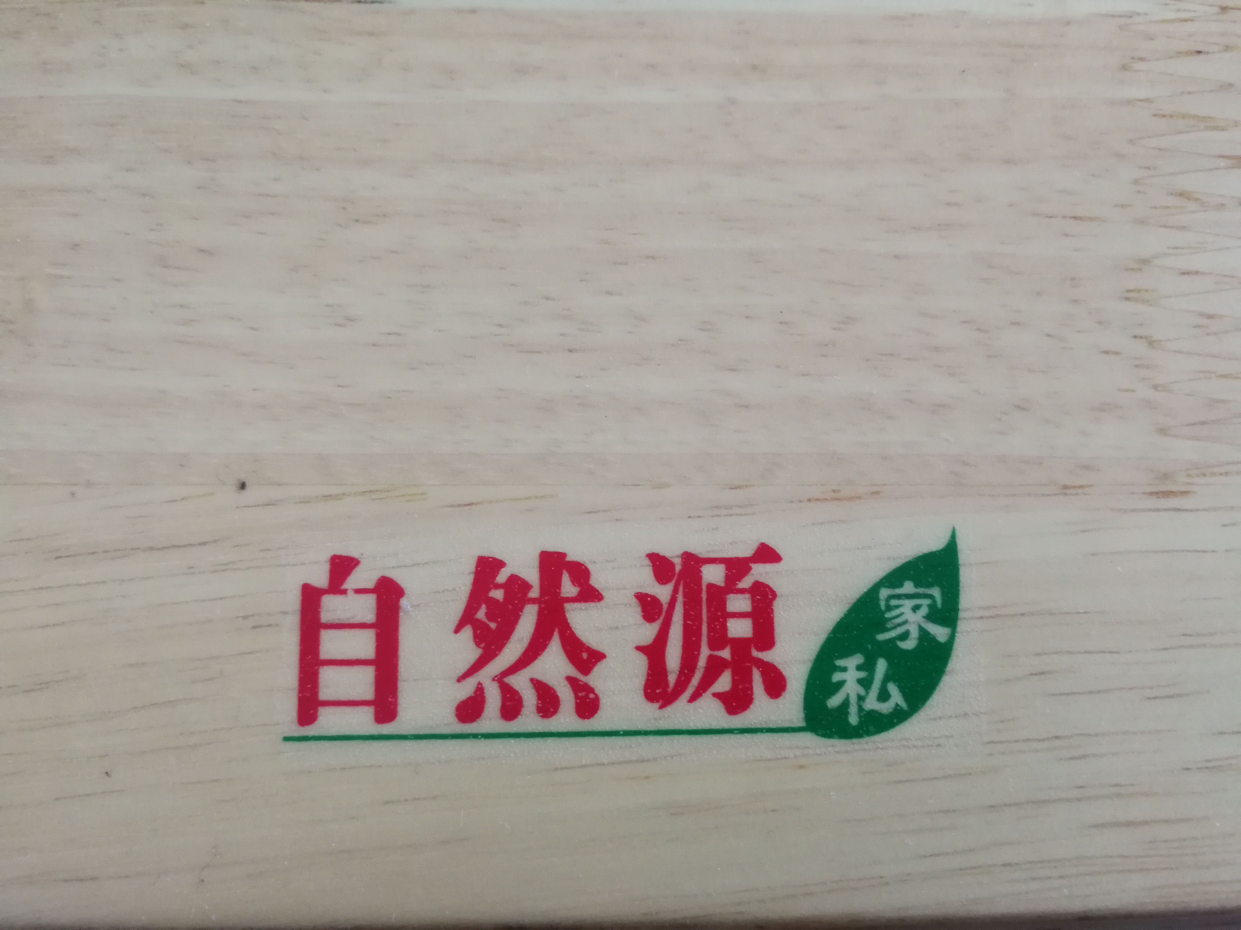
The table in my apartment has a particular sign on its edge.

Slide 78
Task:
BECOMING A SMART CONSUMER
Page: 31-40

