Slide 1
南宁师范大学
Nanning Normal University
Department of Tourism & Culture
Research Methods
Ivan Monich, Ph.D.
Nanning, 2019

Slide 2


Quantitative data collection methods

Slide 3
Learning objectives
From reading this chapter, you should be able to:
provide a summary of quantitative methods, their advantages and disadvantages and when they should be used
explore initial thoughts on questionnaire design and links to the literature review
design workable questionnaires
understand the different types of questions
understand potential errors in the design of questions
explore different types of measurement scales
understand ethical issues with quantitative methods.

Slide 4
5.1 Introduction
During the length of a project, fieldwork is carried out at various times. The nature of the fieldwork you use depends on the type of project and your chosen methods of data collection.
If a survey is to be carried out at a tourist attraction, then it will be necessary to first gain an overview of the site, decide on suitable interviewing points and talk to staff to gain an understanding of the patterns of site use.

Slide 5
Introduction
When it comes to the actual data collection itself, there is a variety of aspects which need to be planned.
This lecture considers the quantitative approach to research in some depth and considers how the techniques can be designed, and administered including the use of online surveys.

Slide 6
5.2 Understanding the value of quantitative methods
There is a wide variety of different types of questionnaire used in hospitality, tourism and events for both academic research and industry application.
Structured questionnaires are those which ask precise, concrete questions prepared in advance to facilitate quantitative analysis.
Unstructured questionnaires, sometimes referred to as interview guides, also aim at precision and contain topic areas where respondents are less restricted in their answers. This latter type is common within in-depth interviews and focus groups.

Slide 7
5.3 Research design and the literature review
The literature review provides the framework for the design of the research method. It is very useful to try to link the review to the questions that are to be asked in your survey or interview.
Consider the example of a chart that was used to develop the questions for an online survey that was carried out to try to discover the perceptions of local food in the Devon area.

Slide 8
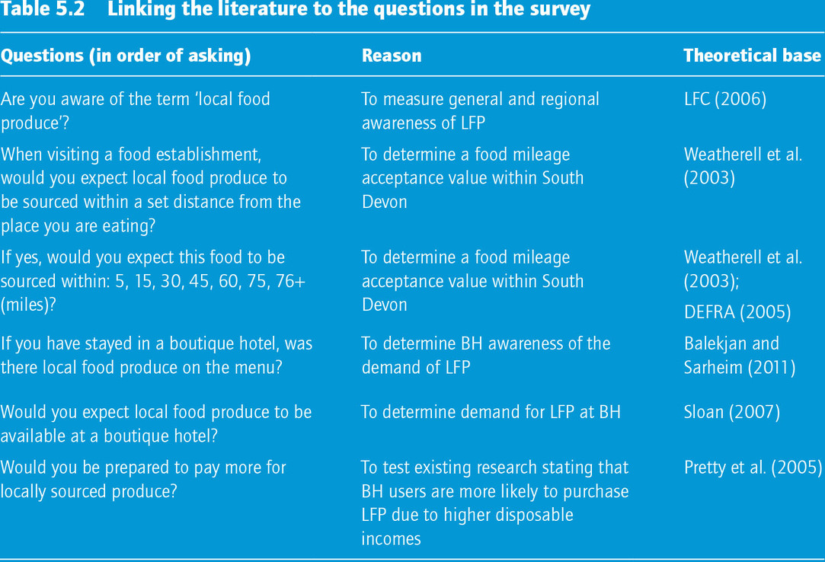

Slide 9
5.4 Designing workable questionnaires

Slide 10
5.4.1 Question types: closed and open questions
Broadly speaking, all questions are either closed (structured) or open (free-response) that you can use.

Slide 11
Closed questions
A closed question is one in which the respondent is offered a choice of replies. He/she may be asked to tick a box in a self-completion questionnaire, or the answers may be read out to him/her or shown on a prompt card.
Questions of this kind may offer simple alternatives such as yes or no, a simple list or something more complex.

Slide 12
Examples of the closed questions
Have you visited this site before? Yes No
How did you travel to this site?
  Car Service bus Coach
  Walk Bicycle Other
If it is proven that bracken at recreation sites affects human health, with which of these statements would you agree most?
  A programme of bracken removal/control should be implemented.
  People should be made aware of the health risks, but the bracken should not be removed.
  I do not think there is anything to worry about.

Slide 13
Examples of the closed questions
Other types of questions that are essentially closed include ranking and rating scales. Below are some examples:

Slide 14
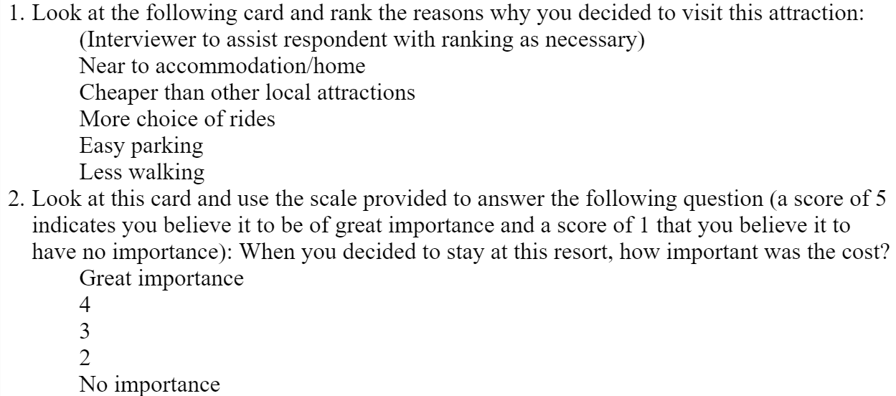
Examples of the closed questions

Slide 15
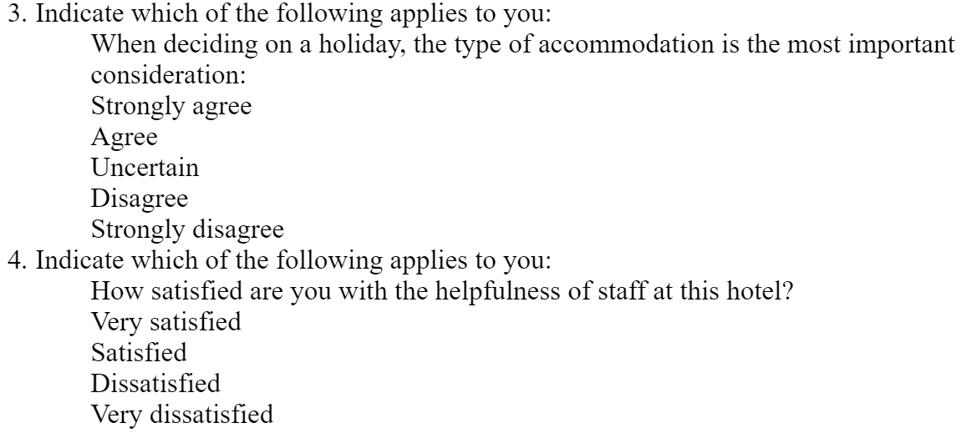
Examples of the closed questions

Slide 16
Reference to the literature will show that there is much debate on the length of the various scoring systems and whether to have an odd or even number of categories.
Note here that I have not included a ‘don’t know’ category. In the next section, this is discussed more fully.

Slide 17
Closed questions
Thus, closed questions can be attitudinal as well as factual.
In the last example, if left to their own thoughts, some respondents may have come up with their own proposals. Here, the list of alternatives has been derived after careful piloting to ensure that the categories do cover the majority of opinion.

Slide 18
Advantages of closed questions:
Easier and quicker to answer.
No writing.
Quantification and coding easier.
More questions possible in terms of time/money available.

Slide 19
Disadvantages of closed questions:
Loss of spontaneity and expressiveness (will never know what the respondent would have said if left to their own devices).
Bias, in forcing a particular set of answers that might not have occurred to the respondent.
Closed questions are often simpler and less subtle as no probing is possible.
Loss of rapport with interviewer – some respondents may become irritated because they feel that their real opinions are not represented in the set of alternatives.
It is easier for the respondent to cheat.

Slide 20
Open questions
Open questions are not usually followed by any kind of choice. Answers are recorded in full. In the case of a self-completion questionnaire, the amount of space made available will help to determine the length and fullness of the responses obtained.
There are several types which are best demonstrated using examples:

Slide 21
Open:
Why did you decide to go on a day trip today? (Record answer.)
Open – with clarification:
In the following questions, I am going to focus on day trips. This is defined as a journey away from home lasting longer than three hours but not including an overnight stay. Why did you decide to go on a day trip today?
Open – with probing:
Why did you decide to go on a day trip today? (This is followed by probing either from a checklist or left up to the interviewer.)

Slide 22
Advantages of open questions:
Freedom on the part of the respondent in giving an answer.
Spontaneous.

Slide 23
Disadvantages of open questions:
Difficult to code.
Hard to analyse quantitatively.
Interviewer bias.

Slide 24
Overall, there are obviously pros and cons with both question types. In order to offset the disadvantages, it may be useful to ask the same question topic both ways.
With open questions, whilst the answer may be valuable, the interpretation and comparison between respondents may be difficult.
With closed questions, you cannot be sure that an impromptu sketch contains all the factors that are important.

Slide 25
5.4.2 Some worked examples illustrating how to decide which type of question system to use
1. You want to find out how many people read the Daily Mirror yesterday.
Answer: Closed question system. This is a straightforward head count, thus the answer is yes or no. There may be potential problems with the word ‘read’ being ambiguous.

Slide 26
5.4.2 Some worked examples illustrating how to decide which type of question system to use
2. In your survey, you aim to ask each head of household what his/her job is.
Answer: If your main ‘aim’ is to find out precisely what their job is, then an open question system will be required. It is not possible to list all jobs so the question will be open. However, sometimes the interviewer (if present) may need to probe or seek clarification of the response. An answer such as ‘engineer’ may require the interviewer to ask for more detail. In other surveys where this is not the main ‘aim’, often job categories are listed and respondents decide for themselves which is most suited to their situation. In a postal survey, closed questions would have to be used.

Slide 27
5.4.2 Some worked examples illustrating how to decide which type of question system to use
3. You want to find out how many people agree with different views about their holiday to the Seychelles, but you do not know what these views are.
Answer: To do this properly, two surveys are required. To begin with, you need to find out what views people have about the Seychelles. Because you do not know what views people have, open questions where interviewers probe for as much information as possible is probably the best method. Then, after analysing the results of this survey, closed questions can be constructed. These can then be used to count the number of people who endorse or reject those views about the Seychelles.

Slide 28
5.4.2 Some worked examples illustrating how to decide which type of question system to use
4. A product of your company is not selling well to your target market. You only have a few vague suspicions as to why this is so and you want to explore in an empirical way the nature of the problem.
Answer: Here your purpose is exploratory. You cannot design closed questions if you only have vague suspicions as to why the product is not selling well. Therefore, open questions are required to explore the nature of the problem.

Slide 29
5.4.2 Some worked examples illustrating how to decide which type of question system to use
5. You have a list of, say, 30 different characteristics of management in a travel firm. You would like to find out, for each of these characteristics, how many employed persons say it is true of their firm. However, you are worried about offering more than 10 characteristics on a show card because you feel your respondents would not properly consider more than that on a single card.

Slide 30
Answer: In this case, you are trying to find out what opinions people have of the 30 characteristics of management you are studying, rather than asking them to describe the characteristics of their firm for themselves. Thus, the answer is that a closed question system is used to count the number of people who say that a given characteristic is true or untrue. Fears about presenting a long list relate to the wording and layout of the questionnaire. These aspects are investigated in the next section.

Slide 31
5.4.3 Wording questions and laying out a questionnaire
The content of your questionnaire is obviously governed by the nature of the survey, but there are many potential problems in the communication of the questions. These types of problem apply to all surveys.
Illustration 5.3 An example of a questionnaire used for a street survey
Succeed with Plymouth University

Slide 32
Familiar words
As a rule, you should always use familiar, simple words. However, occasionally some words are too vague – for example, ‘how often’, ‘how much’ and ‘how far’ may result in answers that are not comparable.
Asking ‘How much do you drink?’ in an open sense is likely to result in a set of replies that either overstate or understate a true reply! In addition, words such as ‘good’, ‘bad’ and ‘regularly’, which are not enumerated precisely, do not lend themselves to quantitative analysis

Slide 33
5.4.4 Language and translation
The language used in the wording of questions is of critical importance. You should give careful thought to how the question will be interpreted by the respondent. There are two salient points to remember when you begin to write your questions:
Be clear and concise. Keep questions short, as long sentences which require respondents to concentrate will not be answered accurately.
Avoid using jargon. The vocabulary should be simple everyday language (unless aimed at a particular technical audience).

