Slide 1
南宁师范大学
Nanning Normal University
Department of tourism & culture
Marketing for Tourism, Hospitality and Events
Ivan Monich, Ph.D.
Nanning, 2019

Slide 2

Previous lecture content:
Market structures
Market structures can be defined in four broad categories, based on the number and size of competitors in the market:
Monopoly
Oligopoly
Monopolistic and perfect competition

Slide 3
Oligopoly
Well-developed market economies are far more likely to see the emergence of oligopolies than monopolies. In an oligopoly, a small number of firms account for a very large share of the market, and a number of the privatised ex-monopolies discussed above are moving into this category.

Slide 4
Oligopoly
The oligopoly creates a certain amount of interdependence between the key players, each of which is large enough for its actions to have a big impact on the market and on the behaviour of its competitors. This certainly occurs in large-scale, worldwide industrial markets, such as chemicals, oil and pharmaceuticals, because the amount of capital investment required, the levels of production needed to achieve economies of scale and the geographic dispersion of large customers demanding large quantities make this the most efficient way for these markets to be structured.

Slide 5
Some consumer oligopolies are not necessarily obvious to the casual observer.
Page 60
In marketing terms, it is nevertheless still very difficult for a new brand from a new competitor to enter an oligopolistic market, other than in a small niche. This is because the oligopolists have spent many years and vast amounts of marketing money establishing their brands and shares.

Slide 6
Unilever vs P&G
Oligopolists therefore spend their time watching each other, and developing their marketing strategies and tactics on the basis of what the other main players are doing or are likely to do. If, for example, Unilever launches a new brand, or implements a major new marketing communications strategy, P&G would prefer to anticipate it, thus either pre-empting Unilever or at least having a calculated response ready when needed

Slide 7
Monopolistic and perfect competition
Good marketing practice and the emphasis on differential advantage have created a market structure that might seem a little paradoxical at first sight: monopolistic competition. The idea is that although there are many competitors in the market, each has a product sufficiently differentiated from the rest to create its own monopoly, because to the customer it is unique, or at least any potential substitutes are considered to be inferior.

Slide 8
Perfect competition p. 63
Perfect competition is at the opposite end of the spectrum from monopoly, and is about as likely to be found in practice. It involves many small producers, all supplying identical products that can be directly substituted for each other. No producer has the power to influence or determine price, and the market consists of many small buyers, who similarly cannot influence the market individually. There are no barriers to market entry or exit, and all buyers and sellers have complete information about what is happening in the market.

Slide 9
The ethical environment
The ethical environment is concerned with what ought to be done, not just what legally must be done, according to the principles and norms regarding what is right and good at a societal, personal, or organisational level. The benchmarks and standards for ethical behaviour in practice tend to be higher than those enshrined in law, and for some tend to lead rather than follow legislation.

Slide 10
The ethical environment
Encouraged by various pressure groups and inquisitive media, consumers now want to see greater levels of corporate responsibility, and more transparency in terms of the openness of companies. Bad publicity about employee relations, environmental records, marketing practices or customer care and welfare now has the potential to move consumers to vote with their pockets and shun an organisation and its products. Corporate social responsibility (CSR) is an all embracing term to guide ethical decision-making within an organisation at whatever level.

Slide 11
The growth of ‘green’ marketing and fair trade initiatives are linked with concerns about the environment and its sustainability, but they are also inextricably linked with ethics and the morality of how people are treated.

Slide 12
Cheating?
The problem is, however, that most organisations are keen to establish their green and ethical credentials but it can be difficult to distinguish ‘greenwash’ from reality. Easyjet, for example, claimed that it is greener to travel by plane rather than car, but that proved to be true only if the calculations were done on a full plane and a car with only one occupant (Randerson, 2009)

Slide 13
Ethics are negotiable
The consumer ethics are negotiable: the survey suggested that price is a barrier to switching to ‘more ethical’ products, especially in a difficult economic environment when household finances are stretched. So the marketer faces the tricky task of implementing their own corporate ethical principles on these issues, but at a price that will keep the consumer on board.

Slide 14
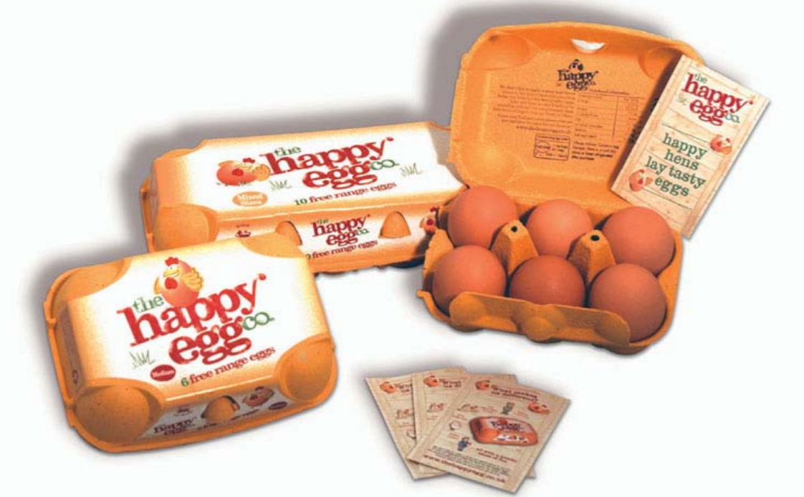
‘We create the perfect environment for our free range hens to run, jump and play, because happy hens lay happy eggs and happy eggs are wonderfully tasty’ read the case study from the page #62

Slide 15
‘We create the perfect environment for our free range hens to run, jump and play, because happy hens lay happy eggs and happy eggs are wonderfully tasty’ read the case study from the page #62
EU ban on caged eggs
Please, describe following types of the eggs production:
Barn eggs
Free-range eggs
Organic eggs
Please, discuss the price depending on the different type of the eggs production

Slide 16
The political and legal environments
Organisations have to exist in and operate according to the laws of the societies within which they do business, and thus in addition to the more general laws of contract and commerce, products have to conform to safety laws; manufacturing processes are subject to pollution controls; copyright and patents protect innovation; and retailers’ opening hours are restricted in Germany, for example, by the Ladenschlussgesetz, and in the UK by the Sunday trading laws.

Slide 17
Regulation is not only defined through legislation from national governments or the European Parliament, however. Organisations are also subject to rules passed by regulatory bodies, some of which have statutory powers delegated to them from government, while others are voluntary groupings, such as trade associations, with codes of practice to which the organisation chooses to adhere.

Slide 18
National and local government
The obvious responsibility of national governments is to determine and maintain the legislative framework within which organisations do business. This will cover areas such as contract law, consumer protection, financial legislation, competition and trading practices, for example. There are variations in approaches across Europe but increasingly, as European integration proceeds and the internal market is fully liberalised, national governments are working within EU guidelines and directives, with the longer-term aim of achieving consistency across member states

Slide 19
National and local government
Within the UK, although Parliament passes legislation and puts it on the statute books, the responsibility for implementing and enforcing it is often delegated to specialist bodies, such as the Office of Fair Trading (OFT), Competition Commission, or Ofcom.
Local government also carries some responsibility for implementing and enforcing laws made at a national level. In Germany, local government has responsibility for implementing pollution and noise control legislation. In the UK, local Trading Standards officers may well be the first to investigate claims of shady or illegal business practices.

Slide 20
The European Union
It is unfortunate that the pronouncements from Brussels that make the headlines tend to be the offbeat or trivial ones, such as the proposal to regulate the curve on a cucumber, the redesignation of the carrot as a fruit to allow the Portuguese to carry on their trade in carrot jam, and questions as to whether Cheddar cheese and Swiss rolls can continue to bear those names if they are not made in those places. Despite these delightful eccentricities, the EU works hard towards ensuring free trade and fair competition across member states’ boundaries.

Slide 21
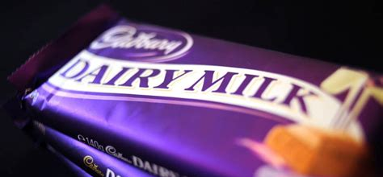
Chocolate wars
There is no “milk chocolate” in the UK, page 66
What is the main reason of the Chocolate war in EU? Which countries were involved into the conflict?
chocolate that included cheaper
vegetable fats rather than a higher proportion of cocoa fats.
Do you like chocolate? What is chocolate?
Dove
Ferrero roche, Rafaello

Slide 22
Regulatory bodies
Within the UK, there are many regulatory bodies with greater or lesser powers of regulation over marketing practice. Quasi-governmental bodies, such as the Office of Fair Trading (OFT) and the Competition Commission, have had statutory duties and powers delegated to them directly by government to ensure the maintenance of free and fair commerce.

Slide 23
Regulatory bodies #2
Slightly more remote from central government, quasi-autonomous non-governmental organisations (quangos) have a specific remit and can act much more quickly than a government department. Quangos such as Ofcom, Ofgem and Ofwat, for instance, exist to regulate the privatised telecommunications, gas and electricity, and water industries respectively in the UK. The prime aim for the quangos is to protect consumer interests by ensuring appropriate levels of competition.

Slide 24
Voluntary codes
Voluntary codes of practice emerge from associations and trade bodies, with which their members agree to comply. The Advertising Standards Authority (ASA), for example, oversees the implementation and enforcement of the CAP Code (which covers non-broadcast advertising, sales promotion, and direct marketing) and the BCAP Code (for broadcast advertising).

Slide 25
Although Ofcom (Office of Communications) is ultimately responsible for the policing of broadcast television and radio advertising, in November 2004 the day-to-day regulation of both these media was contracted out to the ASA. This means that consumers have a one-stop shop for complaints and that there can be consistency in the decisions made about problematic advertisements in different media.

Slide 26
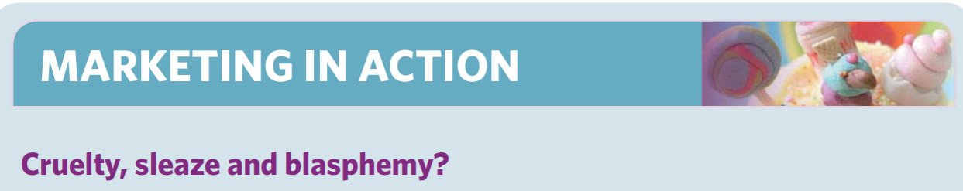
There’s nothing like sex, cruelty to animals or religion for getting the British public outraged and complaining to the ASA.
Read the case study on the page 68 of the main textbook.
“Smart may have the brain, but stupid has the xxx. Be stupid. Diesel”

Slide 27
The ASA is not a statutory body, and can only request an advertiser to amend or withdraw an advertisement that is in breach of the code but it also has remedies other than persuasion. It can request media owners to refuse to accept or repeat the offending advertisement, generate adverse publicity, and/or recommend that the OFT take proceedings to apply for a legal injunction to prevent publication. Most advertisers conform to requests from the ASA to withdraw an advertisement and some avoid any possible problems by voluntarily using the pre-publication vetting service.

Slide 28
The Institute of Sales Promotion (ISP), the Institute of Practitioners in Advertising (IPA), the Institute of Public Relations (IPR) and the Direct Marketing Association (DMA) are effectively trade associations. All these areas are, of course, subject to prevailing commercial legislation generally, but, in addition, these particular bodies provide detailed voluntary codes of practice setting industry standards for fair dealing with customers.

Slide 29
Influences on the political and legal environments
The political and legal environments are clearly influenced by sociocultural factors, and particularly the pressure of public opinion, the media and pressure groups. Greenpeace and Friends of the Earth, for example, have educated consumers to become more aware of the content, origins and after-effects of the products they buy and use, and this led to the phasing out of chlorofluorocarbons (CFCs) as an aerosol propellant and as a refrigerant.

Slide 30
The green movement has also spurred the drafting of regulations on the acceptable emissions from car exhausts, which has had a major impact on the product development plans of motor manufacturers for the next few years. Similarly, the consumer movement, through organisations such as Which?, has also played an important role in promoting the rights of the consumer and thus in driving the regulators and legislators towards laws and codes of practice regarding product safety, selling techniques and marketing communications, for instance.

Slide 31
Lobbism
With increasing public concern for sustainability, competitiveness of markets, fair trading, product safety and quality and consumer rights, it is a very brave politician that can ignore the pressures for change. However, lobbying and participating in the legislative discussion can help steer outcomes towards those preferred by an organisation.

Slide 32
The ecological environment
The ecological environment includes all the earth’s resources, including all raw materials or energy sources and their sustainability, needed by or affected by organisations and their marketing activities. This concept was introduced in Lecture 1 as fundamental in considering sustainable marketing and corporate social responsibility. The tourism industry has long recognised that the earth is a finite resource and needs to be protected from over-use.

Slide 33
Climate change
Climate change is accelerating at a faster rate than many scientists had predicted and thus it is all the more important to reduce personal and organisational carbon footprints.
12 ton of CO2 emission
Ivan 10 ton of CO2 emission

Slide 34
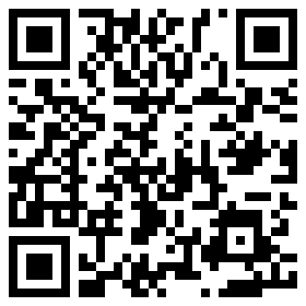
Climate change
Home task
To estimate your annual carbon footprints.

Slide 35
Sustainable consumption
Perhaps educating consumers on green consumption offers the best chance of seriously changing what and how we buy. The task will be enormous: how can we, as consumers, be turned off fashion, brands that make statements about who we are, conspicuous consumption and even products we just like when these things are so embedded in our culture and lifestyle?

Slide 36
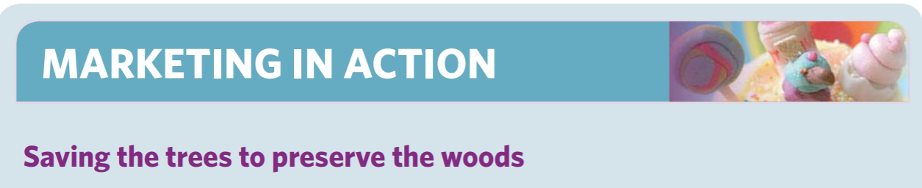
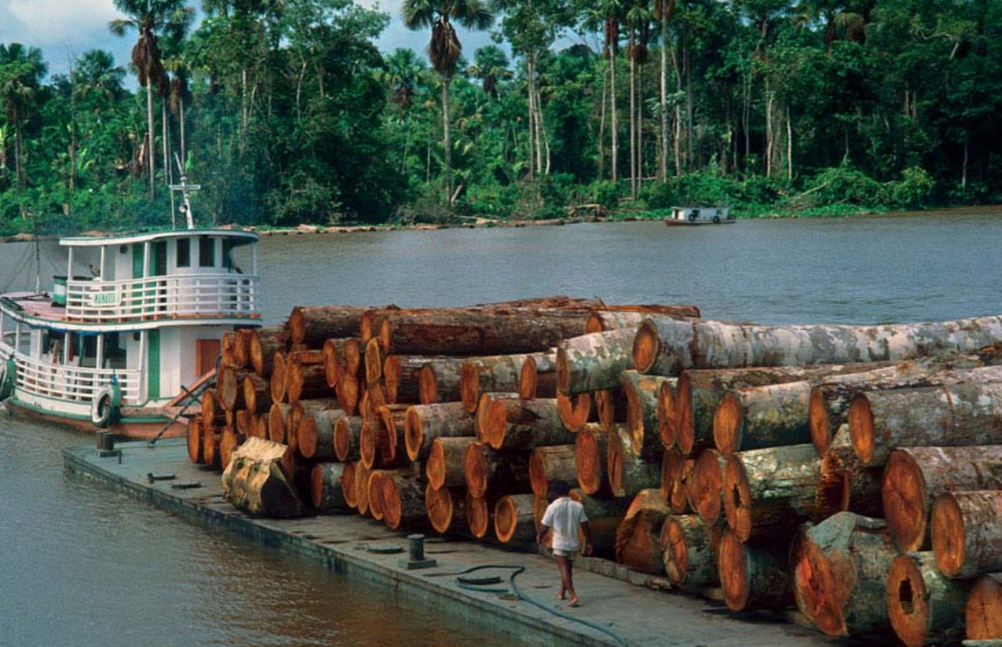
Page 71 of the shared materials.

Slide 37
Summary
This lecture has explored the importance of the external marketing environment as an influence on the way in which organisations do business and make their decisions. Ways in which customers, markets, competitors, technology and regulation are changing are all important pointers to future strategy

Slide 38
Summary
The main framework for the chapter is the categorisation of the marketing environment into STEEPLE factors: sociocultural, technological, economic, ethical, political and legal, and ecological.

Slide 39
Summary
The economic environment constitutes the third STEEPLE factor, and can be further divided into macro- and microeconomic environments. The macroeconomic environment analyses the effects of the broader economic picture, looking at issues such as taxation, government spending and interest rates. It also takes account of the threats, opportunities and barriers arising from membership of international trading blocs. The microeconomic environment is a little closer to the individual organisation, and is concerned with the structure of the market(s) in which it operates.

Slide 40
Summary
The political and legal environments give us the fifth and sixth STEEPLE factors. Laws, regulations and codes of practice emanate from national governments, the EU, local government, statutory bodies and trade associations to affect the way in which organisations do business.
Consumer groups and other pressure groups, such as those representing the ecological movement, health issues and animal rights, are active in trying to persuade government to deregulate or legislate, or to influence the scope and content of new legislation

Slide 41
Summary
The final STEEPLE factor is the ecological environment, reflecting a growing concern about the natural environment and the impact of consumerism upon it. Organisations need to consider, for example, how they can reduce their carbon footprints and continue to satisfy consumer needs and wants more sustainably.

Slide 42
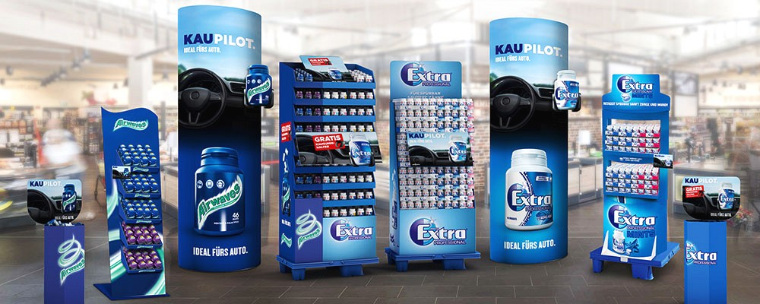
Case study 02, page 75
GOT ANY GUM, CHUM?
Wrigley’s has a dominant position in the global chewing gum market with annual sales of over $22 billion with sales in 180 countries.

Slide 43

The Founding of a Chewing Gum Empire: Wrigley and His Freebies

Slide 44

BUBBLEGUM | How It's Made

Slide 45
Thank you for attending!

