Slide 1


南宁师范大学
Nanning Normal University
Department of Tourism & Culture
Visitor Attraction Experience
Ivan Monich, Ph.D.
Nanning, 2019

Slide 2
02-12-2019
The influence of images in shaping the consumer experience

Slide 3
Aims and objectives
In this lecture we describe the influence of images in shaping the consumer/tourist experience. Images and media sources have a strong impact on tourist choices. This lecture will emphasize the importance of images and films as a tool to promote tourism in a destination.

Slide 4
Aims and objectives
The formation and the influence of the destination image will be described through the following themes:
1) the definition of the concept of destination image through a multidisciplinary and a marketing literature review,
2) the destination image formation process,
3) the impact of media and film experiences on the image of a tourism destination, and
4) the measurement of tourism destination images.

Slide 5
After completing this lecture, you should be able to:
Define the concept of destination image and explain its construction process.
Know the characteristics and the components of a destination image in the tourism sector.
Understand the influence of sources such as media and films on the image of a tourism destination and how the influence of these sources relates to persuasion.
Understand the importance of media sources for consumer/tourist preferences and choices of a tourism destination.
Know the marketing implication related to the use of media and film-induced tourism to promote and improve the image of a destination.

Slide 6
Academic interest in the concept of image
The early works proposed that human behaviour is dependent upon image rather than objective reality. Refinement and enhancement of this foundational base and adoption of the image concept have led to image theory, which suggests that the world is a psychological or distorted representation of objective reality existing in the individual's mind

Slide 7
The concept of destination image in the multidisciplinary literature
It is well accepted that destination image is a crucial marketing concept in understanding the destination selection of vacation (Baloglu and McCleary, 1999). Growing evidence has demonstrated that destination image plays a key role in the tourist perception and consequent tourist experience and decision-making process (Echtner and Ritchie, 1991; Gartner, 1993).

Slide 8
Destination image
The prevalent topics can be classified into several broad categories:
the conceptualization of the destination image (Hunt, 1971; Crompton, 1979a);
the dimensions and measurement of the destination image (Echtner and Ritchie, 2003; Gartner, 1993);
the destination image formation process and its determinants (Baloglu and McClearly, 1999);
and the destination image management policies (Ryan and Montgomery, 1994).

Slide 9
Tourism
In tourism, research on the concept of destination image can be traced back to the early 1970s. In this era, images signify a pre-testing of the destination, which can be referred to as transposing a representation of the destination into the potential tourist's mind (Fakeye and Crompton, 1991).
Copacabana in Rio de Janeiro
Natural environment or beautiful beaches are among the images that are likely to play an important role in tourism development, and this became the concern of Hunt's study in 1971 and 1975 (Echtner and Ritchie, 1991).

Slide 10
Information source
Gunn (1972) presents a stage theory of destination image that is dependent on the information source and encounters differences in image perception according to the type of information source
In recent years, the Internet has become one of the most important sources of tourism information (Buhalis and Law, 2008) that has an influence in shaping tourist experiences as well as tourist's perception of the destination image.

Slide 11
The definition and construction of the destination image
Destination image in marketing and consumer studies
In the marketing and consumer field, studies show that marketers seek to establish, reinforce, or change the image of a destination. Their goal is to match to the greatest extent possible the promoted and perceived image (Kotler ef al., 1993).
the stronger the relationship between the image of the destination and customer needs and desires, the more likely they are to have purchase intentions for that destination.

Slide 12
The definition and construction of the destination image
Please, think about the destination that inspires you, the destination you would like to visit due to its strong image in your mind. Give some examples.
Northern lights? 北极光
Snow?
Paris, Rome, Milan (fashion)?
MMA？

Slide 13
Destination image definitions in tourism studies
Hunt defines image as 'the perception held by potential visitors about an area' (1971, p.l). A more integrative definition was given by Crompton who defined destination image as 'the sum of beliefs, ideas, and impressions that a person has of a destination' (1979b, p. 18).

Slide 14
Although authors in the human science disciplines have been unable to accept a common definition, they do share a common opinion, namely that a tourism destination image plays an extremely important role in tourists' destination evaluation and selection process

Slide 15
The image of a place as a potential destination comprises three components: cognitive, affective, and conative (Gartner)
The cognitive is what is known, or perceived to be known about the potential destination
The affective is the weighting of what is known by the consumer's value system.
The conative component of destination image is the choice stage
It refers to the process of making a decision on whether to travel to a destination, based on the cognitive and affective stages of image development.

Slide 16
Furthermore, Echtner and Ritchie (1993, p.3) note that destination image perceptions (and thus research) should contain three major areas:
Destination images should comprise two main components (those that are attribute based and those that are holistic);
Each of these components contains functional (or more tangible) and psychological (or more abstract) characteristics;
Images of destinations can range from those that are based on common functional and psychological traits to those based on more distinctive or even unique features, events, feelings or auras.

Slide 17
Destination image construction
In the tourism field, Gunn (1972) was the first author to explaine the image formation process by identifying two dimensions: organic image and induced image. In his work, Gunn suggested that the evolution of image might be both organic and induced.

Slide 18
Organic and induced image
The organic dimension of the image formation process is characterized by unsolicited media, such as newspaper reports and information received from friends and relatives. However, in the induced evolution, the image shaped through official promotion of the destinations including advertising and other solicited efforts.

Slide 19
As discussed in the literature, although not evidence-based, there is general agreement that the secondary sources of information fulfil three basic functions in destination choice: to minimize the risk that the decision entails, to create an image of the destinations, and to serve as a mechanism for later justification of the choice (Mansfeld, 1992)

Slide 20
Fakeye and Crompton (1991) who based their works on Gunn's 'dimorphic theory' augmented the categorization by listing three factors: organic, induced, and complex.
The complexity related to destination image formation might be explained by several stimulus factors. Thus, Gartner (1993) classified the stimulus factors influencing destination image as different 'formation agents': (a) overt induced agents, referring to conventional advertising projected by the relevant institutions in the destination or by tour operators and wholesalers; (b) covert induced agents, referring to second-party endorsement through traditional advertising or unbiased reports; (c) autonomous agents, including mass media broadcasting news, literature, movies, photography, etc., about the place; (d) organic agents, involving solicited or unsolicited information of a destination originated from friends and relatives based on their own knowledge or experience; and (e) actual visitation to the destination.

Slide 21
Impact of cultural media and other sources on the destination image formation
The popular cultural media, consisting of things such as films, TV programs, magazines, music, and literature, are omnipresent in our society (Mansson, 2011). They provide a constant flow of images and information about places (Moores, 2005), and thus impact the consumers in many ways. Therefore, popular cultural media not only have a great transformational power in the tourism industry in general, but also have a significant impact on the construction of tourist's imagery.

Slide 22
Printed material
Some printed media are also frequently used by tourists to draw the image of a destination. For example, through a textual or semiotic analysis of a guidebook published by Lonely Planet, India: A Travel Survival Kit, Bhattacharyya (1997) found that as the most popular of the tourism guidebooks for India,

Slide 23
Online materials
Supported by the rapid growth of communication technology, new media has generated a new set of mediators for tourists' experiences. Tussyadiah and Fesenmaier (2009) investigated the role of online-shared videos in tourist experiences.

Slide 24
Convergence
By applying convergence, a new media concept, to representations of and references to Rosslyn Chapel and 'The Da Vinci Code' in social media networks such as Facebook, Twitter, blogs, YouTube and Flickr, Mansson (2011) found that tourists are both consumers and producers of media products.
They are active in participation in the 'the circulation of media content'

Slide 25
Convergence
That is to say, tourists create media products such as reviews, comments and perceptions of destinations that circulate online through various channels like social media. These media products are then available for consumption by other tourists, which in turn influences new media products.
The results of these studies indicated that online-shared videos can provide mental pleasure to viewers through imagination and act as a narrative transportation.

Slide 26
04-12-2019

Slide 27
Film experiences and consumer behaviour
In the marketing field, one research stream has concentrated on the relationship between film consumption experience and consumer behaviour.
Inherently, films are hedonistic products. This means they are generally 'consumed for pleasure rather than for the maximization of an economic benefit' (Eliashberg and Shugan, 1997, p.69). The consumption of hedonistic products like movies and concerts usually relates to 'the multisensory, fantasy and emotive aspects of one's experience'

Slide 28
Film-induced tourism
Film is considered to be the most effective imaging medium (Croy, 2010). It acts as a display window for a destination, especially when the location plays a part in the film (Tooke and Baker, 1996).
Compared with the printed media, what is shown in movies and television appears to have more accessibility and credibility (Butler, 1990).

Slide 29
Relationships between the consumption of film, television and tourism.
In the last decade, fuelled by both the rapid growth of the entertainment industry and the increase in outbound travel, there has been an upsurge of research related to the close relationships between the consumption of film (movie or motion picture), television (TV programmes or TV series) and tourism.

Slide 30
New trend
Therefore, a new form of tourism, so-called 'film-induced tourism' (cf. Beeton, 2005,2006; Connell, 2005a; Roesch, 2009), also named as 'film tourism' (Buchmann ef al., 2010; Hudson and Ritchie, 2006a, 2006b; Croy, 2010), or 'movie-induced tourism' (Riley et al., 1998; Busby and Klug, 2001), or 'screen-tourism' (Connell and Meyer, 2009) has been created.

Slide 31
As a relatively new field of study, this touristic phenomenon refers to 'visitation to sites where movies and TV programmes have been filmed as well as to tours of production studios, including film-related theme parks' (Beeton, 2005, p.ll)".

Slide 32
Types of movie tourists
Busby and Klug (2001) provide a comprehensive summary of the different forms of film-induced tourism. Sometimes tourists may visit film sites during the trip without any previous knowledge of these sites. They are incidental film tourists.
Sometimes tourists just choose tour packages offered by tour operators that encompass the locations of the famous TV series and films (Evans, 1997). In more cases, the film locations were not considered to be tourism destinations until they were seen on screen.

Slide 33
Lord of the rings
The New Zealand Tourism Board estimated that the exposure of New Zealand in the first of the Lord of the Rings film was worth over US$41 million (New Zealand Institute of Economic Research, 2002).
In addition, tourists have a strong desire to be in the actual places where scenes were shot

Slide 34


Slide 35
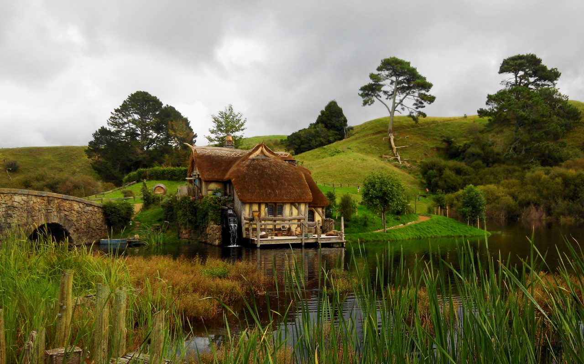

Slide 36
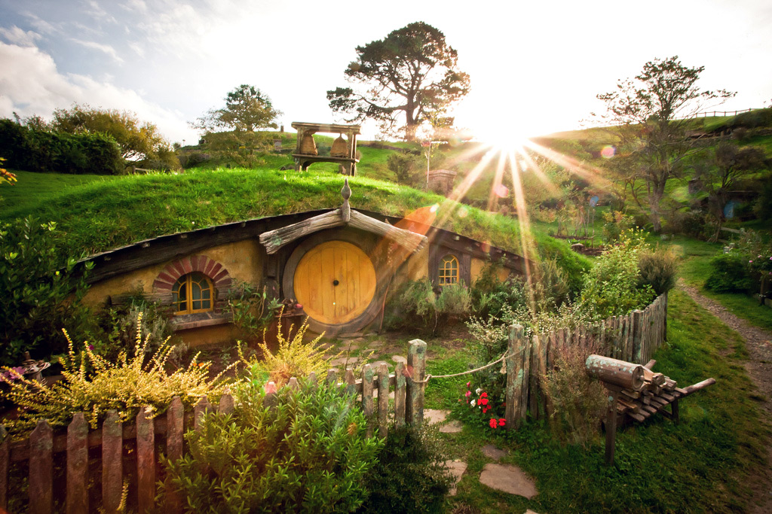

Slide 37
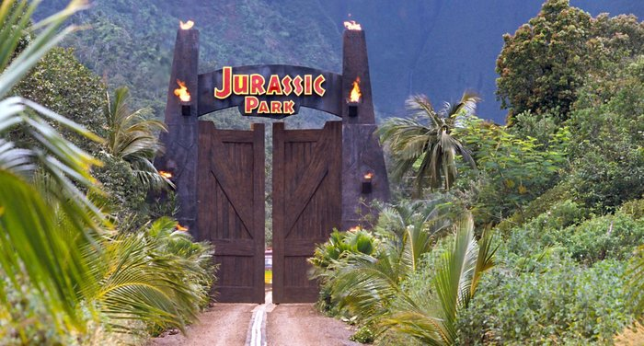
Jurassic park, Hawaii

Slide 38
Jurassic park, Hawaii
Case study questions:
Name three other destinations around the world that are attracting film tourists and explain why.
Take a look at Kualoa Ranch’s website (www.kualoa.com) and describe how the ranch is currently leveraging this ‘film tourism’ phenomenon.
Referring to the material on product placement earlier in the lecture, explain how Hawaii could measure the effectiveness of this ‘destination placement’.

Slide 39
Case-study questions:
Name three other destinations around the world that are attracting film tourists and explain why.
Two activities related to film – hosting production and running movie tours – are equally important. Why, so? Which of them generates more profit?

Slide 40
Star Wars
One of the world’s most intensely specific forms of niche tourism is found in Tunisia, where scenes from five of the six “Star Wars” films where shot. Largely intact film sets and props remain in towns such as Tatouine (the inspiration for the fictional planet “Tatooine”), and every year these extremely non-traditional forms of tourism capital draw large numbers of visitors to places that might otherwise have little or no tourism industry at all.
http://goafrica.about.com/od/peopleandculture/ss/Star-Wars-Tours-In-Tunisia.htm.

Slide 41
09-12-2019

Slide 42

Visiting the Star Wars Sets of Southern Tunisia

Slide 43
Visiting the Star Wars Sets of Southern Tunisia
Think about your favourite movie or TV series. Do you know the place where it was recorded? Is it possible to create a tour to the place for movies’ fans?

Slide 44
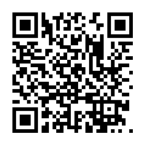
Star
Wars

Slide 45

Have you seen the阿凡达 movie?

Slide 46
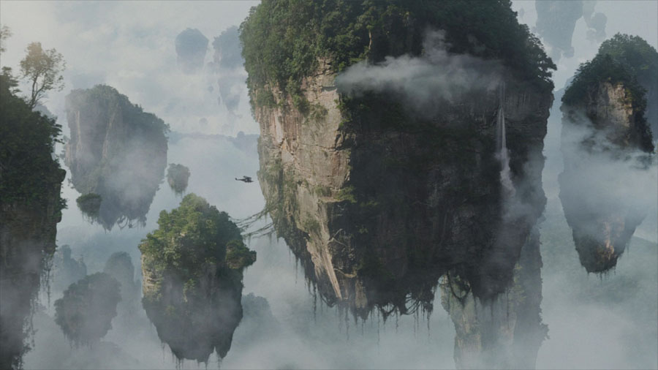
Avatar mountains. Watch the Video

Slide 47
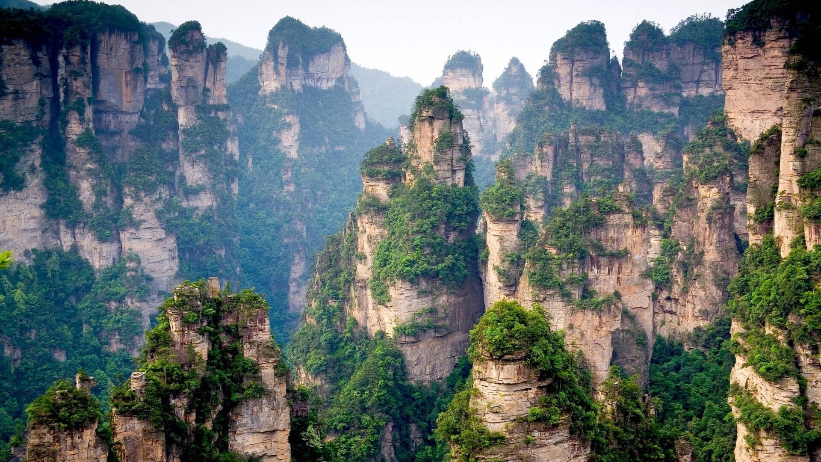
Have you been to the planet Pandora from Avatar movie?

Slide 48
Avatar’s mountains
The Hallelujah Mountains (Na'vi name: Ayram alusìng meaning "Floating Mountains")^{[1]} are floating islands that circulate slowly in the magnetic currents like icebergs at sea, scraping against each other and the towering mesa-like mountains of the region. On Pandora, huge outcroppings of unobtanium rip loose from the surface and float in the magnetic vortices due to the Meissner Effec

Slide 49
Welcome to Hunan! And
This vertical pinnacle in China was the inspiration for the floating mountains in the movie “Avatar”. ... It wasn’t until 1982 that China created its first national park: Zhangjiajie National Forest Park

Slide 50
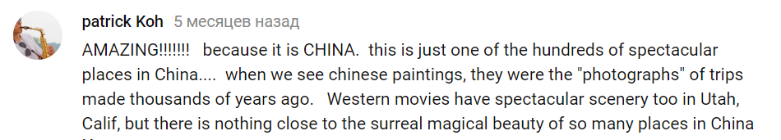

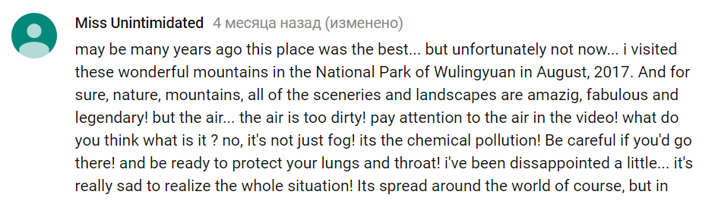
Shared comments in YouTube

Slide 51
Continue of the lecture
Global impact of films
Hudson and Ritchie (2006a) summarized some of the research related to the impacts of him tourism on visitation numbers and on residents, noting that the phenomena of films and televisions having a very positive impact on tourism visits has been recorded worldwide.

Slide 52
Film experiences and tourist destination image
Just as product placements will influence a viewer's attitude toward a brand, so too will films have an impact on destination image if the plot storyline and the location site are intimately interrelated (Hudson and Ritchie, 2006a).

Slide 53
China?
Moreover, there is a shortage of research into the influence of film experiences on the destination perceptions of Western countries among Asian tourists, in particular, among the Chinese tourists. Given the scale and potential of China's outbound market, it is an emerging area of inquiry. However, there is a general lack of cross-cultural comparative analysis in this area.

Slide 54
The same film projected in different culture settings might yield different results and arouse different emotions. Therefore, cross-cultural studies focusing on the effects of film consumption experience on the perceived image of specific destinations are needed.

Slide 55
Measuring of tourism destination image
Most of the research conducted on evaluating destination image used quantitative approaches. A Likert-type scale or semantic differential scales are often used to measure destination image.
Up until 1993, Reilly (1990) was the only one to use open-ended questions in his destination image measurement study. This technique allows one to measure or capture individuals' holistic view about the place - the holistic component - as well as the characteristics of the destination they judge to be unique or distinctive (Echtner and Ritchie, 1993).ge.

Slide 56
Problems of measuring
One of the basic problems with which destination image studies have been confronted is the measurement of destination image. 'The majority of destination image studies have relied on structured surveys developed from a researchers' point of view' (Echtner and Ritchie, 1993, p.6). However, if structured methodologies are easy to administer and analyse, they tend to miss other dimensions of image such as its holistic component.

Slide 57
Conclusion
This lecture has attempted to outline the main developments in tourist destination image assessment. As was explained, the definition and construction of image can be quite difficult to pin down. Nonetheless, image is a very interesting construct to study in regard to the tourist experience, since it brings a very relevant insight into predefined mental images which necessarily impact customers' expectations about the experience they intend to live while at the destination.

Slide 58
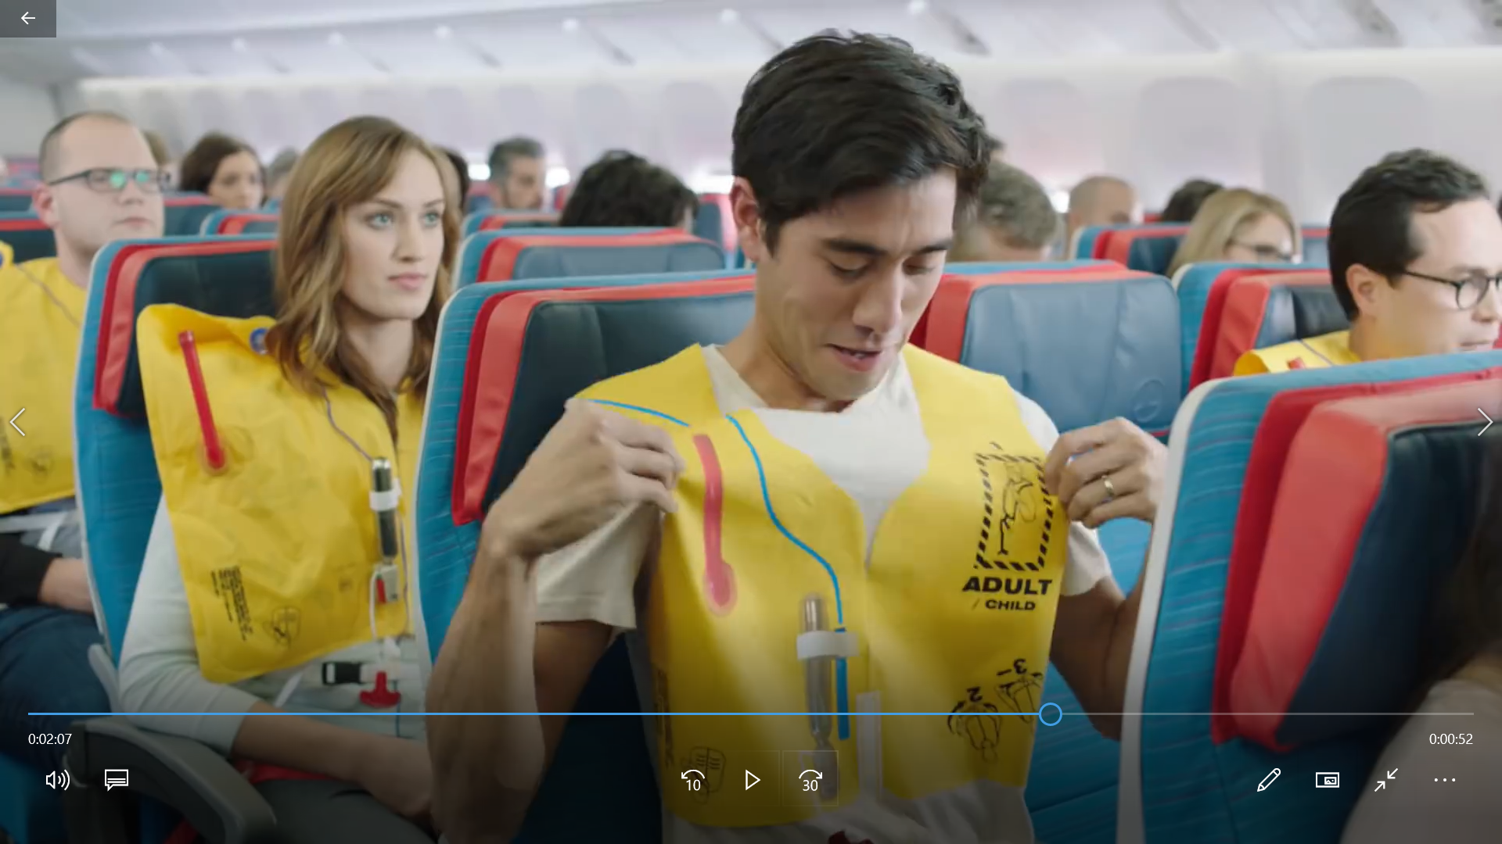
Safety instruction Videos

Slide 59

The impact of the film tourist perception of the destination image p. 128 of the textbook

Slide 60
Case-study questions:
Films will have an impact on destination image if the plot storyline and the location site are intimately interrelated (Hudson and Ritchie, 2006a). After reading the case-study text, Have you changed the way you perceive Paris?

Slide 61
11-12-2019

Slide 62

P. 160 of the textbook
1. Couchsurfing – new behavior trend in tourism
2. Couchsurfing: a shared experience with locals
Questions:
How did the Couchsurfing service start?
What are the core values of the service?
Please, provide the couchsurfers age structure?

Slide 63
Let’s try to use the couch surfing philosophy in 南宁。
Register an account on www.couchsurfing.org
Find your host (accommodation)
The profile
The reviews
Comments Safeties
Location, type of the apartment
The task: Please, select the host and give me the explanation why you have selected him/her.

Slide 64
How we can trust the unknown people in the couchsurfing website
How can we minimize the risks of the contact with the people we do not know from the couchsurfing website?
What are the main reasons of using this web service? (cultural and economic dimensions)

Slide 65
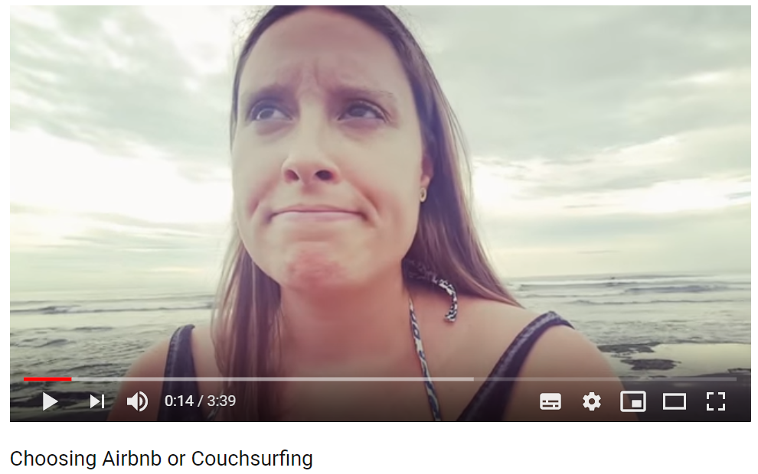
Choosing Airbnb or Couchsurfing

