Slide 1
南宁师范大学
Nanning Normal University
Department of tourism & culture
Marketing for Tourism, Hospitality and Events
Ivan Monich, Ph.D.
Nanning, 2019

Slide 2

Home task:
Find a news about tourism in Guangxi which meets the news’ structure in PR
News Title
5Ws+1H
5Ws: What? When? Where? Who? Why?
1H: How
Details
‘’Quote’’
cite someone
Background

Slide 3
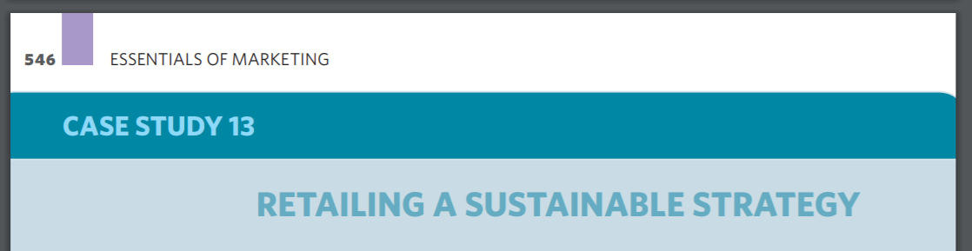

Slide 4
Questions
1 What do you think might be the particular problems that M&S might face in implementing the kind of Plan A initiatives described in the case?
2 Does a sustainability and CSR agenda offer sufficient grounds for a viable competitive positioning strategy in the retail sector?
3 According to an IGD survey, 68 per cent of shoppers agree strongly, or tend to agree that ‘food and grocery companies should just get on with doing the right thing for the environment rather than telling me about it’ and 83 per cent agree strongly or tend to agree that ‘I expect food and grocery companies to be constantly checking that their suppliers are acting responsibly towards the environment’ (Pickard, 2011). What are the implications of these findings for Plan A and M&S’s management of the interface between Plan A and the general public?
4 M&S found a certain amount of consumer reluctance to ‘buy into’ its provision of organic foods. How could M&S overcome that? To what extent should a retailer be expected to tell its customers ‘what’s good for them’? Should it simply respond to consumer demands?

Slide 5
Services and non-profit marketing

Slide 6
LEARNING OBJECTIVES
define the characteristics that differentiate services from other products and outline their impact on marketing;
develop an extended marketing mix of 7Ps that takes the characteristics of services into account and allows comprehensive marketing strategies to be developed for services;
understand the importance and impact of service quality and productivity issues; and
understand the special characteristics of non-profit organisations within the service sector, and the implications for their marketing activities.

Slide 7
Services
Services are not a homogeneous group of products. There is wide variety within the services category, in terms of both the degree of service involved and the type of service product offered. Nevertheless, there are some general characteristics, common to many service products, that differentiate them as a genre from physical goods. This section, therefore, explores the criteria by which service products can be classified, and then goes on to look at the special characteristics of services and their implications for marketing.

Slide 8
Classifying services
There are few pure services. In reality, many product ‘packages’ involve a greater or lesser level of service. Products can be placed along a spectrum, with virtually pure personal service involving few, if any, props at one end, and pure product that involves little or no service at the other.

Slide 9
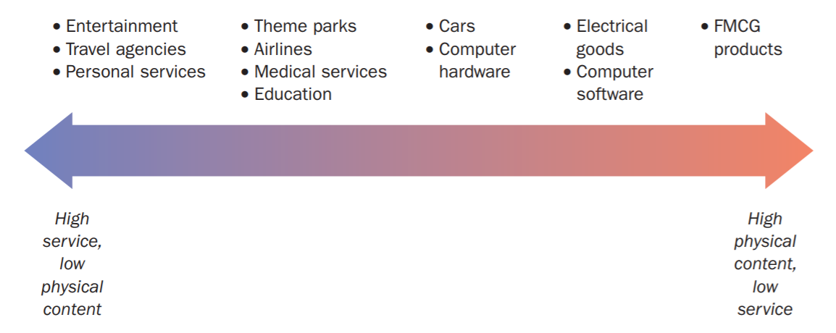
The product spectrum

Slide 10
Special characteristics of service markets
Lack of ownership
Intangibility
Perishability
Inseparability
Heterogeneity

Slide 11
Lack of ownership
Perhaps the most obvious aspect of a service product is that no goods change hands, as such, and therefore there is no transfer of ownership of anything. A legal transaction does still take place; an insurance company agrees to provide certain benefits as long as the premiums are paid and the terms and conditions of the policy are met

Slide 12
Heterogeneity
With simultaneous production and consumption and the involvement of service staff and other customers, it can be difficult to standardise the service experience as planned.
It means that each service experience is likely to be different, depending on the interaction between the customer and other customers, service staff, and other factors such as time, location and the operating procedures.

Slide 13
Intangibility
A visit to a retail store reveals an inviting display of products to purchase. These products can be examined, touched, tried on, sampled, smelt or listened to. All this can help the customer to examine what is on offer and to make choices between competing brands. The consumer regularly uses the whole range of senses to assist decision-making

Slide 14
In choosing a hotel, for example, a customer might look at the following:
1 Location. If the customer is on holiday, then perhaps a hotel near to the beach or other tourist attraction would be preferred, or one in a very peaceful scenic setting. A business traveller, in contrast, might look for one that is convenient for the airport or close to the client being visited.

Slide 15
2 Appearance.
2 Appearance. A customer’s expectations about a hotel are likely to be affected by its appearance. Does it look shabby or well kept? Is it too big or too small? Does it look welcoming? What is the decor like, both internally and externally? Do the rooms seem spacious enough and well-appointed?

Slide 16
3 Additional services.
3 Additional services. The customer might be concerned about the peripheral aspects of the service on offer. The tourist who will be spending two weeks in a hotel might be interested in the variety of bars and restaurants provided, hairdressing, laundry or crèche facilities, shopping and postal services, or the nightlife. The business traveller might be more concerned about car parking, shuttle buses to the airport, or fax and telephone provision.

Slide 17
4 Customer handling.
4 Customer handling. If the potential customer contacts the hotel for further information or to make a reservation, the quality of the handling they receive might affect the purchase decision. Courtesy and friendliness will make a good impression, as will a prompt and accurate response to the query. This kind of efficiency implies a commitment to staff training and good operating systems to assist easy access to relevant information and the speedy processing of bookings

Slide 18
Perishability
Services are manufactured at the same time as they are consumed. A lecturer paces the lecture theatre, creating a service experience that is immediately either consumed or slept through by the students. Manchester United, Barcelona or Inter Milan manufacture sporting entertainment that either thrills, bores or frustrates their fans as they watch the match live.

Slide 19
Inseparability
Many physical products are produced well in advance of purchase and consumption, and production staff rarely come into direct contact with the customer. Often, production and consumption are distanced in both space and time, connected only by the physical distribution system.

Slide 20
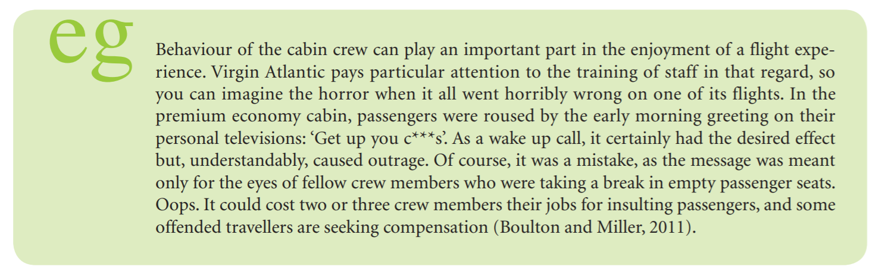

Slide 21
Services marketing strategy
The traditional marketing mix, consisting of the 4Ps, forms the basis of the structure of this book. For service products, however, additional elements of the marketing mix are necessary to reflect the special characteristics of services marketing. Shown in Figure on the next slide, these are as follows:

Slide 22
+3Ps
people: whether service providers or customers who participate in the production and delivery of the service experience;
physical evidence: the tangible cues that support the main service product. These include facilities, the infrastructure and the products used to deliver the service;
processes: the operating processes that take the customer through from ordering to the manufacture and delivery of the service.

Slide 23
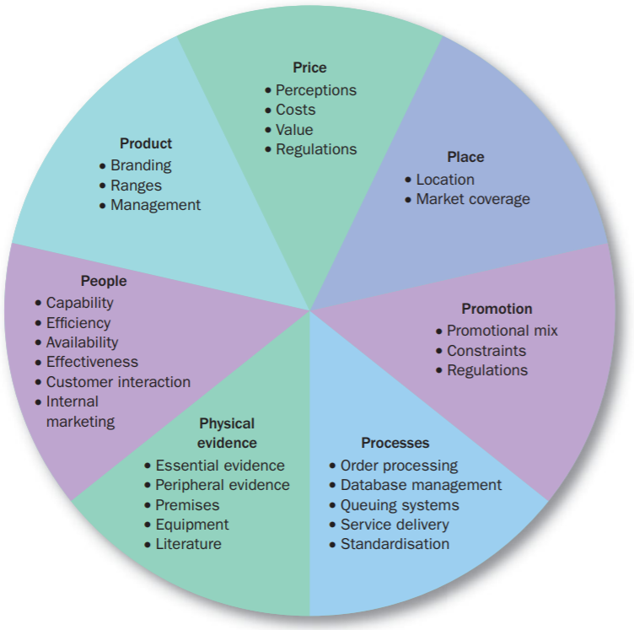

Slide 24
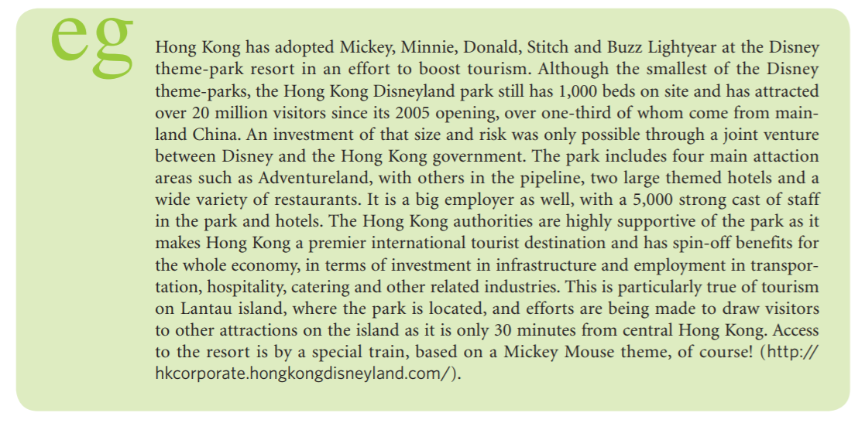

Slide 25

Case –study from the page 569
Tourism Australia is targeting what it has defined as a key segment: ‘experience seekers’, which describes 30–50 per cent of the visitors to Australia.
The experience seeker is not defined by age or nationality, but does tend to have higher than average income; is very well educated;

Slide 26
People
Services depend on people and interaction between people, including the service provider’s staff, the customer and other customers. As the customer is often a participant in the creation and delivery of the service product, there are implications for service product quality, productivity and staff training. The ability of staff to cope with customers, to deliver the service reliably to the required standard and to present an image consistent with what the organisation would want is of vital concern to the service provider. This is known as internal marketing, and will be discussed later at p. 573 et seq. The role of the customer in the service is known as interactive marketing

Slide 27
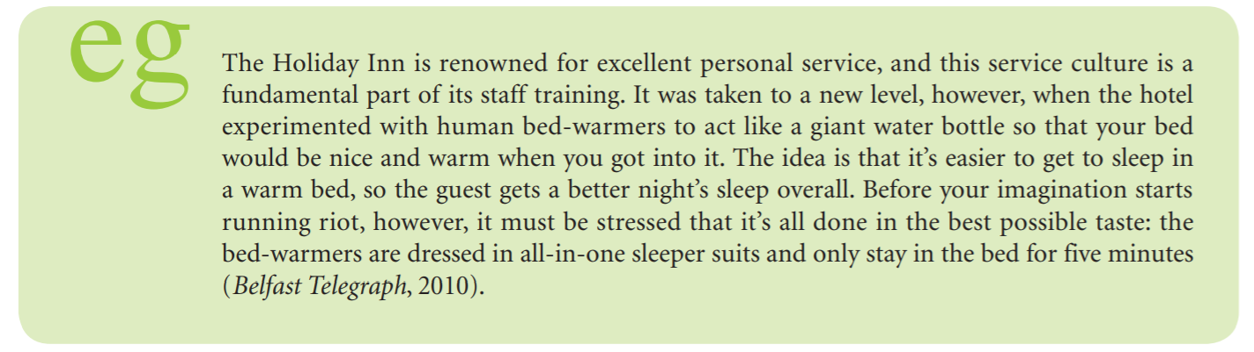

Slide 28
Physical evidence
Physical evidence comprises the tangible elements that support the service delivery, and offer clues about the positioning of the service product or give the customer something solid to take away with them to symbolise the intangible benefits they have received. Shostack (1977) differentiates between essential evidence and peripheral evidence. Essential evidence is central to the service and is an important contributor to the customer’s purchase decision. Examples of this might be the type and newness of aircraft operated by an airline or of the car fleet belonging to a car hire firm, the layout and facilities offered by a supermarket or a university’s lecture theatres and their equipment as well as IT and library provision. Peripheral evidence is less central to the service delivery and is likely to consist of items that the customer can have to keep or use.

Slide 29
Processes
Because the creation and consumption of a service are usually simultaneous, the production of the service is an important part of its marketing as the customer either witnesses it or is directly involved in it. The service provider needs smooth, efficient customer-friendly procedures. Some processes work behind the scenes, for example administrative and data processing systems, processing paperwork and information relating to the service delivery and keeping track of customers.

Slide 30
Measuring service quality
A particular group of researchers, Berry, Parasuraman and Zeithaml, have developed criteria for assessing service quality and a survey mechanism called SERVQUAL for collecting data relating to customer perceptions (see, e.g., Parasuraman et al., 1985, 1988; Zeithaml et al., 1990). They cite 10 main criteria that, between them, cover the whole service experience from the customer’s point of view:

Slide 31
These first five criteria influence the quality of the outcome of the service experience.

Slide 32
1 Access. How easy is it for the customer to gain access to the service? Is there an outlet for the service close to the customer? Is there 24-hour access by telephone to a helpline? 2 Reliability. Are all the elements of the service performed and are they delivered to the expected standard? Does the repair engineer clean up after himself after mending the washing machine and does the machine then work properly? Does the supermarket that promises to open another checkout when the queues get too long actually do so? 3 Credibility. Is the service provider trustworthy and believable? Is the service provider a member of a reputable trade association? Does it give guarantees with its work? Does it seem to treat the customer fairly? 4 Security. Is the customer protected from risk or doubt? Is the customer safe while visiting and using a theme park? Does an insurance policy cover all eventualities? Will the bank respect the customer’s confidentiality? Can the cellular telephone network provider prevent hackers from hijacking a customer’s mobile phone number? 5 Understanding the customer. Does the service provider make an effort to understand and adapt to the customer’s needs and wants? Will a repair engineer give a definite time of arrival? Will a financial adviser take the time to understand the customer’s financial situation and needs and then plan a complete package? Do front-line service staff develop good relationships with regular customers?

Slide 33
These first five criteria influence the quality of the outcome of the service experience. The next five influence the quality of the inputs to the process to provide a solid foundation for the outputs

Slide 34
6 Responsiveness. Is the service provider quick to respond to the customer and willing to help? Can a repair engineer visit within 24 hours? Will a bank manager explain in detail what the small print in a loan agreement means? Are customers’ problems dealt with quickly and efficiently? 7 Courtesy. Are service staff polite, friendly and considerate? Do they smile and greet customers? Are they pleasant? Do they show good manners? Do service staff who have to visit a customer’s home treat it with proper respect and minimise the sense of intrusion? 8 Competence. Are service staff suitably trained and able to deliver the service properly? Does a financial adviser have extensive knowledge of available financial products and their appropriateness for the customer? Does a librarian know how to access and use information databases? Do theme park staff know where the nearest toilets are, what to do in a medical emergency or what to do about a lost child? 9 Communication. Do service staff listen to customers and take time to explain things to them understandably? Do staff seem sympathetic to customer problems and try to suggest appropriate solutions? Do medical, legal, financial or other professional staff explain things in plain language?

Slide 35
10 Tangibles. Are the tangible and visible aspects of the service suitably impressive or otherwise appropriate to the situation? Does the appearance of staff inspire confidence in the customer? Are hotel rooms clean, tidy and well appointed? Do lecture theatres have good acoustics and lighting, a full range of audiovisual equipment and good visibility from every seat? Does the repair engineer have all the appropriate equipment available to do the job quickly and properly? Are contracts and invoices easy to read and understand?

Slide 36
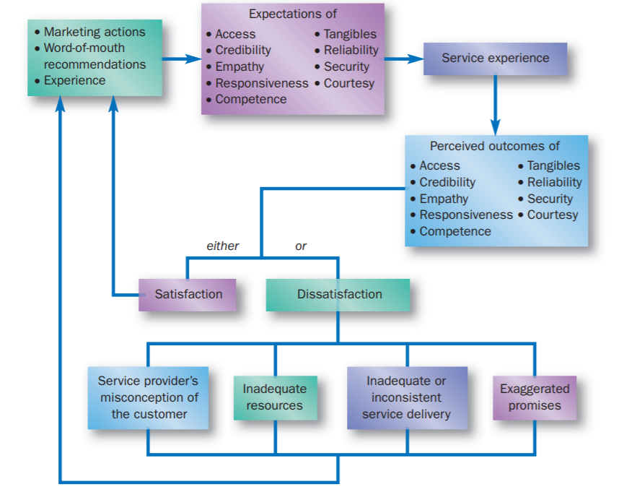
Figure 14.3 Service quality: expectations, perceptions and gaps

Slide 37
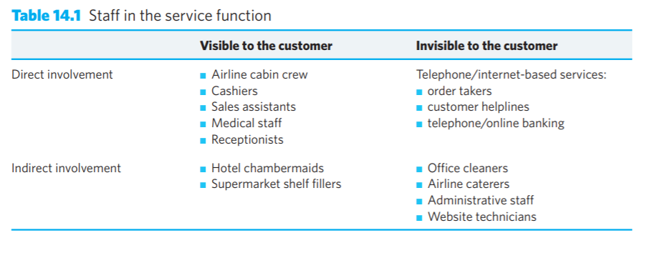
Staff training

Slide 38
Lecture summary

